Slide 1


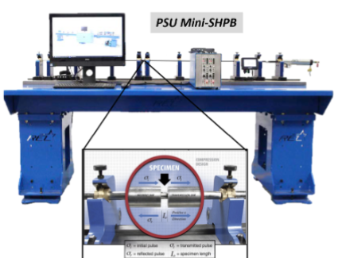
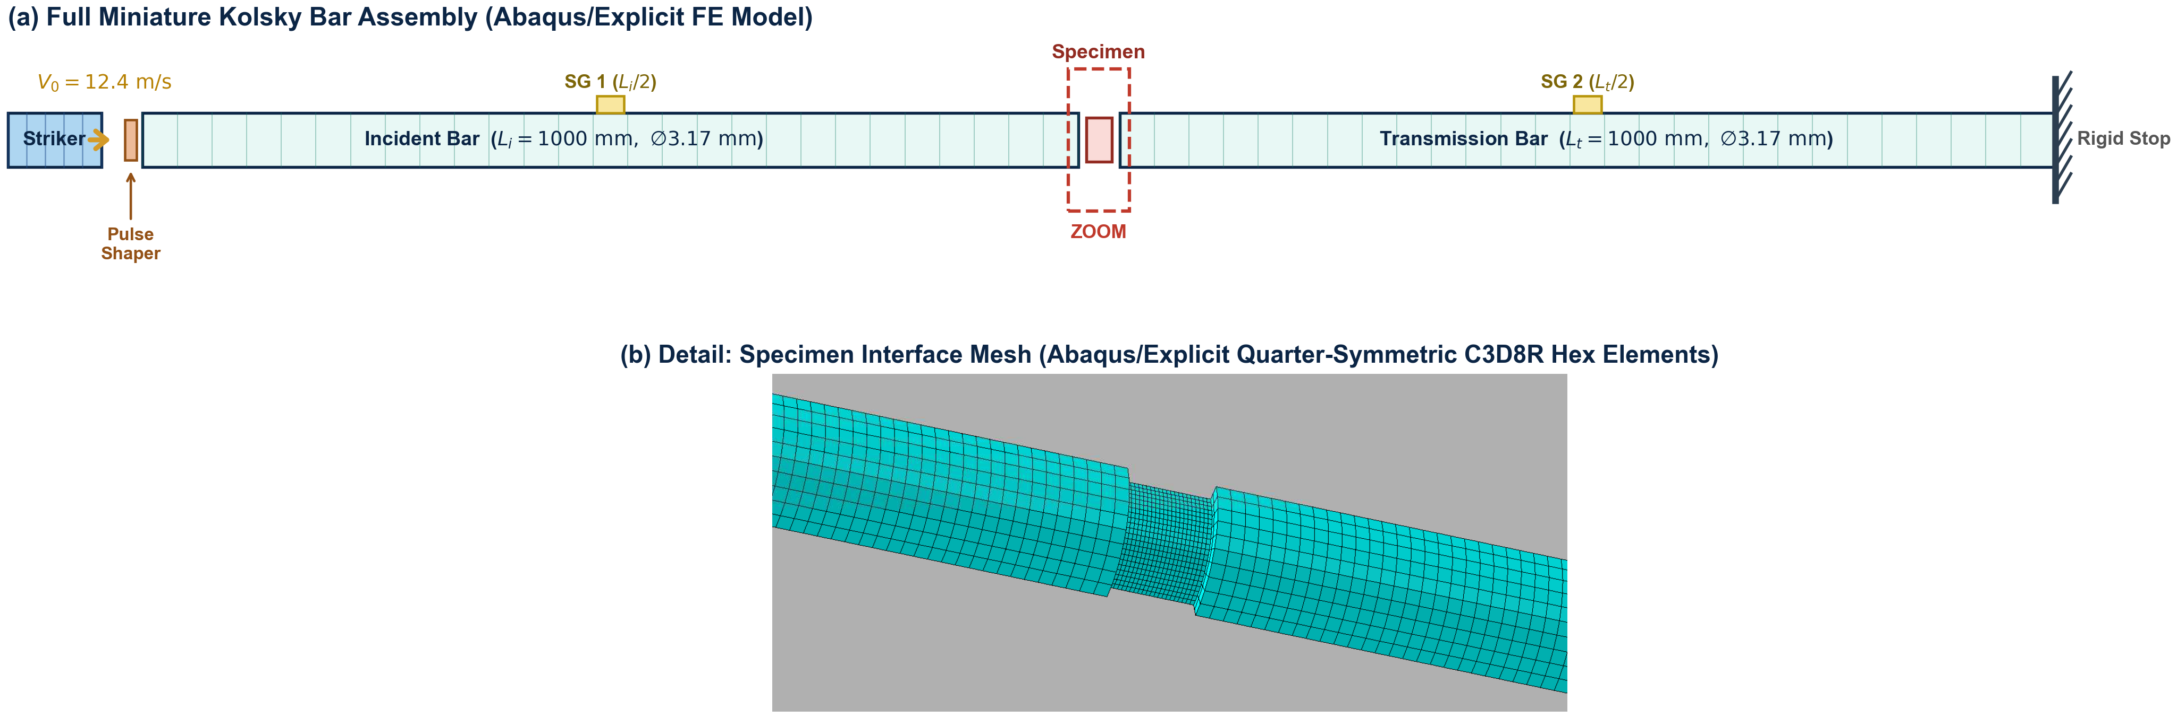
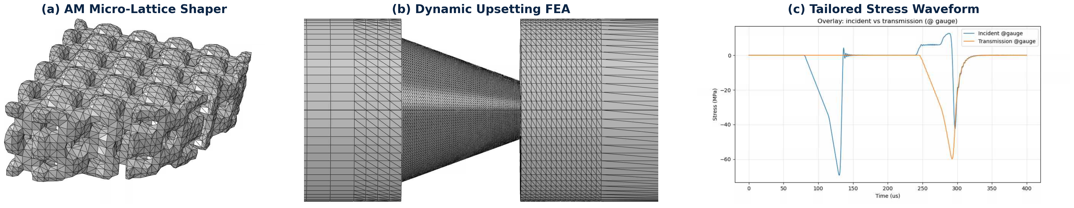
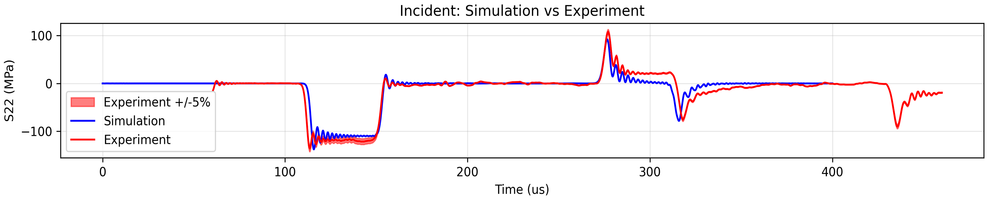
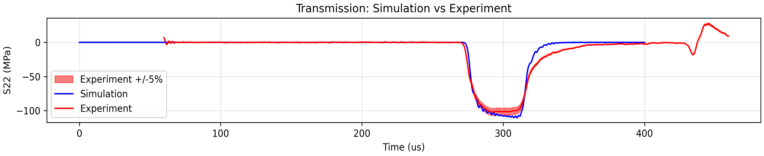
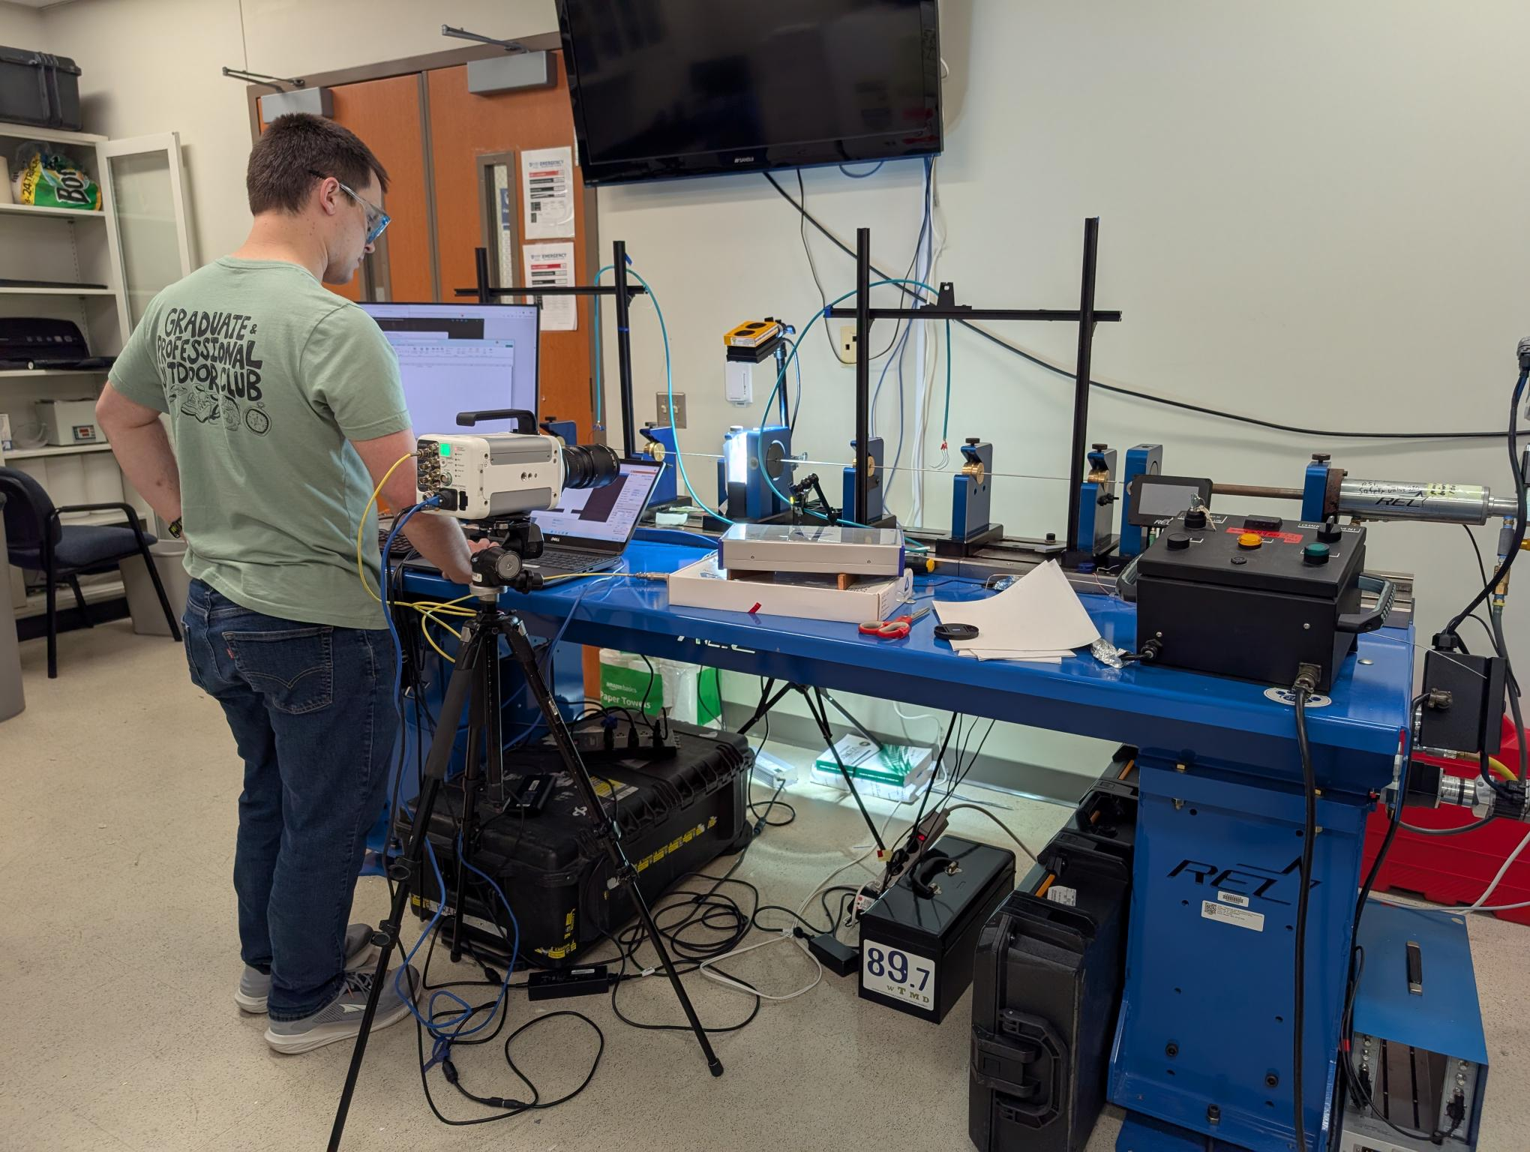
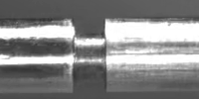
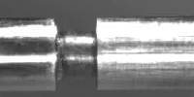
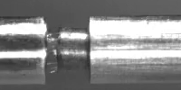
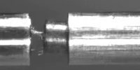
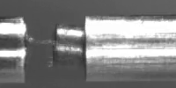
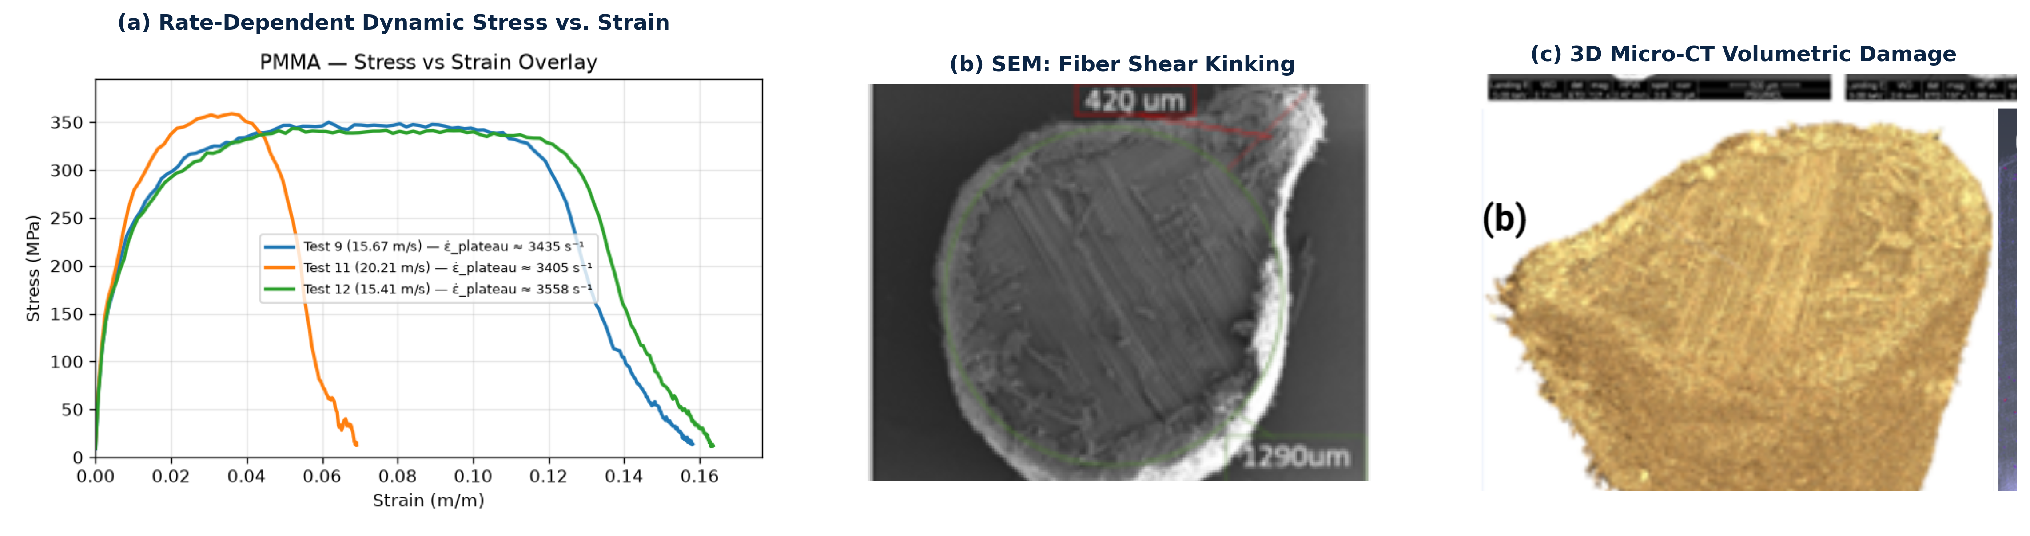
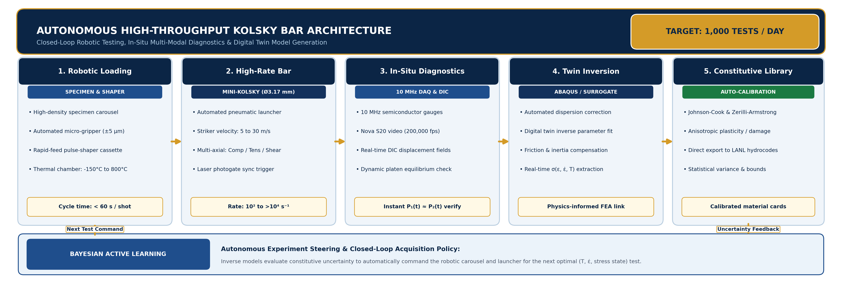
High-Throughput Dynamic Material Characterization
Synergistic Experimental & Digital Twin Framework for Rate-Dependent Model Discovery
Zachary Salas¹ | Jeremy Croom¹ | Reuben H. Kraft, Ph.D.¹
¹Department of Mechanical Engineering, The Pennsylvania State University, University Park, PA
Miniature Kolsky Bar Apparatus (Ø 3.17 mm)
EXPERIMENTAL APPARATUS
Abaqus/Explicit Digital Twin Modeling
COMPUTATIONAL TWIN
HARDWARE ARCHITECTURE
Bar Material: C350 Maraging Steel
Bar Diameter: Ø 3.17 mm (1/8″ OD)
Bar Lengths: Inc. 1.0 m, Trans. 1.0 m
Wave Speed: C₀ ≈ 4,960 m/s
Striker Range: Lₛ = 200 mm, V₀ ≤ 30 m/s
Pulse Duration: Tₚ ≈ 78 μs
Diagnostics: Semiconductor (10 MHz DAQ)
Strain Rate: ε̇_max ~ 1.2 × 10⁴ s⁻¹
▪ Multi-Symmetry FE Formulations: 3D quarter- and full-symmetry models constructed in Abaqus/Explicit with C3D8R hex elements for dispersive wave propagation, striker impact, and boundary condition verification.
▪ Pre-Shot Waveform Optimization: Virtual striker velocity and boundary impedance sweeps eliminate trial-and-error testing and maximize constant-strain-rate deformation duration.
▪ Ultra-Small Diameter Architecture: Precision Ø 3.17 mm C350 maraging steel bar system specifically engineered for sub-scale testing of advanced composites, ductile metals (OFHC copper), and transparent polymers (PMMA).
▪ Extreme Dynamic Strain Rate Regime: Achieves dynamic strain rates from ε̇ ~ 10³ to 1.2 × 10⁴ s⁻¹ under strictly verified 1D wave propagation with minimal Pochhammer-Chree radial dispersion.
▪ High-Frequency Diagnostics: Instrumented with high-bandwidth semiconductor strain gauges at bar midpoints; isolates incident (σᵢ), reflected (σᵣ), and transmitted (σₜ) stress waves digitized at 10 MHz.
▪ High-Throughput Testing Protocol: Modular alignment guides and precision collets enable rapid shot cycles (>10 shots/hr), providing dense empirical datasets for statistical uncertainty bounds.
INNOVATIVE PULSE SHAPING FOR TAILORED RESPONSE
TAILORED WAVEFORMS
▪ AM Micro-Architected Shapers: Additively manufactured micro-lattices (nTopology/Abaqus) engineered to eliminate high-frequency wave dispersion and initial stress spikes.
▪ Constant Strain-Rate Control: Programmable rise times dynamically tailor the incident pulse to ensure dynamic equilibrium and steady ε̇ deformation across soft and hard materials.
1. Virtual Pulse Shaping
Abaqus sweeps shaper geometry & velocity
▶
2. Specimen & Shaper Prep
Wire-EDM precision fabrication & alignment
▶
3. Dynamic Mini-SHPB Run
10 MHz strain acquisition + Nova S20 video
▶
4. Model Calibration & Discovery
Extract σ-ε curves & refine digital twin
Dynamic Wave Alignment & Validation
WAVE PROPAGATION
Photron FASTCAM Nova S20 High-Speed Video
OPTICAL DIAGNOSTICS
Optical Configuration & Sync:
Coupled with macro-telephoto optics and high-intensity LED matrix illumination, triggered synchronously with the incident strain bridge.
▪ Framing Rates: 100,000 to 200,000 fps with sub-μs exposure to freeze dynamic wave motion.
▪ Alignment Verification: Real-time visualization guarantees coaxial platen impact without bar bending.
High-Speed Dynamic Compression Sequence (ε̇ ~ 4000 s⁻¹ OFHC Copper on Ø 3.17 mm Bars)
▪ Dispersion-Corrected Voltage Signals: Incident and transmitted pulses captured at 10 MHz sampling frequency; wave profiles time-shifted to specimen contact interface.
▪ Digital Twin Predictive Accuracy: Tight overlay between finite element simulation predictions and experimental bridge voltages across the primary pulse duration.
▪ Dynamic Force Equilibrium: Verified across incident and transmission bar platens (P₁(t) ≈ P₂(t)), ensuring homogeneous stress distribution throughout deformation.
▪ Model Refinement Feedback: Waveform discrepancies directly guide the identification of rate-dependent strain hardening and thermal softening parameters.
0.0 μs [Initial]
35.0 μs [Elastic]
70.0 μs [Flow]
105.0 μs [Barreling]
140.0 μs [Perm. Set]
▪ Deformation Kinematics: In-situ high-speed sequence captures progressive axial upsetting, uniform radial expansion, and plastic barreling without shear localization.
▪ Dynamic Contact Uniformity: Sub-microsecond exposure verifies planar platen seating and absence of specimen tilt or reverberating acoustic reflections during wave entry.
▪ Full-Field Optical Strain Tracking: Synchronous frame recordings enable DIC to cross-validate bar 1D wave reduction against true surface kinematics.
Rate-Dependent Response & Failure Diagnostics
MATERIAL BEHAVIOR
Future Horizons: Autonomous Kolsky Bar System
1,000 TESTS / DAY
▪ Extended Constant Strain-Rate Plateau: Tailored pulse shaping yields a flat strain-rate plateau (ε̇ ≈ 3,400–3,560 s⁻¹), ensuring constitutive data is uncontaminated by transient wave accelerations.
▪ Dynamic Yield & Flow Enhancement: PMMA specimens exhibit distinct rate hardening, elevating flow stress to ~345 MPa at high rates compared to quasi-static yield values (~100 MPa).
▪ Micro-Scale Failure Mechanisms: Post-test SEM imaging reveals transverse fiber shear kinking, matrix crushing, and dynamic spallation at rates >10³ s⁻¹.
▪ Symbiotic Digital Twin Feedback: Experimental flow stress curves and 3D micro-CT damage fields directly inform and calibrate anisotropic plasticity and dynamic failure criteria in LANL penetration simulations.
▪ Autonomous 1,000-Tests/Day Throughput: High-density robotic carousels, automated pick-and-place micro-grippers (±5 μm), and rapid-cycle pulse-shaper cassettes achieve <60 s shot turnaround.
▪ Multi-Condition Parametric Testing: Rapid automated sweeps across wide thermal bounds (−150°C to 800°C), strain rates (10²–10⁴ s⁻¹), and multi-axial stress states (compression, shear, tension).
▪ Active Learning Experiment Steering: Bayesian acquisition algorithms identify high-uncertainty regions in constitutive space, automatically commanding the next test conditions to maximize information gain.
▪ Automated Rate-Dependent Model Discovery: Synchronized 10 MHz DAQ and DIC feed into automated inverse FE solvers, auto-calibrating Johnson-Cook and damage models for direct LANL hydrocode deployment.

