Slide 1
Bioinformatics 101 Simple and Efficient Genomic Data Analysis
Vijay Kumar, Naomi Yamada, Rahul Vegesna
Annual BG workshop
Sep 23rd, 2017

Slide 2
Workshop outline
In the workshop, we will cover
Text file manipulation & shell scripting (Naomi)
Short read alignment & inference (Rahul)
Interfacing with High Performance Computing (HPC) clusters (Vijay)
Notes:
Full names

Slide 3
Please ask volunteers for help!
Notes:
Full names

Slide 4
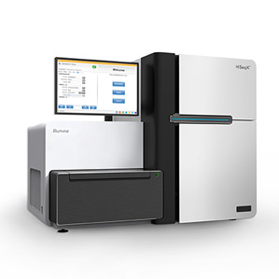
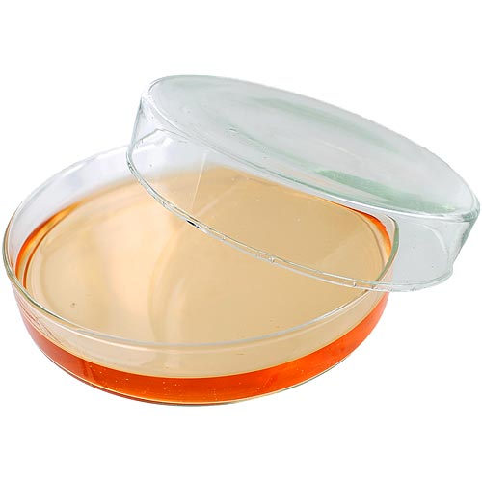

Biological Sequence Analysis
DNA / RNA extraction
Shearing
Library prep etc
Sequencing machine
Illumina HiSeq
Notes:
Reference genome:
Downstream analysis examples

Slide 5
Biological Sequence Analysis
Sequencing machine
Reads
(Short DNA fragments)
Mapping
Reference Genome
(human, mouse etc)
~ million/billion bp
Illumina HiSeq
100-250 bp
caatcgaaggttcagcc
ccatcgaaggttagggc
…..
…..
Millions !!!

Slide 6
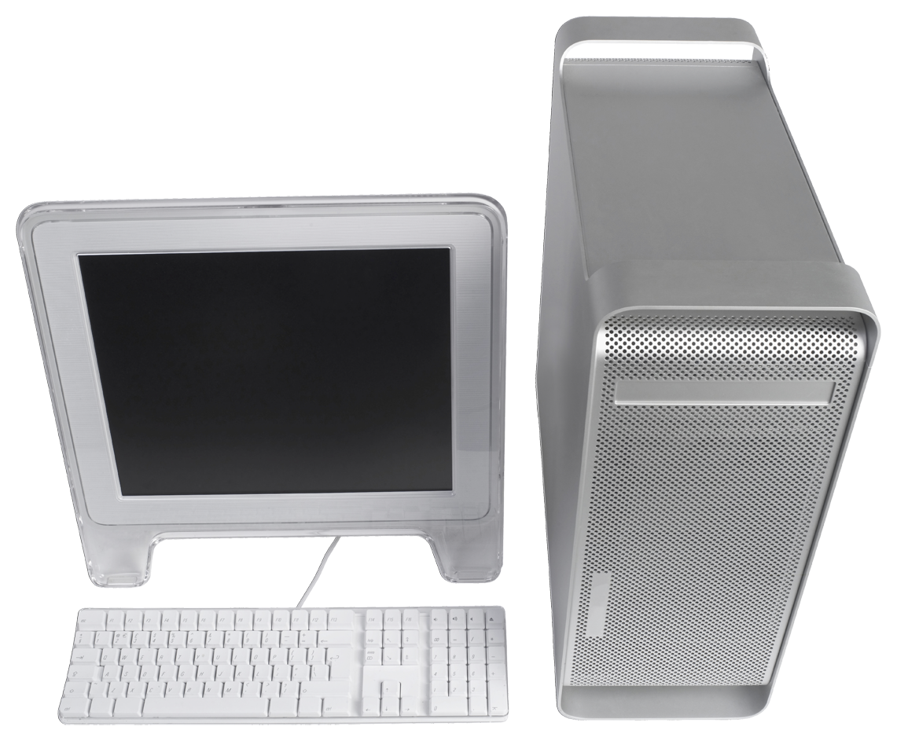
Biological Sequence Analysis
Bioinformatics Tools
Reads
Mapping
Reference Genome
Part 2 : Short read alignment and inference (Rahul)

Slide 7
Biological Sequence Analysis
Bioinformatics Tools
Reads
Mapping
Bam file
(mapped reads)
Reference Genome (fasta file)
Part 2 : Short read alignment and inference (Rahul)
gff file : Annotations. Genomic coordinates of genes etc.

Slide 8
Biological Sequence Analysis
Reads
Mapping
Part 3 : High performance computing cluster (Vijay)

Slide 9
Part 1: Text manipulation and shell scripting (Naomi)
Date Added to Catalog PUBMEDID First Author Date Journal Link Study Disease/Trait Initial Sample Description Replication Sample Description Region Chr_id Chr_pos Reported Gene(s) Mapped_gene Upstream_gene_id Downstream_gene_id Snp_gene_ids Upstream_gene_distance Downstream_gene_distance Strongest SNP-Risk Allele SNPs Merged Snp_id_current Context Intergenic Risk Allele Frequency p-Value Pvalue_mlog p-Value (text) OR or beta 95% CI (text) Platform 10/22/2014 24528284 Ji Y 08/01/2014 Br J Clin Pharmacol http://www.ncbi.nlm.nih.gov/pubmed/24528284 Citalopram and escitalopram plasma drug and metabolite concentrations: genome-wide associations. Response to serotonin reuptake inhibitors in major depressive disorder (plasma drug and metabolite levels) 300 European ancestry Escitalpram treated individuals, 130 European ancestry Citalopram treated individuals NA 17q25.3 17 79831041 CBX4 CBX8 - CBX4 57332 8535 33.93 2.12 rs9747992-? rs9747992 0 9747992 Intergenic 1 0.086 2E-7 6.698970004336019 (S-DCT concentration) NR NR10/22/2014 24528284 Ji Y 08/01/2014 Br J Clin Pharmacol http://www.ncbi.nlm.nih.gov/pubmed/24528284 Citalopram and escitalopram plasma drug and metabolite concentrations: genome-wide associations. Response to serotonin reuptake inhibitors in major depressive disorder (plasma drug and metabolite levels) 300 European ancestry Escitalpram treated individuals, 130 European ancestry Citalopram treated individuals NA 5p13.3 5 31766326 PDZD2 PDZD2 23037 rs2059865-? rs2059865 0 2059865 intron 0 0.235 3E-7 6.522878745280337 (S-DCT concentration) NR NR Illumina [7,537,437] (Imputed) N
10/22/2014 24528284 Ji Y 08/01/2014 Br J Clin Pharmacol http://www.ncbi.nlm.nih.gov/pubmed/24528284 Citalopram and escitalopram plasma drug and metabolite concentrations: genome-wide associations. Response to serotonin reuptake inhibitors in major depressive disorder (plasma drug and metabolite levels) 300 European ancestry Escitalpram treated individuals, 130 European ancestry Citalopram treated individuals NA 11p15.2 11 13107616 CTC-497E21.5 RASSF10 - ARNTL 644943 406 95.51 170.12 rs117020818-? rs117020818 0 117020818 Intergenic 1 0.046 7E-7 6.154901959985743 (S-DCT concentration) NR NR Illumina [7,537,437] (Imputed) N
10/22/2014 24528284 Ji Y 08/01/2014 Br J Clin Pharmacol http://www.ncbi.nlm.nih.gov/pubmed/24528284 Citalopram and escitalopram plasma drug and metabolite concentrations: genome-wide associations. Response to serotonin reuptake inhibitors in major depressive disorder (plasma drug and metabolite levels) 300 European ancestry Escitalpram treated individuals, 130 European ancestry Citalopram treated individuals NA 10q23.33 10 94922089 CYP2C19,CYP2C9 CYP2C115P - CYP2C9 100874513 1559 15.96 16.50 rs1074145-? rs1074145 0 1074145 Intergenic 1 0.162 4E-9 8.397940008672036 (S-CT concentration) NR NR Illumina [7,537,437] (Imputed) N
GWAS data example
Lot of information
We only want to extract necessary information !
Notes:
Full names

Slide 10
Workshop objective
By the end of the workshop, you will
Be able to navigate and work with files and directories, and do simple text manipulations using the command line.
Become familiar with basic genomic tools such as samtools and bedtools, and align reads against reference genome
Become familiar with terminologies and commands in high performance computing environment, and submit jobs

Slide 11
Part I : Text file manipulation & shell scripting

Slide 12
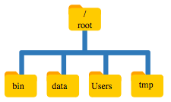
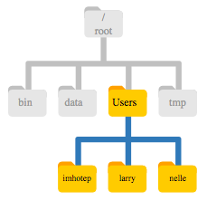
File system
/Users
$ pwd
/Users/nelle

Slide 13
Shell scripting basic syntax
[command name] [-options] [file or directory name]
Ex.
mkdir test
mkdir –p test
Verb
Object

Slide 14
Logging into HPC
Has ACI account:
- Mac users
ssh username@aci-b.aci.ics.psu.edu
- Windows
Log in with PuTTY or other ssh client
No ACI account
- You can still follow part 1 and 2.
https://mediatemple.net/community/products/dv/204404604/using-ssh-in-putty-

Slide 15
Changing directory
If you have ACI account
cd ~/scratch
2. No ACI account:
Mac
cd ~/Downloads
Windows
C:\Downloads

Slide 16
How to get datasets
Go to
https://github.com/PSUGenomix/BG_retreat_workshop_2017
1. If you have ACI account, log in to ACI and copy the following.
git clone https://github.com/PSUGenomix/BG_retreat_workshop_2017.git
2. If you don’t have ACI account, click “clone or download” and “Download ZIP”.

Slide 17
Please download the datasets and go to the directory where the downloaded files are.

Slide 18
Command list
Command | Example usage | Meaning
pwd | - | Print a current working directory
ls | - | List names of files and directories
cd | cd scratch | Change a directory
mkdir | mkdir test | Make a directory
cp | cp draft.txt draft2.txt | Copy a file
mv | mv draft2.txt draft3.txt | Move a file
rm | rm draft.txt | Remove a file
wc | wc draft.txt | Count number of words
cat | cat draft.txt | Show contents of file
head | head draft.txt | Show the beginning of a file
tail | tail draft.txt | Show the end of a file
sort | sort draft.txt | Sort contents
cut | cut –f1 draft.txt | Extract specified fields
uniq | uniq draft.txt | Show uniq lines
grep | grep gene draft.txt | Search text

Slide 19
Vi Text editor
Why do we need it :
- Built-in text editor
How to use vi text editor:
vi [name of text]
Example : vi draft.txt
How to get out of vi
[esc] :q

Slide 20
Run the following codes before the break
bash install_tools.sh

