Slide 1
Bioinformatics 101
Rahulsimham Vegesna
09/23/2017
Bioinformatics and Genomics Retreat

Slide 2
Session 2
File formats : VCF, BED and GFF
Data Processing
Analysis

Slide 3
Access to Unix terminal.
Downloaded GIT repository.
git clone https://github.com/PSUGenomix/BG_retreat_workshop_2017.git
Have BWA, Samtools, freebayes, bedtools installed.

Slide 4
File formats
Many file formats.
Few are standardized.
Commonly used ones are FASTA, FASTQ, SAM/BAM, VCF, BED, GFF and GTF.
Specific to data type or tool
Good place to start if you want to learn about file format is :
https://genome.ucsc.edu/FAQ/FAQformat.html

Slide 5
VCF – Variant Call Format

Slide 6
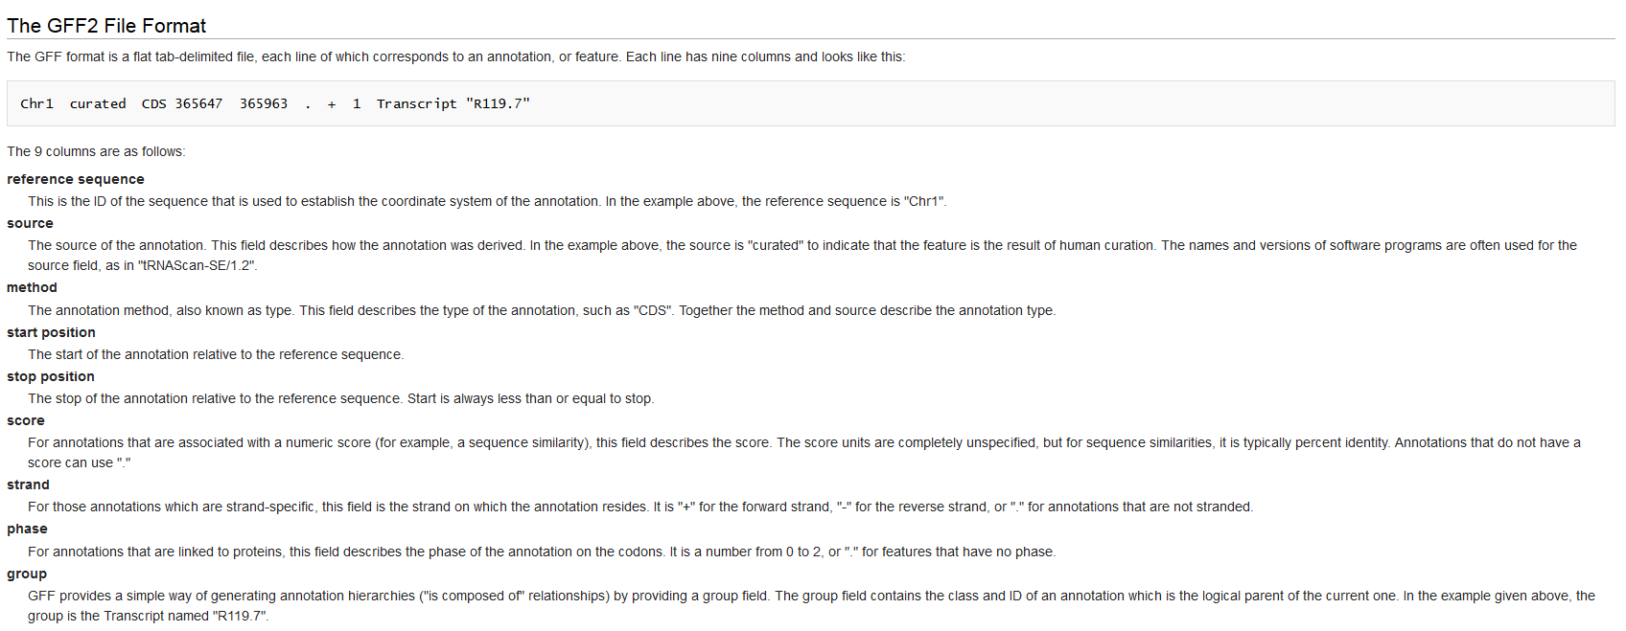
GFF - General Feature Format

Slide 7
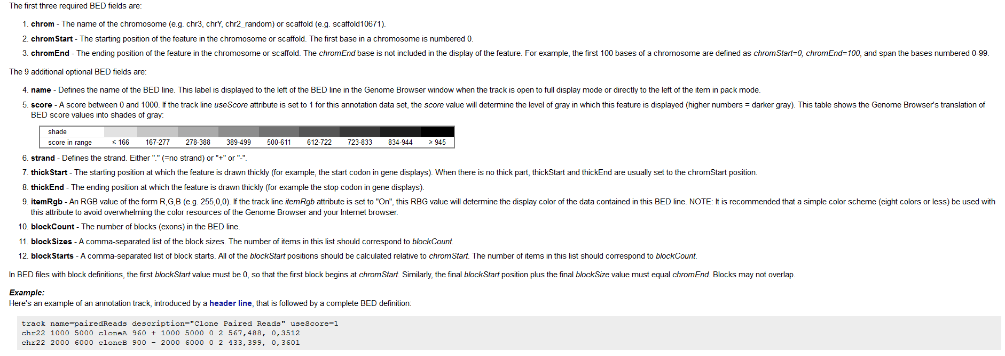
BED - Browser Extensible Data

Slide 8
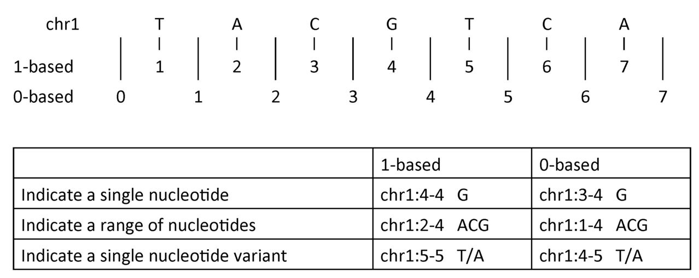
0 based and 1 based coordinates
Some file formats are 1-based (GFF, SAM, VCF) and others are 0-based (BED, BAM)
https://www.biostars.org/p/84686/

Slide 9
Check point
cd ~/work
bin
src
You can also make directories for reference and save all references in one place for easy access.

Slide 10
Data
Download BAM or FASTQ files from public resources.
We provided
Whole genome Yeast single end BAM file.
Yeast Ref genome
Yeast gene coordinates

Slide 11
Questions
Which genes have mutations?
Which genes do not have mutations?
Which genes have the highest number of mutations?
Can we check if the flanking regions of the genes have mutations as well ?
Get coverage of each gene and number of reads mapping to it.
Get the sequence of a particular gene from the genome.

Slide 12
Convert BAM to FASTQ
Command:
bedtools bamtofastq -i Example_bamFile_singleEnd_reads_45bp_sg11.bam -fq yeast.end1.fq

Slide 13
Preprocessing
Alignment
Sort
Index

Slide 14
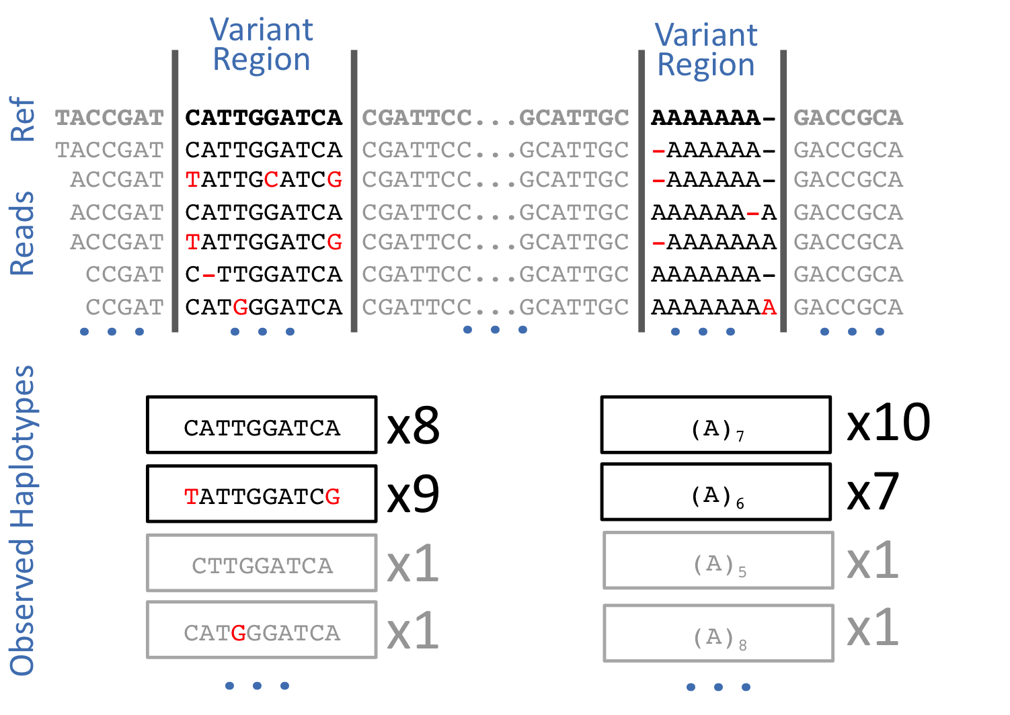
Freebayes
https://github.com/ekg/freebayes

Slide 15
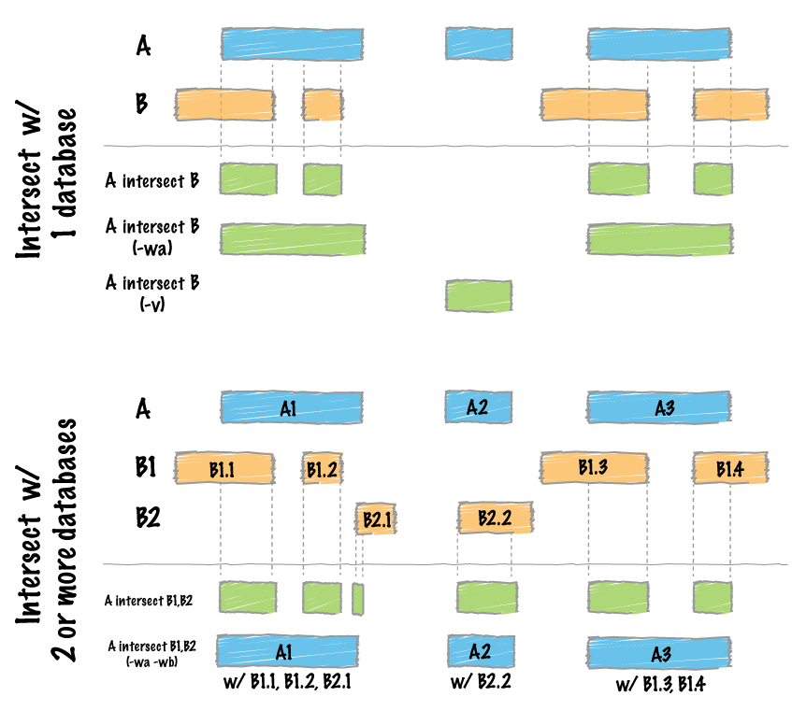
Bedtools intersect
Each feature in A is compared to B in search of overlaps.
http://bedtools.readthedocs.io/en/latest/content/tools/intersect.html

Slide 16
Which genes have mutations?
Solution: Using bedtools we find the intersect of the Gene coordinates and Mutation calls.
Command:
bedtools intersect -a sg11_reference_gene_annotation.gff -b yeast_ variants .vcf > genes_with_mutations.bed

Slide 17
Which genes do not have mutations?
Use extra parameter –v, which reports entries in A that have no overlap in B.
Command:
bedtools intersect -a sg11_reference_gene_annotation.gff -b yeast_variants.vcf -v > genes_ without_mutations.bed

Slide 18
Which genes have the highest number of mutations?
Lets make use of unix command line tools
Cut – Remove or "cut out" sections of each line of a file or files.
Sort – sorts the contents of a text file, line by line.
Uniq – reports or filters out repeated lines in a file.
Command :
bedtools intersect -a sg11_reference_gene_annotation.gff -b yeast_variants.vcf | cut -f 9 | sort| uniq -c | sort -rn | head

Slide 19
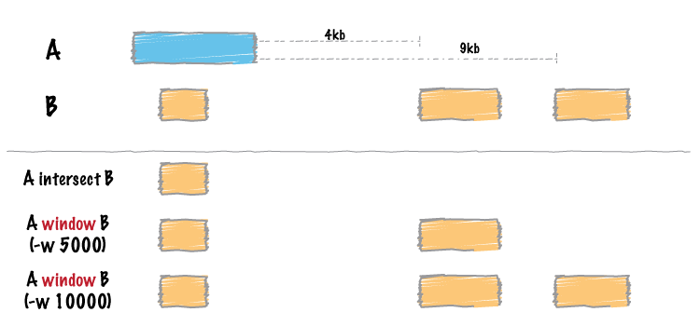
Bedtools window
http://bedtools.readthedocs.io/en/latest/content/tools/window.html

Slide 20
Can we check if the flanking regions of the genes have mutations as well ?
This can be answered different ways using bedtools. We will use bedtools window.
Command :
bedtools window -w 500 -a sg11_reference_gene_annotation.gff -b yeast_varients.vcf > mutations_gene_plus_500bpwindow.bed
#Flanking region specific Mutations (window – gene= flank)
bedtools intersect -a mutations_gene_plus_500bpwindow.bed -b sg11_reference_gene_annotation.gff –v > mutations_within_500bpwindow.bed

Slide 21
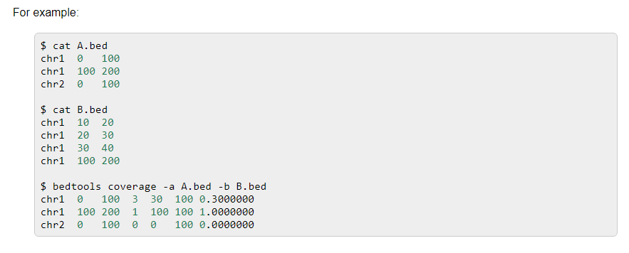
Bedtools coverage
After each interval in A, bedtools coverage will report:
The number of features in B that overlapped (by at least one base pair) the A interval.
The number of bases in A that had non-zero coverage from features in B.
The length of the entry in A.
The fraction of bases in A that had non-zero coverage from features in B.
http://bedtools.readthedocs.io/en/latest/content/tools/coverage.html

Slide 22
Get coverage of each gene and number of reads mapping to it.
Command:
bedtools coverage -a sg11_reference_gene_annotation.gff -b yeast_aln_sorted.bam > gene_coverage.bed

Slide 23
Bedtools getfasta
If you have a region of interest, we can extract its sequence with a single command.
Region of interest:
cat gene_extract.bed
chr1 1807 2169 YAL068C
Command:
bedtools getfasta -fi sg11_all_chromosomes.fa -bed gene_extract.bed -fo YAL068C.fa -name

