Slide 1
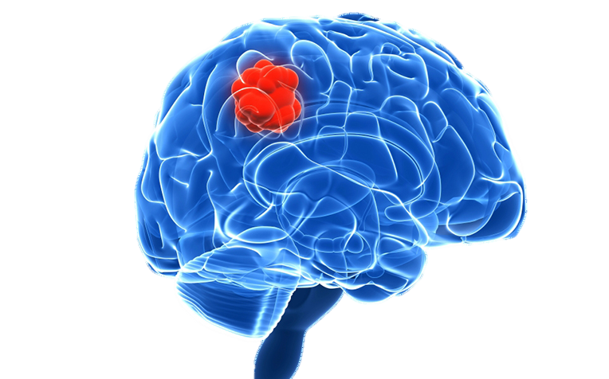
BRAIN TUMOUR DETECTION
CE9010 GROUP 4
Sun Yun Qian Priscila (U1740761A)
Lau Zhe Ru Zachary (U1621345C)
Github: https://github.com/PSUN98/CE9010_Project

Slide 2
Content
Project Description (Zachary)
Data Acquisition (Zachary)
Data pre-processing & exploration (Priscila)
PCA (Priscila)
K-MEANS (Priscila)
Logistic Regression (Zachary)
CNN (Priscila & Zachary)
Conclusion/ Future Work (Zachary)

Slide 3
PROJECT DESCRIPTION

Slide 4
1. Motivation
Brain and other nervous system cancers are the 10th leading causes of death for men and women in the US ("Brain Tumor - Statistics", 2020).
Segmentation, detection and extraction of tumour information from MRI images are crucial in diagnosis. However, this is tedious, time-consuming and highly dependent on the experience of the radiologist (Bahadure et al., 2017).
Computer-aided technology (in this case, for tumour detection) is thus of interest to reduce these limitations.

Slide 5


2. Task
Supervised classification of brain MRI images into 2 classes:
Yes, tumour is present.
No, tumour is not present

Slide 6
DATA ACQUISITION

Slide 7

1. Downloading of Data Set to Local Drive
The data set was obtained by importing the Kaggle library and downloaded using the following code:

Slide 8
DATA PRE-PROCESSING & EXPLORATION

Slide 9
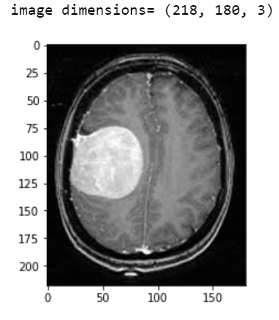
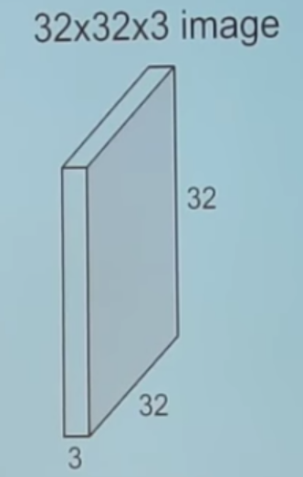
1. Decode Image
After loading the dataset, assign variables with the proper file path for the "yes"(with tumour) and "no"(without tumour) set.
We then decode the image into a 3-dimensional matrix: (height, width, colour channels).
Visualise the first raw image from the "yes" dataset.
218X180X3 image
218
180
3

Slide 10
2. Create X matrix
218X180X3 image
Before we can feed the data into sklearn packages, we need to resize all images (both "yes" and "no" set) into the same size (224x224x3).
For simplicity, we will convert the images into grey scale, which will simplify the image dimension to (224x224). You can see that height of the image is now 224 pixels, width is 224.
Each element in the array represents grey scale value, which is calculated by taking the average of color channels at the respective pixel.
Store image matrices into X:
218
180
3

Slide 11
2. Create X matrix
224x224x3 image
218X180X3 image
Before we can feed the data into sklearn packages, we need to resize all images (both "yes" and "no" set) into the same size (224x224x3).
For simplicity, we will convert the images into grey scale, which will simplify the image dimension to (224x224). You can see that height of the image is now 224 pixels, width is 224.
Each element in the array represents grey scale value, which is calculated by taking the average of color channels at the respective pixel.
Store image matrices into X:
218
224
224
180
3

Slide 12
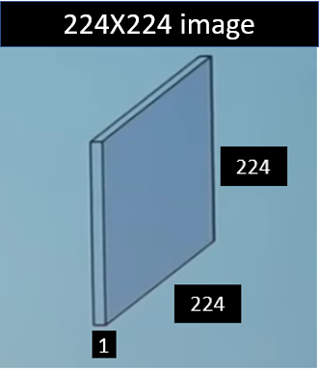
2. Create X matrix
Before we can feed the data into sklearn packages, we need to resize all images (both "yes" and "no" set) into the same size (224x224x3).
For simplicity, we will convert the images into grey scale, which will simplify the image dimension to (224x224). You can see that height of the image is now 224 pixels, width is 224.
Each element in the array represents grey scale value, which is calculated by taking the average of color channels at the respective pixel.
Store image matrices into X:

Slide 13
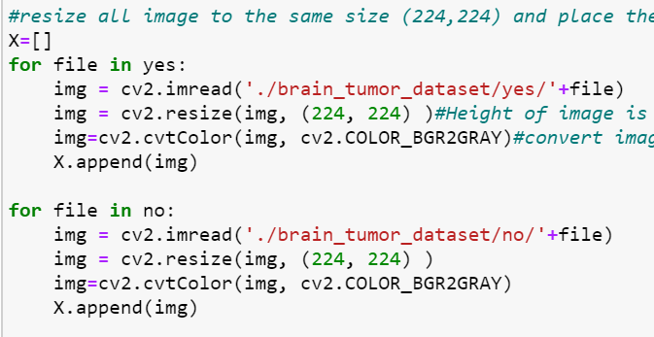
2. Create X matrix

Slide 14
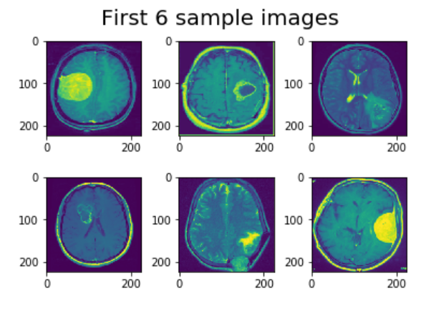
3. Visualise Data

Slide 15

4. Normalise pixel values, flatten image mat.
Pixel values are often integers in the range between 0 and 255, which can be computationally expensive for our models.
To lower computational cost, we can normalise pixel values to a range between zero and one.
We then flatten all the 2D image matrices (224x224) into a 1D array of size 224*224=50176 features:
Notes:
pixel values are between 0 and 255, which is computionally expensive. Hence, we can normalise pixel to a range between 0 and 1 by dividing by 255. we then flatten all 2D image matrices into a 1D array of 50176 features.

Slide 16
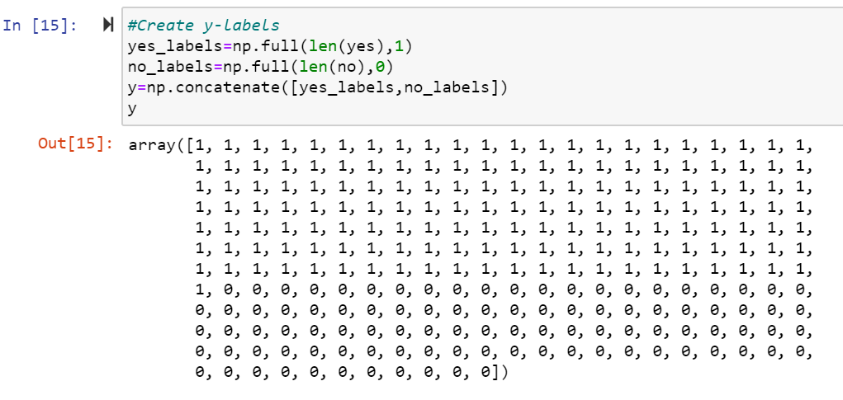
5. Create y labels
Create an array, y, which consists of the image labels.
Images from the "yes" (tumour present) set will be assigned class 1
Images from the "no"(tumour absent) set will be assigned class 0.
Notes:
We will also create an array y which consist of image labels

Slide 17

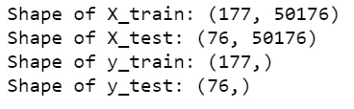
6. Split train-test
We split the dataset into 70% of training data and 30% of testing data:

Slide 18
PRINCIPAL COMPONENT ANALYSIS (PCA)

Slide 19
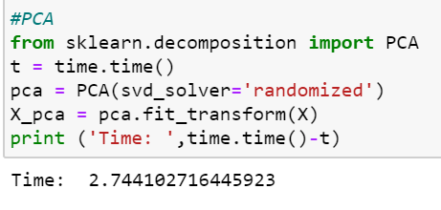


1. WHY?
Currently, we have a very high dimensional data with 50176 features!
With principal component analysis(PCA), we can effectively reduce the dimensionality of our dataset to reduce memory needed for the data and speed up learning speed.
K-means(PCA):
K-means(No PCA):
Notes:
What PCA does is it projects the image data from a higher dimensional space (50176 dimensions) into a lower dimensional space (k dimensions).
These k dimensions are nothing but the k Principal Components that captures (or holds) most of the variance (information) of our data.

Slide 20
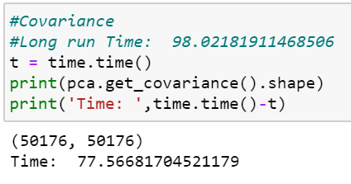
2. Co-variance matrix
Covariance matrix is a dxd matrix which encodes all data variations.
d is the number of dimensions, which is 50176 in our case.
Therefore, our covariance matrix will be a 50176x50176 matrix as shown below.

Slide 21
3. Principal directions
Principal directions are computed by the eigenvalue decomposition(EVD) of the co-variance matrix.
Data variations are captured by each principle directions. The first principal direction captures the largest data variance and the second principal direction captures the second largest data variance and so on...

Slide 22
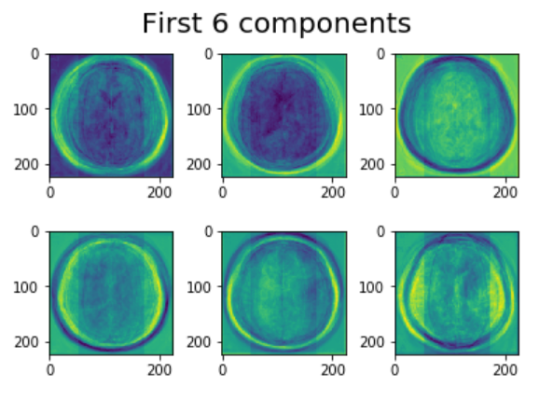
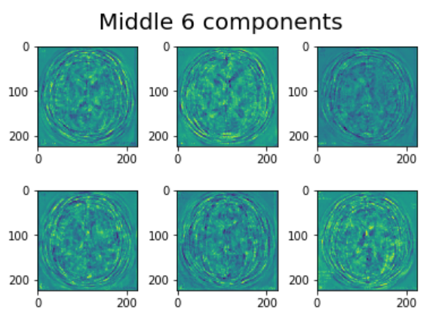
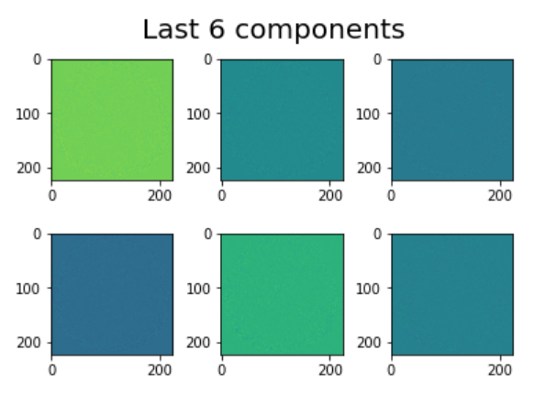
4. Principal Components
Principal components are computed by projecting image data matrix X on principal directions to get compressed data.
Captures the largest variation
Noise

Slide 23

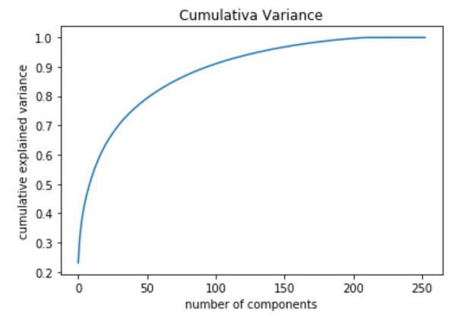
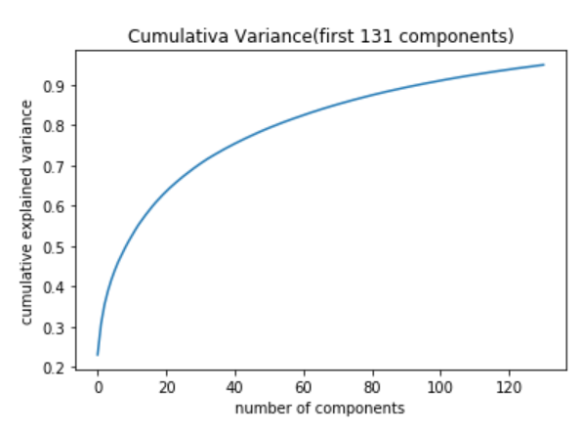
5. Find number of principle components that captures 95% of variance.

Slide 24
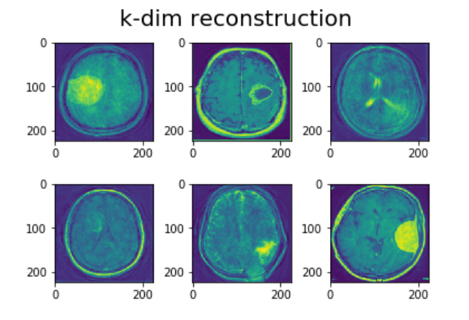
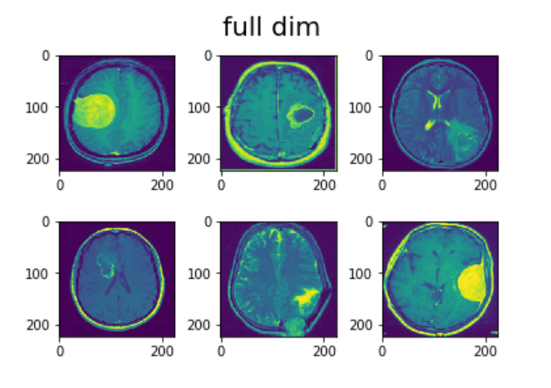
6. Visualise the reconstructed sample images from only the first k principal components
We then run PCA with only k components
Comparing the processed images with the original ones, most of variances are maintained after dimension reduction.

Slide 25
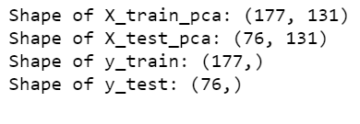
7. Split train/test
We split the image data with reduced dimensions (PCA) into 70% of training data and 30% of testing data by using the same indexes for the original training set and test set as defined above.
This is to ensure that the only difference between the new train/test sets (i.e. X_train_pca, X_test_pca) and original train/test sets (i.e. X_train, X_test) will be the dimensions/number of features for each image data.

Slide 26
K-MEANS

Slide 27

1. K-MEANS(PCA)-Algorithm
To reduce dependence with respect to initialisation, We repeat the following K-means algorithm 100 times with random initialisation of centroids each time.
Inputs:
no of clusters= 2
Training set (nxd), n(number of training data)=177, d(number of features)= k(reduced no of features)
K-means algorithm:
initialisation: Randomly initialise 2 centroids/means
Repeat until convergence:
Cluster assignment (0 or 1)
Means update
Outputs:
clusters for training set
K-means loss
We then save the clusters in clust_iters and loss value in L_iters for each run.
We pick the solution with the smallest K-MEANS loss value

Slide 28

2. K-MEANS (NO PCA)-Algorithm
Since PCA may worsen the performance of the learning algorithm due to lesser features/information to learn from, we will try K-means clustering without PCA.
This time, training set will have 50176 number of dimensions/features.

Slide 29
3. K-MEANS++ (PCA)-Algorithm
K-means++ initialisation:
Randomly select the first centroid from the data points. For each data point compute its distance from the first centroid.
The probability that a point is chosen as the second centriod is directly proportional to its distance from the first centriod.
Hence, using kmeans++ initialisation will help us pick up centroids which are far away from one another.
This increases the chances of initially picking up centroids that lie in different clusters, which increase the chances for the algorithm to find a global solution.
Notes:
Choose datapoints that are furthest away from the first centroid as the second centriod

Slide 30
4. K-MEANS – Results Summary
K-means is not a good choice as it only achieves about 50 something % accuracy.
Even with full dimensionality (50176 features), accuracy still did not improve. This means that the poor performance is not attributed to reduction of dimensions by PCA.
K-means++ did not improve accuracy either. This means that the poor performance of K-MEANS is unlikely due to poor initialisation. Also, we probably have already accounted for initialisation issues with random initialisation by running the K-MEANS algorithm 100 times and picking the solution with the smallest loss value.

Slide 31
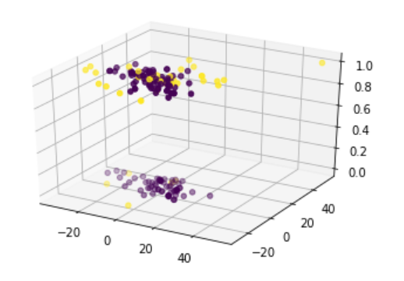
4. K-MEANS -3D plot
As you can see, there is no clear relationship between data separated by presence and absence of brain tumour and data seperated by k-means clustering.

Slide 32
LOGISTIC REGRESSION

Slide 33
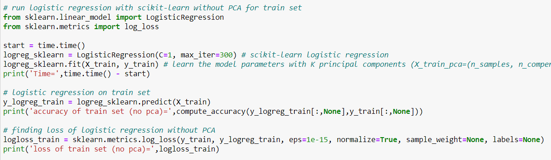
1. Sklearn Linear Logistic Regression Model
Linear logistic regression model was imported from sklearn library
Default regularisation parameter used initially
Modelling process:
Initialise -> Fit -> Predict -> Calculate accuracy and loss

Slide 34
2. Accuracy Results
Logistic regression model performed better than K-means with highest accuracy of 77.6 %.
It performed worse with PCA, suggesting that some important components were missing after PCA.
Train set (no PCA) | Train set (PCA) | Test set (no PCA) | Test set (PCA)
100 % | 100 % | 77.6 % | 73.7 %

Slide 35
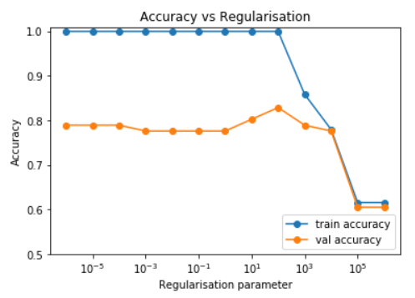
3. Tuning of Regularisation Parameter, λ
Different models were trained with λ varied from 10⁻⁶ to 10⁶
Highest accuracy of 82.9 % was obtained at λ = 10².
Values greater led to underfitting while those smaller led to overfitting as seen from the trend for training accuracy.

Slide 36
Convolutional Neural Networks (CNN)

Slide 37
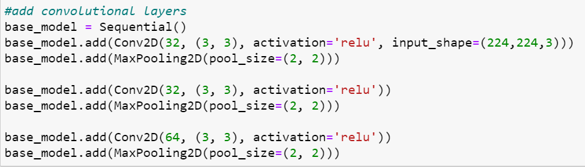
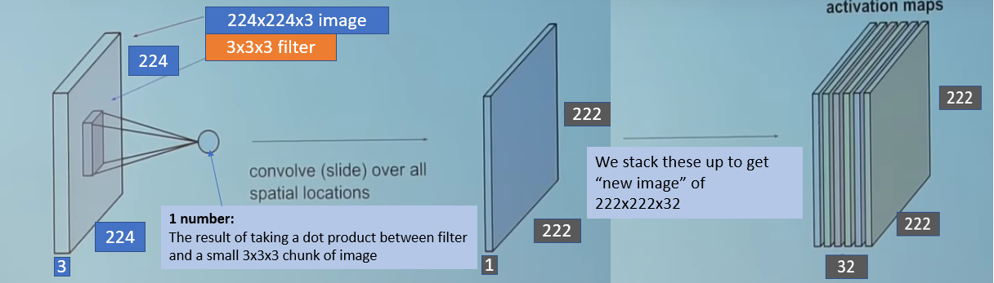
1. Feature Extraction
The first Conv2D layer’s input_shape : 224x224x3
The Conv2D layer has a filter size of 3x3.
We take this 3x3x3 filter and slide it over the complete image and along the way take the dot product between the filter and small 3x3x3 chunks of the input image

Slide 38
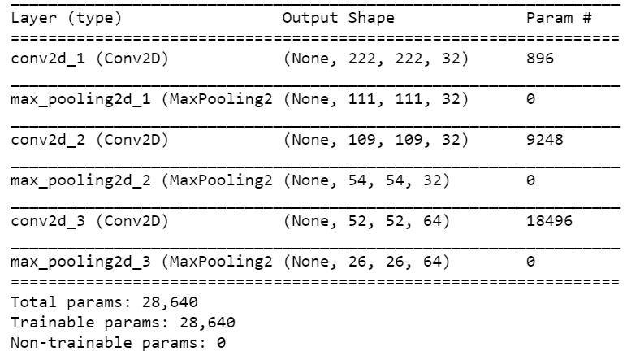
1. Feature Extraction
After convolving the entire image with the filter, we get a feature map of shape 222x222x1.
This means that there are 222x222 unique positions where the filter can be put on the image.

Slide 39
1. Feature Extraction
The purpose of the Convolution layers is to automatically extract meaningful features from the input image.
Lower layers detect simple structures like shapes/edges, as we go deeper the layers build on top of each other and learn to encode more complex patterns like eyes/nose.

Slide 40
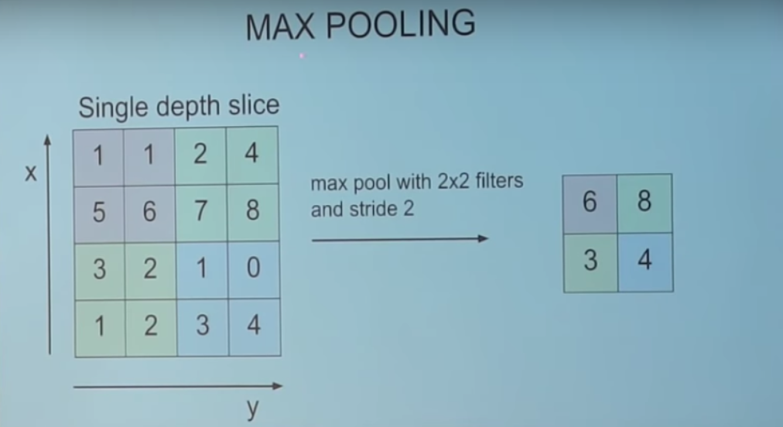
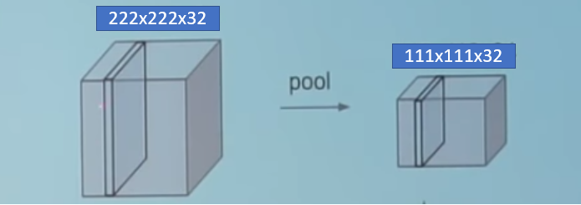
1. Feature Extraction
MaxPooling2D has a filter size of 2x2
Filter slide over the 222x222 picture and select the pixel with max value.
effectively reduces the image size by half. Therefore 222x222 pic becomes a pic size of 111x111.

Slide 41
1. Feature Extraction
The purpose of the pooling layers is to progressively reduce the spatial size of the representation to reduce the amount of parameters
making the network less computationally expensive, while still retaining most of the useful information from visual inputs.

Slide 42
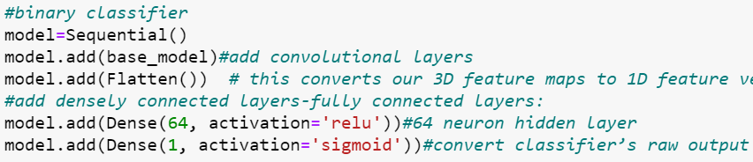
2. Classifier
2 fully-connected layers:
hidden layer with 64 output units
final layer with a single output unit and a sigmoid activation.
Sigmoid function is perfect for a binary classification since it converts the classifier's raw input value into a probability in the range [0,1].

Slide 43
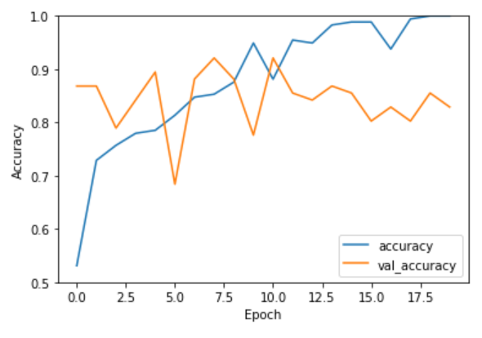
3. Results
Validation accuracy stops improving after a certain number of epochs while the training accuracy continues to increase
Significant gap between training and validation accuracy.
This is a sign of overfitting, since the model learned patterns that are too specific to the training data, but fails to generalise on the test data.

Slide 44
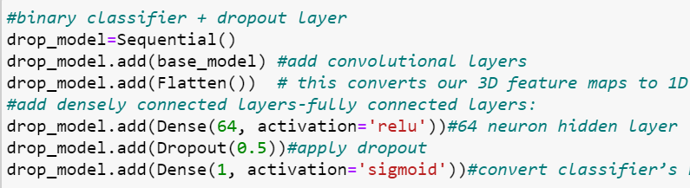
4. Adding dropout layer
A Dropout layer will randomly remove output features of a layer by setting it to zero.
When applying 0.5 dropout to a certain layer, it randomly removes 50% of the output units in each training epoch.
This helps to avoid overfitting on the training dataset.

Slide 45
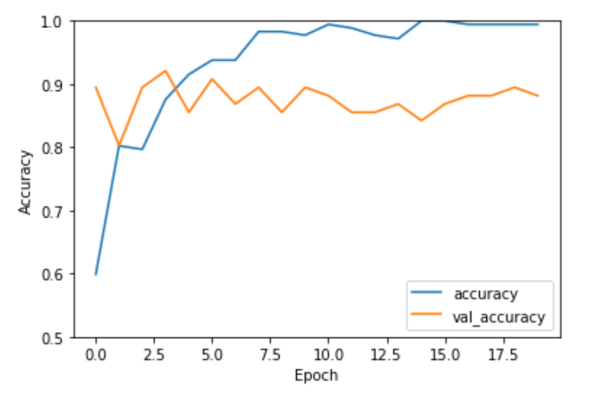
4. Adding dropout layer- Results
However, dropout does not seem to improve our accuracy much. Sometimes, it even makes our accuracy worse!
This is probably because output features are removed at random. This means that some important features that help us distinguish between the 2 classes may be removed, which impedes the accuracy of our model.

Slide 46
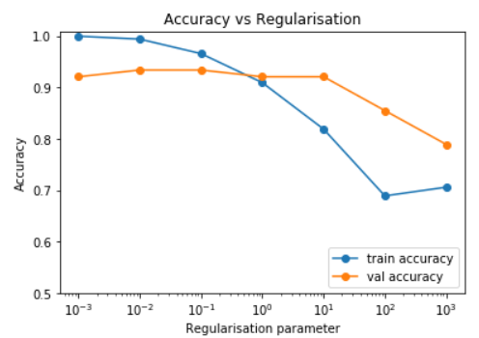
5. L2 Regularisation
L2 regularisation was implemented in the fully connected layer preceding the output layer to reduce overfitting.
Not applied to convolutional layers since no prediction happens in these layers.
Grid search using L2 regularisation parameters showed only 1 % improvement at best parameter value (λ = 10⁻² to 10⁻¹) over the original without regularisation.

Slide 47
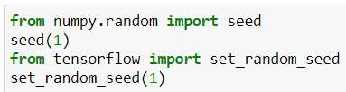
5. L2 Regularisation – Fixed Seed
However, due to stochastic nature of NN and regularisation, results were not very stable.
Fixed seed for random number generators to make results more reproducible and repeated NN model 3 times for single value of λ = 10⁻², but model was still unstable.

Slide 48
5. L2 Regularisation – Average Performance
To get a more representative value for accuracy, 10 iterations for each λ = 10⁻⁴, 10⁻², 1 were run, and the mean accuracy and standard deviations were calculated.
However, the mean accuracy for all values were lower than without regularisation (< 92 %), suggesting that most of the weights in FC layer are important and were being penalised.

Slide 49
5. CNN-Results Summary
We used CNN to automatically extract more meaningful features, which is probably why CNN perform the best with about 80 something % to 90% accuracy.
We tried to reduce overfitting issues by adding dropout layer, which randomly remove output features of a layer in the network. However, since output features are removed at random, at times it worsens the performance of our model as meaningful features may be removed when dropping out.
We also tried regularization, which after averaging, performed worse than without regularization. This is probably due to the minimization of important weights in the FC layer.

Slide 50
CONCLUSION & FUTURE WORK

Slide 51
Conclusion
Future Work
We used PCA to reduce the dimensionality of our image data.
We tried K-means clustering, logistic regression and CNN, with CNN attaining the best accuracy of ~ 90 %.
Improve overfitting of CNN
Increase dataset
Cross-validation
Reduce network’s capacity
Data augmentation
Optimisation of tuning parameters (e.g. learning rate, no. of epochs)
Consideration of other performance metrics (e.g. precision, recall, F1)

Slide 52
THANK YOU
References:
Bahadure, N., Ray, A., & Thethi, H. (2017). Image Analysis for MRI Based Brain Tumor Detection and Feature Extraction Using Biologically Inspired BWT and SVM. International Journal Of Biomedical Imaging, 2017, 1-12. https://doi.org/10.1155/2017/9749108
Brain Tumor - Statistics. Cancer.Net. (2020). Retrieved 24 April 2020, from https://www.cancer.net/cancer-types/brain-tumor/statistics.

