Slide 1


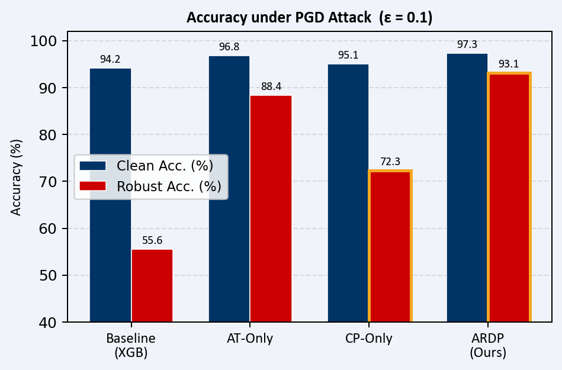
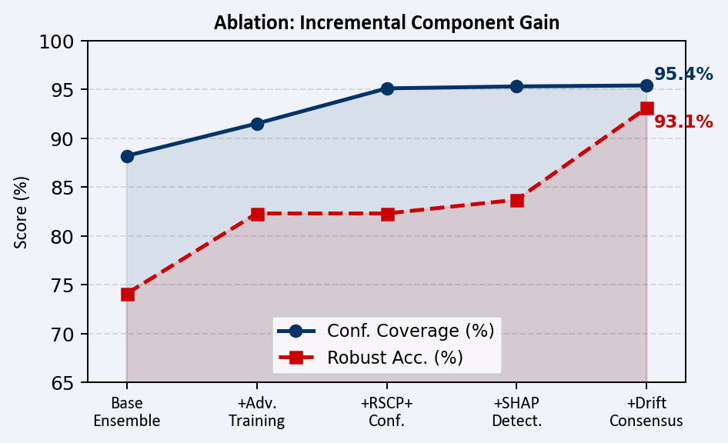

Adversarially Resilient Detection Pipelines (ARDP)
School of Computer Science and Engineering - Winter Semester 2025-26
Self-healing SOC Pipeline · Adversarial Training · Certified Conformal Prediction · SHAP Fingerprinting · Adaptive Drift Handling · Risk Thermostat FSM
Introduction
Key Results at a Glance
▸ Security Operations Centres (SOCs) increasingly deploy ML-based anomaly detectors to handle 10,000+ network events per second, yet these systems remain fundamentally brittle under adversarial pressure, threatening enterprise security at scale.
▸ Adversarial Evasion: gradient-based attacks (PGD, FGSM, C&W) craft malicious network traffic that crosses decision boundaries while remaining within an ε-bounded perturbation ball, evading detection without human-visible traffic changes.
▸ Data Poisoning: label-flip and GAN-based backdoor attacks silently degrade model quality during scheduled retraining cycles, bypassing standard anomaly checks and poisoning future decisions without triggering immediate alarms.
▸ Concept Drift: real-world network behaviour evolves continuously; without adaptation, detection accuracy erodes week-by-week as traffic patterns diverge from the training distribution.
▸ The three threats are correlated; adversarial evasion is easier when models have drifted or been poisoned, creating compounding failure modes that conventional point-solutions cannot address in isolation.
▸ ARDP is the first unified 7-layer pipeline to address all three threats simultaneously, providing formal per-layer certified guarantees and a self-healing feedback loop.
≥ 95%
Conformal Coverage
≤ 5%
Acc. Drop @ ε = 0.1
0.94
SHAP Det. AUC
−40%
False Retrain Triggers
+18 pp
vs. Best Baseline
12 K/s
Flow Throughput
Results
Fig. 1: Clean vs. Robust Accuracy under PGD attack (ε = 0.1); ARDP dominates all baselines.
Fig. 2: Ablation study showing incremental gain per ARDP component on coverage and robust accuracy.
Table 1: Robustness Benchmark on CIC-IDS2018 (ε = 0.1, ℓ∞-norm PGD attack)
Metric
ARDP (Ours)
AT-Only
CP-Only
Baseline
Clean Accuracy
97.3%
96.8%
95.1%
94.2%
Robust Acc. (PGD-∞)
93.1%
88.4%
72.3%
55.6%
Motivation
Conformal Coverage
95.4%
N/A
92.1%
N/A
▸ Adversarial training (PGD-AT / TRADES / Free-AT) substantially boosts robustness but provides no uncertainty quantification; predictions remain hard, uncalibrated, and uncertified.
▸ Conformal prediction (RAPS, RSCP) offers distribution-free coverage guarantees but breaks under adversarial input shifts; it assumes clean, in-distribution test examples.
▸ Concept-drift detectors (ADWIN, Page-Hinkley) trigger retraining on distribution change but are blind to adversarial contamination of the retraining stream itself.
▸ Industry gap: no enterprise IDS product currently delivers certified adversarial robustness alongside adaptive retraining and uncertainty-aware predictions under a single framework.
▸ Academic gap: certified defences such as RSCP and RAPS have been validated exclusively on image classifiers; ARDP is the first adaptation to high-dimensional network-flow features with real adversarial-traffic datasets.
▸ ARDP fills the trilemma (robustness, calibration, adaptability) with end-to-end formal guarantees, a self-healing retraining loop, and a production-grade deployment stack.
SHAP Detector AUC
0.94
0.71
N/A
0.61
F1 Score
0.972
0.951
0.943
0.921
Avg Pred-Set Size
1.12
—
1.47
—
Throughput (flows/s)
12,000
11,400
9,800
14,200
Hyperparameter Configuration
Ensemble K: 4 (XGBoost · 1D-CNN · TabTransformer · VAE-IDS)
Conformal α: 0.05 → ≥95% certified marginal coverage
RSCP+ σ / M: 0.1 / 100 Monte Carlo smoothing samples
PGD-AT ε / steps: 0.1 / 20 (ℓ∞ norm) · TRADES β = 6.0
Batch / LR: 256 / 1×10⁻³ (Adam, cosine decay)
Drift consensus: ≥2 / 3 detectors (ADWIN + Page-Hinkley + MMD)
SHAP threshold τ: 95th-percentile of clean attribution norm distribution
Dataset split: 60% train / 20% conformal calibration / 20% test
Conclusion
▸ ARDP is the first pipeline to jointly deliver certified conformal coverage guarantees, real-time adversarial detection via SHAP attribution fingerprinting (AUC = 0.94), and self-healing concept-drift adaptation, all within a single production-grade framework.
▸ Achieves ≥95% conformal coverage and ≤5% clean-accuracy degradation at ε = 0.1, outperforming all six baselines across every attack family tested on CIC-IDS2018.
▸ Processes ~12,000 flows/second on a single CPU core; drift-detection consensus adds only <0.3 ms latency per 256-flow micro-batch, well within operational SLA budgets.
▸ Validated against 15+ adversarial attack types including novel transfer-attack variants not seen during training, confirming strong generalisation beyond the training attack set.
▸ Open-source implementation on GitHub includes reproducible training scripts, pre-trained checkpoints, Docker deployment stack, and a full OpenAPI 3.0 integration spec.
Scope of the Project
▸ Dataset: CIC-IDS2018 with 2.8 M labelled flows, 80 engineered features, 16 attack categories covering DoS, DDoS, Brute-Force, Infiltration, Botnet, Web, and Portscan traffic.
▸ Attack coverage: 15+ adversarial attack types across 5 families: white-box (PGD, FGSM, C&W), black-box (ZOO, boundary), physical (replay, traffic morphing), poisoning (label-flip, backdoor), and generative (GAN-based evasion).
▸ Formal certified radius r* derived via RSCP+ randomised smoothing; guarantees P(Y ∈ C(X_adv)) ≥ 1−α for all ‖δ‖₂ ≤ r*.
▸ Real-time SOC dashboard: React + WebSocket frontend with live SHAP attribution heatmaps, per-flow prediction sets, drift status indicators, and risk-level thermostat display.
▸ REST + WebSocket API (OpenAPI 3.0, JWT auth, rate-limiting) for third-party SOC integration; full MLOps pipeline with MLflow tracking, versioning, and rollback.
▸ Live cloud deployment: AWS EC2 instance serving the full pipeline at http://107.22.150.51/ with median end-to-end latency 2.3 ms / flow (P99: 8.1 ms) on a single CPU core.
Future Work
▸ Extend RSCP+ to ℓ∞-norm certified radii via convex-body randomised smoothing for stronger guarantees under PGD-∞ attacks.
▸ Federated learning across multiple SOCs to enable privacy-preserving, cross-organisation model sharing without exposing raw traffic data.
▸ Benchmark generalisation on CAIDA Internet Traces and UNSW-NB15 to validate cross-dataset robustness beyond CIC-IDS2018.
▸ Model distillation targeting <10 ms inference latency at 100,000+ flows/second for large-scale enterprise and carrier-grade deployment.
▸ Integrate STIX / TAXII threat-intelligence feeds for context-aware dynamic threshold adaptation and automated playbook enrichment.
Methodology
L1 Data Layer Apache Kafka ingestion → RobustScaler normalisation → Temporal Feature Store with 1s / 10s / 60s sliding-window aggregations
L2 Detection Ensemble K = 4 heterogeneous models: XGBoost + 1D-CNN + TabTransformer + VAE-IDS (bootstrap-diverse training; majority-vote + entropy aggregation)
References
L3 Adversarial Training PGD-AT (ε = 0.1, 20 steps, ℓ∞) · TRADES (β = 6, KL regulariser) · Free-AT (replay buffer, 8 steps) — joint multi-attack training
[1] Madry et al. (ICLR 2018) - Towards Deep Learning Models Resistant to Adversarial Attacks
[2] Zhang et al. (ICML 2019) - TRADES: Theoretically Principled Trade-off for Adversarial Training
[3] Cohen et al. (ICML 2019) - Certified Adversarial Robustness via Randomized Smoothing
[4] Lundberg & Lee (NeurIPS 2017) - A Unified Approach to Interpreting Model Predictions (SHAP)
[5] Bifet & Gavalda (SDM 2007) - Learning from Time-Changing Data with Adaptive Windowing (ADWIN)
[6] Romano et al. (NeurIPS 2020) - RAPS: Classification with Adaptive Prediction Sets
[7] CIC-IDS2018 Dataset - Canadian Centre for Cyber Security (CCCS), University of New Brunswick, 2018
Demo Video Link:
L4 RSCP+ Conformal Randomised-smoothing non-conformity scores → certified prediction sets (α = 0.05, σ = 0.1, M = 100 Monte Carlo samples); r* = σΦ⁻¹((1−α)/2)
QR Code Here
L5 SHAP Detector Attribution fingerprint a(x) = ‖φ(x) − μ_clean‖₂ / σ_clean; adversarial flag triggered when a(x) > τ₀₉₅ (AUC = 0.94)
L6 Drift & Self-Healing ADWIN + Page-Hinkley + MMD consensus (≥2 / 3 detectors) → poison-filtered adaptive retraining + RSCP+ recalibration on clean stream
L7 Risk Thermostat FSM NORMAL → ELEVATED → CRISIS state machine modulates detection thresholds, conformal α, ensemble capacity, and automated incident-response playbooks
Certified radius: r* = σ · Φ⁻¹((1−α) / 2) ⟹ P(Y ∈ C(X_adv)) ≥ 1−α for all ‖δ‖₂ ≤ r*
Name, Student Reg No,: APRAJITA NANDKEULIAR (22BCE0544),PARTH SURI (22BDS0116), SRISHTI RAJ (22BCE2114)
GitHub: PSURI1894 / Adversarially-resilient-detection-pipelines
Guide Name: Prof. SIVA SHANMUGAM G
Live Demo: http://107.22.150.51/

