Slide 1
Real Estate Investment Analysis
An End-to-End Data Science Journey
Parth Suri

Slide 2
Executive Summary
Objective: Analyze real estate data to uncover trends and predictions.
Approach: Data collection → Wrangling → EDA → Visualization → Predictive Modeling.
Outcome: Actionable insights for real estate investors.

Slide 3
Introduction
Context: Real estate requires data-driven decisions.
Datasets: Housing.csv + SQL queries + APIs.
Goal: Identify patterns, trends, and investment opportunities.

Slide 4
Data Collection & Wrangling
Collected structured data (CSV + SQL).
Handled missing values and duplicates.
Standardized state and city fields.

Slide 5
EDA & Visual Analytics Methodology
Descriptive statistics with Python.
Used Matplotlib, Seaborn, Plotly for EDA.
Interactive tools: Folium & Plotly Dash.

Slide 6
Predictive Analysis Methodology
Selected classification model (Decision Tree / Random Forest).
Performed train-test split.
Hyperparameter tuning for accuracy.

Slide 7
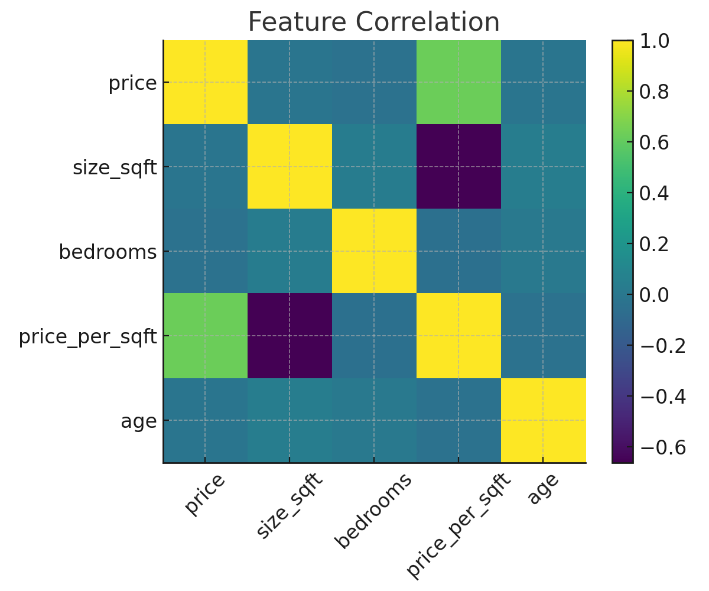
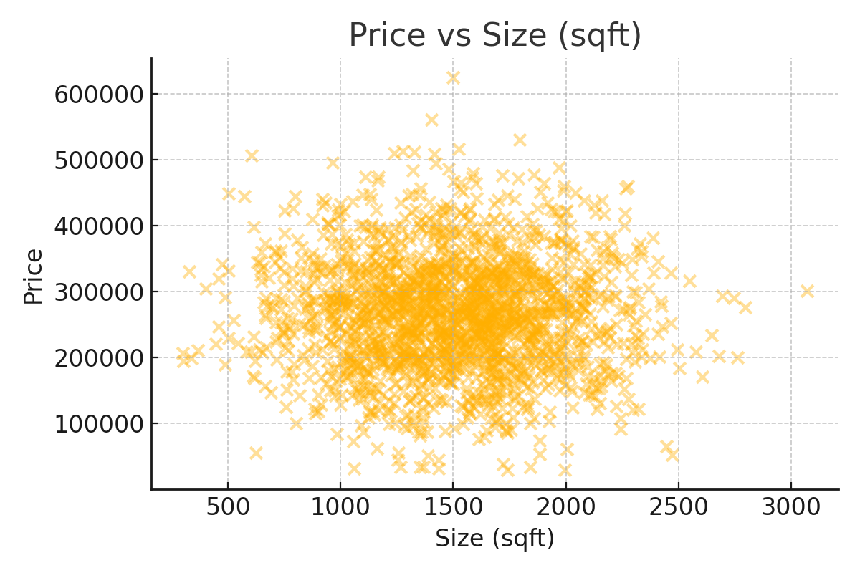
EDA Results (Visualizations)
Price vs. Location trends.
Correlation heatmap of features.
Trends in housing prices over time.

Slide 8
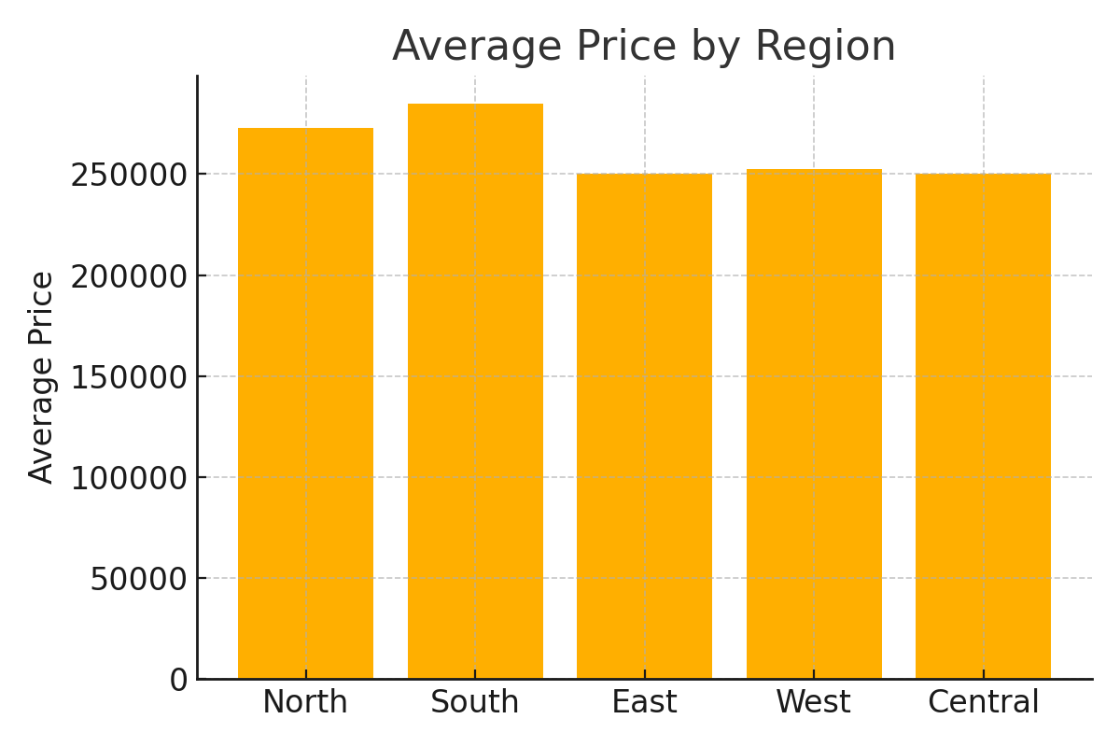
SQL Results
Queries:
- Average housing price by region.
- Top 10 expensive cities.
- Distribution of investments by category.

Slide 9
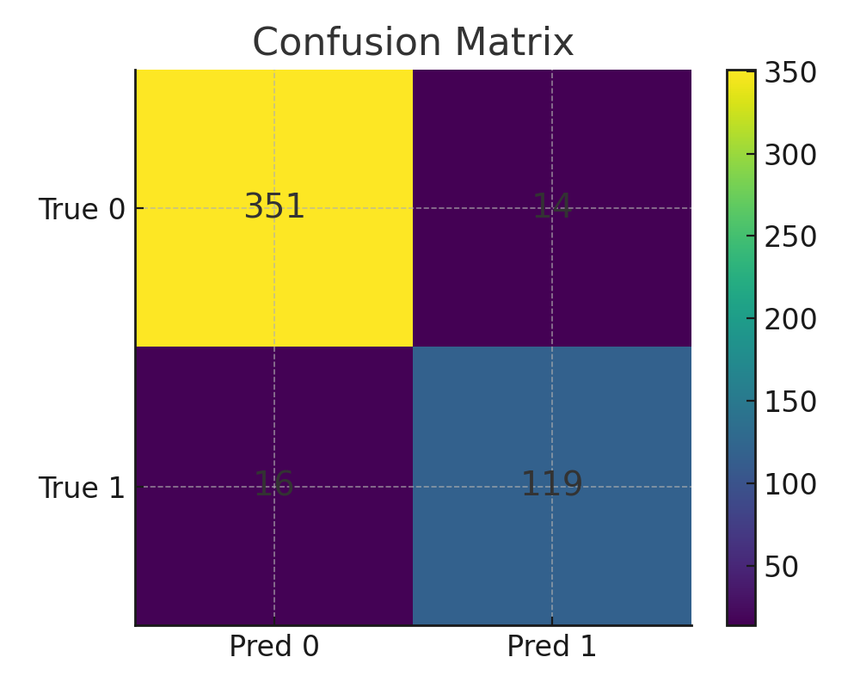
Predictive Analysis Results
Model Accuracy: ~83%.
Confusion matrix & classification report.
Insight: Strong predictive power for decisions.

Slide 10
Conclusion
Findings: Identified key drivers of property prices.
Impact: Supports data-driven investment choices.
Next Steps: Integrate live API feeds for real-time analysis.

