Slide 1


#5- Preparing MYSQL & Workbench for Gen AI query
Install the following and configure
MySQL
MySQL workbench
Use script to create DB “db_inventory”
Create 2 tables (tbl_inventory, tbl_OS)
Run some script to make sure MySQL working fine

Slide 2
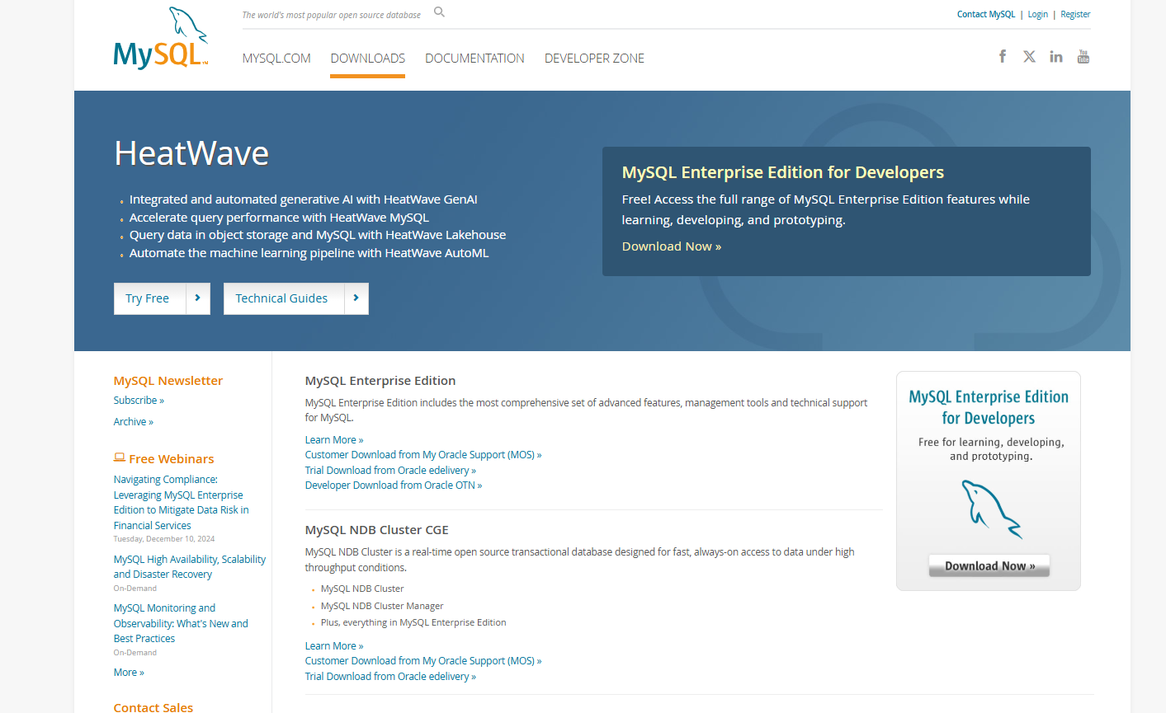
Open a browser
Go to
https://www.mysql.com/downloads/

Slide 3
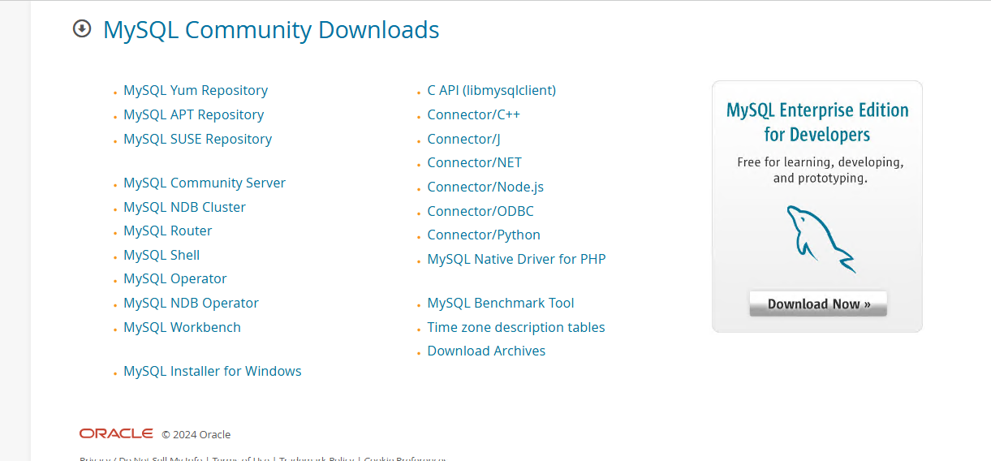

Slide 4
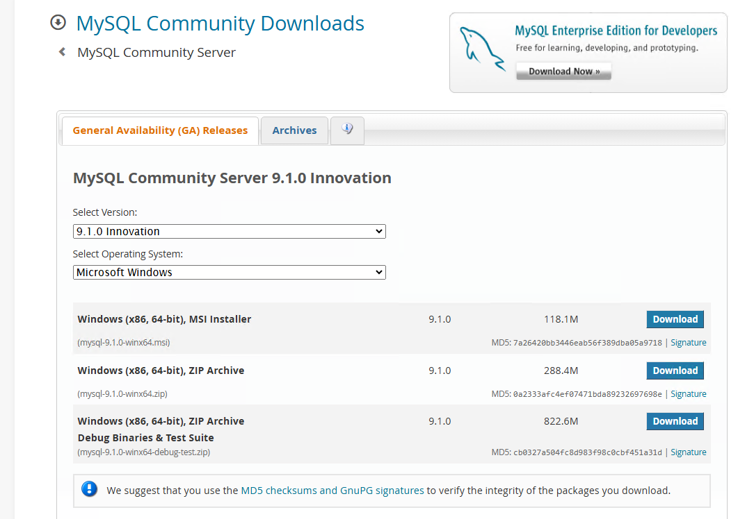

Slide 5
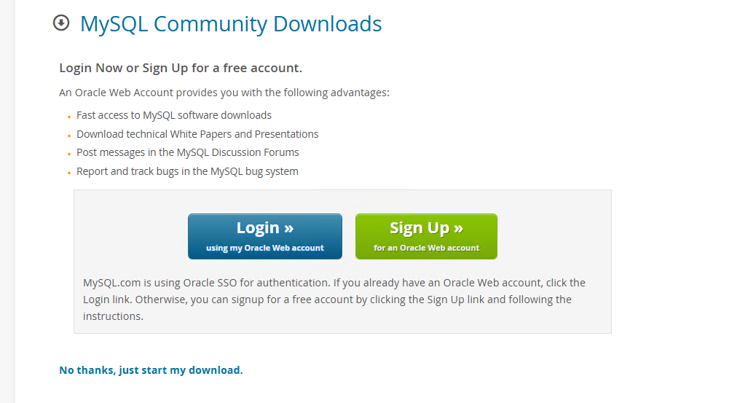
mysql-9.1.0-winx64.msi - > double click to install

Slide 6
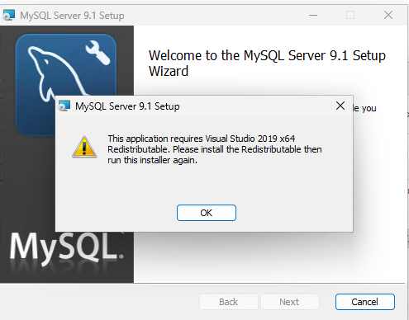
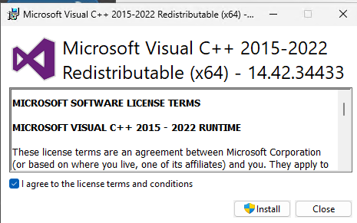
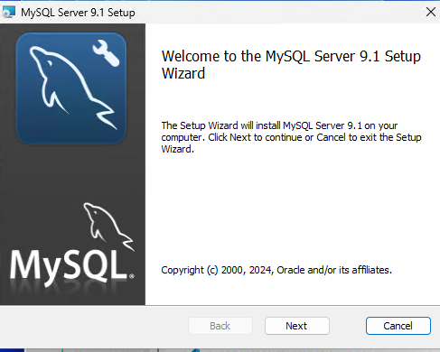
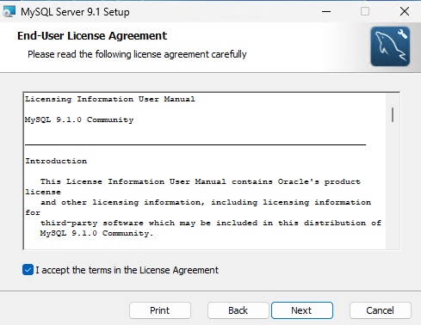
If you get error message download VC_redist.x64.exe
Install and reboot

Slide 7
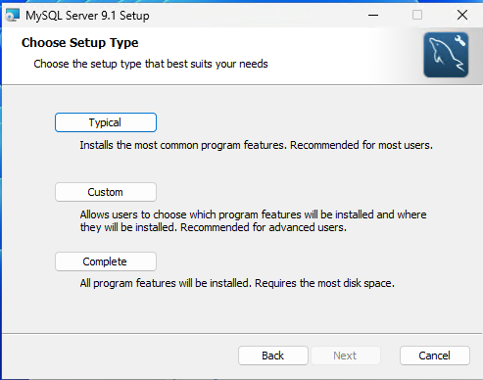
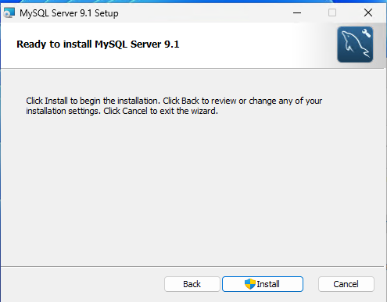
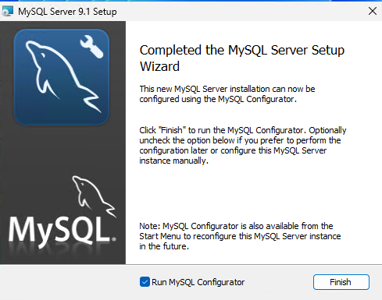

Slide 8
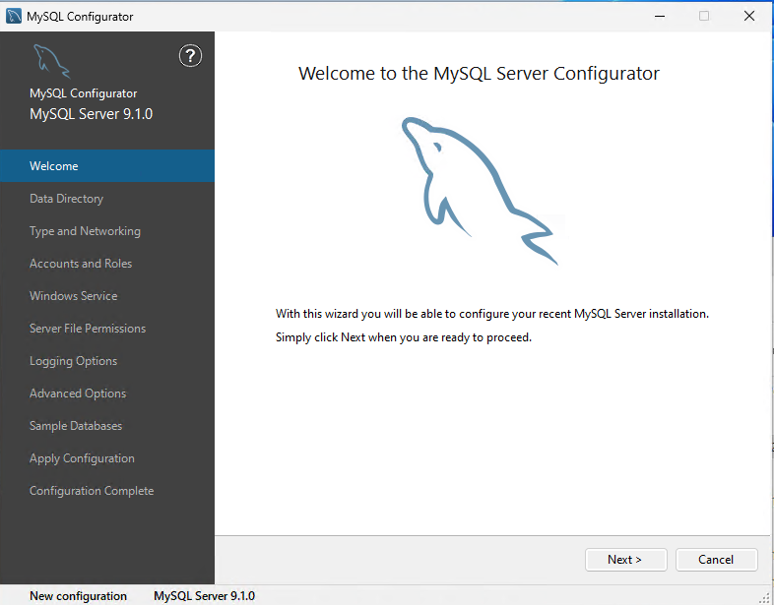
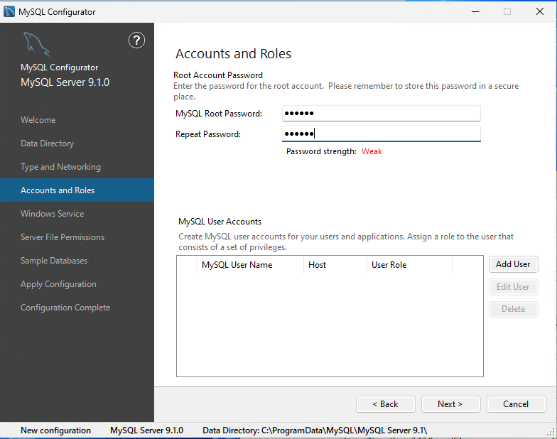

Slide 9
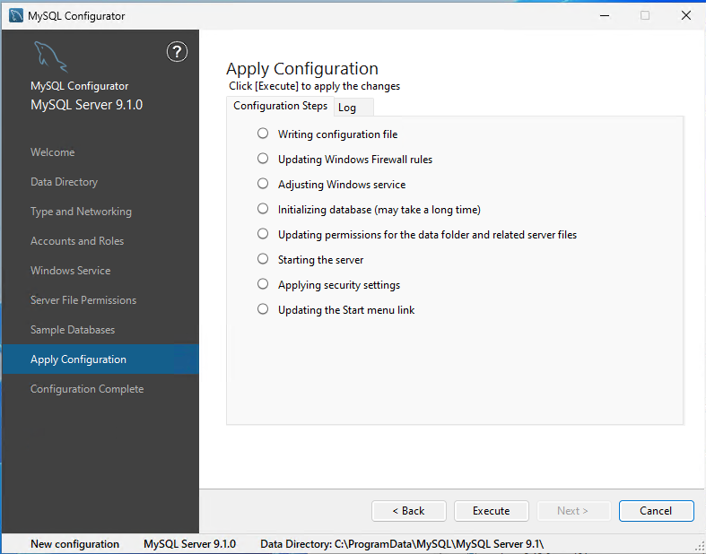
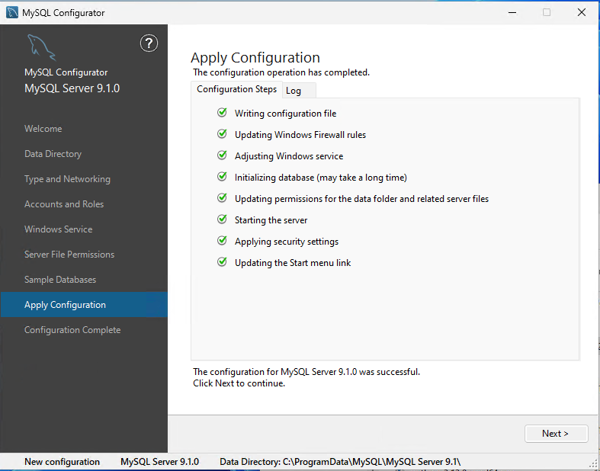

Slide 10
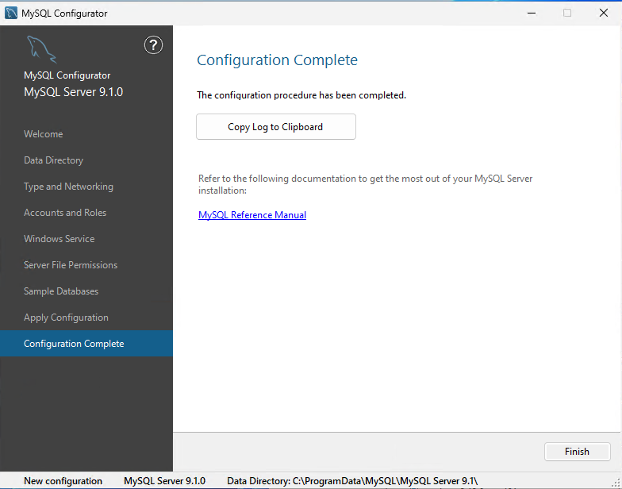

Slide 11
Install work bench for MySQL

Slide 13
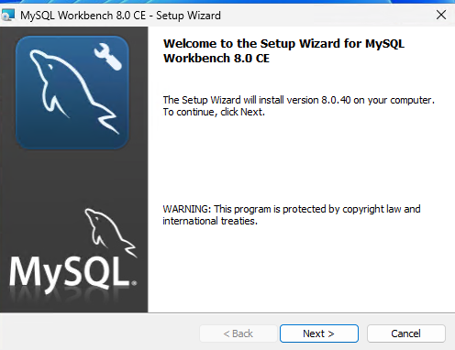
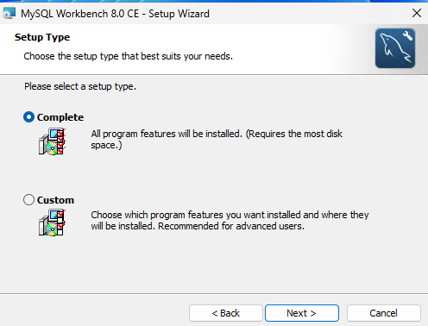
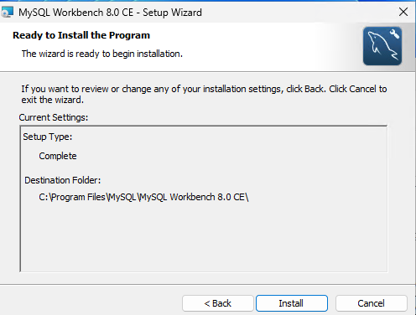
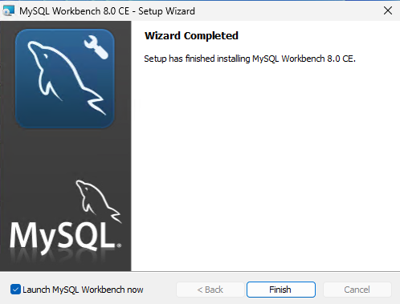
mysql-workbench-community-8.0.40-winx64.msi - > double click to start installing

Slide 14
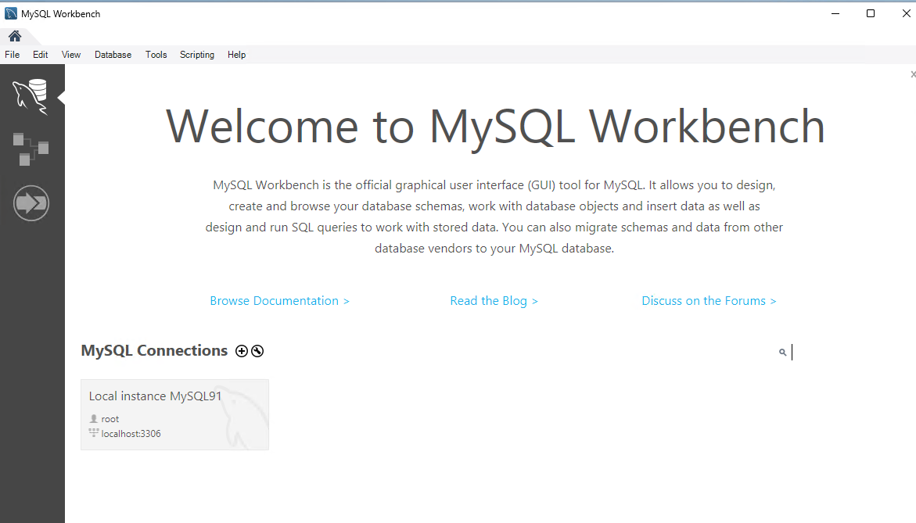

Slide 15
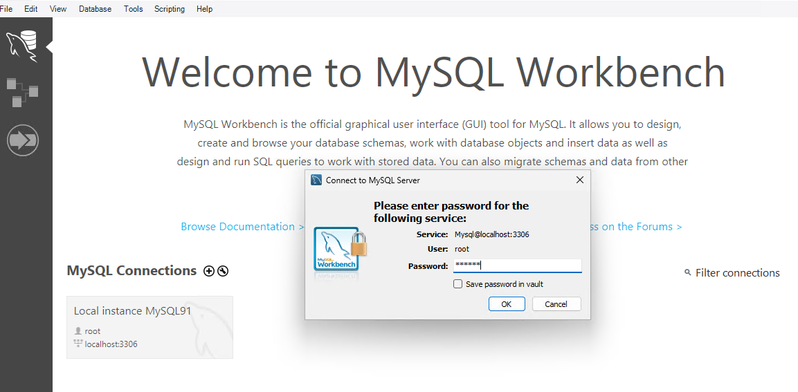

Slide 16
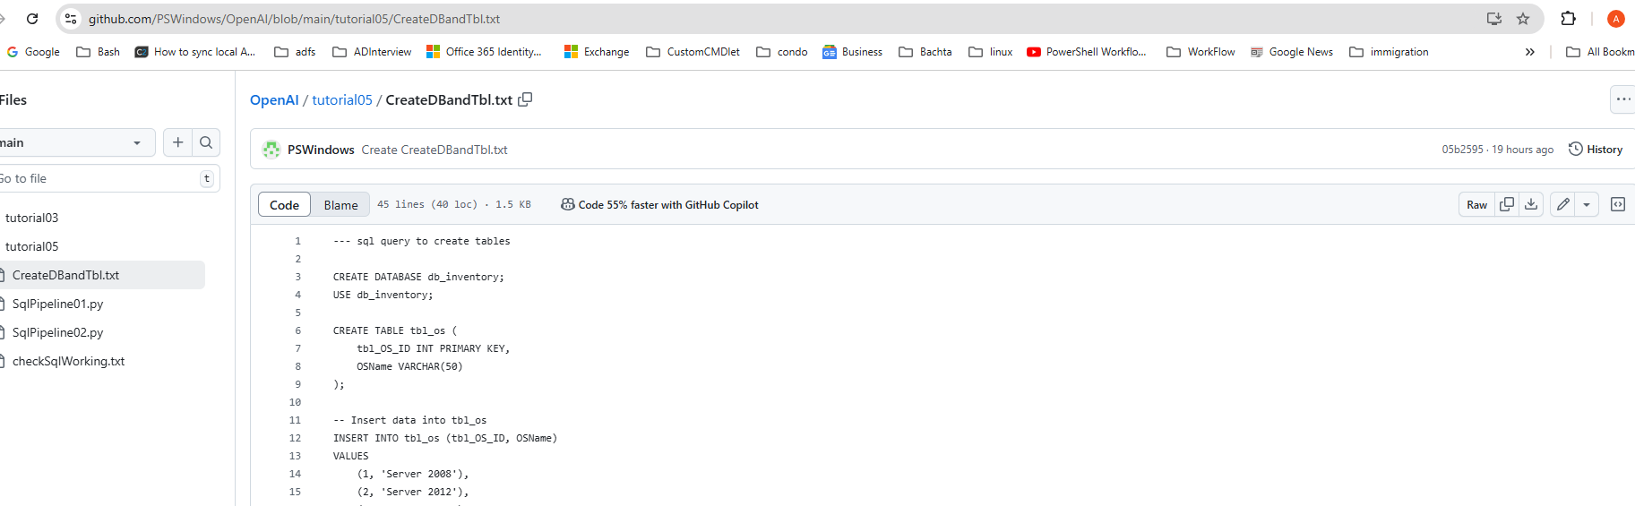
https://github.com/PSWindows/OpenAI/blob/main/tutorial05/CreateDBandTbl.txt - > here and copy the code

Slide 17
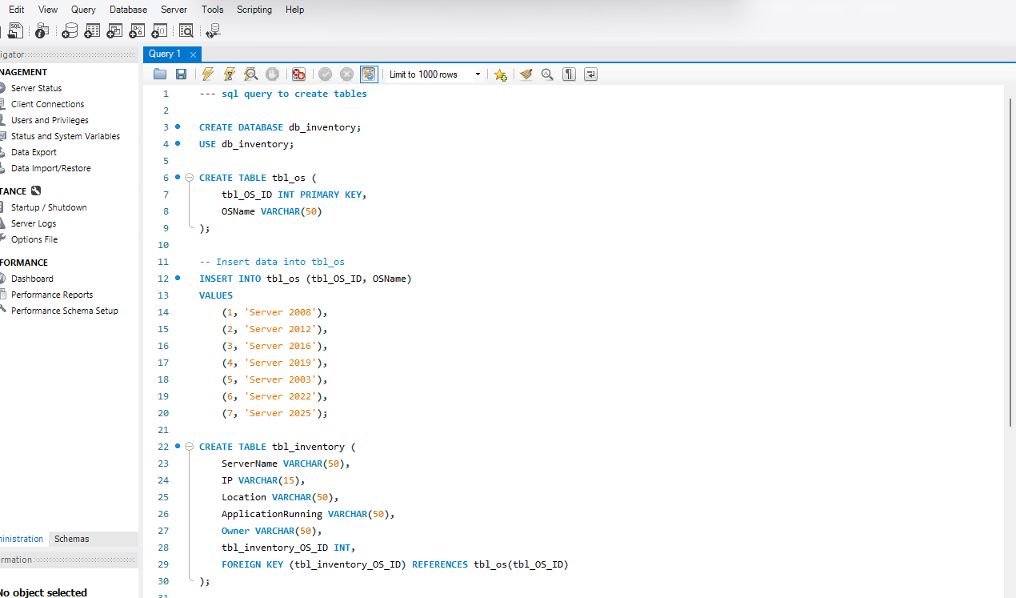
Paste here and run the code

Slide 18
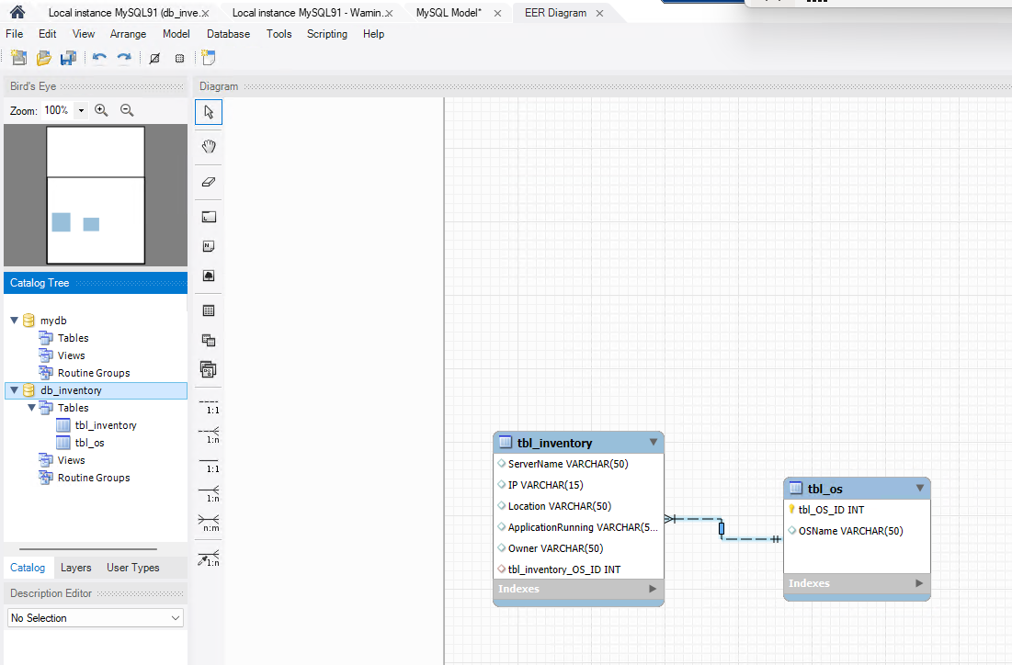
The script would create a DB called - > db_inventory
It will create tables
tbl_Inventory
tbl_OS

Slide 19
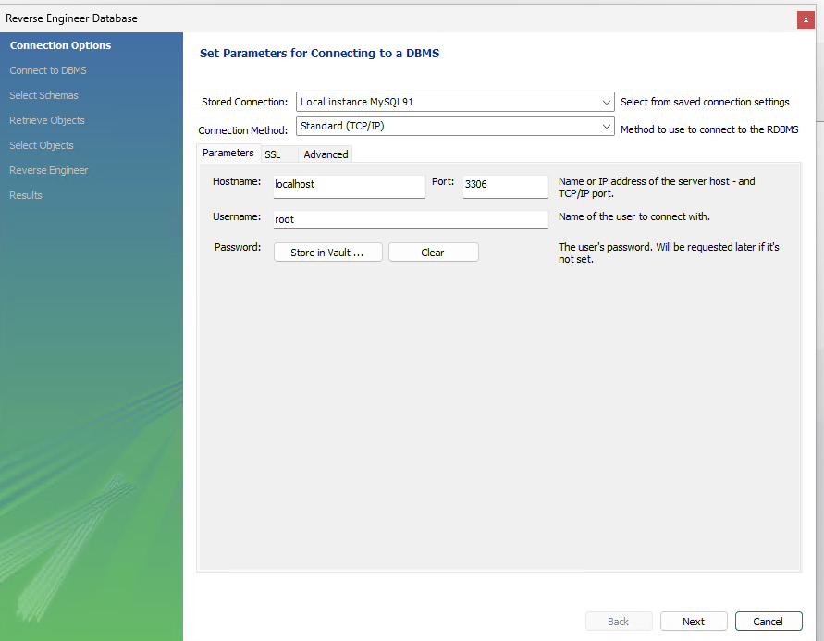
To see the table scheme
Databases - > Reverse Engineer

Slide 20
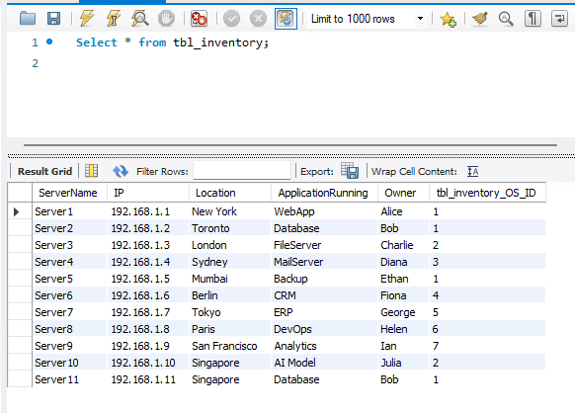
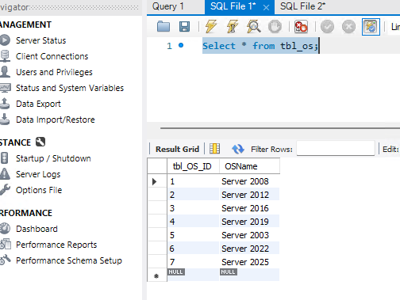

Slide 21
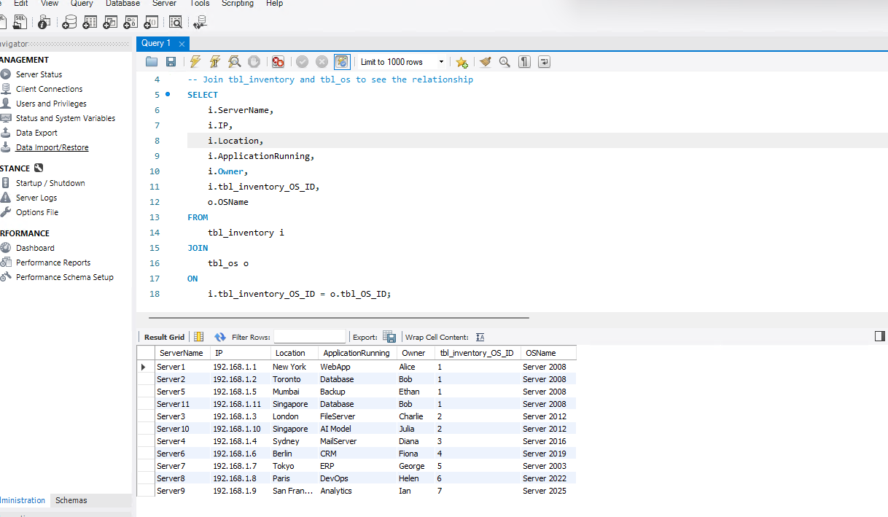
Go to https://github.com/PSWindows/OpenAI/blob/main/tutorial05/checkSqlWorking.txt
Copy paste the code and make sure it is working

