Slide 1

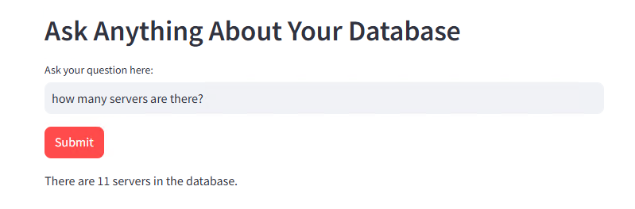

# 9a – Streamlit APP To Chat With SQL Database Using Langchain

Slide 2
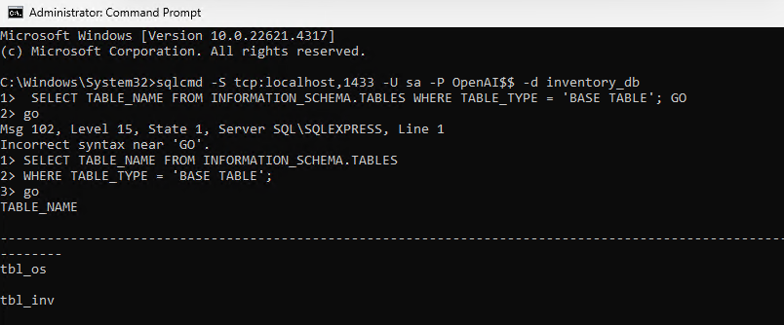
sqlcmd -S tcp:localhost,1433 -U sa -P OpenAI$$ -d inventory_db
1> SELECT TABLE_NAME FROM INFORMATION_SCHEMA.TABLES
3> WHERE TABLE_TYPE = 'BASE TABLE';
4> GO
netstat -aon | find "1433“ - > if this comes blank then there is an issue with FW blocking port 1433
netsh advfirewall firewall add rule name="SQL Server" dir=in action=allow protocol=TCP localport=1433
net stop MSSQLSERVER
net start MSSQLSERVER

Slide 3
