Slide 1


# 5a - LlamaIndex, MySQL, Python: Querying Database Using Natural Language

Slide 2
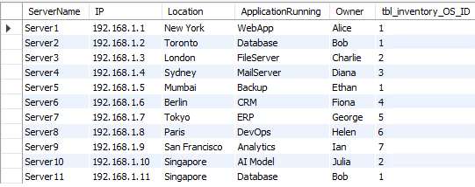
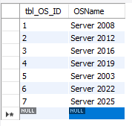
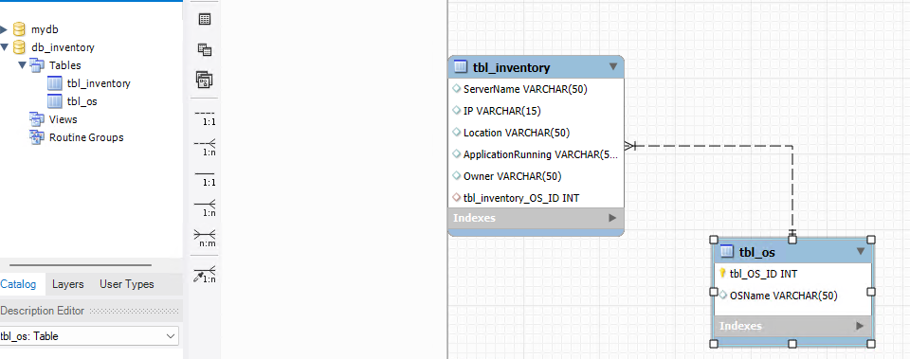
db_inventory
Tbl_inventory
Tbl_OS

Slide 3
https://github.com/PSWindows/OpenAI/blob/main/tutorial05a/QueryMySQL.py

