Slide 1
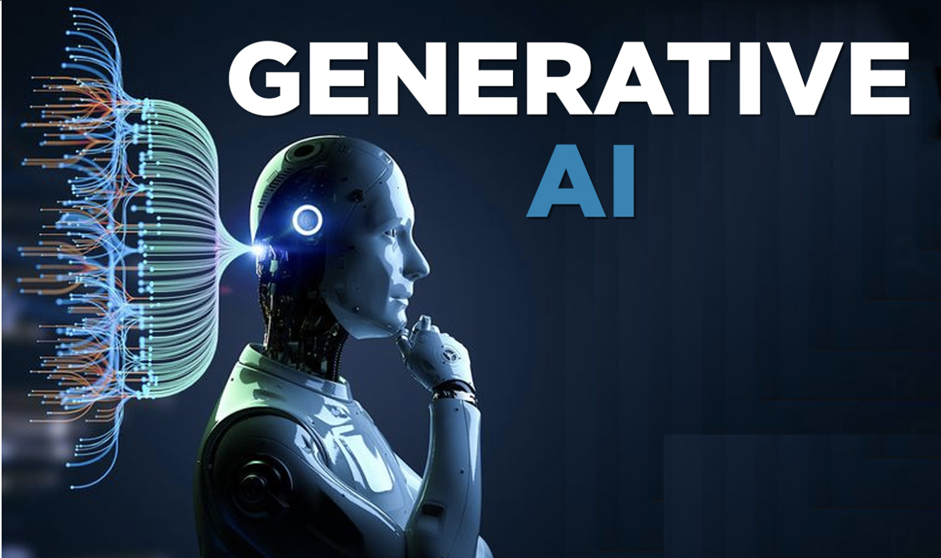

# 10 – Q&A Chatbot with OpenAI, Langsmith and streamlit front end

Slide 2
LangChain framework
Open AI API
Gpt4o
Gpt4-Turbo
gpt-3.5-turbo
Response
Query
Streamlit web app
Langsmith
Monitoring
Debugging

