Slide 1
Contraceptive method and the vaginal environment
Group B project — the vaginal microbiome, host gene expression and community types in Study B
93 participants · one vaginal sample each
Three contraceptive arms: pill (28) · injectable (39) · vaginal ring (26)
Data Science for Biology workshop — Workshop 2, multiomics group project
Notes:
Good morning, everyone, and thank you for coming. Today I am presenting our Group B project: how contraceptive method relates to the vaginal environment. We brought together three layers of information from the same 93 women — the vaginal microbiome, the expression of their own human genes, and their clinical details. Over the next few minutes I will show you the dataset, the three questions we asked of it, what we found for each one, and what the answers mean when you put them together.

Slide 2
The dataset: Study B (contraception)
• A cross-sectional study: one vaginal sample per person, at a single time point (93 participants)
• Three contraceptive arms — the main grouping variable, defined from the sample sheet:
• For every sample, three data layers:
– Microbiome: 220 bacterial species × 93 samples (raw read counts)
– Host transcriptome: 14,226 human genes × 93 samples (RNA-seq, raw counts)
– Cytokines: 15 immune proteins per sample (not used in the three questions)
• Clinical variables: BV status (51 negative / 39 positive / 3 intermediate), Nugent score, pH, any STI (48 of 93), RNA-seq batch (B1 / B2)
Arm (method) | n
Injectable (e.g. DMPA injection) | 39
Pill (oral contraceptive) | 28
Vaginal ring | 26
• Quality control first: sample sheet complete, tables aligned to it, counts integer with no gaps, batch not confounded with arm
• One flagged item: sample B006 has low microbiome depth (5,247 reads) — kept, but noted; cytokines missing for 2 samples
• Workshop rule kept throughout: raw counts into DESeq2, groups defined from one table and tested on the other
Notes:
Before any results, let me show you the data itself. This is Study B, a cross-sectional study — one vaginal sample per woman, at a single time point. The 93 participants use one of three contraceptive methods: the injectable, the pill, or the vaginal ring. That method is our main grouping variable, and it comes from the sample sheet — we never derive groups from the count data we are testing. For every sample we have three layers: bacterial species counts, human gene expression from RNA-seq, and fifteen cytokines — though the cytokines were not used in the three questions I will show you. We did quality control first: the tables align, the counts are complete, and the lab batch is not confounded with the method. One sample, B006, had low microbiome depth; we kept it but flagged it. With the data checked, here are the three questions we asked.

Slide 3
Three questions, three analyses
Does the vaginal microbiome differ between contraceptive methods?
Species table · diversity, composition, ordination, DESeq2
Q1
Does the ring — which acts locally — differ from systemic methods in host gene expression?
Gene table · DESeq2, local vs systemic route
Q2
Does the vaginal community type explain host gene expression better than contraceptive method does?
Types defined from the microbiome · tested on genes · DESeq2 LRT + PERMANOVA
Q3
Notes:
Our three questions build on each other. First, the simplest one: does the vaginal microbiome itself differ between the methods? Second, we turn to the host: the ring is the only method that acts locally at the vagina, so do ring users show a different gene-expression profile? And third, we put the two data layers head-to-head: which explains host gene expression better — the bacterial community type, or the contraceptive method? Let us start with the microbiome.

Slide 4
Question 1 of 3
One of three questions we asked of the Study B data
Does the vaginal microbiome differ between the three contraceptive methods (pill, injectable, ring)?
What this question means
Different contraceptives expose the vagina to different hormones — oestrogen and progestin given orally, by injection, or released locally from a ring. If the hormonal environment shapes which bacteria thrive, the three arms should have different bacterial communities.
How we answered it (methods)
Groups defined from the METADATA (arm); the species count table is what we test.
Alpha diversity: Shannon index per sample, compared with Kruskal–Wallis (a rank test for 3 groups).
Composition: mean relative abundance of the top 9 genera per arm (plot only — shares, not amounts).
Community structure: Bray–Curtis distances between samples, PCoA ordination, PERMANOVA test (999 permutations), adjusting for BV, STI and batch.
Differential abundance: DESeq2 on RAW counts (design ~ batch + BV + arm), adjusted p < 0.05; 110 of 220 species kept after minimal filtering.
Notes:
Question one: does the vaginal microbiome differ between pill, injectable and ring users? The reasoning is that different methods expose the vagina to different hormone doses and routes, and the hormonal environment is known to shape which bacteria thrive. We defined the groups from the metadata and tested the species table. We looked at diversity with the Shannon index and a Kruskal–Wallis test, at composition with mean relative abundance plots, at whole communities with Bray–Curtis ordination and PERMANOVA adjusting for bacterial vaginosis, STIs and batch, and at individual species with DESeq2 on raw counts. First: is there the same kind and amount of bacterial life in each arm?

Slide 5
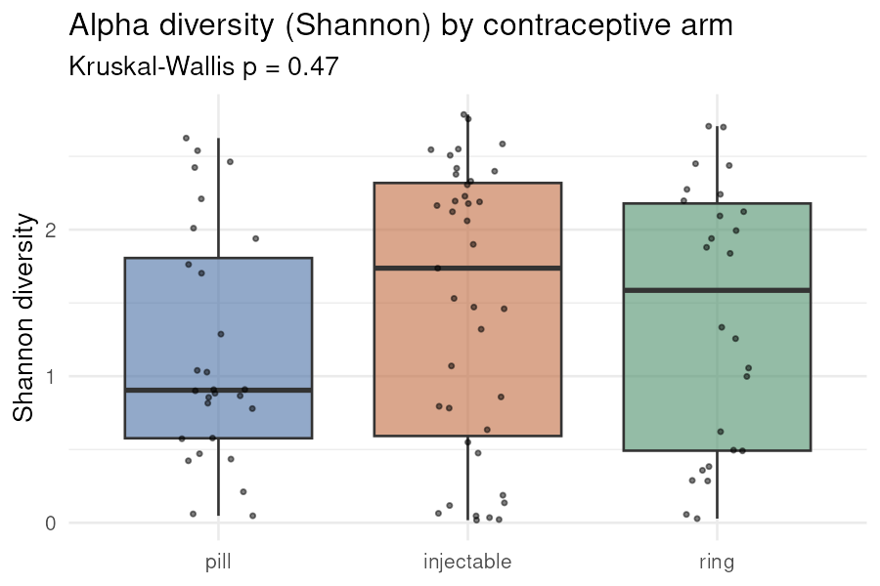
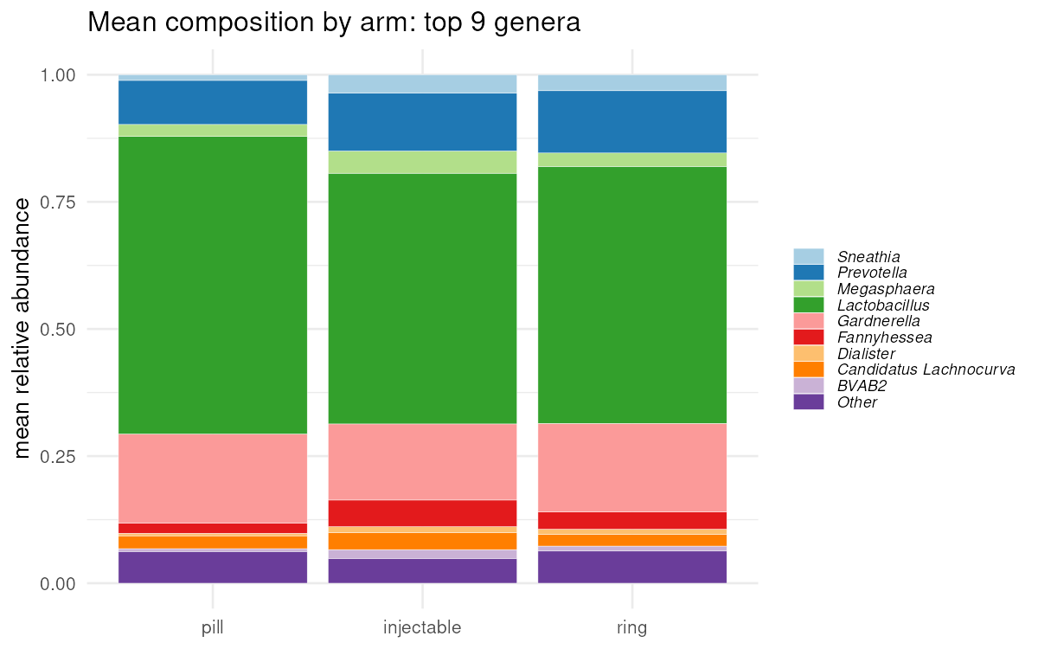
Q1 · Results 1 — diversity and dominance
Is there as much / the same kind of bacterial life in each arm?
• Shannon medians: pill 0.90, injectable 1.74, ring 1.59 — Kruskal–Wallis p = 0.47 (no difference)
• Lactobacillus-dominant samples (>50% of reads): 61% of pill, 49% of injectable, 46% of ring users
Main finding: Diversity and overall dominance do not differ by method — every arm holds a mix of Lactobacillus-dominant and diverse communities.
Notes:
Here diversity does not differ: the Shannon medians are 0.90 for pill, 1.74 for injectable and 1.59 for ring, and the Kruskal–Wallis p-value is 0.47 — no significant difference. The composition panel on the right tells a similar story: Lactobacillus-dominant samples make up 61 percent of pill users, 49 percent of injectable and 46 percent of ring users — a slight downward trend, but every arm contains a mix of Lactobacillus-dominant and diverse communities. So the amount of bacterial life is similar. But maybe the communities as wholes still differ — that is the next test.

Slide 6
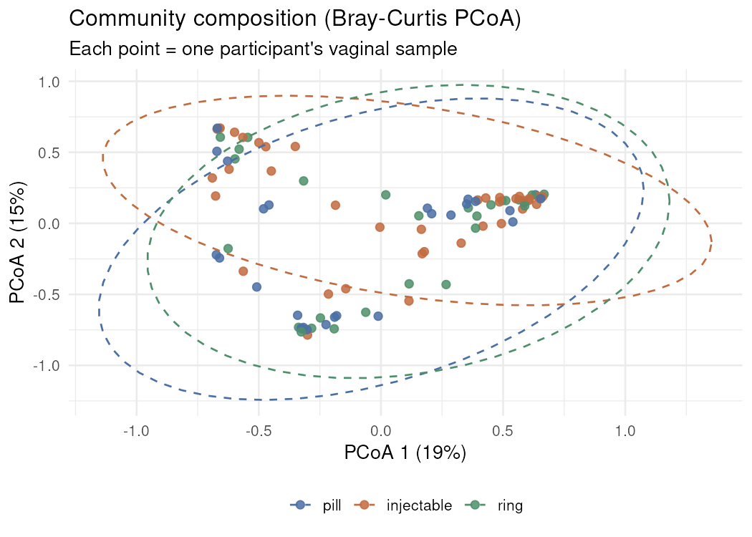
Q1 · Results 2 — whole-community composition
Do the communities as wholes shift between arms?
PERMANOVA (Bray–Curtis) | R² | p
Arm alone | 0.033 | 0.112
Arm + BV + STI + batch | 0.272 | 0.001
• Each point is one participant's sample; dashed ellipses group arms
• Arms overlap heavily; BV status, not arm, drives the significant full model
Main finding: Method alone does not significantly explain overall community composition (R² = 0.033, p = 0.11) — 3% of the variation.
Notes:
This ordination shows each woman's whole community as one point, positioned by how similar her bacteria are to everyone else's. The ellipses group the arms, and you can see they overlap heavily. Formally, contraceptive method alone explains only about three percent of the variation in community composition — R squared 0.033, p equal to 0.11, not significant. The full model on the right is significant, but that is driven by bacterial vaginosis status, not by the method. So whole communities do not shift by arm — but perhaps individual species do. That is the species-level test.

Slide 7
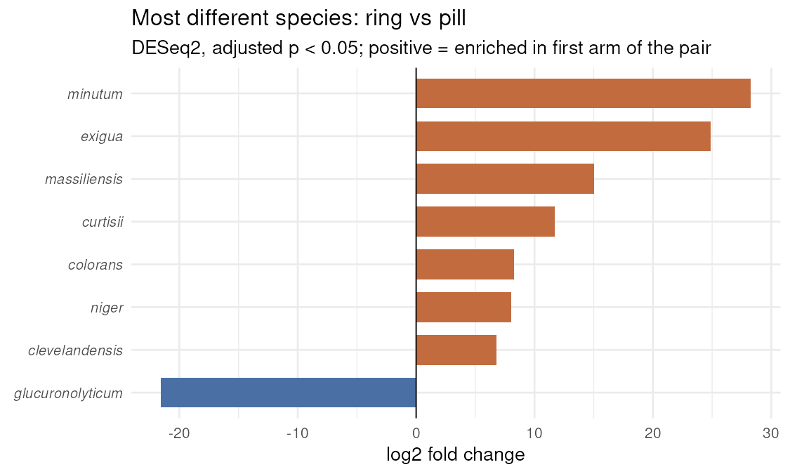
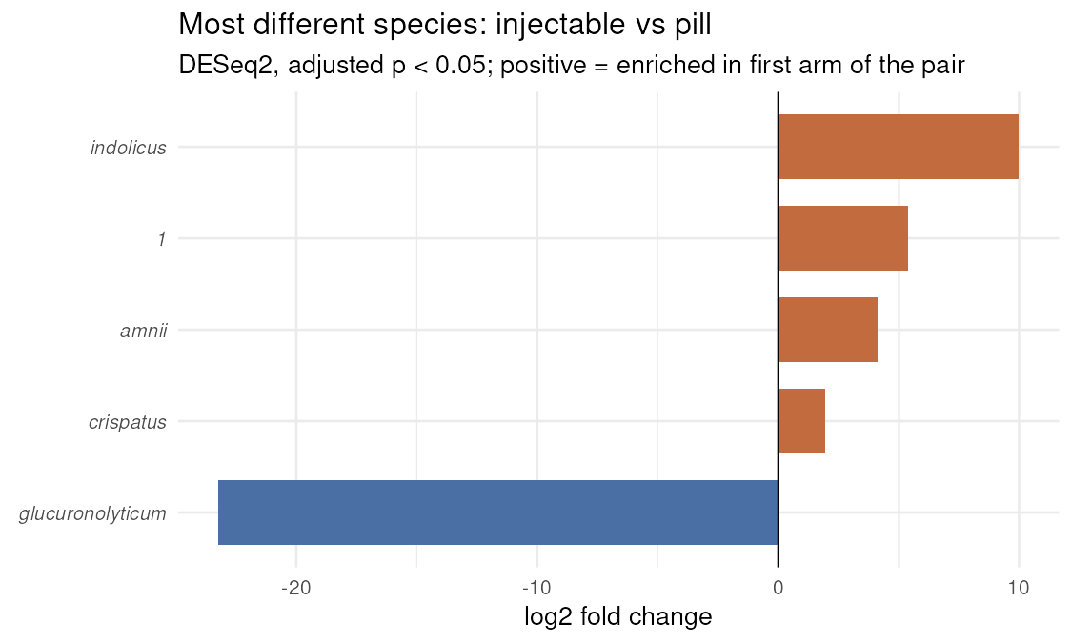
Q1 · Results 3 — which species differ
Species-level tests (DESeq2 on raw counts, adjusted p < 0.05)
• Ring vs pill: 27 significant species — BV-associated anaerobes (Atopobium, Mobiluncus, Prevotella, Sneathia) higher in ring users
• Injectable vs pill: 6 significant species (incl. L. crispatus higher in injectable); ring vs injectable: 14
Main finding: Species-level differences exist — largest between ring and pill (27 species), and they point toward a more BV-like flora in ring users.
Notes:
And here the answer changes. Testing species one at a time with DESeq2, ring users differ from pill users in 27 species — the largest contrast — and the pattern is striking: BV-associated anaerobes like Atopobium, Mobiluncus, Prevotella and Sneathia are higher in ring users. Injectable versus pill shows only 6 significant species, and ring versus injectable 14. So species-level differences do exist, largest between ring and pill, pointing toward a more BV-like flora in ring users. Let me summarise question one.

Slide 8
Question 1 — the answer
Does the vaginal microbiome differ between contraceptive methods?
Modestly, yes — at the species level, not in overall structure.
Diversity (Shannon, p = 0.47) and whole-community composition (PERMANOVA R² = 0.033, p = 0.11) do not significantly differ by arm.
But DESeq2 finds consistent species-level differences: 27 species between ring and pill, mostly BV-associated anaerobes higher in ring users.
BV status is the stronger correlate of community composition in this dataset.
Notes:
So: does the microbiome differ between methods? Modestly, yes — at the species level, not in overall structure. Diversity and whole-community composition show no significant differences, but DESeq2 finds consistent species-level differences, especially between ring and pill. And throughout, BV status is the stronger correlate of the microbiome than the method itself. That is the bacterial side. Now we turn the lens around to the host, and specifically to the ring — the only method that releases its hormone locally at the vagina rather than through the bloodstream.

Slide 9
Question 2 of 3
One of three questions we asked of the Study B data
Does the ring — which releases hormone locally at the vagina — differ from the systemic methods in host gene expression?
What this question means
The ring acts at the vaginal surface; the pill and injectable act through the bloodstream. If local hormone exposure changes the vaginal tissue itself, ring users should show a distinct pattern of host (human) gene expression in the RNA-seq data.
How we answered it (methods)
Route defined from the METADATA: local (ring, n = 26) vs systemic (pill + injectable, n = 67); the gene table is what we test.
RNA-seq depth is even between routes (median ~12.9 M reads).
DESeq2 on RAW counts, design ~ RNA-seq batch + BV + STI + route, adjusted p < 0.05.
PCA on variance-stabilised values of the 500 most variable genes (a plot, not a test).
Consistency check: separate ring-vs-pill and ring-vs-injectable models — a real local signal should point the same way against both.
Notes:
Question two: does the ring differ from the systemic methods in host gene expression? If local hormone exposure changes the vaginal tissue itself, ring users should show a distinct expression pattern. We grouped women by delivery route — 26 local, 67 systemic — defined from the metadata, and tested the gene table with DESeq2 on raw counts, adjusting for batch, BV and STI. RNA-seq depth was even between the groups. Before any formal test, an important sanity check: does a difference show up in an unsupervised plot?

Slide 10
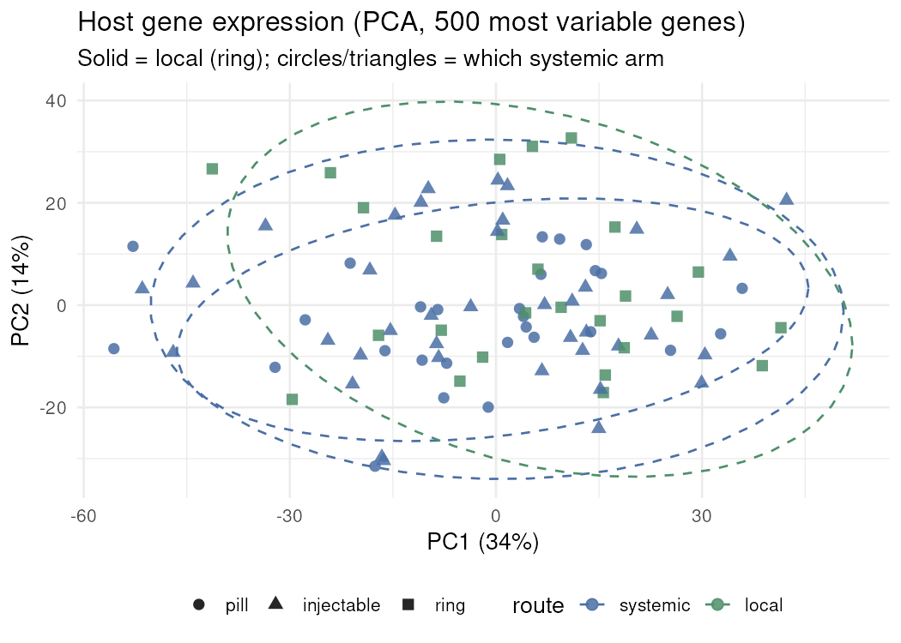
Q2 · Results 1 — the expression landscape
Do ring users look different before any formal test?
• Each point = one participant; solid = local (ring), circles/triangles = which systemic arm
• Mean PC1: ring (local) +4.6 vs systemic −1.8 — ring samples shift along PC1
• Separation is visible but partial: individuals overlap
Main finding: There is a visible route-related shift in host gene expression along PC1 — worth testing formally.
Notes:
It does. This is a principal component analysis of the 500 most variable genes — no group labels were used to build it. Ring users, the solid squares, shift along the first axis: their mean PC1 is plus 4.6 against minus 1.8 for the systemic methods. The separation is visible but partial — individuals still overlap. So there is a route-related signal worth testing formally. The obvious next question: which genes drive it?

Slide 11
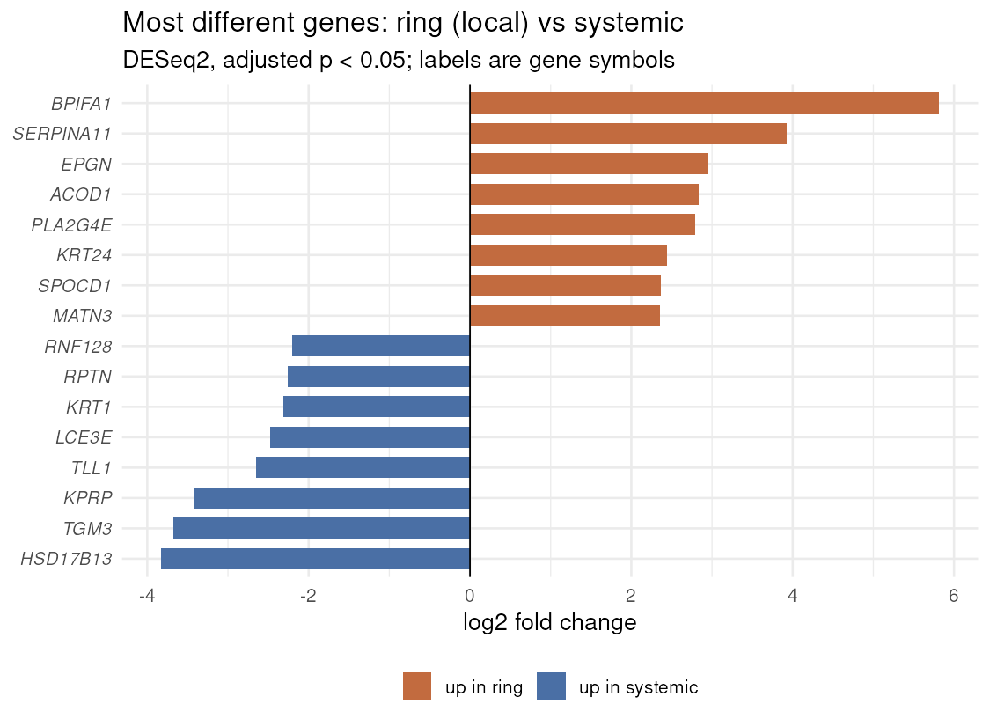
Q2 · Results 2 — which genes differ
DESeq2, ring (local) vs pill + injectable (systemic), adjusted p < 0.05
• 66 of 14,226 tested genes significant: 40 up in ring, 26 down
• Up in ring: secretory & inflammatory genes — BPIFA1 (antimicrobial secretory protein, log2FC 5.8), SERPINA11, PTGS2 (prostaglandin synthase, log2FC 1.6)
• Down in ring (higher in systemic): epithelial keratinisation genes — TGM3 (−3.7), KPRP (−3.4), KRT1 (−2.3)
Main finding: A small but interpretable signature: more secretory/inflammatory activity and less epithelial keratinisation in ring users.
Notes:
Of the 14,226 genes tested, 66 are significant at adjusted p below 0.05 — 40 higher in ring users, 26 lower. The chart shows the strongest hits. Up in the ring: secretory and inflammatory genes — BPIFA1, an antimicrobial secretory protein, with a log2 fold change of 5.8; PTGS2, the prostaglandin synthase; SERPINA11. Down in the ring — that is, higher in systemic users — are keratinisation genes: TGM3, KPRP, KRT1. In plain terms: more secretory and inflammatory activity, less epithelial cornification, in ring users. A small but very interpretable signature. But one grouping choice could fool us here — the two systemic methods might differ from each other. So we ran a consistency check.

Slide 12
Q2 · Results 3 — is the signal consistent?
A real local-vs-systemic effect should hold against either systemic method
Consistency check (adjusted p < 0.05) | Result
Ring vs pill — significant genes | 60
Ring vs injectable — significant genes | 87
Significant in BOTH contrasts | 11 of 14,226
…of which point the same direction | 11 of 11 (100%)
Main finding: The route signal is internally consistent: whichever systemic method the ring is compared against, the shared significant genes always point the same way.
Notes:
If the local-versus-systemic signal is real, the ring should differ from pill AND from injectable in the same direction. It does: 60 significant genes against pill, 87 against injectable, and 11 genes are significant in both contrasts — every single one of them points the same way. The signal holds whichever systemic method we compare against. Here is the answer to question two.

Slide 13
Question 2 — the answer
Does the ring differ from systemic methods in host gene expression?
Yes — a small but coherent local-vs-systemic signature.
66 of 14,226 genes differ (adjusted p < 0.05): secretory and inflammatory genes up in ring users, keratinisation genes down.
The signal is consistent against both systemic methods (11 genes significant in both, all same direction).
It is a modest effect — 0.5% of tested genes — but biologically interpretable: local hormone delivery appears to change the vaginal epithelial state.
Notes:
Yes — the ring leaves a small but coherent local-versus-systemic signature. Sixty-six genes differ: secretory and inflammatory genes up in ring users, keratinisation genes down. The signal is internally consistent against both systemic methods. And it is a modest effect — half a percent of tested genes — but biologically interpretable: local hormone delivery appears to change the state of the vaginal epithelium. We have now seen the microbiome differ modestly by method, and the host respond to local delivery. Our final question puts the two data layers head-to-head: which explains host expression better — the bacterial community type, or the method?

Slide 14
Question 3 of 3
One of three questions we asked of the Study B data
Does the vaginal community type explain host gene expression better than contraceptive method does?
What this question means
Vaginal microbiomes fall into a few recurring 'community state types' (CSTs) — classic examples are Lactobacillus-dominant vs diverse/BV-like. If the bacterial environment shapes the host tissue, women sharing a community type should share gene-expression patterns, possibly more than women sharing a contraceptive method.
How we answered it (methods)
Types defined from the MICROBIOME table: Bray–Curtis distances, Ward clustering; k = 3 chosen by mean silhouette (0.32, best of k = 2–5).
Types named by biology: Crispatus-dominant, Iners-dominant, Diverse (BV-like).
Workshop rule kept: types come from one table, the GENES are tested in the other.
DESeq2 likelihood-ratio tests (LRT) with identical covariates — community type vs arm — so the two groupings are compared fairly.
PERMANOVA on variance-stabilised values (top 2,000 genes) for how much variance each grouping explains.
Notes:
Question three. Vaginal microbiomes fall into a few recurring community state types — classically Lactobacillus-dominant versus diverse and BV-like. If the bacterial environment shapes the host tissue, women sharing a community type should share expression patterns, perhaps more than women sharing a method. We defined the types from the microbiome table — Bray–Curtis distances, Ward clustering, three clusters chosen because they scored best on the silhouette measure — and then tested the genes, respecting our workshop rule: the group comes from one table, the test happens on the other. To compare the two groupings fairly we used identical covariates and likelihood-ratio tests. First: what do these community types look like?

Slide 15
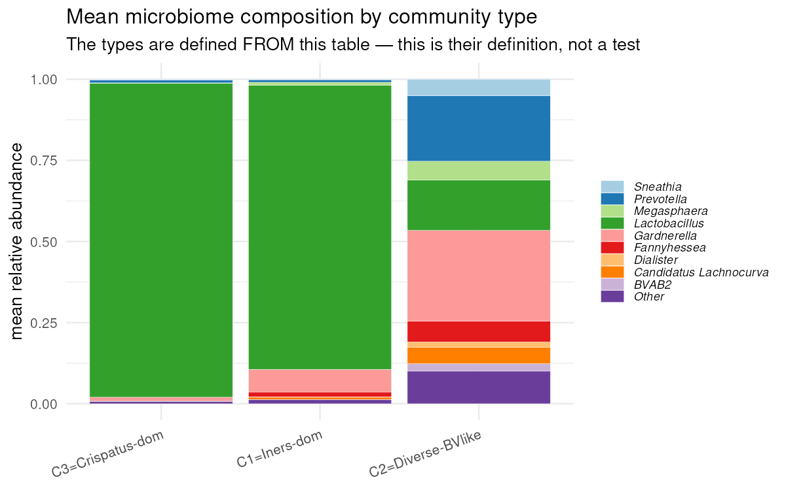
Q3 · Results 1 — three community types
What the microbiome table looks like when clustered
Community type | n | Lactobacillus share
Crispatus-dominant | 21 | 97%
Iners-dominant | 24 | 88%
Diverse (BV-like) | 48 | 16%
• The diverse type is largely BV-positive: 37 of its 48 members; nearly all BV-negative women are Lactobacillus-dominant
Main finding: The dataset splits into the classic CSTs, and the diverse/BV-like type tracks BV status almost perfectly — this is the type's definition, not a test.
Notes:
The dataset splits into the three classic types: 21 women are Crispatus-dominant, with 97 percent Lactobacillus; 24 are Iners-dominant, 88 percent Lactobacillus; and 48 fall into a diverse, BV-like type with only 16 percent Lactobacillus. Notice how tightly that diverse type tracks BV status — 37 of its 48 members are BV-positive, while almost all BV-negative women are Lactobacillus-dominant. One caution: this panel is the type's definition, not a test. Now the head-to-head on the genes.

Slide 16
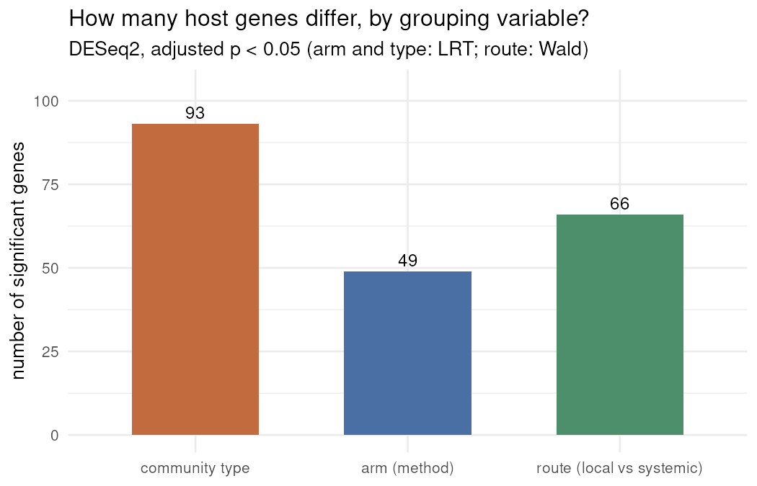
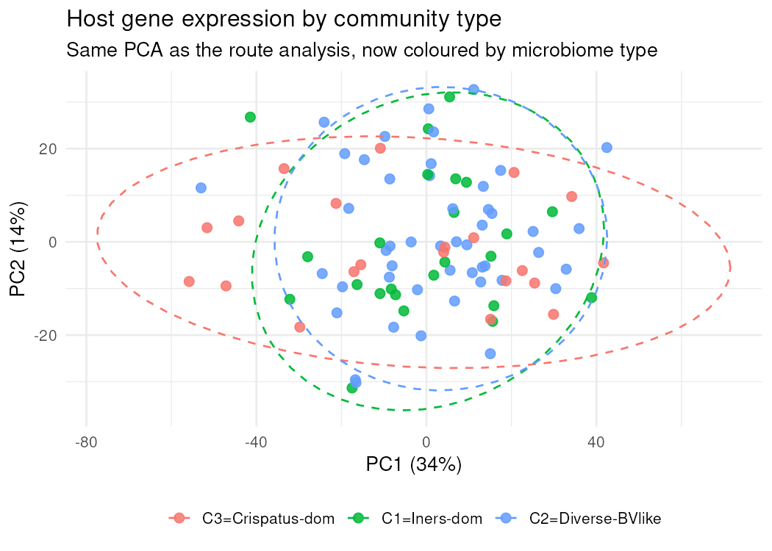
Q3 · Results 2 — how many genes each grouping explains
Same covariates, only the grouping differs (LRT; route: Wald test)
• Community type: 93 significant genes; arm (method): 49; route (local vs systemic): 66
• Top community-type genes (EDN2, CCNG2, ARL4C) are highest in the Crispatus-dominant type
Main finding: Gene by gene, community type flags nearly twice as many genes as method (93 vs 49) — the bacterial environment looks like the better correlate.
Notes:
Here is the gene count comparison, with everything else held equal. Community type flags 93 significant genes; contraceptive method, 49; route, 66. Gene by gene, community type looks like the stronger correlate — nearly twice as many genes as method — and the top hits, like EDN2 and CCNG2, are highest in the Crispatus-dominant type. But counting genes is only one view, and it can mislead: the formal question is how much variance each grouping actually explains.

Slide 17
Q3 · Results 3 — how much variance, formally
PERMANOVA on host gene expression (VST, top 2,000 genes, 999 permutations)
Grouping | R² | p-value | Reading
Community type | 0.020 | 0.51 | not significant
Arm (method) | 0.032 | 0.059 | borderline
Route (local vs systemic) | 0.022 | 0.038 | significant
Type + arm together | 0.054 | 0.14 | adds nothing significant
Main finding: Globally, neither grouping explains much expression variance (~2–3%); only route is significant, and the gene-count advantage of community type does not translate into more explained variance.
Notes:
And here the picture changes. On the full expression profile, community type explains only two percent of the variance and is not significant — p equal to 0.51. Method explains three percent, borderline. The only globally significant grouping is route — the same local-versus-systemic signal from question two. And combining type and method adds nothing significant. So the gene-count advantage of community type does not translate into more explained variance. Let me give you the honest answer to question three.

Slide 18
Question 3 — the answer
Does community type explain host gene expression better than method?
Mixed evidence — neither grouping dominates.
Gene by gene, community type flags more genes than method (93 vs 49), but its global variance share is the smallest of the three groupings (R² = 0.02, p = 0.51).
Community type largely mirrors BV status, so part of its signal is BV ecology rather than type itself.
The only globally significant grouping is route (local vs systemic) — the same signal found in Question 2.
Honest summary: both effects are small; local-vs-systemic delivery is the clearest host-expression correlate in this dataset.
Notes:
The evidence is mixed — neither grouping dominates. Community type flags more genes than method, 93 versus 49, but explains the least variance globally, and much of its signal is really BV ecology, since the diverse type mirrors BV status. The only globally significant grouping is route — the same signal we found in question two. Both effects are small; local-versus-systemic delivery is the clearest host-expression correlate in this dataset. Let me put all three answers on one page.

Slide 19
Putting the three answers together
What this dataset says, overall
• Contraceptive method leaves a modest footprint on the vaginal microbiome: no diversity difference, no significant global compositional shift, but consistent species-level differences — largest between ring and pill, pointing toward a more BV-like flora in ring users.
• How the hormone is delivered matters more than which method it is: the locally acting ring shows a small, internally consistent host transcriptional signature (secretory/inflammatory genes up, keratinisation genes down), and route is the only grouping with a significant global effect on gene expression.
• The bacterial environment (community type) is the strongest gene-level correlate in the gene-by-gene comparison — but it largely mirrors BV status, and neither type nor method explains more than ~3% of expression variance.
• Taken together: in this cross-sectional study, BV-like ecology and local-vs-systemic hormone delivery matter more for the vaginal environment than the specific contraceptive chosen.
• Not yet analysed: the cytokines layer (15 immune proteins; 2 samples lack values) — the natural next question is whether the ring's transcriptional signature shows up as measurable inflammation.
Notes:
Taken together, three messages. First: contraceptive method leaves a modest footprint on the vaginal microbiome — no diversity difference, no significant global shift, but consistent species-level differences, largest between ring and pill. Second: how the hormone is delivered matters more than which method it is — the locally acting ring shows a small, reproducible transcriptional signature, and route is the only grouping with a significant global effect on gene expression. Third: the bacterial community type is the strongest gene-by-gene correlate, but it largely mirrors BV status, and neither grouping explains more than about three percent of expression variance. In short: BV-like ecology and local hormone delivery matter more than the specific contraceptive chosen. The natural next step is the cytokine layer we have not yet analysed — does the ring's transcriptional signature show up as measurable inflammation? Finally, so you can judge how much to trust each number, here are the choices we made.

Slide 20
Choices made
Each with the alternative we did not choose
• Community types: k = 3 Ward clusters on Bray–Curtis, chosen by mean silhouette (0.32) — alternative: k = 2–5 were computed and scored lower
• Route grouping: ring vs pill + injectable, defined from metadata — alternative: a three-arm gene model, run as the consistency check
• DESeq2 on raw counts with design ~ batch + BV (+ STI) — alternative: no covariates, which would confound route with batch
• Significance threshold: adjusted p < 0.05 (BH) — alternative: raw p < 0.05, far too permissive across 14,226 genes
• Minimal filter before testing: total reads ≥ 10 — alternative: stricter prevalence filter (would drop rare features)
• Low-depth sample B006 kept — alternative: dropped (would remove one ring sample from species analyses)
• VST transform used only for plots and ordination — alternative: testing VST values would violate the raw-counts rule
• Cytokines not analysed (sub-LLOD values; 2 samples all-NA) — deferred rather than forced into the tests
Notes:
A few decisions worth knowing about. We chose three community types by the silhouette score and tested alternatives. We used DESeq2 on raw counts with batch and BV as covariates, so route differences are not confounded. We required adjusted p below 0.05 across more than fourteen thousand genes. We kept the low-depth sample rather than dropping it. And we used the variance-stabilising transform only for plots, never for tests. Every alternative we did not choose is listed in the project reports. Thank you very much — I am happy to take questions.

