Slide 1

OMR-SCANNER-APP
-A simpler evaluation method

Slide 2

TEAM MEMBERS:
YASHWANTH KUMAR DATTA. T
POLOJU SAHITHI

Slide 3
Problem Statement...
Through out our education we have observed that the common method used by all in order to evaluate our progress is the mode of examination.
We have various methods of examination like paper based tests where the questions were asked and below the person taking the test was to write the answers, another method was the multiple choice questions.
The multiple choice questioning test was conducted in two means, one over the internet, that is online test and the other is the offline test which is done by using the OMR sheet. Not all can afford the online testing platform. So, they go for the OMR based testing.

Slide 4
Proposed Solution...
The Optical Mark Recognition Scanner (OMR Scanner) application helps the organizations to evaluate all their OMR sheets and get the scores of the participants. This reduces the time taken in evaluating the answer sheets.
OMR software is a computer software application that needs to be installed in the computer after which it reads bubble sheets and OMR based questionnaires using a simple scanner. It is a multi-functionality software and covers various aspects of the complete OMR process.

Slide 5
Software Modules Used...
Tkinter:Tkinter is the standard GUI library for Python. Python when combined with Tkinter provides a fast and easy way to create GUI applications. Tkinter provides a powerful object-oriented interface to the Tk GUI toolkit.
imutils 0.5. 3: A series of convenience functions to make basic image processing functions such as translation, rotation, resizing, skeletonization, displaying Matplotlib images, sorting contours, detecting edges, and much more easier with OpenCV and both Python 2.7 and Python 3.
OpenCv: OpenCV is a Python library which is designed to solve computer vision problems.

Slide 6
Hardware Requirements: • System : Pentium IV 2.4 GHz or Above • Hard Disk : 80 GB. • Floppy Drive : 1.44 Mb. • Monitor : 15 VGA Colour. • Mouse : Logitech. • Ram : 2 GB Software Requirements: ● OS : Windows XP Professional/Vista/7/8/8.1 or Linux ● Front End : Python ● Tool : NetBeans
SOFTWARE AND HARDWARE REQUIREMENTS

Slide 7
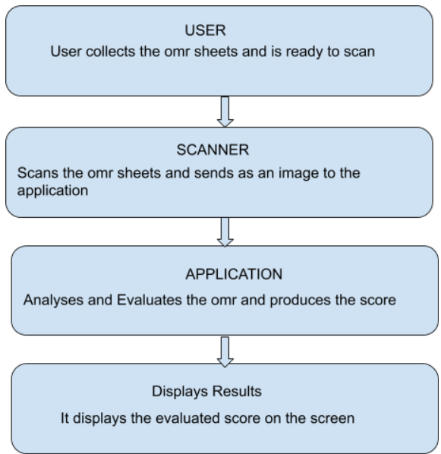
CLASS DIAGRAM...

Slide 8
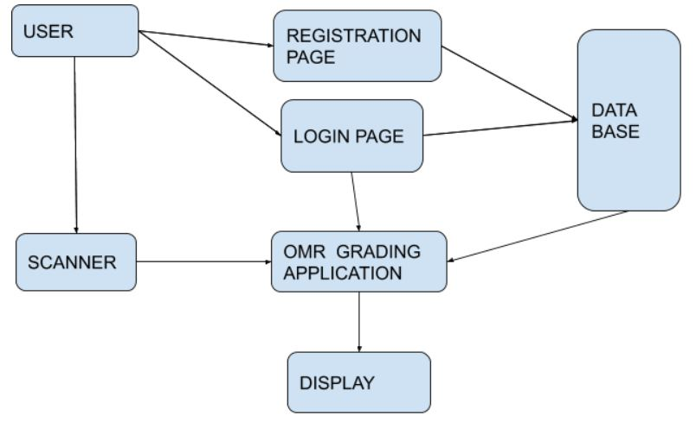
Data Flow Diagram...

Slide 9
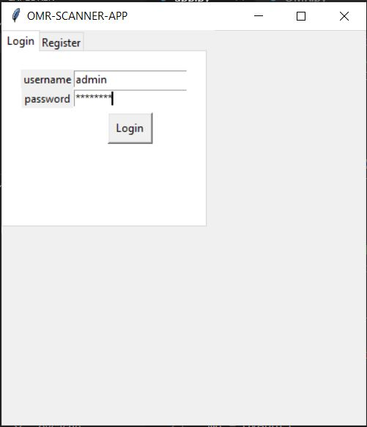
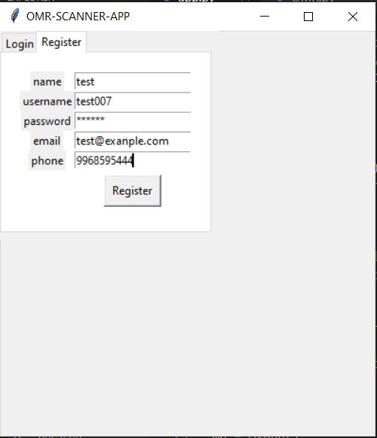
Result And Validation...

Slide 10
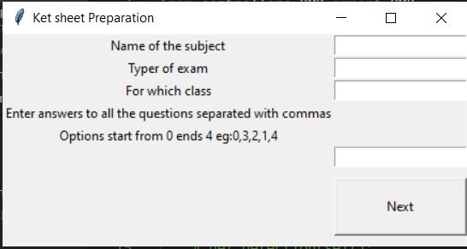
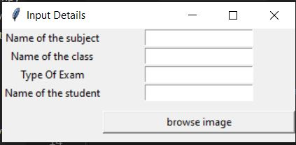
Result And Validation...

Slide 11
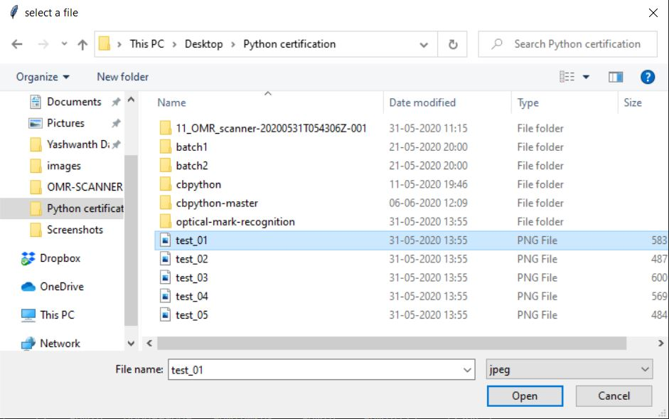
Result And Validation...

Slide 12
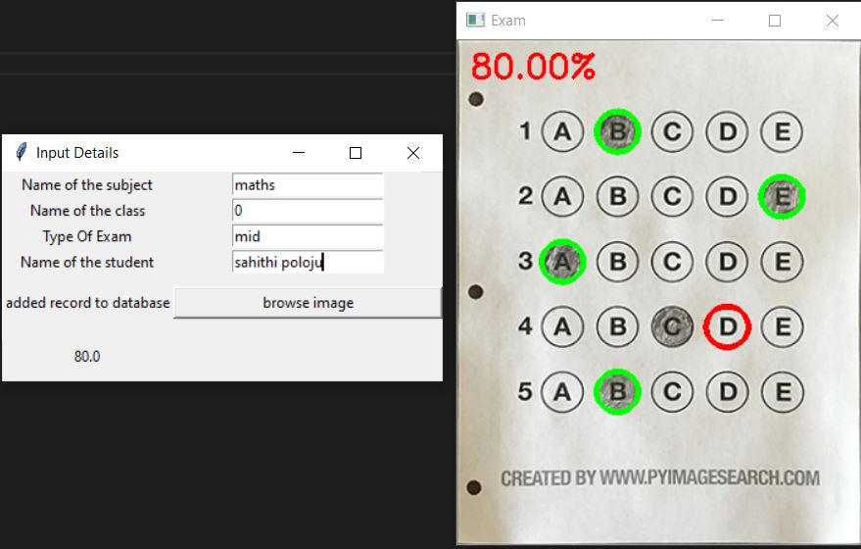
Result And Validation...

Slide 13
Conclusion...
This project is an application that performs evaluation of the students OMR sheets and displays the result evaluating it with the key answer sheet. It provides a convenient way of evaluating the OMR sheets in a very short period of time. The UI is simple and convenient for the user. This application just needs the answer key and the scanned image of the OMR sheet and the score is evaluated. Thus saving a lot of time and energy.

Slide 14
References...
[1]. https://pypi.org/project/opencv-python/-opencv implementation and documentation.
[2]. https://docs.opencv.org/master/d0/de3/tutorial_py_intro.html
[3].https://www.pyimagesearch.com/2018/06/18/face-recognition-with-opencv-python-and-deep-learning/
[4]. https://docs.python.org/3/library/tkinter.html
[5]. https://docs.python.org/2/library/tkinter.html
[6]. https://docs.python.org/2/library/os.html

Slide 15
THANK YOU...

