Slide 1

CANCER DRUG CLASSIFICATION
SARAYU - 2420080004
M SPOORTHI - 2420080086

Slide 2
Table of Contents
Title and Task
Problem Statement
Datasets Description
Methodology
Methodology of the Explainable AI
Patient Data Entry Interface
Clinical Recommendation Insights
The Most Prescribed Drugs
Sex Distribution and Cancer Types
Explainable AI on the Recommended Drug
Explainable AI & Summary of the Patient
Conclusions

Slide 3
TITLE AND Task
TITLE :
Develop an intelligent machine learning-based application that accurately classifies drugs based on patient medical attributes.
Task1: Develop and integrate a real machine learning drug classification model.
Task2: Build secure backend authentication and database-based prediction history.
Task3: Implement explainable AI and clinical recommendation insights in the results dashboard.

Slide 4
Problem Statement
Cancer treatment involves different drugs for different types of cancer and patient conditions. However, selecting the most appropriate drug can be complex because it depends on multiple factors such as patient age, gender, physical health, and cancer type. There is a need for an effective method to classify and predict cancer drugs based on patient and disease information. The problem is to analyze patient data and develop a system that can accurately classify cancer drugs to support better treatment decisions.

Slide 5
Dataset/s Description
Dataset-1
Total no of Samples: 1000 records
Training Samples: 700 (70%)
Validation Samples: 150 (15%)
Testing Samples: 150 (15%)
Labels Format
The target label is the Drug prescribed for cancer treatment.
Cisplatin
Tamoxifen
Sorafenib
5-Fluorouracil
Other cancer drugs
DATASET FROM: Jawaharlal Nehru Technological University, Kakinada.

Slide 6
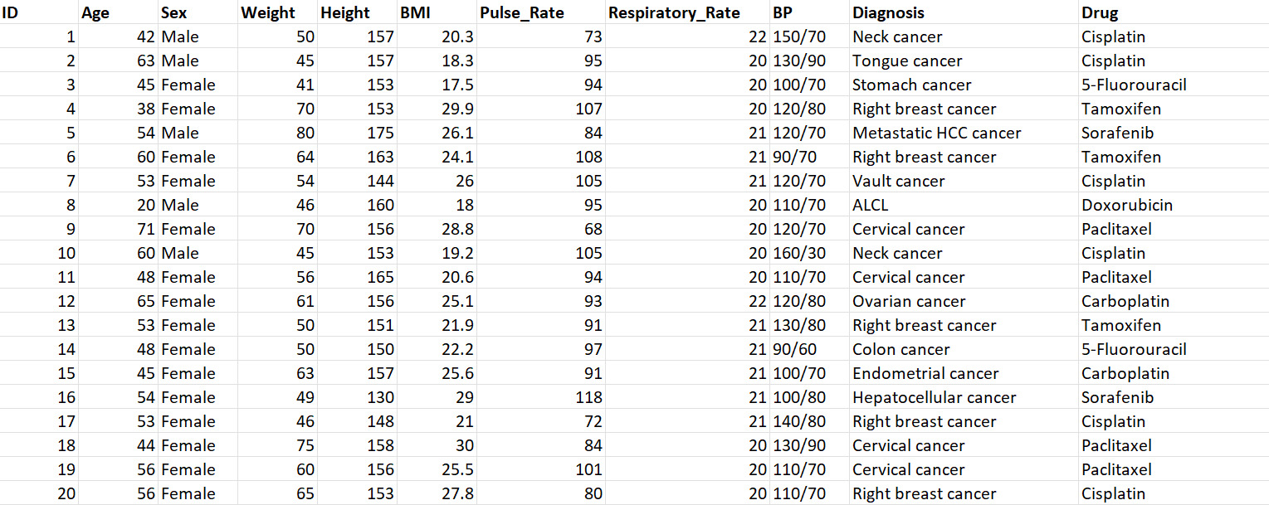
Dataset/s Description Few sample of the dataset

Slide 7
Methodology
Pipeline Stage | Purpose | Model Used
1. Raw Data Collection | Collect patient clinical data (age, BP, cholesterol, BMI, etc.) | No ML model (data acquisition stage)
2. Data Cleaning | Remove errors and prepare dataset | Preprocessing using Scikit-learn preprocessing tools
3. Feature Engineering | Create meaningful features for training | StandardScaler / Feature Selection (SelectKBest)
4. Encoding | Convert categorical medical variables into numerical form | OneHotEncoder / LabelEncoder
5. Model Training & Prediction | Train ML model to predict the optimal drug | Random Forest Classifier (Primary Model)

Slide 8
Methodology of the Explainable AI
Explainability Method | Purpose | Output
SHAP | Shows feature impact on prediction | Feature contribution graph
LIME | Explains individual predictions | Local feature importance
Feature Importance | Shows most important variables | Ranked feature list
Decision Path | Shows model reasoning | Rule-based explanation

Slide 9
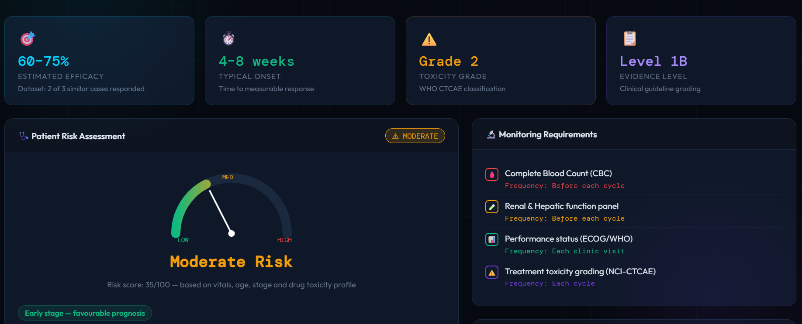
Clinical Recommendation Insights:

Slide 10
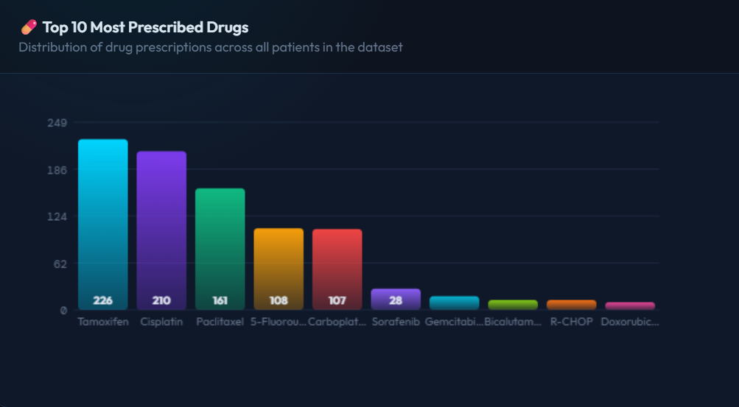
The Most Prescribed Drugs:

Slide 11
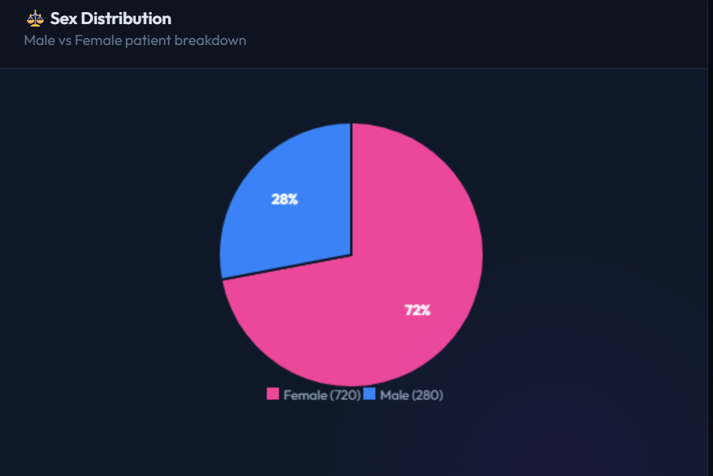
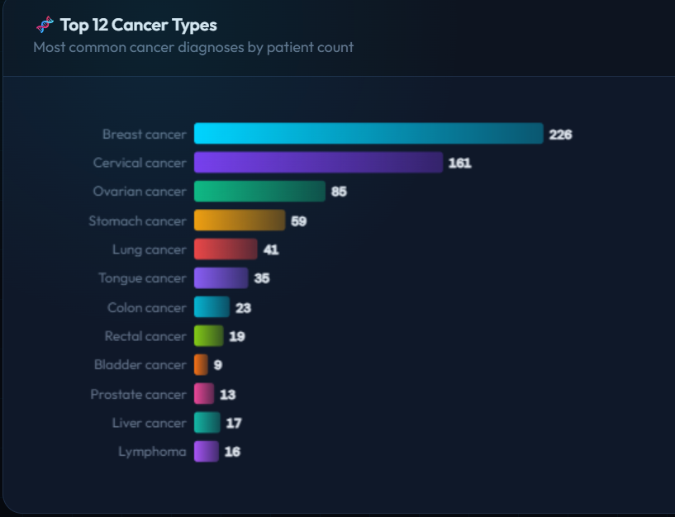
Sex Distribution and Cancer Types:

Slide 12
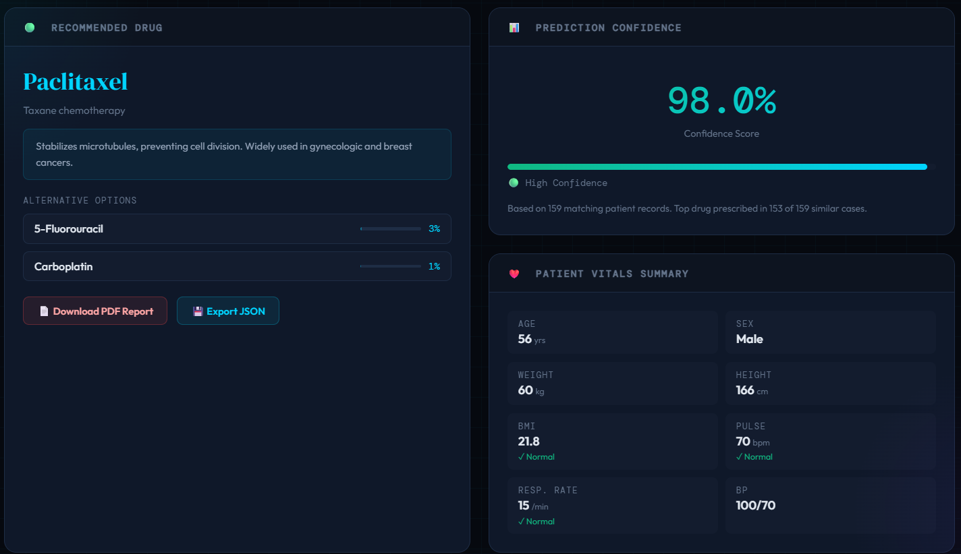
Explainable AI on the Recommended Drug:

Slide 13
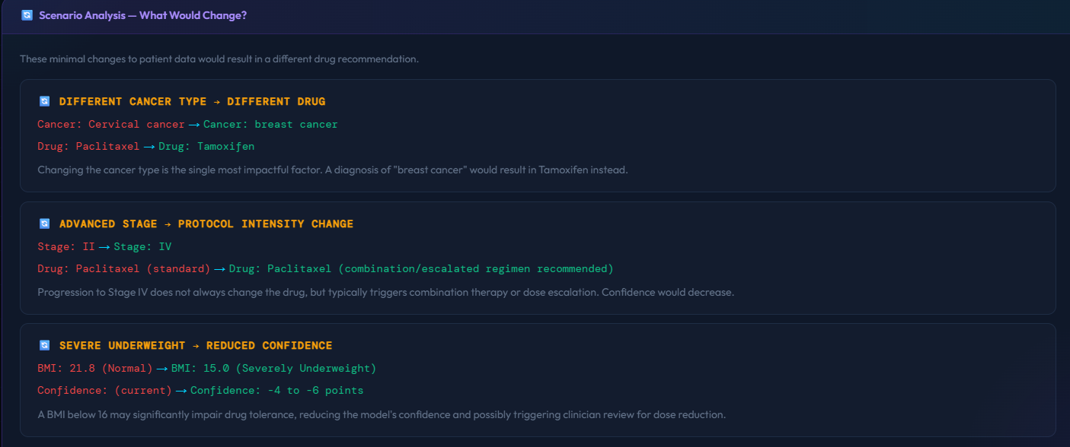
Explainable AI & Summary of the Patient:

Slide 14
Conclusions
OncoDx is a smart and user-friendly oncology drug prediction system designed to support doctors in making better treatment decisions.
By combining patient details, clinical vitals, cancer information, prediction confidence, analytics, history tracking, and clinical decision support, the application provides a complete platform for evidence-based drug recommendation.
Its modern interface, secure login, explainable prediction features, and downloadable reports make it both practical and professional.
Overall, OncoDx shows how AI can improve healthcare by making drug prediction more accurate, transparent, and efficient while still keeping the final decision in the hands of medical professionals.

Slide 15
Thank You

