Slide 1
Container
Coding
Patrick
Schwisow
Midwest PHP Conference
X
Y
Z
Q
March 14, 2015

Slide 2
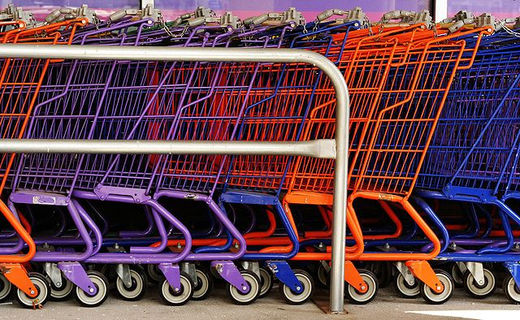
A Long Time Ago, in an Office Far, Far Away…
Notes:
You’re a software developer at a small e-commerce company. It’s 4:30 on Monday afternoon. The product owner rushes over to your desk, then stands there as is he’s not sure what to say. “What do you know about sales tax?” he finally asks. “Another rate change?” you guess. “No, we just leased warehouse space on the other side of the state line, all our shipping and receiving is moving there. Legal says we have to start charging sales tax in both states, starting next Monday. We should be able to do that, right?”

Slide 3
Problem or No Problem?
RESEARCH / PLAN
IMPLEMENT
TOTAL
EFFORT*
TESTING
*more or less
DEPLOYMENT
Notes:
Set aside the biggest problem (your company makes major decisions without fully assessing the impact on all departments).
All of these factors will vary depending on the current state of your application.
The reliability of any estimates you make will also vary depending on the current state of your application (and your own experience estimating).

Slide 4

“Old School PHP”
No code structure / minimal structure
No separation of concerns
Code is typically procedural (not OO)
Notes:
It gets the job done, but imagine trying to do surgery on it.
Research / planning effort: LARGE
Implementation effort: LARGE
Testing effort: ???
Little certainty of correctness
What are we trying to separate and structure?

Slide 5
What is “Domain Logic”?
Product
A set of rules that defines:
The different types of “things” that your software cares about
How the “things” relate to each other
What processes and workflows are allowed in the system
User
can be added to cart
has one or more
Cart
can be cleared
can complete checkout
Address
Log Entry
Notes:
Also known as “Business Logic”
Domain logic often determines database structure (each type of “thing” may be a database table)
It’s “the stuff that makes your app what it is”
How do we start to separate?

Slide 6
Bring in the MVC
INSERT DOMAIN LOGIC HERE
Model
Updates
Manipulates
View
Controller
Uses
Sees
Notes:
Object-Oriented
Use a framework?
All domain logic should be pulled into the Model
In practice, some domain logic may be left in the controller

Slide 7
What’s in the Model?
At this stage, Table Modules
One class per table with all logic to fetch / update data
One instance per invocation
Each class can only do single table operations
Notes:
Show Models
Show Controller
Brief Demo

Slide 8
Scorecard: MVC
Improvements:
Controller and View don’t need to care how tax is calculated → reduced time to plan and implement
Problems:
Domain logic is still intertwined with persistence (database) logic → testing is still difficult
Notes:
STOP FOR QUESTIONS ON MVC

Slide 9
Splitting the Layers
Controller
View
Controller
View
Service
Layer
Model
Domain Layer
Storage
(DB)
Storage
(DB)

Slide 10
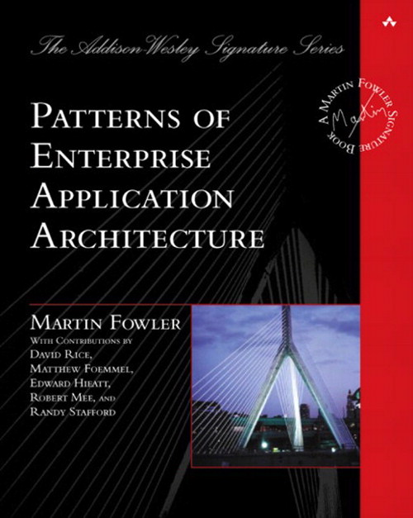
Domain Layer vs. Service Layer
Service Layer
Unified means of accessing business logic
Includes some application logic for accessing things
Domain Layer
Representation of our business logic
Application- and invocation-independent
Recommended Reading: Patterns of Enterprise Application Architecture by Martin Fowler
Notes:
“Unified” = full layer, nothing should bypass it
“application logic” = can know about application structure and be somewhat dependent on it
“independent” = should not know or care about application structure or how it was called
Show service layer

Slide 11
Scorecard: Service / Domain Layer Split
Improvements:
Service layer can be tested in isolation (by mocking domain layer) → reduce testing time, improve testing reliability
Complete extraction of domain logic from controllers → reduce planning and implementation time
Problems:
Domain Layer still mixes persistence with domain logic
Domain logic cannot be tested in isolation from persistence logic
Notes:
STOP FOR QUESTIONS ABOUT SERVICE LAYER / DOMAIN LAYER

Slide 12

ORM to the Rescue?
Object-relational mapping (ORM) replaces Table Modules with Entities
Doctrine 2 ORM is a PHP implementation
Entities
Plain Old PHP Objects (POPO’s)
Don’t directly access databases
Entity logic can easily be tested in isolation
Notes:
Show entities
Show tests

Slide 13
Scorecard: ORM
Improvements:
Complete separation of domain logic and persistence logic → reduce testing time, improve testing reliability
Changes to domain logic (typically) require updates in a smaller area of code → reduce planning and implementation time
Problems:
Learning curve for ORM
Data architecture must conform to ORM
Some negative performance impact, limited opportunities to optimize
Notes:
STOP FOR QUESTIONS ON ORM

Slide 14
Service-Oriented Architecture
Controller
View
Controller
View
Service Layer
Service Layer
Svc Client
Svc Client
Domain Layer
Storage (DB)
Controller
View
Controller
View
Service Layer
Service Layer
Domain Layer
Domain Layer
Storage (DB)
Storage (DB)

Slide 15
Scorecard: Service-Oriented Architecture
Improvements:
Designing to API simplifies definition of test cases and creation of test mocks → reduced time creating tests, improved test reliability
Services can serve many different clients
Opportunities to scale development teams (separate ownership of services)
Services can be implemented with language / technology that is best suited
Problems:
Coordination between apps and services (and their owners)
Network overhead
Notes:
STOP FOR QUESTIONS ABOUT SOA

Slide 16

Takeaways
Plan for change
Manage technical debt
More structured == more maintainable
Increasing application size requires increasing separation of concerns
Application architecture is a series of trade-offs

Slide 17

Who am I? Feedback / Contact / Slides
Software Engineer at Shutterstock
Zend Certified Engineer – PHP 5 & Zend Framework
Founder / Organizer of Lake / Kenosha PHP
Email: patrick.schwisow@gmail.com
Twitter: @PSchwisow
Slides: https://github.com/PSchwisow/Miscellaneous/
Sample Code: https://github.com/PSchwisow/container-coding/
Joind.in: https://joind.in/talk/view/13087
now
hiring
Notes:
Tie it back into the story.

