Slide 1

Achieving High-Quality Code Standards
Patrick Schwisow
Midwest PHP
April 23, 2021
Notes:
Q: Why do we need standards?

Slide 2
Why do we need standards?
function convert($data){ $l = strlen($data)-2; $str = substr($data,1,$l); $a = explode(",",$str); $a2 = array(); for ($i=0;$i<sizeof($a);$i++) { $l2 = strlen($a[$i])-2; $a2[] = substr($a[$i],1,$l2); } return $a2; }
Notes:
Hard to read
Hard to understand (unless you wrote it… maybe)
Problems are hard to spot

Slide 3
Why do we need standards?
function jsonStringsToArray($jsonData) { // remove first and last [] $length = strlen($jsonData) - 2; $jsonString = substr($jsonData, 1, $length); // tokenize, using , as a divider $newArray = explode(",", $jsonString); $lastArray = array(); for ($i = 0; $i < sizeof($newArray); $i++) { $thisLength = strlen($newArray[$i]) - 2; $lastArray[] = substr($newArray[$i], 1, $thisLength); } return $lastArray; }
Notes:
Hard to read
Hard to understand (unless you wrote it… maybe)
Problems are hard to spot

Slide 4
Why do we need standards?
/** * Converts JSON data string to PHP array. * * Assumes this format: ["Some text","Even more text"] * * @param string $jsonData * @return array */ function jsonStringsToArray($jsonData) { ...
}
Notes:
Hard to read
Hard to understand (unless you wrote it… maybe)
Problems are hard to spot
DON’T NEED THIS, USE json_decode()!!!

Slide 5
What areas should standards address?
Naming practices
Code formatting
File structure
Autoloading
Application file structure
Separation of concerns
Consistent architectural patterns
Documentation standards
Testing standards
Version control standards
Process standards
Notes:
File structure -> one class per file, don’t define and execute in the same file, etc.
Documentation standards
in file – comments
Separately – user docs, dev docs, API docs
Last 3 – wait until later for details

Slide 6
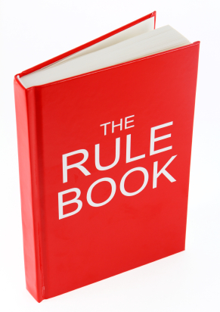

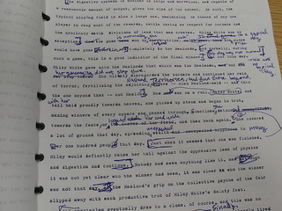
How do we define our standards?
OR
+
Notes:
Write your own
Use a published standard
Start with a published standard and customize to your needs

Slide 7
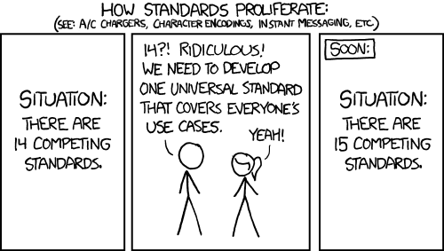
Published Standards
Notes:
Talk about progression of PHP standards here:
PEAR
ZF1, sf1
WP, Drupal
PHP-FIG (PSRs)

Slide 8
PSR-0/-4 Autoloading
Filenames end in .php
One class per file
Classes must be under a vendor namespace (at least)
Classname (after namespace) must match filename
\Symfony\Core\Request ➔ /path/to/proj/lib/vendor/Symfony/Core/Request.php
\Zend_Controller_Front ➔ /path/to/proj/lib/vendor/Zend/Controller/Front.php (PSR-0 only)
\Aura\Web\Response\Status ➔ /path/to/aura-web/src/Response/Status.php (PSR-4 with prefix of “Aura\Web”)

Slide 9
PSR-1 Basic Coding Standard
Must follow PSR-0 or PSR-4 autoloading requirements
Side effects: “A file SHOULD declare new symbols (classes, functions, constants, etc.) and cause no other side effects, or it SHOULD execute logic with side effects, but SHOULD NOT do both.”
Namespace and class names: StudlyCaps
Class constants: ALL_CAPS
Method names: camelCase()

Slide 10
PSR-12 Extended Coding Style Guide
Must follow PSR-1
Omit closing ?> tag from PHP-only files
No more than one statement per line
Indents: 4 spaces (per level)
PHP keywords and constants true, false, and null must be lower case
Short form of type keywords must be used (int not integer)

Slide 11
PSR-12 Extended Coding Style Guide
Visibility: properties, constants, and methods must be declared public, protected, or private
Opening braces:
Classes and methods: next line
Closures: same line
Control structures: same line
Must use elseif instead of else if

Slide 12
Checking and Enforcing Standards
Code Reviews
PHP_CodeSniffer (phpcs)
PHP Code Beautifier and Fixer (phpcbf)

Slide 13
PHP_CodeSniffer
$ ./vendor/bin/phpcs --standard=PSR2 src/Controller/IndexController.php
FILE: src/Controller/IndexController.php
----------------------------------------------------------------------
FOUND 9 ERRORS AFFECTING 9 LINES
----------------------------------------------------------------------
2 | ERROR | [x] There must be one blank line after the namespace
| | declaration
11 | ERROR | [x] Multi-line function call not indented correctly;
| | expected 12 spaces but found 0
12 | ERROR | [x] Multi-line function call not indented correctly;
| | expected 12 spaces but found 0
13 | ERROR | [x] Multi-line function call not indented correctly;
| | expected 12 spaces but found 0
31 | ERROR | [x] Multi-line function call not indented correctly;
| | expected 12 spaces but found 0
...
----------------------------------------------------------------------
PHPCBF CAN FIX THE 9 MARKED SNIFF VIOLATIONS AUTOMATICALLY
----------------------------------------------------------------------
Time: 74ms; Memory: 4.25Mb

Slide 14
PHP Code Beautifier and Fixer
$ ./vendor/bin/phpcbf --standard=PSR2 src/Controller/IndexController.php
Changing into directory /Users/patrickschwisow/code/standards-checker/src/Controller
Processing IndexController.php [PHP => 274 tokens in 42 lines]... DONE in 15ms (9 fixable violations)
=> Fixing file: 0/9 violations remaining [made 2 passes]... DONE in 32ms
Patched 1 file
Time: 105ms; Memory: 4.75Mb
$ git diff
@@ -1,16 +1,15 @@
<?php
namespace PSchwisow\StandardsChecker\Controller;
-
class IndexController extends BaseController
{
public function index()
{
$files = array_map(
function ($file) {
-// $return = explode('-', substr($file, 0, -5));
+ // $return = explode('-', substr($file, 0, -5));

Slide 15
Custom Standards
In your project root phpcs.xml
<?xml version="1.0"?>
<ruleset name="Foo_Project">
<description>The coding standard for the Foo Project.</description>
<!-- directories and files to check -->
<file>src</file>
<file>public/index.php</file>
<!-- directory to exclude -->
<exclude-pattern>*/Tests/*</exclude-pattern>
<!-- command-line arguments -->
<arg name="report" value="summary"/>
<arg value="np"/>
<!-- use all of PSR-1 -->
<rule ref="PSR1"/>
<!-- All PHP files MUST use the Unix LF (linefeed) line ending. --> <rule ref="Generic.Files.LineEndings"> <properties> <property name="eolChar" value="\n"/> </properties> </rule> </ruleset>
See https://github.com/squizlabs/PHP_CodeSniffer/wiki/Coding-Standard-Tutorial for more details.

Slide 16
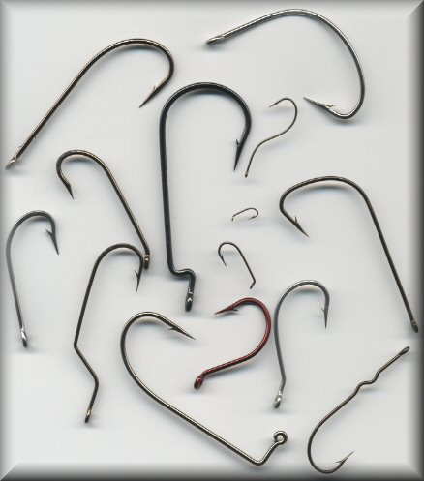





Automation!

Slide 17
Documentation Standards: DocBlocks
<?php
/**
* A summary informing the user what the associated element does.
*
* A *description*, that can span multiple lines, to go _in-depth_
* into the details of this element and to provide some background
* information or textual references.
*
* @param string $myArgument With a *description* of this argument,
* these may also span multiple lines.
* @return void
* @throws \InvalidArgumentException
*/
function myFunction($myArgument)
{
}

Slide 18
Documentation Standards: DocBlocks
DocBlocks are attached to Structural Elements:
Function
Constant
Class
Interface
Trait
Class constant
Property
Method
File
require / include

Slide 19
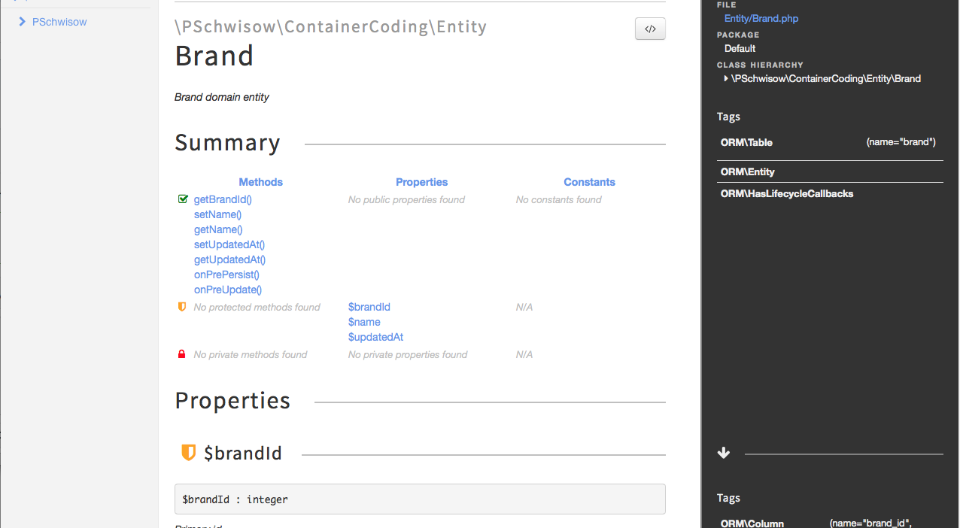
Documentation Standards: phpDocumentor

Slide 20
Documentation Standards: PSR-5 and PSR-19
Coming
Soon?

Slide 21
Other Standards
Testing
Version Control
Process
Notes:
Testing
Unit tests / coverage
Acceptance tests
Version Control
Commit messages
Workflow (branching model, merge, rebase, squash)
Process
Defining work
Prioritizing work
Analyzing work
QA
Deployment
Re-evaluating / refining process

Slide 22

Who Am I? Feedback / Contact / Slides
Senior Full Stack Engineer at Moonrise
Email: patrick.schwisow@gmail.com
Twitter: @PSchwisow
Slides: https://github.com/PSchwisow/Miscellaneous/

