Slide 1
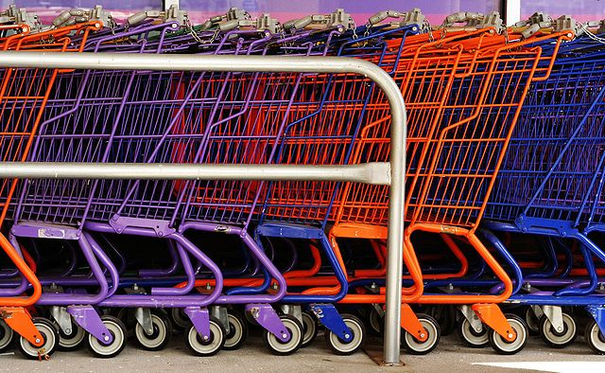
eCommerce Content Management
Patrick Schwisow
php[architect] eCommerce Summit
January 30, 2014

Slide 2


Who am I?
Software Development Team Leader at OpticsPlanet, Inc.
Zend Certified Engineer – PHP 5 & ZF
Founder / Organizer of Lake / Kenosha PHP
Father of 3 boys: Jack, Henry, and Charlie

Slide 3
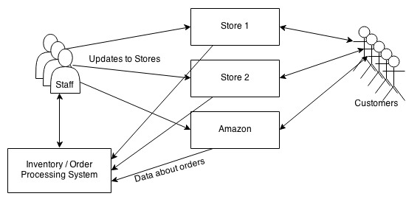
eCommerce: The Simple Way
Staff members directly update the data for each product on each store
Notes:
Stores are fully independent
Any data that exists in multiple stores must be duplicated / synchronized

Slide 4
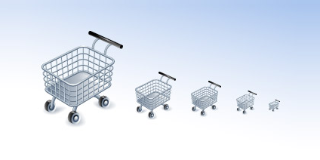
But… Does It Scale?
Increasing number of stores
Increasing number of products
Increasing frequency of updates
Increasing staff == increasing concurrency issues
Cost of staff to do manual updates increases faster than the cost to automate
Notes:
In a word, “NO”

Slide 5
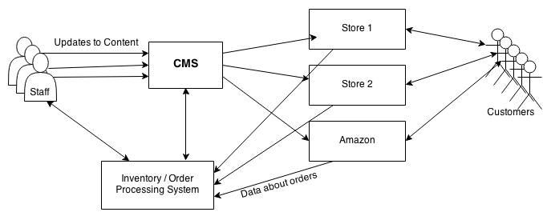
Content Management FTW!
Staff updates data for products in CMS
CMS manages publishing data to each store
Notes:
Products can appear on multiple stores but share data
CMS can include logic!

Slide 6
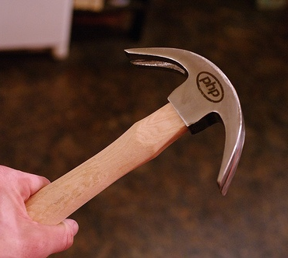
How do we build it?
Application structure
Features easily added / expanded
Access control based on role
Key features
CRUD operations on products, brands, etc.
Automated publishing process
Monitoring / reporting
Notes:
Building a tool for internal use only (users are staff at your company)
CRUD = create, read, update and delete

Slide 7
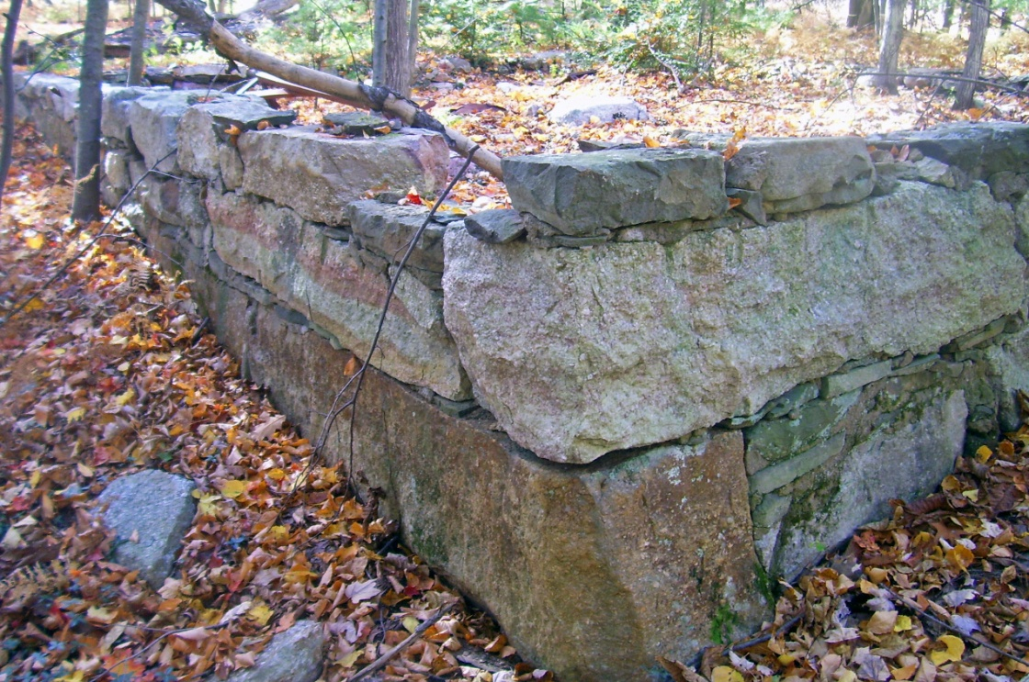
Laying the Foundations
Build a good framework
Define data structures / relationships
Plan for growth
Document your plans
Notes:
That’s “framework” with a small “f”
Data structures: brand, category, product, etc.
Doesn’t matter if it’s formal entity-relationship diagrams or sketches on a whiteboard
Expect change! Do what you can to make it less painful when it happens
The developer who looks at things in 3 months or 3 years will thank you… and that developer might be you!

Slide 8
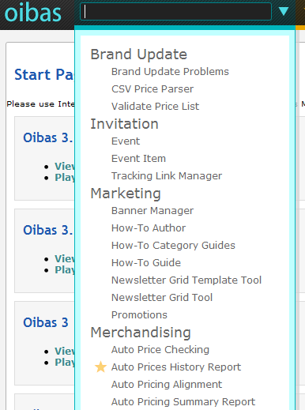
Building the Frontend for the Backend
Keep it simple! Function > Beauty
How will tools be arranged?
By function
By user role
Notes:
You don’t have to attract customers; you need to make sure they can work as efficiently as possible.

Slide 9
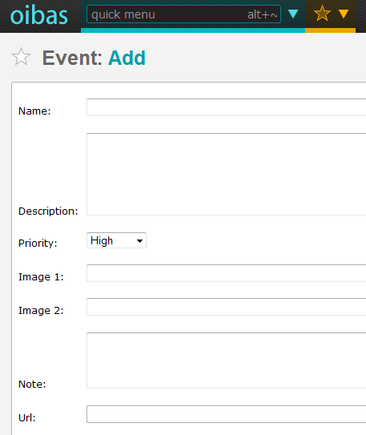
Building the Frontend for the Backend
Re-use as often as possible
Users get consistent behavior
Developers don’t constantly re-invent
Keep a tight feedback loop with users
Notes:
Build reusable pieces (PHP, JS, and HTML)
Lean / Agile works well

Slide 10
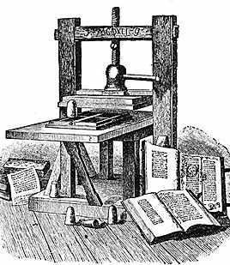
Publishing the Stores
API vs. web scraping
Periodic publishing vs. real-time updates
Incremental updates vs. full-data publish
Shared product data vs. unique content

Slide 11

Automating the Inputs
From our other systems
Inventory
Orders
Forecasting models
From third-party systems
Supplier inventory / cost data
Supplier product data

Slide 12

Feeds to Everywhere!
Multiple store types
Current eCommerce platform
Legacy platforms
Special types
Sales event stores
Partner stores

Slide 13
Feeds to Everywhere!
Third-party sales channels
Amazon
eBay
Walmart.com
Gunbroker.com
Third-party advertising feeds
Google Shopping

Slide 14

Background Processes
How to run non-web processes?
cron
Gearman
RabbitMQ
Other existing solutions
Create your own process controller

Slide 15
Background Processes
Major hurdles
Mutual exclusion / locks
Monitoring
Detecting / handling failures
Detecting / handling jobs that do not finish

Slide 16
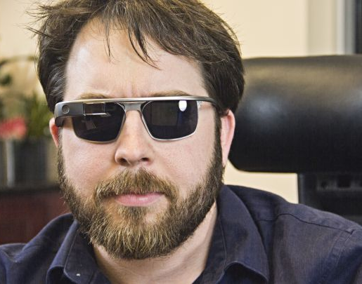
Additional Features
Managing images and videos
Bulk data import / export
Gathering competitor data
Automatic pricing
Automatic content generation

Slide 17
Feedback / Contact / Slides
Joind.in: https://joind.in/10313
Email: patrick.schwisow@gmail.com
Twitter: @PSchwisow
Slides: https://github.com/PSchwisow/Miscellaneous/
OpticsPlanet is Hiring: http://www.opticsplanet.com/careers/

