Slide 1
Achieving High-Quality Code Standards
Patrick Schwisow
Madison PHP
June 25, 2015
Notes:
Q: Why do we need standards?

Slide 2
Why do we need standards?
function convert($data){ $l = strlen($data)-2; $str = substr($data,1,$l); $a = explode(",",$str); $a2 = array(); for ($i=0;$i<sizeof($a);$i++) { $l2 = strlen($a[$i])-2; $a2[] = substr($a[$i],1,$l2); } return $a2; }
Notes:
Hard to read
Hard to understand (unless you wrote it… maybe)
Problems are hard to spot

Slide 3
Why do we need standards?
function jsonStringsToArray($jsonData) { // remove first and last [] $length = strlen($jsonData) - 2; $jsonString = substr($jsonData, 1, $length); // tokenize, using , as a divider $newArray = explode(",", $jsonString); $lastArray = array(); for ($i = 0; $i < sizeof($newArray); $i++) { $thisLength = strlen($newArray[$i]) - 2; $lastArray[] = substr($newArray[$i], 1, $thisLength); } return $lastArray; }
Notes:
Hard to read
Hard to understand (unless you wrote it… maybe)
Problems are hard to spot

Slide 4
Why do we need standards?
/** * Converts JSON data string to PHP array. * * Assumes this format: ["Some text","Even more text"] * * @param string $jsonData * @return array */ function jsonStringsToArray($jsonData) { ...
}
Notes:
Hard to read
Hard to understand (unless you wrote it… maybe)
Problems are hard to spot
DON’T NEED THIS, USE json_decode()!!!

Slide 5
What areas should standards address?
Naming practices
Code formatting
File structure
Autoloading
Application file structure
Separation of concerns
Consistent architectural patterns
Documentation standards
Testing standards
Version control standards
Process standards
Notes:
File structure -> one class per file, don’t define and execute in the same file, etc.
Documentation standards
in file – comments
Separately – user docs, dev docs, API docs
Last 3 – wait until later for details

Slide 6
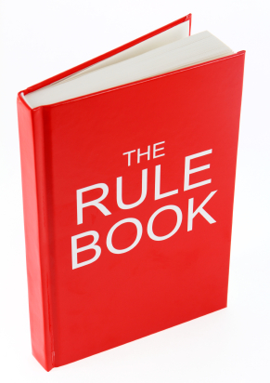

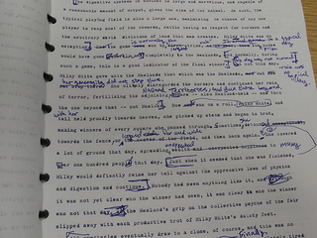
How do we define our standards?
OR
+
Notes:
Write your own
Use a published standard
Start with a published standard and customize to your needs

Slide 7
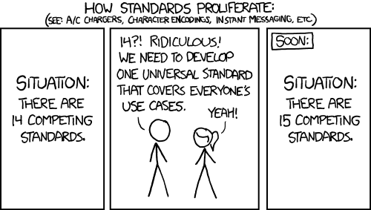
Published Standards

Slide 8
Published Standards
PEAR
Zend Framework (v1)
symfony (v1)
WordPress
Drupal
PHP-FIG (PSRs)

Slide 9
PHP-FIG Standards
PSR-0 Autoloading Standard DEPRECATED
PSR-1 Basic Coding Standard
PSR-2 Coding Style Guide
PSR-4 Improved Autoloading
Notes:
There are others, but they are outside the scope of what we’re covering.

Slide 10
PSR-0/-4 Autoloading
Filenames end in .php
One class per file
Classes must be under a vendor namespace (at least)
Classname (after namespace) must match filename
\Symfony\Core\Request ➔ /path/to/project/lib/vendor/Symfony/Core/Request.php
\Zend_Controller_Front ➔ /path/to/project/lib/vendor/Zend/Controller/Front.php (PSR-0 only)
\Aura\Web\Response\Status ➔ /path/to/aura-web/src/Response/Status.php (PSR-4 with prefix of “Aura\Web”)

Slide 11
PSR-1 Basic Coding Standard
Must follow PSR-0 or PSR-4 autoloading requirements
Side effects: “A file SHOULD declare new symbols (classes, functions, constants, etc.) and cause no other side effects, or it SHOULD execute logic with side effects, but SHOULD NOT do both.”
Namespace and class names: StudlyCaps
Class constants: ALL_CAPS
Method names: camelCase()

Slide 12
PSR-2 Coding Style Guide
Must follow PSR-1
Omit closing ?> tag from PHP-only files
Indents: 4 spaces (per level)
PHP keywords and constants true, false, and null must be lower case
Opening braces:
Classes and methods: next line
Control structures: same line
Visibility: properties and methods must be declared public, protected, or private

Slide 13
Checking and Enforcing Standards
Code Reviews
PHP_CodeSniffer (phpcs)
PHP Code Beautifier and Fixer (phpcbf)

Slide 14
PHP_CodeSniffer
$ ./vendor/bin/phpcs --standard=PSR2 src/Controller/IndexController.php
FILE: src/Controller/IndexController.php
----------------------------------------------------------------------
FOUND 9 ERRORS AFFECTING 9 LINES
----------------------------------------------------------------------
2 | ERROR | [x] There must be one blank line after the namespace
| | declaration
11 | ERROR | [x] Multi-line function call not indented correctly;
| | expected 12 spaces but found 0
12 | ERROR | [x] Multi-line function call not indented correctly;
| | expected 12 spaces but found 0
13 | ERROR | [x] Multi-line function call not indented correctly;
| | expected 12 spaces but found 0
31 | ERROR | [x] Multi-line function call not indented correctly;
| | expected 12 spaces but found 0
...
----------------------------------------------------------------------
PHPCBF CAN FIX THE 9 MARKED SNIFF VIOLATIONS AUTOMATICALLY
----------------------------------------------------------------------
Time: 74ms; Memory: 4.25Mb

Slide 15
PHP Code Beautifier and Fixer
$ ./vendor/bin/phpcbf --standard=PSR2 src/Controller/IndexController.php
Changing into directory /Users/patrickschwisow/code/standards-checker/src/Controller
Processing IndexController.php [PHP => 274 tokens in 42 lines]... DONE in 15ms (9 fixable violations)
=> Fixing file: 0/9 violations remaining [made 2 passes]... DONE in 32ms
Patched 1 file
Time: 105ms; Memory: 4.75Mb
$ git diff
@@ -1,16 +1,15 @@
<?php
namespace PSchwisow\StandardsChecker\Controller;
-
class IndexController extends BaseController
{
public function index()
{
$files = array_map(
function ($file) {
-// $return = explode('-', substr($file, 0, -5));
+ // $return = explode('-', substr($file, 0, -5));

Slide 16
CodeSniffer Standards
Recommended
PEAR
PSR1
PSR2
Outdated / Not Recommended
MySource
PHPCS
Squiz
Zend

Slide 17
Custom Standards
In your project root phpcs.xml
<?xml version="1.0"?>
<ruleset name="Foo_Project">
<description>The coding standard for the Foo Project.</description>
<!-- directories and files to check -->
<file>src</file>
<file>public/index.php</file>
<!-- directory to exclude -->
<exclude-pattern>*/Tests/*</exclude-pattern>
<!-- command-line arguments -->
<arg name="report" value="summary"/>
<arg value="np"/>
<!-- use all of PSR-1 -->
<rule ref="PSR1"/>
<!-- All PHP files MUST use the Unix LF (linefeed) line ending. --> <rule ref="Generic.Files.LineEndings"> <properties> <property name="eolChar" value="\n"/> </properties> </rule> </ruleset>
See https://github.com/squizlabs/PHP_CodeSniffer/wiki/Coding-Standard-Tutorial for more details.

Slide 18
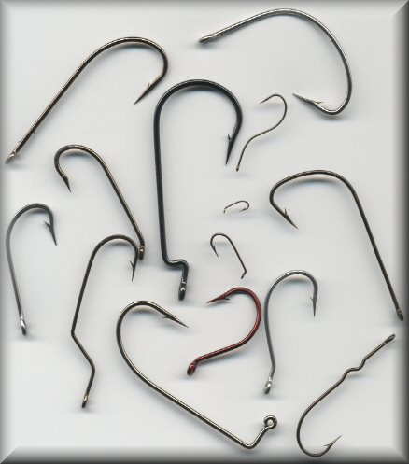


Automation!

Slide 19
Documentation Standards: DocBlocks
<?php
/**
* A summary informing the user what the associated element does.
*
* A *description*, that can span multiple lines, to go _in-depth_
* into the details of this element and to provide some background
* information or textual references.
*
* @param string $myArgument With a *description* of this argument,
* these may also span multiple lines.
* @return void
*/
function myFunction($myArgument)
{
}

Slide 20
Documentation Standards: DocBlocks
DocBlocks are attached to Structural Elements:
Function
Constant
Class
Interface
Trait
Class constant
Property
Method
File
require / include

Slide 21
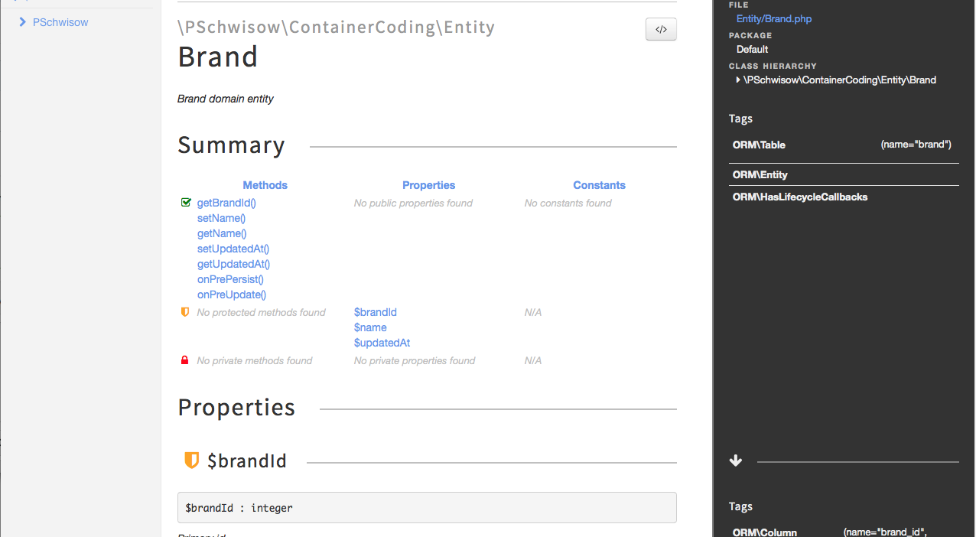
Documentation Standards: phpDocumentor

Slide 22
Documentation Standards: PSR-5
Coming
Soon!

Slide 23
Other Standards
Testing
Version Control
Process
Notes:
Testing
Unit tests / coverage
Acceptance tests
Version Control
Commit messages
Workflow (branching model, merge, rebase, squash)
Process
Defining work
Prioritizing work
Analyzing work
QA
Deployment
Re-evaluating / refining process

Slide 24

Who Am I? Feedback / Contact / Slides
Software Engineer at Shutterstock
Zend Certified Engineer – PHP 5 & Zend Framework
Founder / Organizer of Lake / Kenosha PHP
Email: patrick.schwisow@gmail.com
Twitter: @Pschwisow
Joind.in: https://joind.in/14619
Slides: https://github.com/PSchwisow/Miscellaneous/

