Slide 1
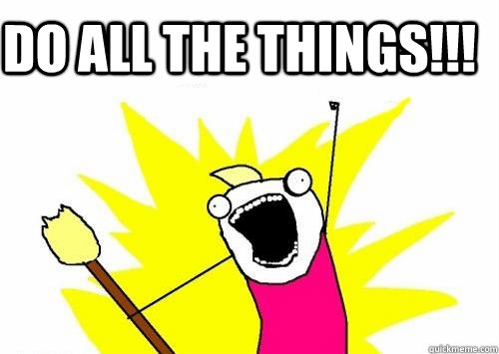
Patrick Schwisow
php[tek] 2013
May 16, 2013
Notes:
Moving from full-time developer to manager is tough. In my case, the transition happened unexpectedly fast. This talk is shaped my personal experience, and I hope it’s helpful to those who find themselves in a similar position now or in the future.

Slide 2
How did I get into this mess?
Hired as a mid-level developer for a team that works on a home-grown eCommerce CMS in July 2009
Promoted to “Senior” in Spring 2011
Team leader left the company in October 2011
Asked to “cover day-to-day duties”
“Temporary situation” has continued 1 ½ years

Slide 3
What my job description says I do
Notes:
Write Code: and tests, documentation, etc.
Collaborate on design: bounce ideas of each other, prototype, discuss
Assist Jr’s: answer questions on how, why, what to do
Suggest: What new libraries, techniques, etc. can we use? How can we work better / smarter?
Also: cover for TL during vacations, absences

Slide 4
What I actually do
Notes:
Answer Q’s: Help Jr’s, keep bosses informed, make all the day-to-day decisions
Triage: Handle when something goes wrong in a non-obvious way, provide upper tier tech support, take charge of emergencies
Run projects: Meetings, planning, design, transforming non-technical specs to tickets that can be handed to developers, managing progress, balancing priorities, communicating with PM and KSH, managing tech debt
Talk w/ users: Get feedback, answer questions, bug or expected behavior?
Design: Overall structure for our application, structure for new features, strategic thinking
Review: CRs, QA, code standards, test coverage
Write Code: Often I cannot afford to spend any time on code

Slide 5


Slide 6
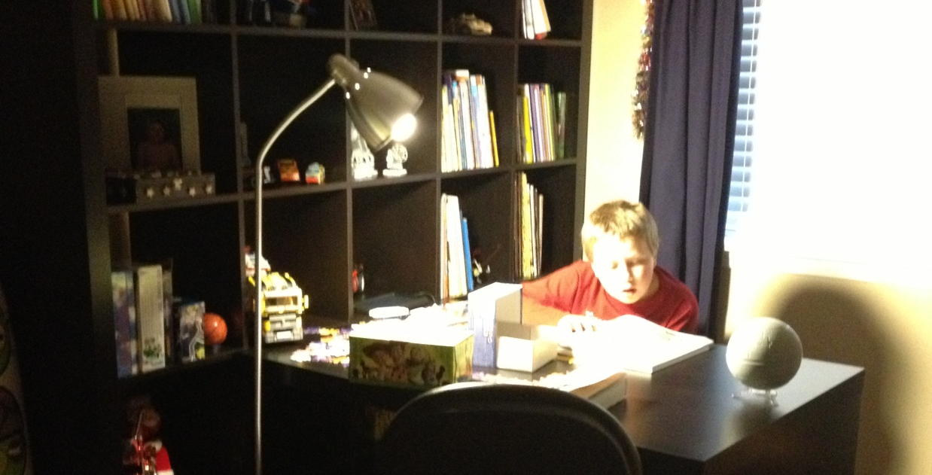
You can’t do it all!
Time is finite
Don’t try to be Superman
Something’s gotta give
Remember your priorities (work-life balance)
Talk with your boss
Notes:
Time: They hired you to work X hours per week. They can’t expect you to work 2X hours per week.
Superman: Management = getting things done through others. Rely on your teammates.
Something’s gotta give: Be willing to give things up. If you don’t do it intentionally, you will do it unintentionally.
Priorities: There will always be more time for work, don’t miss out on life.
Talk: Make sure you’re on the same page. Make sure he / she knows what you are and are not doing. Ask for help when needed.

Slide 7
It builds character!
“I wish I could spend more time romping though our codebase… I just have to remind myself that everyone has different ways they contribute to the team and someone has to keep the wheels from flying off.”
—Chris Cornutt (@enygma)
Notes:
Chris Cornutt: PHPDeveloper.org and LoneStarPHP

Slide 8
It builds character!
Even if you didn’t ask for this, make the most of the experience
Test drive the management chair
See the SDLC from a different perspective
Decide where you want your career to go
Notes:
Experience: All experience is good experience. It makes you more valuable. Talk about what I have learned (project management, more contact with users, more information about other departments).
Test drive: See what it’s like. Minimal risk (because you were not hired to do this).
Different perspective: See where the boss is coming from. It makes you better developer.
Decide: Weigh your options

Slide 9
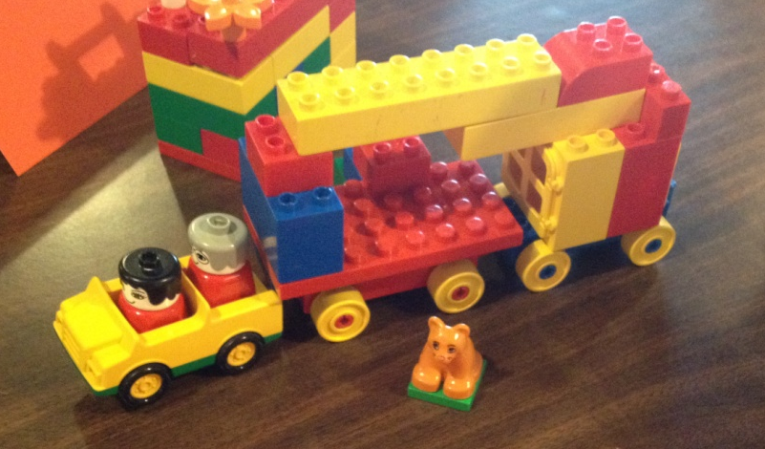
Lessons Learned: Project Management
Maximize “multi-threading”
Minimize dependencies
Your priorities != other people’s priorities
Failure is an option, but fail fast!
Set up milestones, check progress frequently
Miscellaneous bugs and tasks are an on-going project that will never end
Notes:
Multi-threading: Get multiple devs working in parallel
Dependencies: Split tickets in a way that blockers are small. Do them early!
Priorities: Don’t assume, communicate! “Master plan” with priorities is very helpful. Negotiate if necessary.
Failure: Projects may fail due to underestimation, unforeseen problems, changing priorities, etc. Don’t keep beating a dead horse.
Misc: You always devote a portion to non-project. You can adjust, but watch for pile-ups

Slide 10
Lessons Learned: Project Estimation
Estimation is HARD
You will underestimate time and complexity
The fewer details you have worked out, the more you will underestimate
“Dev hours” != “real time to completion”
Include time for code review / testing
Estimate based on “average dev”, not you!
Re-evaluate and revise estimates
Notes:
Real Time: Time is “lost” due to meetings, communications, “time in transit”.
Avg Dev: Not everyone codes at the same rate. Plan for time to get “up to speed”.

Slide 11
Lessons Learned: Communication
Communication == distraction. Manage it!
Tell devs, “It’s OK to say ‘no’ or ‘talk to TL’.”
Don’t get behind
Be proactive
Sometimes you need to “sell it”
Sell your ideas
Show the value of your team’s accomplishments
Notes:
Distraction: Communication is good, but communication to random devs at random times is sub-optimal.

Slide 12

More Lessons Learned
TL had you to rely on. Who is your 2nd in command?
Find or make “lieutenants”
Keeping in touch with the code will be work
Make time for something “tech-y” outside work
User Groups
Open Source Contribution
Reading / Writing / Editing
Notes:
Lieutenants: Look for those who are ready now / soon and those who show promise for future iterations
Keeping in touch: Review the code, ask your devs for details
Outside work: Pick something you find fun and rewarding

Slide 13
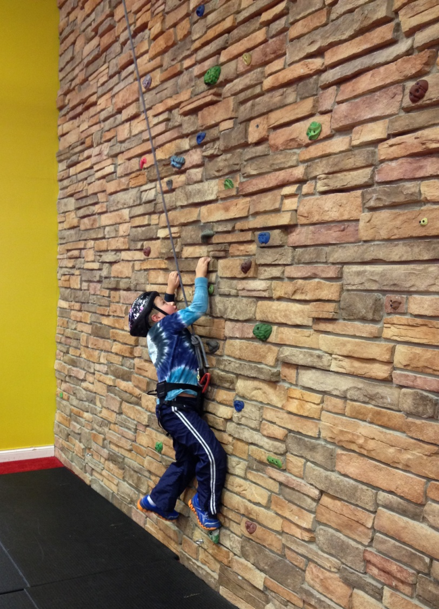
Where do we go from here? (short term)
Move up (to management)
Move back (to development)
The decision is not always yours, but push for what you want
Notes:
Push for whichever way you want to go, but either way is better than staying “in limbo”

Slide 14
Going back
No shame in going back
Don’t take it personally
Watch your ego / attitude
Support your new boss / show your value
Figure out what your new “normal” is
Plan / prepare for your next step

Slide 15
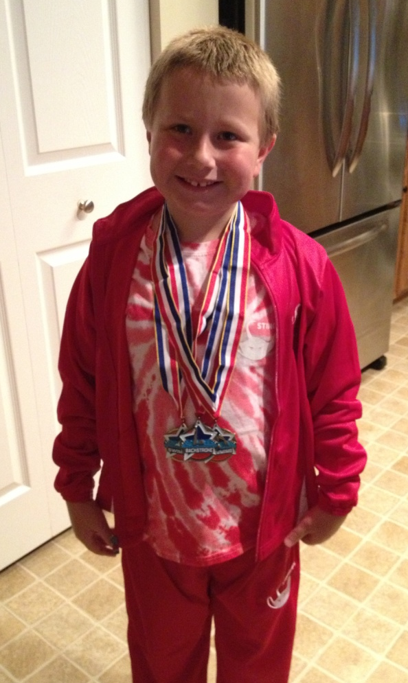

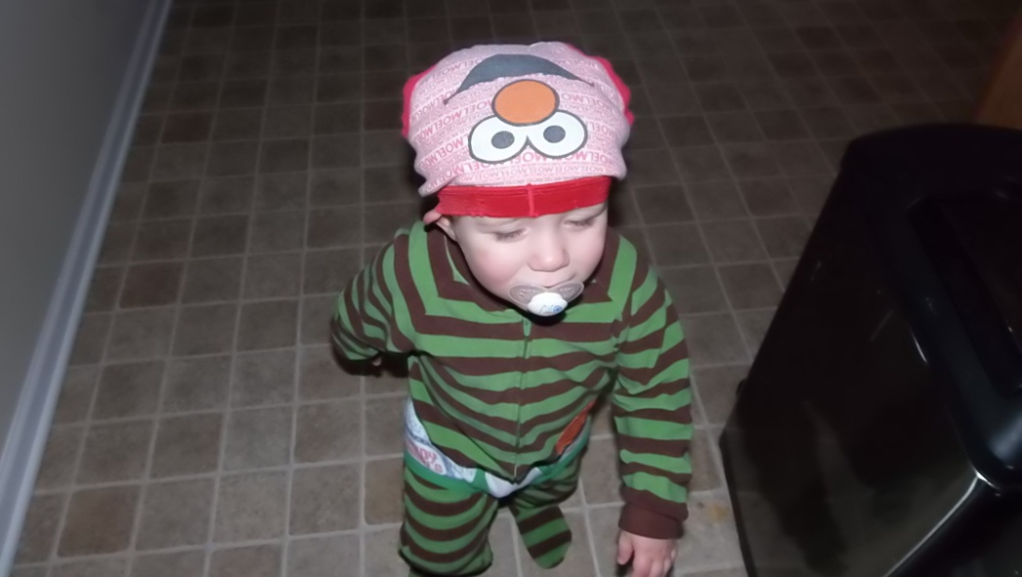
Where do we go from here? (long term)
Everyone wants different things
Career Tracks:
Management
Technical
Project Management
Evangelist / Sales Engineer
???
Notes:
Management: Manage People
Technical: Manage Code
Project Mgmt: Manage Projects
Evangelist / Sales: Use your technical knowledge to help / sell

Slide 16

“Journey’s End”
Promoted to Team Leader in April 2013
Continuing to grow as a leader, architect, and project manger
Taking on new responsibilities:
Recruiting / Hiring
Performance Reviews
Working to stay current
Planning for the next step

Slide 17
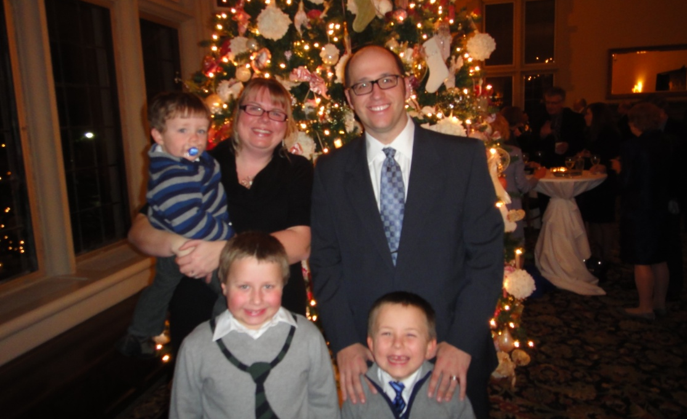
Credits
Chris Cornutt: “Lead Scrumveloper” (posted on the now defunct Accidental Scrummaster Blog)
Brian L. Moon: Being a Better Manager: Communication
The developers and management at OpticsPlanet
Lindsay, Jack, Henry, and Charlie

Slide 18
Who am I? Feedback / Contact / Slides
Team Leader, Oibas / CMS Development, at OpticsPlanet, Inc.
Zend Certified Engineer – PHP 5 & ZF
Founder / Organizer of Lake / Kenosha PHP
Joind.in: https://joind.in/8161
Email: patrick.schwisow@gmail.com
Twitter: @PSchwisow
Slides: https://github.com/PSchwisow/Miscellaneous/

