Slide 1
Code Reviews: The “Secret” to Building Quality Software
Patrick Schwisow
Midwest PHP
March 15, 2014

Slide 2
What is a Code Review?
“Code review is systematic examination…of computer source code.
It is intended to find and fix mistakes overlooked in the initial development phase,
improving both the overall quality of software and the developers’ skills.”
(http://en.wikipedia.org/w/index.php?title=Code_review&oldid=530204872)

Slide 3
Who does Code Reviews?
Peers (other developers)
Managers / Team Leads / Senior Developers
Dedicated QA / Testing Personnel
All of the above

Slide 4
What kind of CRs are you talking about?
Code review by a fellow team member
Required part of development process
Typically a step in an Agile workflow (Scrum, Kan-ban, etc.) but can be applied to other methodologies
Reviews should happen as soon as possible after the task is complete
Reviews are considered part of the task and should be included in all time / workload estimates
Other types of code review (by management or QA) may also be used

Slide 5
The Flip-Side: Functional Testing
“Functional testing” == “checking that all the stuff works”
Test the updated code to make sure it does what is specified
Check all the edge cases (Try to break stuff!)
Run all the unit tests*
Test things that may be affected by this change
Functional testing may happen together with CR or as a separate workflow step
*Unless you’ve got them running automatically for you

Slide 6
Code Review Tools
Prerequisites:
Issue Tracking (JIRA, Trac, GitHub Issues)
Version Control System (git, SVN, etc.)
Atlassian Crucible (http://www.atlassian.com/software/crucible/overview)
Atlassian Stash (http://www.atlassian.com/software/stash/overview)
GitHub Pull Requests
Review Board (http://www.reviewboard.org/)

Slide 7
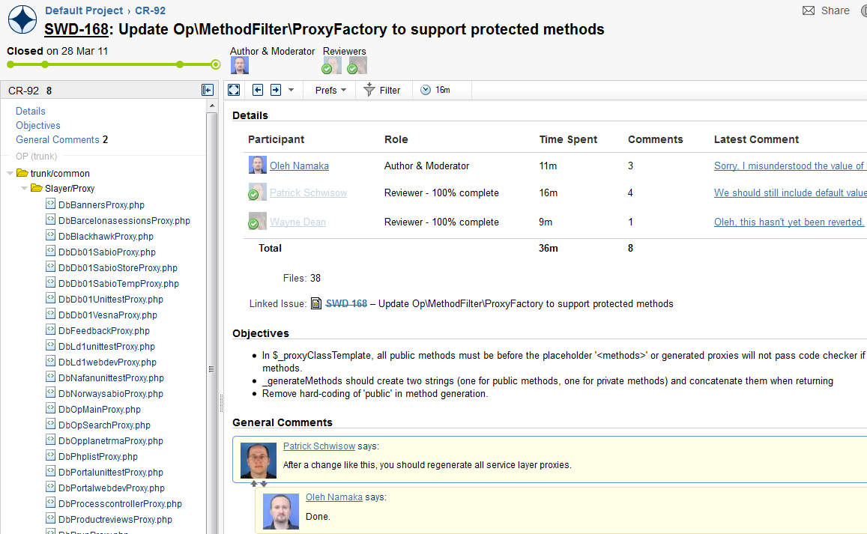
CR Tools: Atlassian Crucible

Slide 8
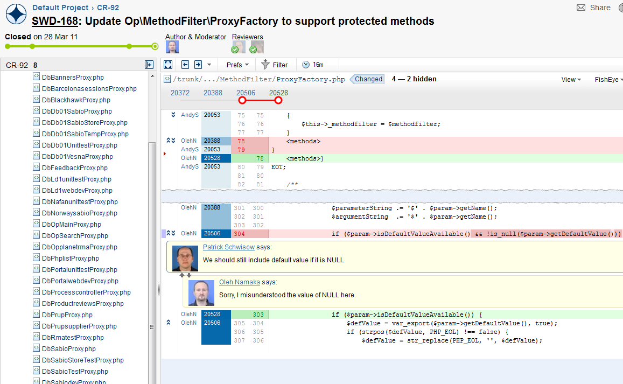
CR Tools: Atlassian Crucible

Slide 9
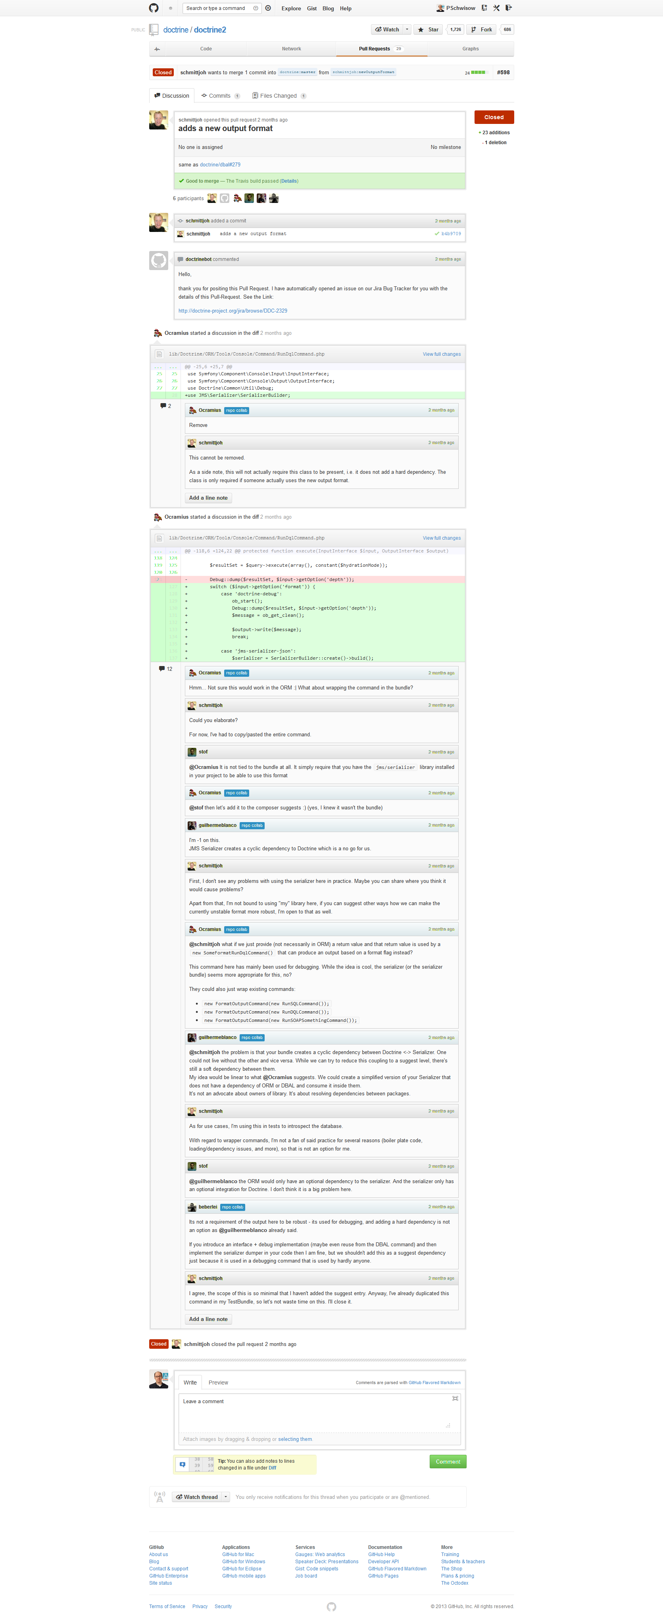
CR Tools: GitHub Pull Requests

Slide 10
CR Tools: GitHub Pull Requests

Slide 11
Rules of Code Reviews
Review ALL the changes.
Do functional testing as much as possible (within reason).
Nothing goes to production until it’s been reviewed and tested.
If something looks wrong or you’re just unsure of the reasoning behind it, ASK!!!
If you don’t see anything wrong, it’s OK to not say anything.

Slide 12
Rules of Code Reviews (cont.)
Code must be correct, but it doesn’t have to be exactly how you would write it.
Don’t just look at what they did; also think about what they didn’t do. (What was missed?)
CR / testing is a higher priority than development.
If you see a problem that’s outside the scope of the ticket, open a separate ticket for that issue.
The goal is better code quality. It’s not personal.

Slide 13

A Suggested Workflow
Jack creates ticket and puts “in scrum”
Henry grabs ticket and writes code
Henry sets ticket to “Testing” and puts “in scrum”
Charlie grabs ticket and does CR / testing
If ticket fails, re-open and send back to Henry, repeat as necessary
If ticket passes, Charlie moves changes to production

Slide 14
Benefits of Requiring Peer CRs
Increased Quality of Work
Decreased Production Bugs
Peer Pressure to Improve Quality
Distributed Knowledge
Improved On-Boarding & Mentoring
Distributed Ownership / Team Building
Notes:
Decreased Production Bugs – Also protects against debugging code making it into production.
Peer Pressure – If you know someone will see your code, you’ll be more conscious of the quality
Distributed Knowledge – At least two people must know what a given line of code does. Reduce “bus factor”. Increase “cross training”.
Distributed Ownership – Instead of each person having his / her own area of responsibility, everything is owned by the team. (We’re all in this together!)

Slide 15
Recommended Reading
Mark Chu-Carroll: Things Everyone Should Do: Code Review
Jeff Atwood: Code Reviews: Just Do It
Steve McConnell: Code Complete: A Practical Handbook of Software Construction (http://amzn.com/0735619670)
Karl Wiegers: Peer Reviews in Software: A Practical Guide (http://amzn.com/0201734850)

Slide 16
Who am I? Feedback / Contact / Slides
Software Development Team Leader at OpticsPlanet, Inc.
Zend Certified Engineer – PHP 5 & ZF
Founder / Organizer of Lake / Kenosha PHP
Email: patrick.schwisow@gmail.com
Twitter: @PSchwisow
Slides: https://github.com/PSchwisow/Miscellaneous/

