Slide 1
AMOLED Image sticking prevention/compensation
30/ Aug/ 2018
DMTL
Matsui (00467790)

Slide 2
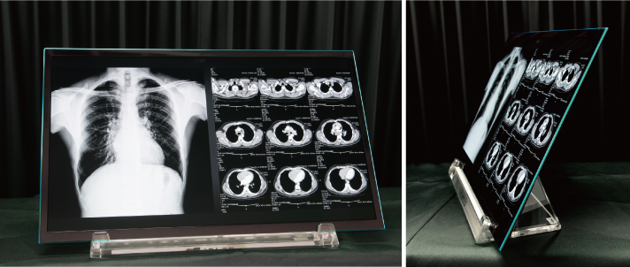
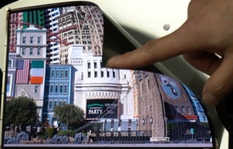
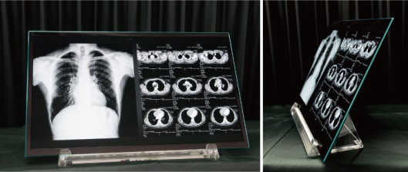
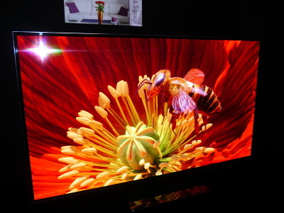
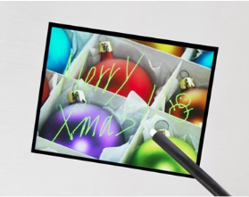
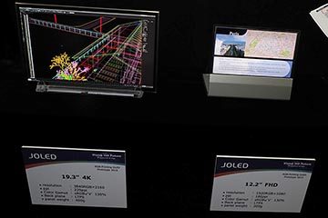
Self-introduction
Name: Matsui Masafumi (from Kyoto, Joined to HUAWEI on 1st. Aug. 2018)
First Mass -Production Model of Printing OLED
Work Experience (Topics)
21.6” 4K
(OLED)
・ Design of LCD panel with optical sensor
・ Panel design with various partners(TMD, Imec etc.)
・ Development of the compensation algorithm
for the OLED image sticking
・ Much experience in various LCD/OLED panel
(The world’s first mass-production of the print OLED)
1
Today’s presentation
2
4
3
12” FHD
(OLED,Sheet)
4
54” 4K (OLED, TAOS)
19” 4K, 12” FHD
(OLED)
3.5” VGA
(Incell-TP LCD)
2
Press Released
Development with
TMD,Imec etc.
3
1
Now
2003
2005
2007
2009
2011
2013
2015
2017
Kyoto unv.
Sony
Panasonic
JOLED
HUAWEI
My Skills
Display circuit and layout design
Language
Japanese: ◎，English: ～× (now in study), Chinese: ×
Today Explain the outline of compensation algorithm for the OLED image sticking developed for TV and Medical applications to the extent that I can speak

Slide 3
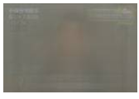
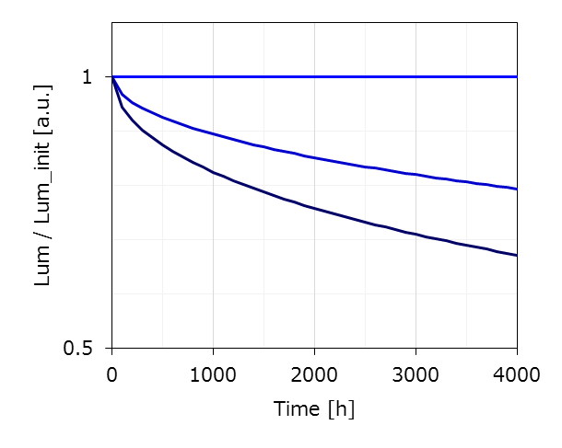
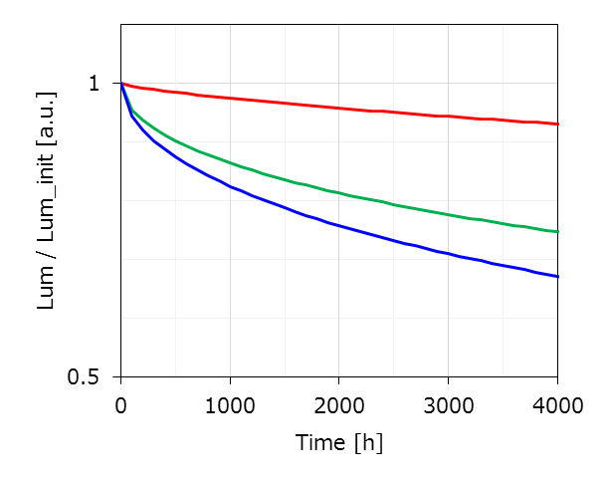
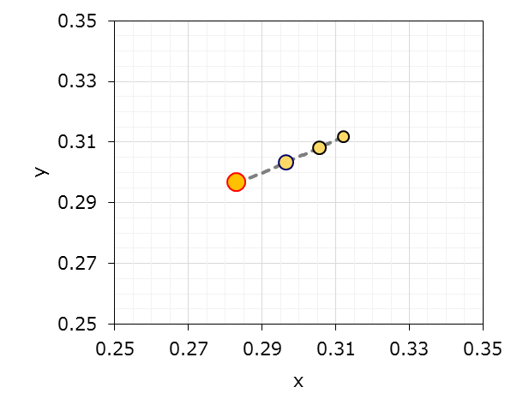
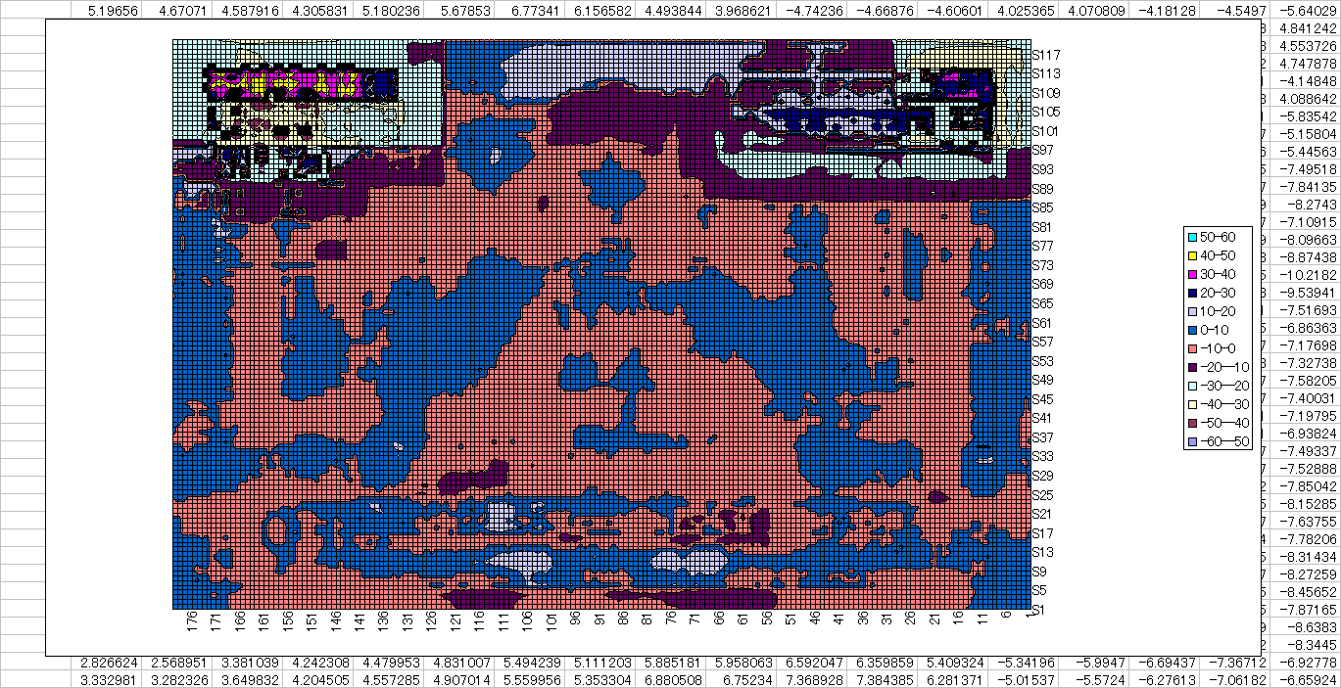
What is Image-Sticking
Difference of stress in adjacent pixels are unevenly distributed in the screen.
Difference of stress in adjacent pixels causes
the loss of uniformity and Chromaticity shift → Image Sticking
(ex.)
Loss of uniformity
Accumulation of video signal (24h,NHK,2011)
Aging:I_{stress1}
I_{stress1}
I_{stress2}
I_{stress3}
Δ₁
Aging
Aging:I_{stress2}
Δ₂
(after t1)
Aging:I_{stress3}
Image Sticking due to Title, Time report…
@Same
Signal level
t1
Δ₁
Δ₂
Chromaticity shift
due to the difference of degradation in RGB
NHK 2011/6/2 8:00～(24h)
(ex.)
(ex.)
Difference of stress in adjacent pixels (current)
Δu’v’>0.01
5000h
3000h
initial
ex. 9300k
1000h
Difference of Stress is about x1.5～x2 (※for TV use)
Image sticking is caused by degradation of OLED.
Precise estimation of OLED degradation is important for Image sticking compensation.

Slide 4
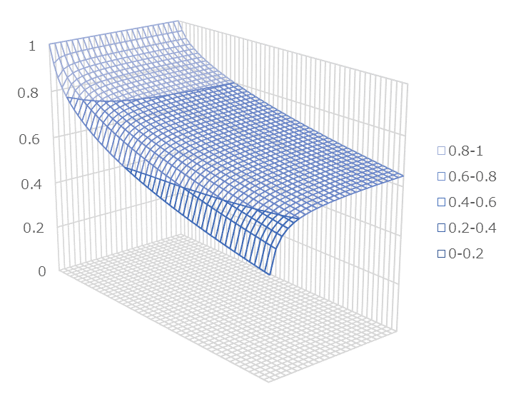
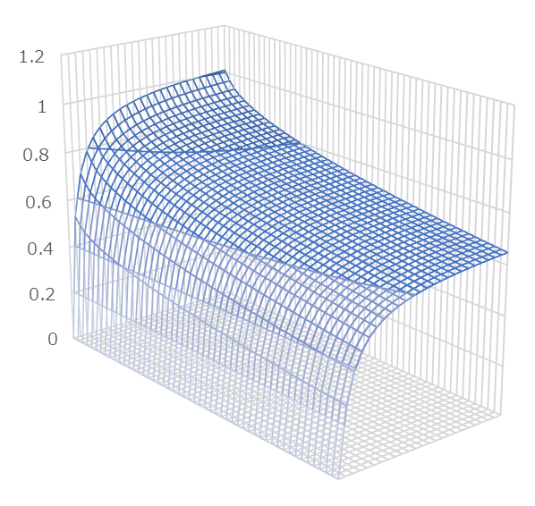
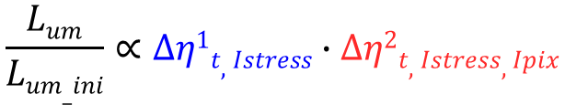

Modeling Approach for OLED Aging ①
How to know degradation at A’～ C’
Reproduce the degradation of each point by a combination of two component (Δη^{１}, Δη²)
→ estimate the gain for compensation of image sticking
(Normalized in the initial state)
C
B
A
Δη^{１}
1
$$\frac{Lum}{Lum_ini}∝∆η1t,Istress∙∆η2t,Istress,Ipix$$
Degradation of OLED
Aging:I_{stress1}
A’
Lum/Lumpeak_init
Lum/Lum_init
B’
C’
1
Ｘ
1
Δη²
Lum/Lum_init
I = Istress
Lum/Lum@Iref
I_{pix}
0
2
time
time
Iref
Depends on operation time, aging current, pixel current at display, etc..
time
I_{pix}
I_{ref}
Ipix
t1
to
0
C
B
A
( Initial )
Lum
( after Aging (@t1) )
100%
100%
100%
Lum
initial
Aging
Compensated
Lum
x gain
Calculate suitable gain
from degraded data
x0.7
Δη^{１}
1
I_{stress1}
Required
(Input signal)
Degraded (calc.)
～60%
～70%
～70%
X0.9
x1
Ipix
Ipix
Δη²
(@t1)
C’
B’
2
A’
$$Lumcompensated=Lumrequired∙gain$$

Slide 5
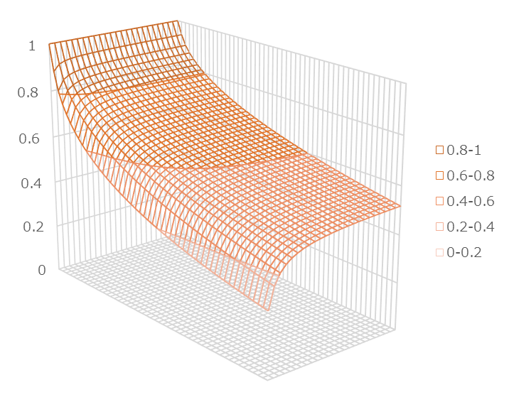
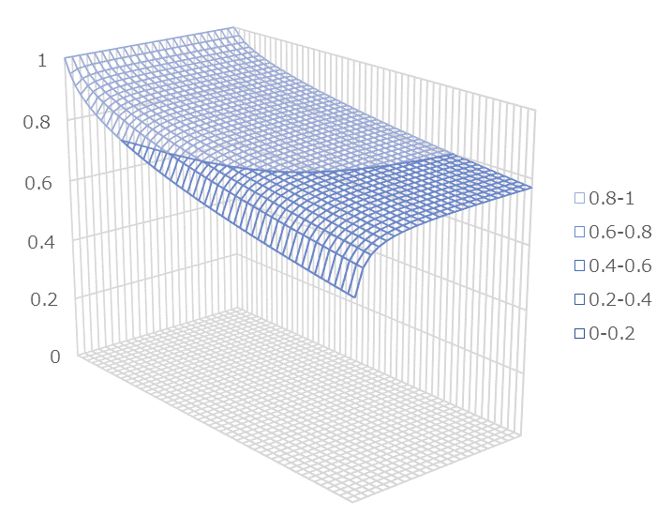
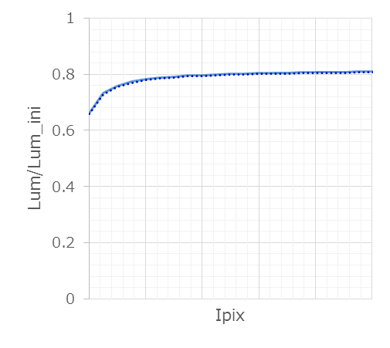

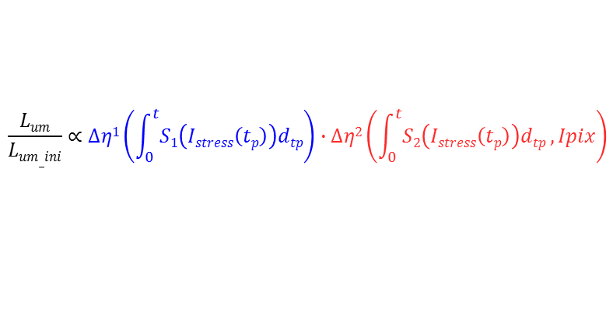
Modeling Approach for OLED Aging ②
Taking into account the difference of stress due to the signal level
Stress caused by the signal history
degradation model:
$$\frac{Lum}{Lum_ini}∝∆η1\left(\int_{0}^{t}{S1\left(Istress\left(tp\right)\right)dtp}\right)∙∆η2\left(\int_{0}^{t}{S2\left(Istress\left(tp\right)\right)dtp},Ipix\right)$$
0
Operation time
1
Convert the run time to the equivalent reference stress (I_{ref}) run time by acceleration factor (a→b)
→ Consider signal history as the accumulation of equivalent I_{ref} stress operation time
Aging
Case1
1
Δη^{１}
2
to
Δη²
Stress time(Case2)
0.8
①
1
Δt
(a)
Stress time(Case1)
Lum/Lum_init
I_{stress1}(case1)
Lum/Lum_init
I_{stress2}(case2)
(b)
I_{ref}
Aging: I_{stress1}
time
I_{pix}
I_{ref}
time
Convert the operation time to the stress time
Δt*(I_{stress2}/I_{ref})^{k}
≒ S(I_{stress2}, I_{ref})
Aging: I_{ref}
Aging
Case2
0
Operation time
to
2
if degradation at Iref is equal, no or small difference in Δη²
→ Can simplify the dependence of signal history
0.8
→ Can simplify the dependence of signal history
Lum/Lum_init
②
①＝②
degradation model (Approximated)
Count stress
degradation
＠Δη^{１}＝0.8_{(at Iref)}
$$\frac{Lum}{Lum_ini}∝∆η1\left(∆t∙\sum_{Ni=0}^{t/{∆t}}{S1\left(Istress\left(Ni∙∆t\right)\right)}\right)∙∆η2\left(∆η1,Ipix\right)$$
Aging: I_{stress2}
time
I_{pix}
I_{ref}

Slide 6
Modeling Approach for OLED Aging ③
(Issue) the degradation is accelerated excessively
by compensation driving → cause correction failure
Adjust the peak brightness according to operating time.
→ Reduce excessive degradation, and prolong the operation time until correction limit
Current is limited (ex. due to power consumption restriction)
 | Conventional | ① | ②
Uniformity change over time | x (Correction limit comes early) |  | preferable
Acceleration of degradation | Yes |  | No
Life time | Depend on device spec. |  | Depend on target curve
Power consumption (change over time) | Increase |  | Decrease
Comment | master monitor (Sony, BVM-E251 etc.) | Need to discuss with customer for target curve
Correction failure
due to the current limited
Target curve (after compensation)
Target curve (after compensation)
Target curve (after compensation)
1.xx
Compensated Ipix(②)
degradation: small
degradation: small
degradation: small
Correction failure
Initial,t1
1
Lum
(①x②) Compensated Lum.
L/L_{ini}
L/L_{ini}
L/L_{ini}
Lum/Lum_init,
Ipix/Ipix_init
Original degradation (No compensation driving)
t2
degradation: large
degradation: large
degradation: large
degradation(①) (Before compensation)
t
t
t
time
Level
t1
t2
a
b
c
Raster pattern
Lev.c
10
Aging
10
Correction failure
10
Lev.b
10
Lev.a
10
10
（at t1）
（at t2）
preferable

Slide 7
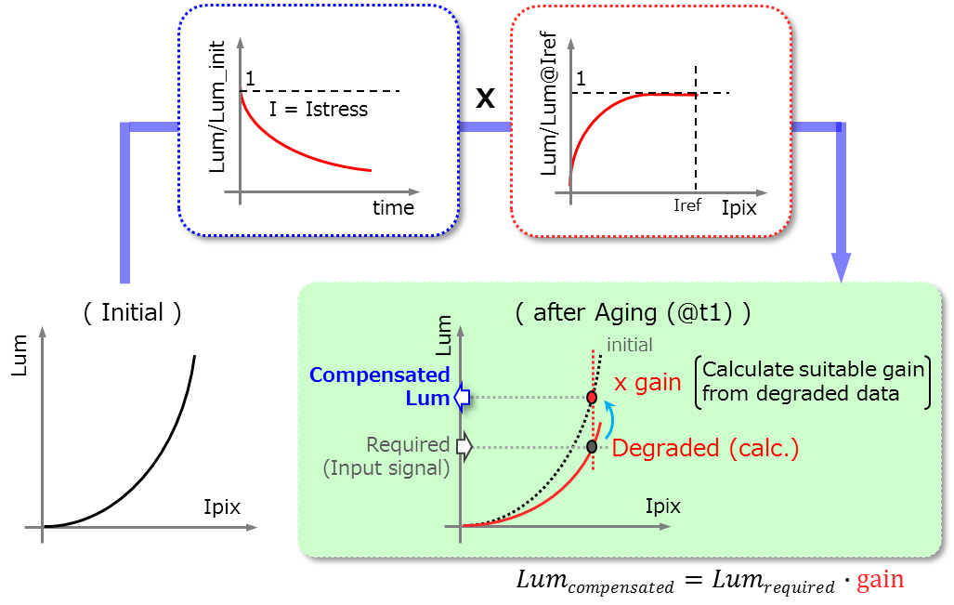

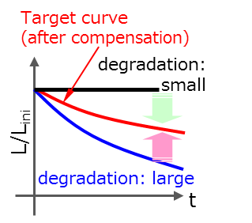
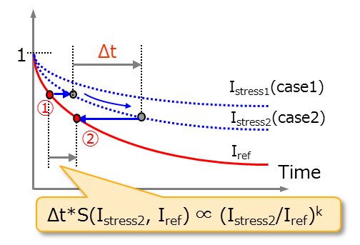
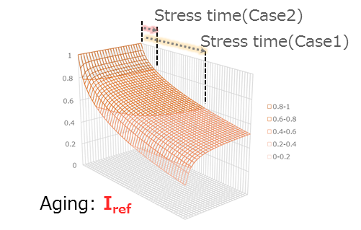
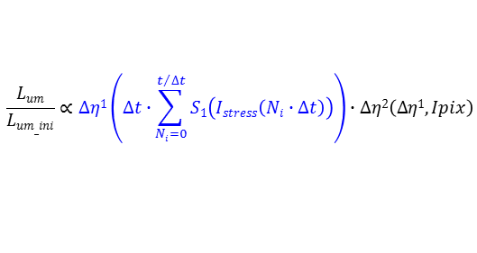
Overview of Compensation System
・For TV, medical use, stress data of all pixels are stored, and correction of all pixels is performed.
(→ Substantial resources are needed (especially memory capacity, band width of DDR etc..))
・It is necessary to simplify the system and compress stress data for use on Smartphone.
Image sticking compensation
Adjust WB
demura
Display Data
×
Signal level is
equivalent to brightness
Calculate the degradation with Δη¹,² and estimate the gain for compensation
Gain Calc.
γ
×
1
γ-1
Operating time
Bright Control
Accumulate Stress
Adjust the peak brightness according to operating time
3
+
2
1
Update cycle is several tens of frames
Convert the operation time to the equivalent one under Iref stress
DDR
Flash
3
Stress Data
Write cycle to Flash is several tens of minutes.
$$\frac{Lum}{Lum_ini}∝∆η1\left(∆t∙\sum_{Ni=0}^{t/{∆t}}{S1\left(Istress\left(Ni∙∆t\right)\right)}\right)∙∆η2\left(∆η1,Ipix\right)$$
2

Slide 8
Summary
The outline of compensation algorithm for the OLED image sticking was explained.
(especially calculation model for degradation of OLED)
The topics for modeling are as follows :
- Reproduce the degradation of each point (time, I_{pix}) by a combination of two component (Δη^{１}, Δη²)
- The difference in stress due to the signal history is managed by converting it into operation time under standard stress.
- To avoid excessive degradation caused by compensation driving, the peak brightness is adjusted according to the operating time. (If needed)
(Sorry that I could not explain detailed models or specific data, but mass-produced OLED display for medical use is based on this model.)
Now in conventional system, stress data of all pixels are stored, and correction of all pixels is performed.
It is necessary to simplify the system and compress stress data for use on Smartphone.
(ex. detect the edge structure in fixed pattern etc.. ) → Next Topics

