Slide 2
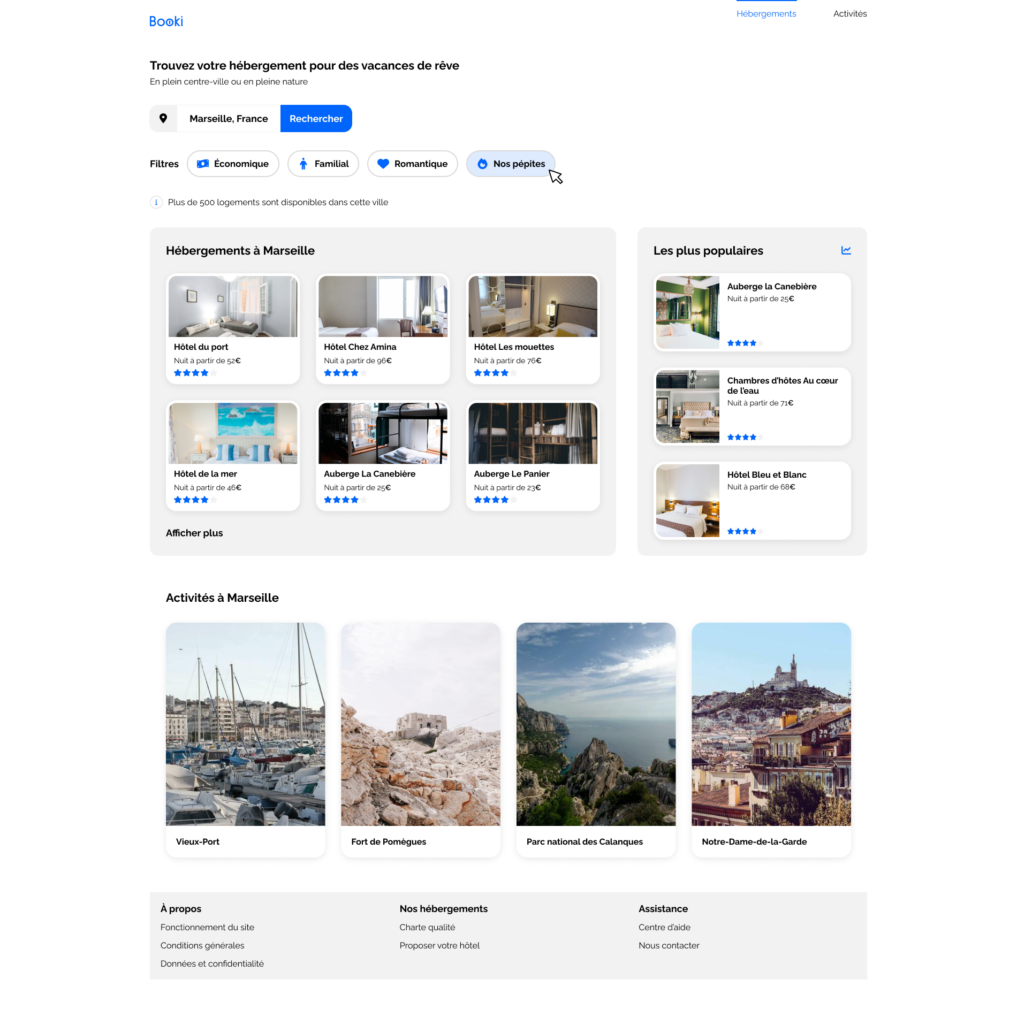
header
main
I
footer
2

