Slide 1
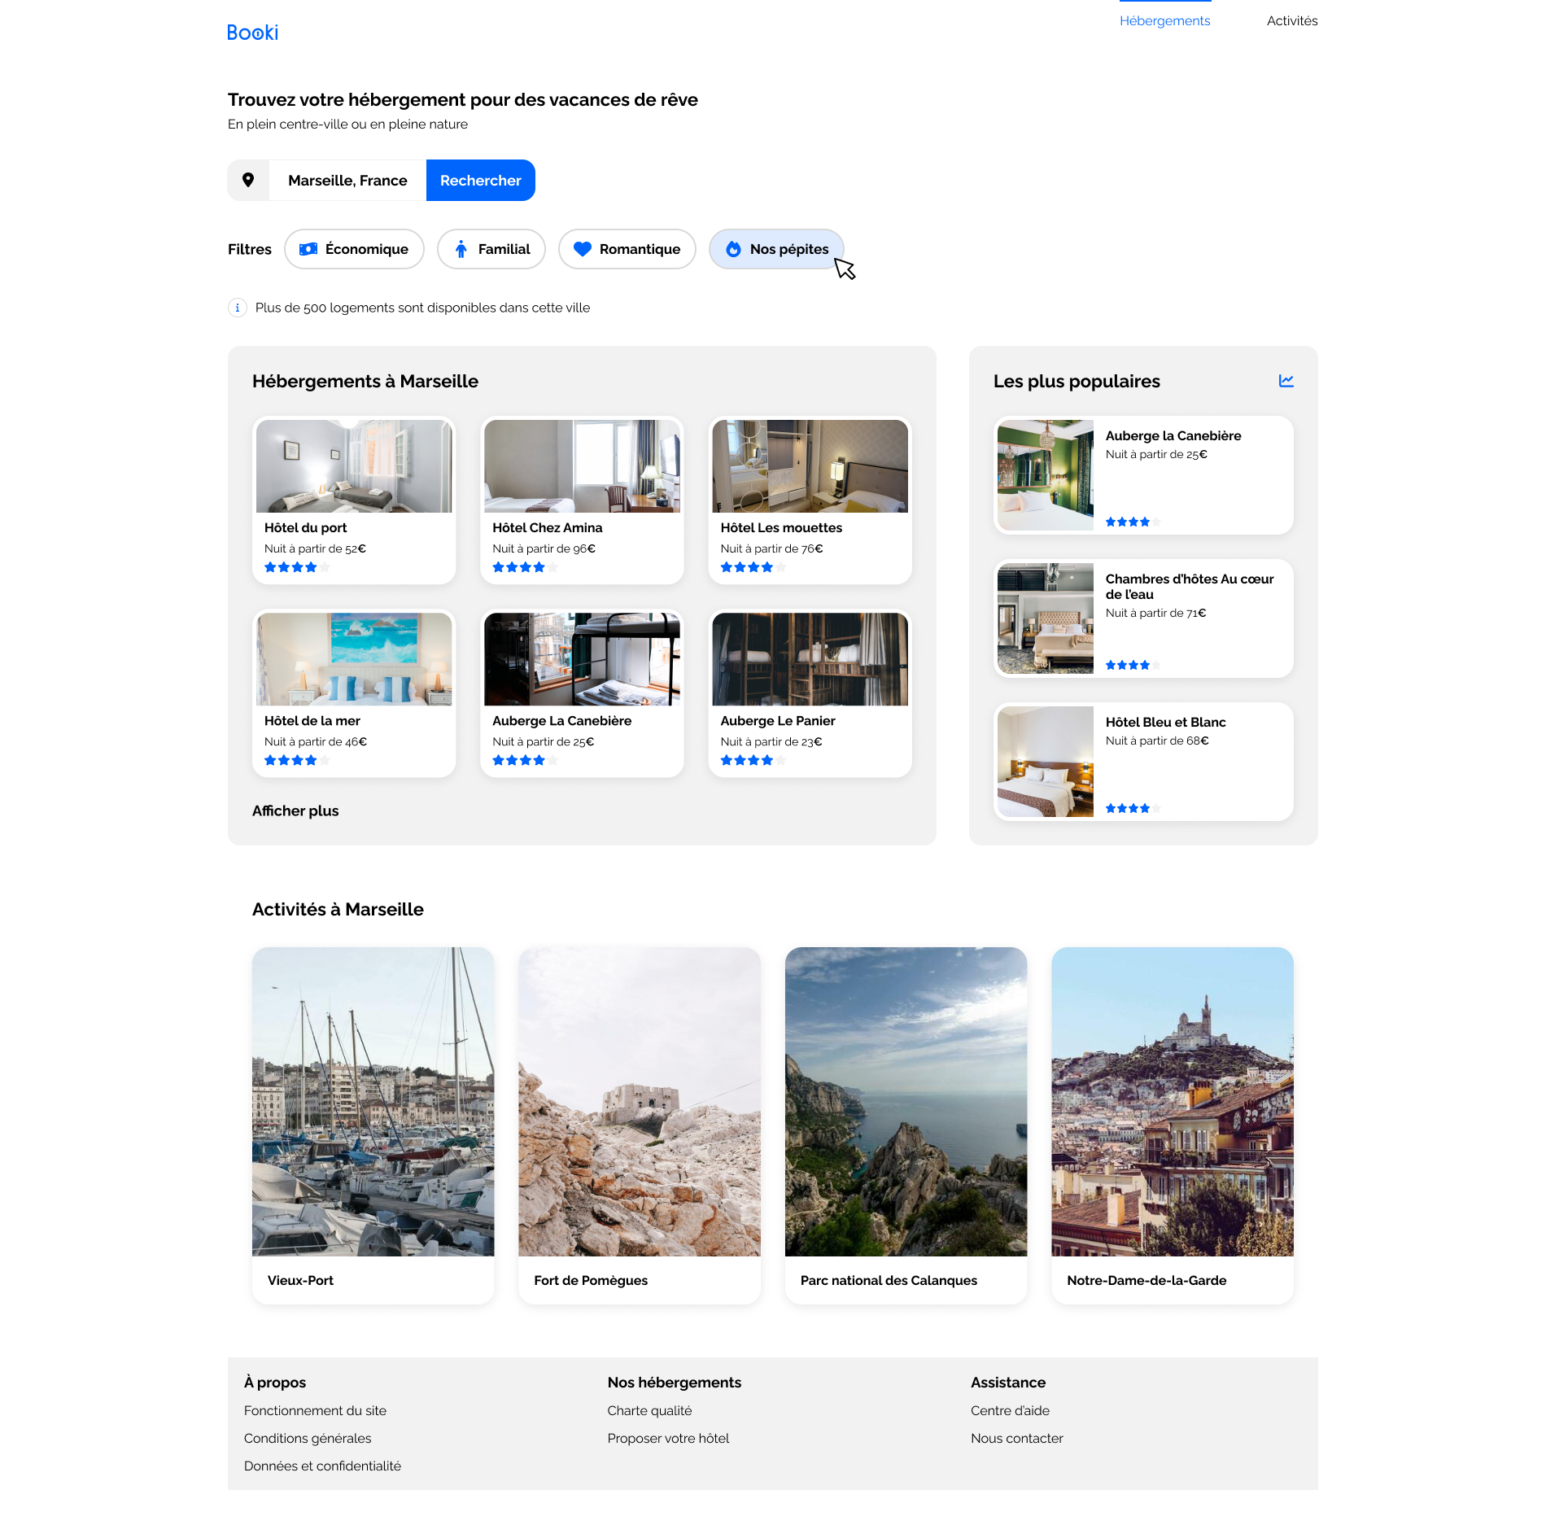
nav
header
i
a
main
h1
section
input
button
p
i
div
h2
article
h2
h3
img
h2
p
h3
h3
h3
I
h3
h3
h3
h3
h3
a
h2
article
img
h3
h3
h3
h3
footer
h3
h3
h3
1
a
a
a
div
a
a
a
a

