Slide 1
Dynamic Fault-Tolerance and Task Scheduling in Distributed Systems
Masters Thesis by Philip ståhl and jonatan broberg

Slide 2
Agenda
Introduction
Related work
System model
Reliability model
Self-adapting model
Calvin
Implementation
Experiments

Slide 3
Introduction
Reliability of applications of services in running in distributed environments

Slide 4
Reliability definitions
Reliability of
Meeting deadlines
Producing the correct result
Our definition
Reliability of a task in a stream processing application, is the probability that no data is lost. In a process with n task replicas, this corresponds to at least one replica is always running and serving requests.

Slide 5
Related work

Slide 6
System model

Slide 7
Reliability model

Slide 8
Fault-tolerant model

Slide 9
Calvin
Runtimes
Actors
Storage

Slide 10
Out contributions to Calvin
Replication
Fan-in/fan-out model

Slide 11
Handling node failure
When a node failure is detected, every node take the following steps:
Select a node among the remaining nodes, select the one with the highest ID
Send a lost node message to the selected node
Wait for reply
If not reply is received - start over at 1
If reply – we’re done
The node receiving the lost node messages will check whether or not new replicas are needed, and if so, send replication request to one of the nodes holding a replica. When done, it will send a reply to everyone it received a lost node message from.

Slide 12
Handling node failure cont’d.

Slide 13
Handling node failure cont’d.

Slide 14
Handling node failure cont’d.

Slide 15
Handling node failure cont’d.

Slide 16
Handling node failure cont’d.

Slide 17
Experiments
We have conducted a set of various tests to prove the usefulness of our model.
The goal was to show our model
Dynamically ensures the required reliability is met, despite the event of node failures, by dynamically creating new replicas when old ones die
Uses the optimal number of replicas by choosing the most reliable nodes
Adapts to changing system properties
We also measured how the replication time varied depending on the state size, as the replication time is an important part of the reliability model.

Slide 18
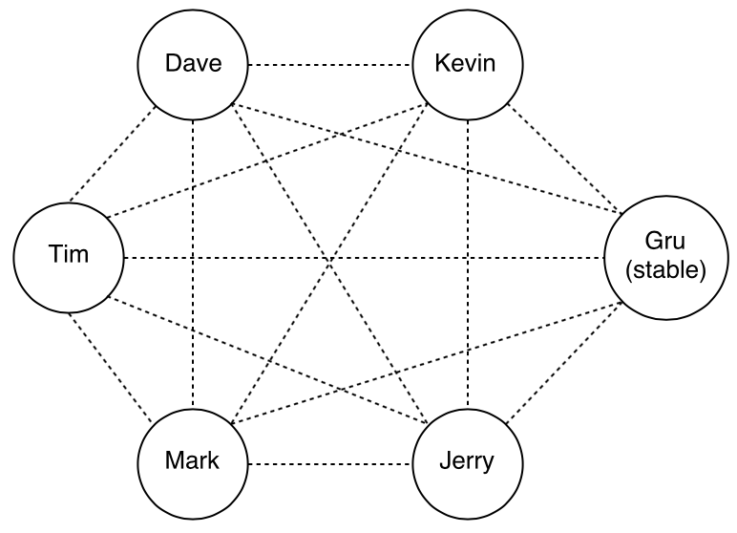
Experiments setup
A cluster of 6 servers were used in the experiments.
Server specification:
Intel(R) Xeon(R) CPU E5-2420 v2 of 2.20 GHz
24 GB RAM
Connected with a 1000 Mb/s link with a latency of less than 0.2 ms.

Slide 19
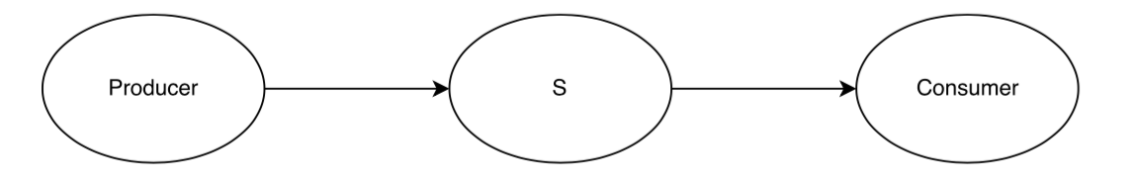
Application used in experiments
The application used in the experiment consisted of three actors, a producer, service actor, and a consumer.

Slide 20
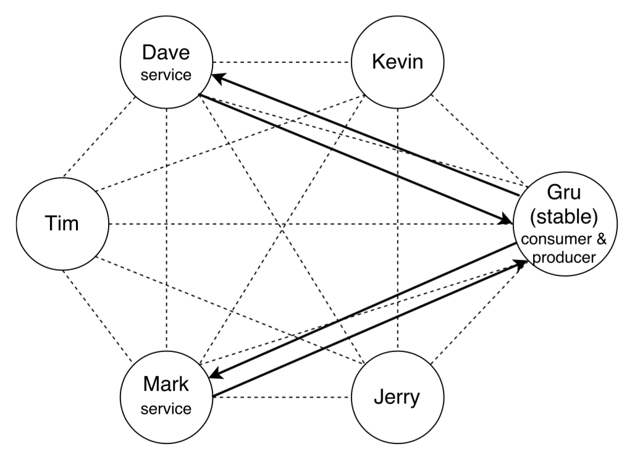
Application used in experiments cont’d.

Slide 21
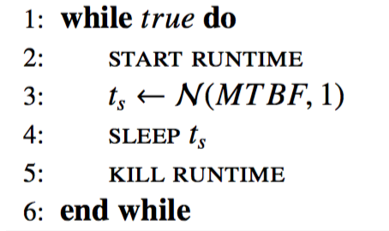
Simulating node failures

Slide 22
Ensuring a certain reliability
One Calvin runtime per server
MTBF for each runtime was 20 seconds
Required reliability: 0.98
Time t: 530 ms
Reliability of nodes: R(t) = e^{-t/MTBF} = e^{-530/20000} = 0.97530
Number of replicas | Reliability
1 | 1 – (1 – R(t))¹ = 0.97530
2 | 1 – (1 – R(t))² = 0.99939
3 | 1 – (1 – R(t))³ = 0.99998

Slide 23
Result

Slide 24
Optimal number of replicas
Runtime | MTBF (s)
dave₁ | 7.5
dave₂ | 7.5
tim₁ | 7.5
tim₂ | 7.5
kevin₁ | 15
kevin₂ | 15
mark₁ | 15
mark₂ | 40
jerry₁ | 40
jerry₂ | 40
Two Calvin runtimes per server
MTBFs varied
Required reliability: 0.999
Time t: 530 ms
Reliability of nodes:
MTBF | Reliability
7.5 | R(t) = e^{-t/MTBF} = e^{-530/20000} = 0.93551
15 | R(t) = e^{-t/MTBF} = e^{-530/20000} = 0.96722
40 | R(t) = e^{-t/MTBF} = e^{-530/20000} = 0.98758

Slide 25
Optimal number of replicas cont’d.
Reliability:
Number of replicas | Nodes | Reliability
2 | 2 * MTBF(7.5) | 1 – (1 – R_{7.5}(t))² = 0.99534
3 | 3 * MTBF(7.5) | 1 – (1 – R_{7.5}(t))³ = 0.99968
2 | 2 * MTBF(15) | 1 – (1 – R₁₅(t))² = 0.99879
3 | 3 * MTBF(15) | 1 – (1 – R₁₅(t))³ = 0.99996
1 | 1 * MTBF(40) | 1 – (1 – R₄₀(t)) = 0.98683
2 | 2 * MTBF(40) | 1 – (1 – R₄₀(t))² = 0.99983
3 | 1 * MTBF(15) + 2 * MTBF(7.5) | 1 – (1 – R₁₅(t)) * (1 – R_{7.5}(t)) ² = 0.99984
3 | 2 * MTBF(15) + 1 * MTBF(7.5) | 1 – (1 – R₁₅(t))² * (1 – R_{7.5}(t)) = 0.99991

Slide 26
Result – total number of replicas

Slide 27
Result – replicas per node (MTBF 7.5)

Slide 28
Result – replicas per node (MTBF 15)

Slide 29
Result – replicas per node (MTBF 40)

Slide 30
Removing unnecessary replicas
One Calvin runtime per server
Three stable, Dave, Tim, Mark, while Kevin and Jerry were given a MTBF of 25 seconds
Dave, Tim, and Mark, got default values of 10 seconds
Required reliability: 0.999
Time t: 530 ms
Reliability of nodes:
MTBF | Reliability
10 | R(t) = e^{-t/MTBF} = e^{-530/20000} = 0.95123
25 | R(t) = e^{-t/MTBF} = e^{-530/20000} = 0.98020

Slide 31
Removing unnecessary replicas cont’d.
Reliability:
Number of replicas | Nodes | Reliability
1 | 1 * MTBF(10) | 1 – (1 – R₁₀(t))¹ = 0.95123
2 | 2 * MTBF(10) | 1 – (1 – R₁₀(t))¹ = 0.99762
3 | 3 * MTBF(10) | 1 – (1 – R₁₀(t))¹ = 0.99988
1 | 1 * MTBF(25) | 1 – (1 – R₂₅(t))¹ = 0.98020
2 | 2 * MTBF(25) | 1 – (1 – R₂₅(t))² = 0.99960
3 | 1 * MTBF(25) + 1 * MTBF(10) | 1 – (1 – R₂₅(t)) * (1 – R₁₀(t)) = 0.99892
3 | 1 * MTBF(25) + 2 * MTBF(10) | 1 – (1 – R₂₅(t)) * (1 – R₁₀(t))² = 0.99994

Slide 32
Result – total number of replicas

Slide 33
Result – replicas per node (MTBF 10)

Slide 34
Result – replicas per node (MTBF 25)

Slide 35
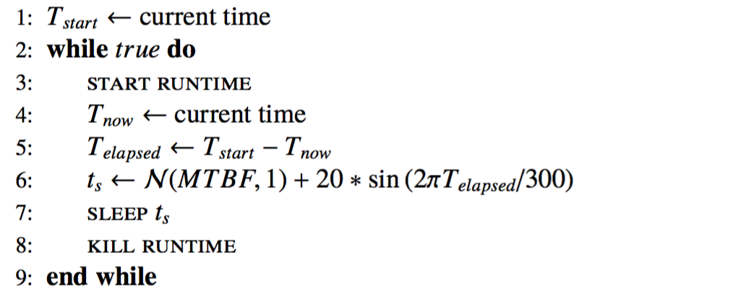
Self-adapting
Two Calvin runtimes per server
Required reliability: 0.999
Time t: 530 ms
Killing nodes:

Slide 36
Result – node reliabilities
MTBF is based on latest 3 values

Slide 37
Result – number of replicas

Slide 38
Replication time
Two runtimes, and one actor with one outgoing port.
The size of the actor state was measured, as well as the time to replicate the actor from one runtime to the other was measured.
The state was increased by increasing the size of the actors port queue.

Slide 39
Result

Slide 40
Result

