Slide 1
Dynamic Fault-Tolerance and Task Scheduling in Distributed Systems
Masters Thesis by Philip ståhl and jonatan broberg

Slide 2
Agenda
Introduction
Related work
System model
Reliability model
Self-adapting model
Calvin
Implementation
Experiments

Slide 3
Experiments
We have conducted a set of various tests to prove the usefulness of our model.
The goal was to show our model
Dynamically ensures the required reliability is met, despite the event of node failures, by dynamically creating new replicas when old ones die
Uses the optimal number of replicas by choosing the most reliable nodes
Adapts to changing system properties
We also measured how the replication time varied depending on the state size, as the replication time is an important part of the reliability model.

Slide 4
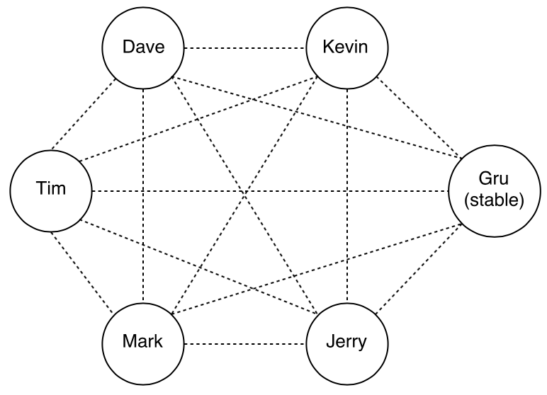
Experiments setup
A cluster of 6 servers were used in the experiments.
Server specification:
Intel(R) Xeon(R) CPU E5-2420 v2 of 2.20 GHz
24 GB RAM
Connected with a 1000 Mb/s link with a latency of less than 0.2 ms.

Slide 5
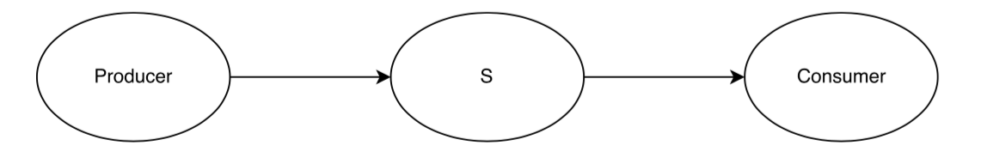
Application used in experiments
The application used in the experiment consisted of three actors, a producer, service actor, and a consumer.

Slide 6
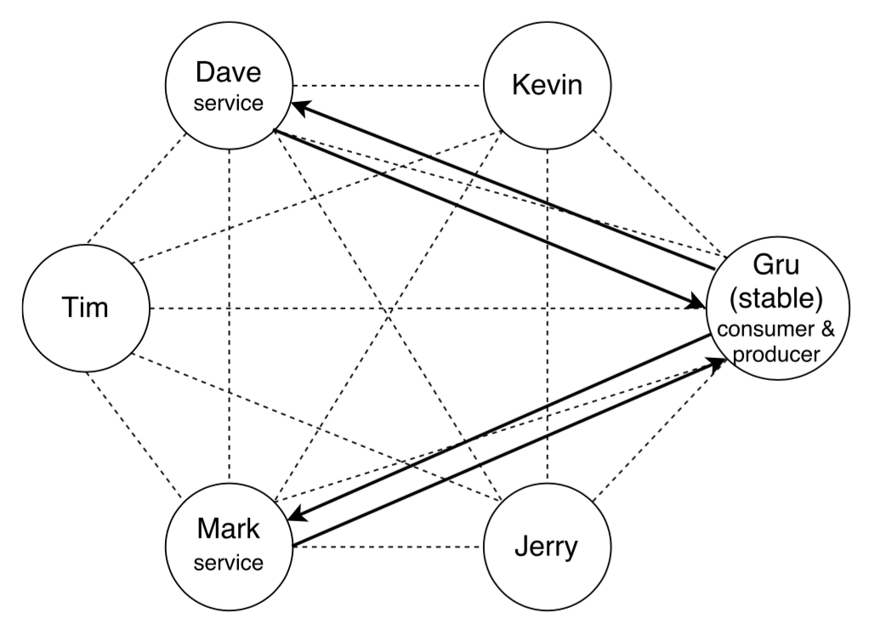
Application used in experiments cont’d.

Slide 7
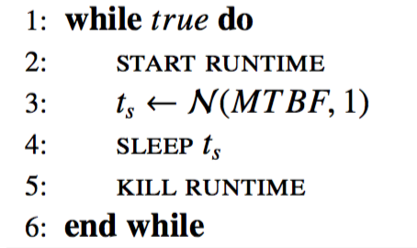
Simulating node failures

Slide 8
Ensuring a certain reliability
One Calvin runtime per server
MTBF for each runtime was 20 seconds
Required reliability: 0.98
Time t: 530 ms
Reliability of nodes: R(t) = e^{-t/MTBF} = e^{-530/20000} = 0.97530
Number of replicas | Reliability
1 | 1 – (1 – R(t))¹ = 0.97530
2 | 1 – (1 – R(t))² = 0.99939
3 | 1 – (1 – R(t))³ = 0.99998

Slide 9
Result

Slide 10
Optimal number of replicas
Runtime | MTBF (s)
dave₁ | 7.5
dave₂ | 7.5
tim₁ | 7.5
tim₂ | 7.5
kevin₁ | 15
kevin₂ | 15
mark₁ | 15
mark₂ | 40
jerry₁ | 40
jerry₂ | 40
Two Calvin runtimes per server
MTBFs varied
Required reliability: 0.999
Time t: 530 ms
Reliability of nodes:
MTBF | Reliability
7.5 | R(t) = e^{-t/MTBF} = e^{-530/20000} = 0.93551
15 | R(t) = e^{-t/MTBF} = e^{-530/20000} = 0.96722
40 | R(t) = e^{-t/MTBF} = e^{-530/20000} = 0.98758

Slide 11
Removing unnecessary replicas cont’d.
Reliability:
Number of replicas | Reliability
1 * MTBF(7.5) | 1 – (1 – R_{7.5}(t))¹ =
2 * MTBF(7.5) | 1 – (1 – R_{7.5}(t))² =
3 * MTBF(7.5) | 1 – (1 – R_{7.5}(t))³ =
1 * MTBF(15) | 1 – (1 – R₁₅(t))¹ =
2 * MTBF(15) | 1 – (1 – R₁₅(t))² =
1 * MTBF(15) | 1 – (1 – R₁₅(t))³ =

Slide 12
Result – total number of replicas

Slide 13
Result – replicas per node (MTBF 7.5)

Slide 14
Result – replicas per node (MTBF 15)

Slide 15
Result – replicas per node (MTBF 40)

Slide 16
Removing unnecessary replicas
One Calvin runtime per server
Three stable, Dave, Tim, Mark, while Kevin and Jerry were given a MTBF of 25 seconds
Dave, Tim, and Mark, got default values of 10 seconds
Required reliability: 0.999
Time t: 530 ms
Reliability of nodes:
MTBF | Reliability
10 | R(t) = e^{-t/MTBF} = e^{-530/20000} = 0.95123
25 | R(t) = e^{-t/MTBF} = e^{-530/20000} = 0.98020

Slide 17
Removing unnecessary replicas cont’d.
Reliability:
Number of replicas | Reliability
1 * MTBF(10) | 1 – (1 – R₁₀(t))¹ = 0.95123
2 * MTBF(10) | 1 – (1 – R₁₀(t))¹ = 0.99762
3 * MTBF(10) | 1 – (1 – R₁₀(t))¹ = 0.99988
1 * MTBF(25) | 1 – (1 – R₂₅(t))¹ = 0.98020
2 * MTBF(25) | 1 – (1 – R₂₅(t))² = 0.99960
1 * MTBF(25) + 1 * MTBF(10) | 1 – (1 – R₂₅(t)) * (1 – R₁₀(t)) = 0.99903

Slide 18
Result – total number of replicas

Slide 19
Result – replicas per node (MTBF 10)

Slide 20
Result – replicas per node (MTBF 25)

Slide 21
Self-adapting
Runtime | MTBF (s)
dave₁ | 7.5
dave₂ | 7.5
tim₁ | 7.5
tim₂ | 7.5
kevin₁ | 15
kevin₂ | 15
mark₁ | 15
mark₂ | 40
jerry₁ | 40
jerry₂ | 40
Two Calvin runtimes per server
MTBFs
Required reliability: 0.999
Time t: 530 ms
Reliability of nodes:
MTBF | Reliability
7.5 | R(t) = e^{-t/MTBF} = e^{-530/20000} = 0.93551
15 | R(t) = e^{-t/MTBF} = e^{-530/20000} = 0.96722
40 | R(t) = e^{-t/MTBF} = e^{-530/20000} = 0.98758

