Slide 1
Utilizing Lego Mindstorms nxt(tm) as Teaching and Training Platform for IEC 61499
4DIAC Users’ Workshop ETFA, Bilbao, Spain September 16, 2010
Alois Zoitl zoitl@acin.tuwien.ac.at
Notes:
This slide replaces the first slilde in order to provide additional contact details if the presentation is handed out to the audience on paper.

Slide 2
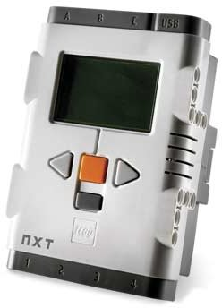
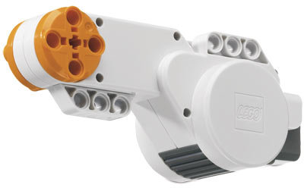
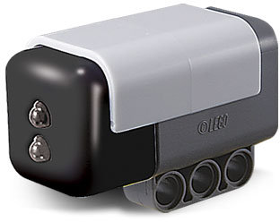
Motivation
Inexpensive starting kits (~300€):
Processor (Arm 7)
64kB Ram, 256kB Flash
3 Motors
Sensors (color, 2 push-button, ultrasonic)
~600 Lego-Blocks
ECOS port available (open source real-time operating system)
FORTE port included on SourceForge

Slide 3
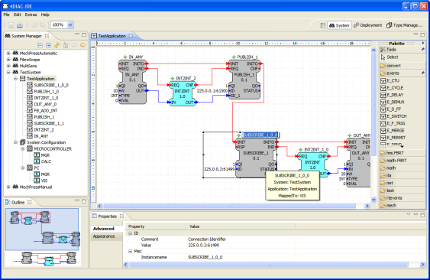
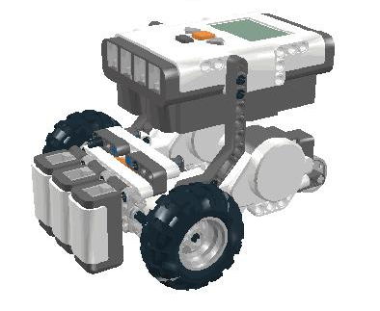
Vision
FORTE
firmware type
file generation
FORTE source files / eCos libraries
.h /.cpp
FB.h
Application download
arm-elf-gcc
forte.bin
IEC 61499 Ethernet to USB Converter
ATMEL AT91 ISP/SAM-BA®
USB serial profile
USB

Slide 4
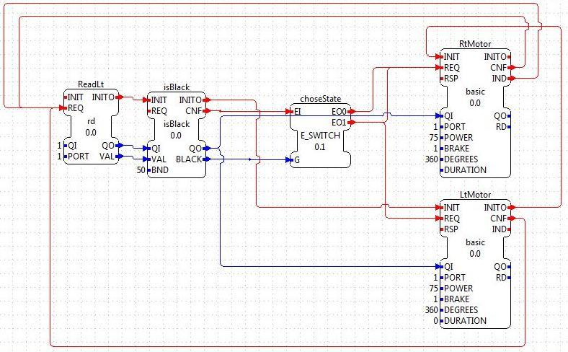
Planned Training Scenarios
Typical applications in industrial automation
Built on each other
Increasing difficulty
Deepening main IEC 61499 concepts
Currently tutorials are beeing developed

Slide 5
Tutorials Under Development
Light blinking application
Goal: usage of sensors and actuators (light); understand application timing
Line following robot
Goal: understand Basic Function Blocks; Closed Loop Control (Motors); Management of resources
Car Wash
Goal: develop Service Interface Function Blocks; Improved Closed Loop Control (e.g., PID)
Part Sorting and Packaging
Goal: timed buffers; Position control (Pick and Place); Monitoring of conveyor belt

Slide 6
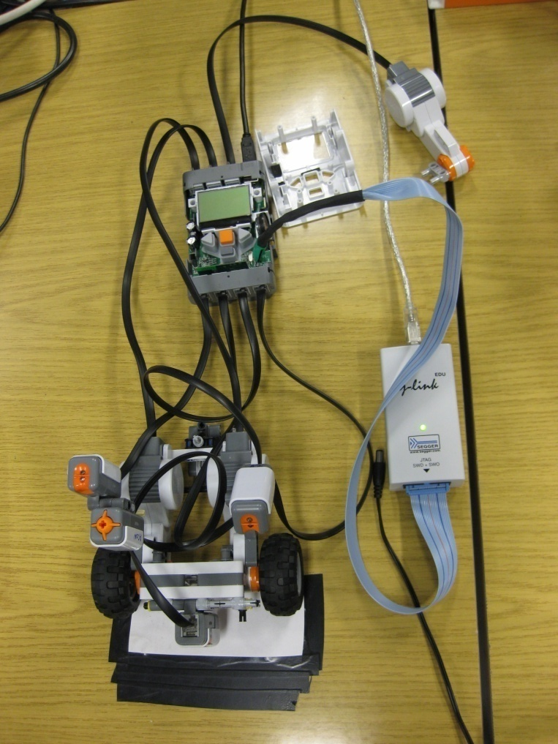
Current State
FORTE runs on Lego Controller
4DIAC-IDE can download via Java-proxy and USB
FBs for
Push-Sensor
Buttons
LED / Light-Sensor
Sound Sensor
Motors
Needs JTAG connector for debugging → voids guarantee

Slide 7
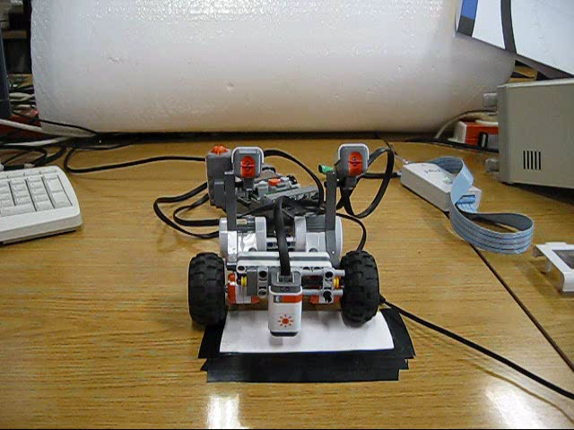
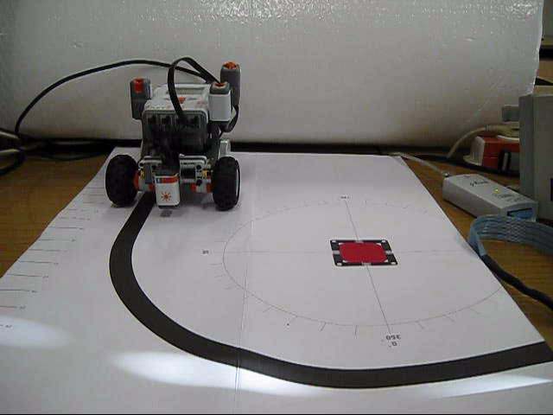
Example Line Following Robot

Slide 8
Next Steps
Develop FBs for
Ultra-sonic sensor
Display
Sound
Testing and improvements
Work without JTAG
Use binary XML for improving performance and memory usage
Will be released to public via 4DIAC-Wiki: http://sourceforge.net/apps/mediawiki/fordiac
Additional tutorials, examples and suggestions are warmly welcome

Slide 9
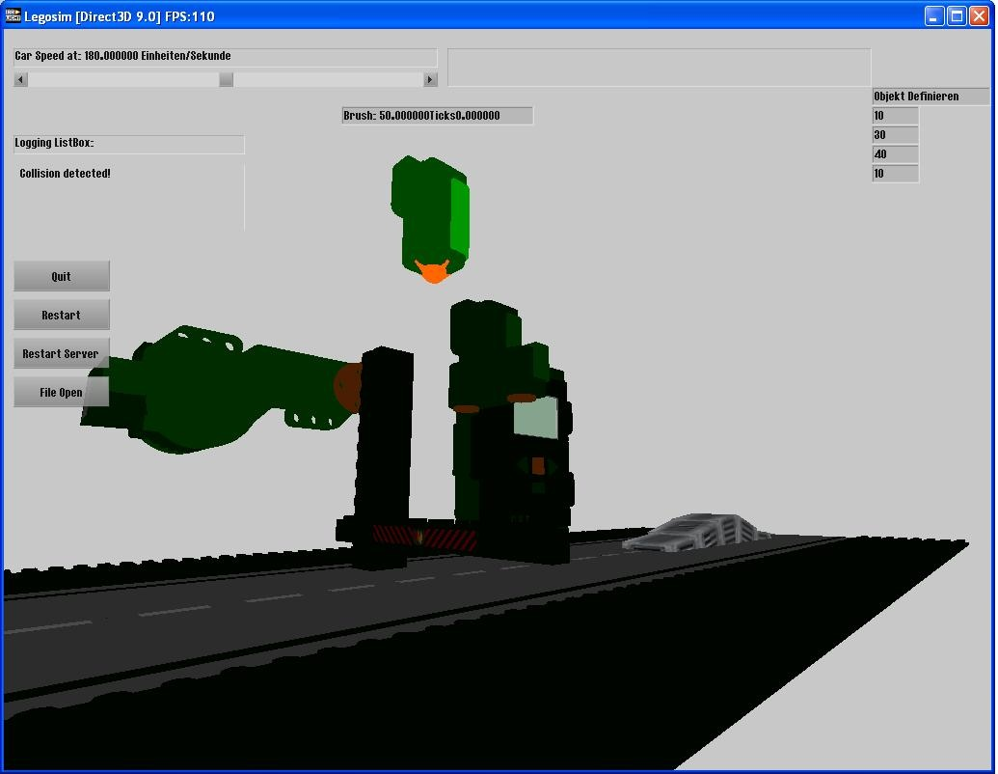
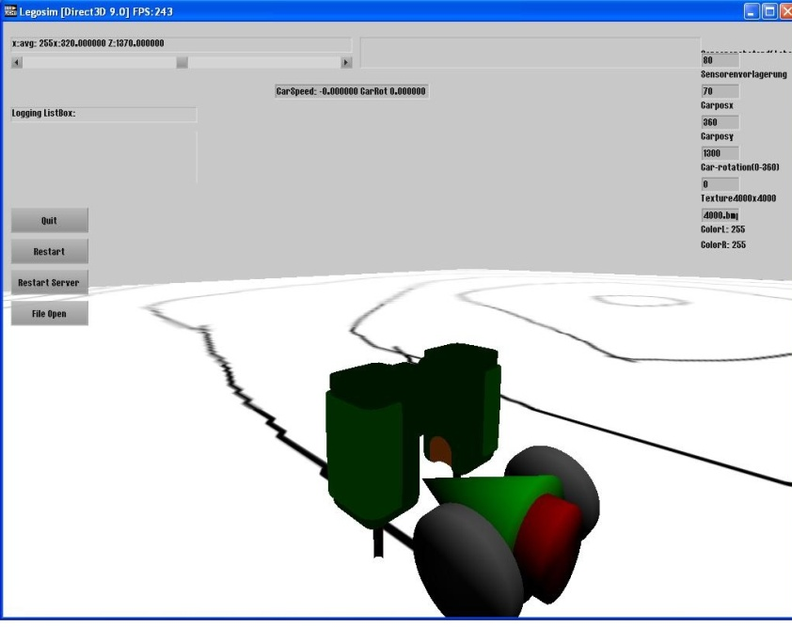
Further Developments
Utilizing Lego’s Bluetooth for distributed applications
Connecting 4DIAC with Virtual Lego

