Slide 1



Implementation of control systems and future trends at the Martin-Luther-University using 4DIAC
Scientific work of Dipl.-Ing. Christian Gerber

Slide 2
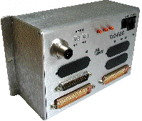
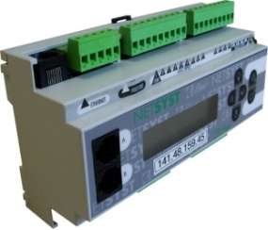
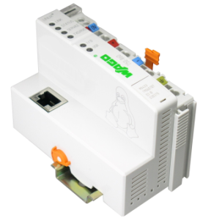
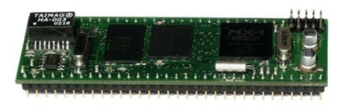
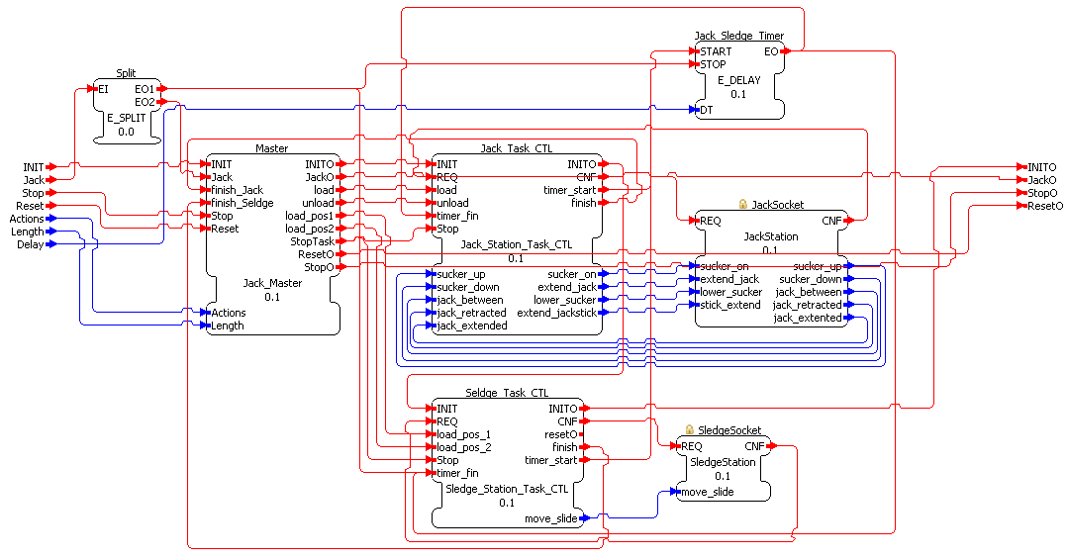
Implementation of Distributed Control Systems
Using several testbeds
Festo Manufacturing System
EnAS-Demonstrator
Simulation of a Servo-Control-System
Using different Engineering Environments and Hardware
Function Block Development Kid (FBDK)
Framework for Distributed Industrial Automation and Control (4DIAC)
FBench
Corfu ESS
ISAGraph
Usability test of several control implementation approaches
Central-Controller
Master-Task-Controller
Parametrised Master-Task-Controller
Workpiece-Controller

Slide 3
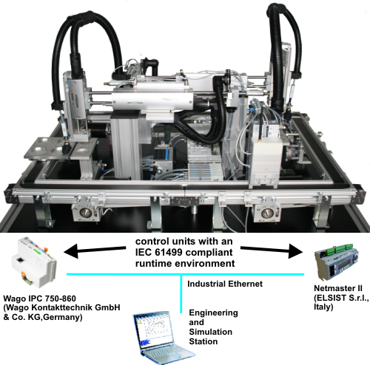
Energy autarkic Actuator Sensor System Demonstrator
testbed, equipped with a wireless actuator/sensor system (2007-09) ➔ new SIFB
Base Station + Sensor-Actuator Modules
2,4 GHz with frequency adaptation to the gaps of WLAN
1st phase – initialisation, get all Sensor-Actuator Modules
2nd phase – real time wireless communication – time sliced
Control and Base Station exchange messages as follow: 76 00 03 52 FF 00 FF 00 FF 00
1. Byte - Identifier the following data is an array (76)
2. & 3. Byte - Length of the array (data values)
4. Byte - datatype of the contained values (52)
5. & 6. Byte - Low and HighByte SAM0 (FF 00)
7. & 8. Byte - Low and HighByte SAM1 (FF 00)
9. & 10. Byte - Low and HighByte SAM2 (FF 00)

Slide 4
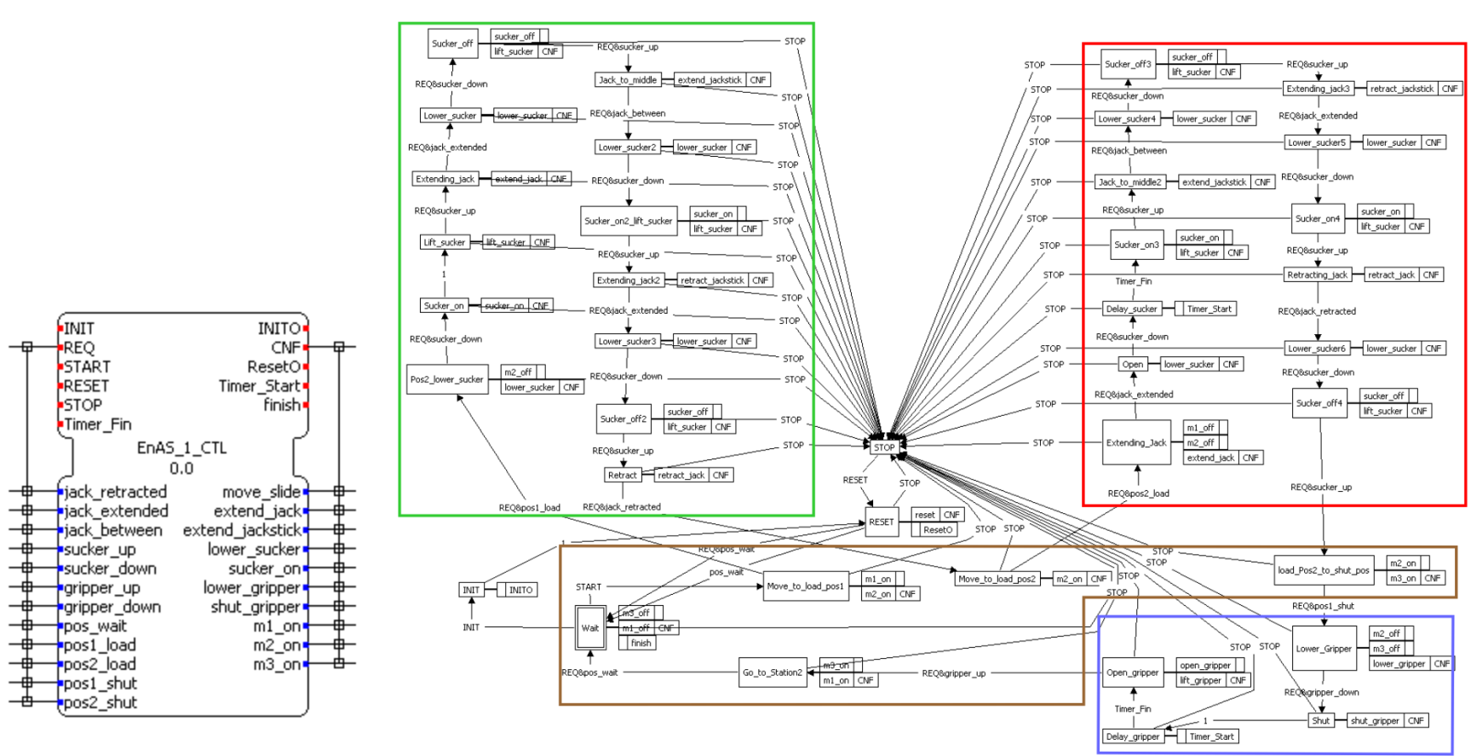
Central-Controller Approach
Central-Controller of the left plant part
No reconfiguration possibility or reusability (one monolithic FB)
Load Workpiece into tin– green
Unload Workpiece from tin – red
Close a tin - blue
Move conveyor - brown

Slide 5
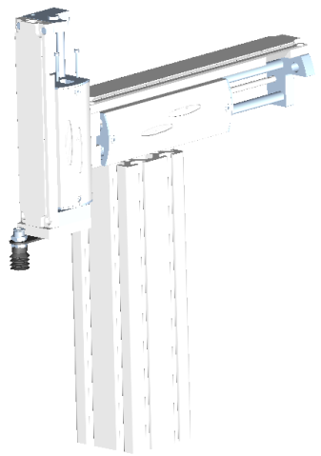
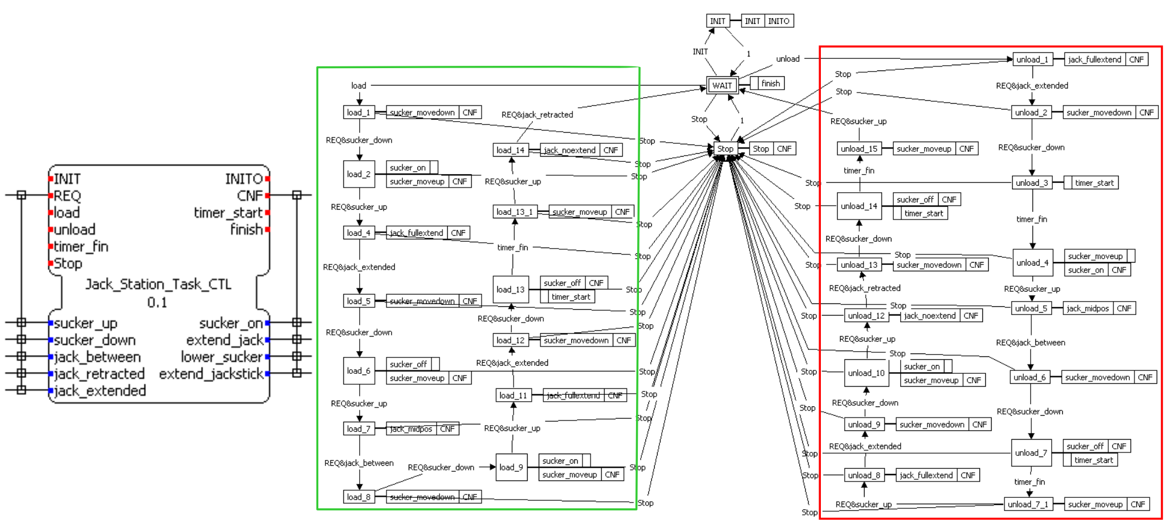
Parameterized Master-Task-Controller
Task-Controller of the Jack Station
Reuseable, if the component is used again
Load Workpiece into tin – green
Unload Workpiece from tin – red

Slide 6
Parameterized Master-Task-Controller
Function Block Network of the Master and Task-Controller controlling the Jack-Station
Using Adapter Interfaces as Sockets

Slide 7
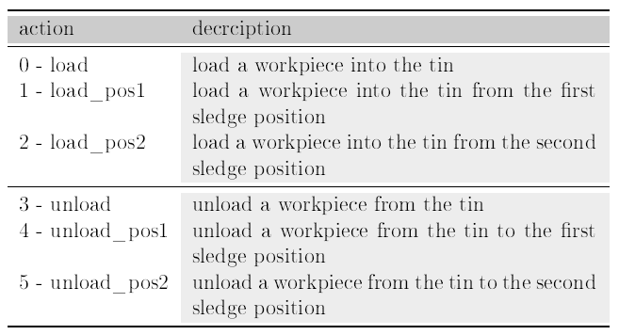
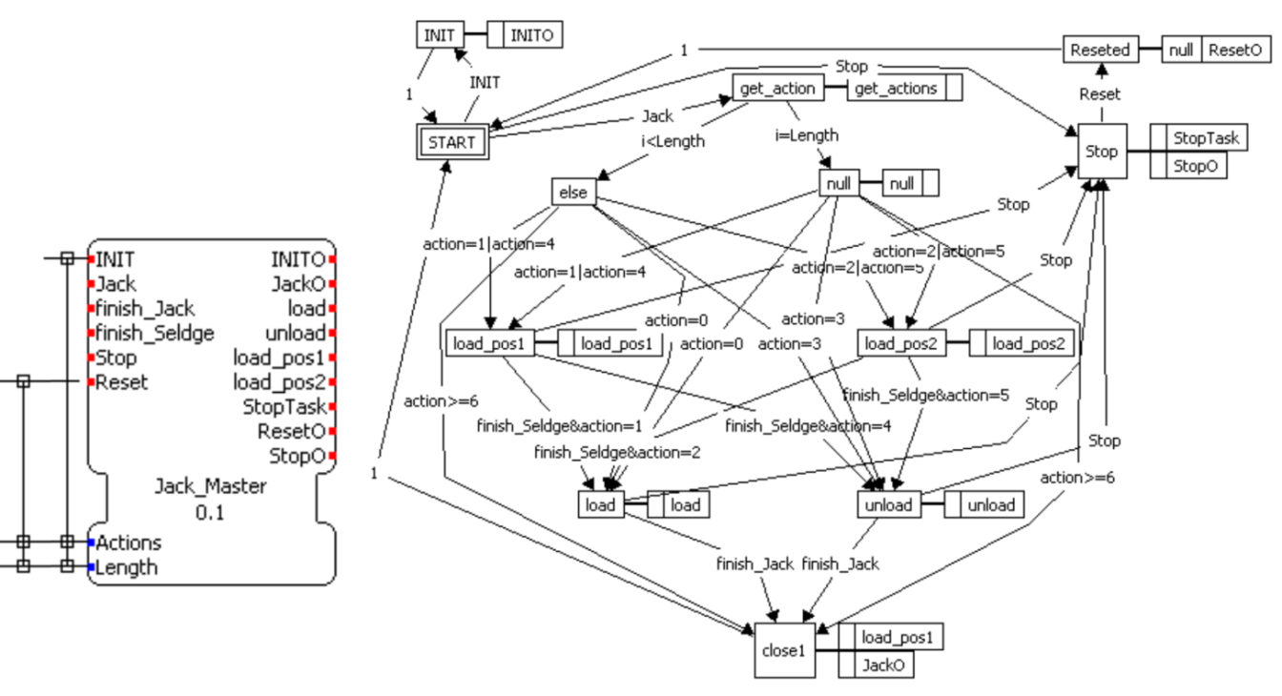
Parameterized Master-Task-Controller
Master-Controller
Reconfiguration by implementing all production possibilities and parameterize the production scenario
Actions – Array (sequence) of actions to perform
Length – amount of sequenced actions

Slide 8
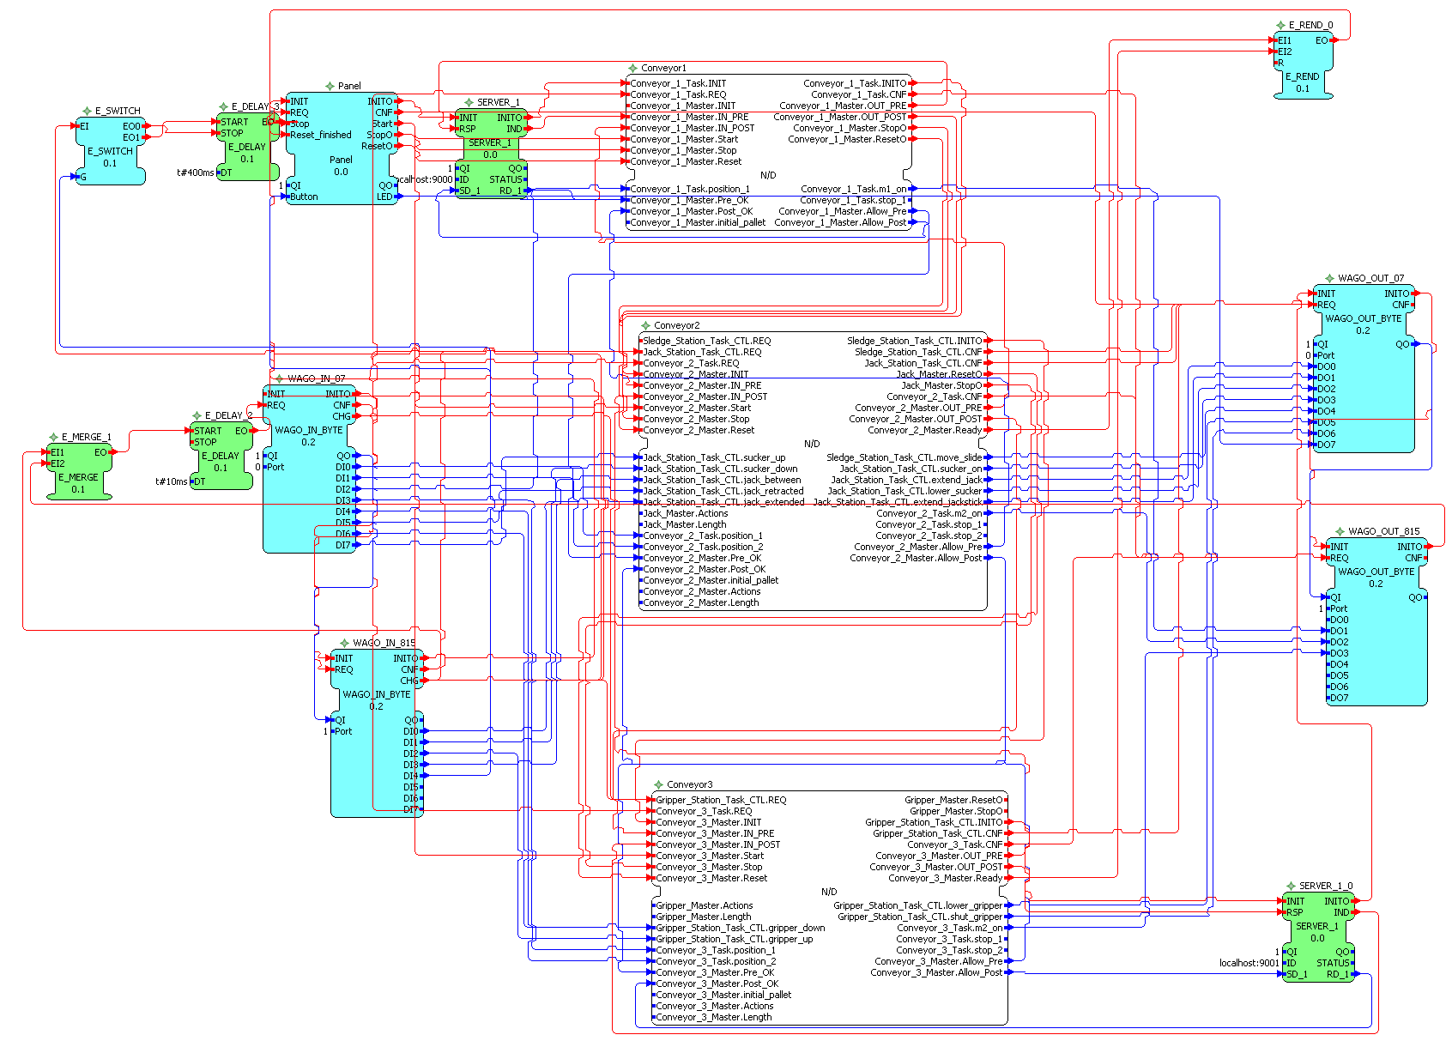
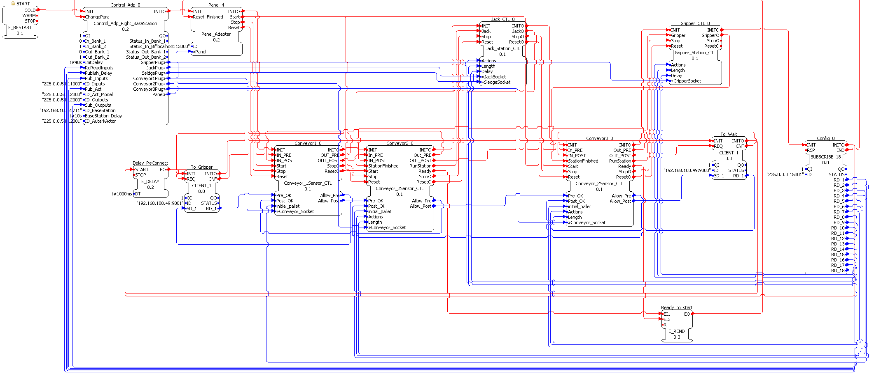
Parameterized Master-Task-Controller – Resource Mapping
Without Adapter Interfaces
Reconfiguration is missing due to a better visualisation of the FBN
Subapplication encapsulates the Master and Task-Controller
SIFB to the right and left
Everytime a FB is changed, update data connections
With Adapter Interfaces
Each FB provides an adapter corresponding to the one of the I/O-Adapter FB (Process Interface) ➔ only one Adapter Connection if a FB is changed

Slide 9
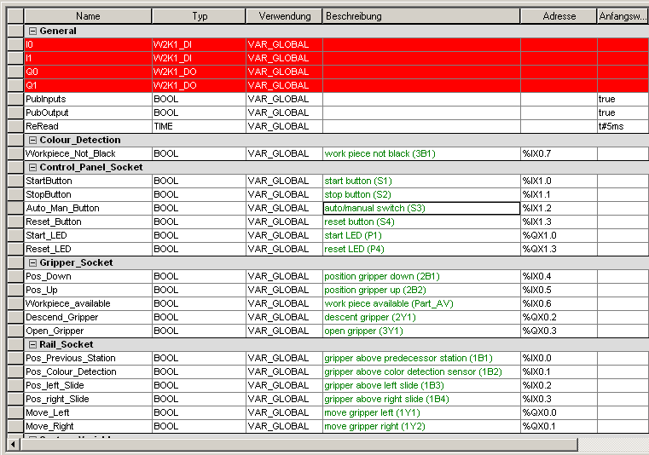
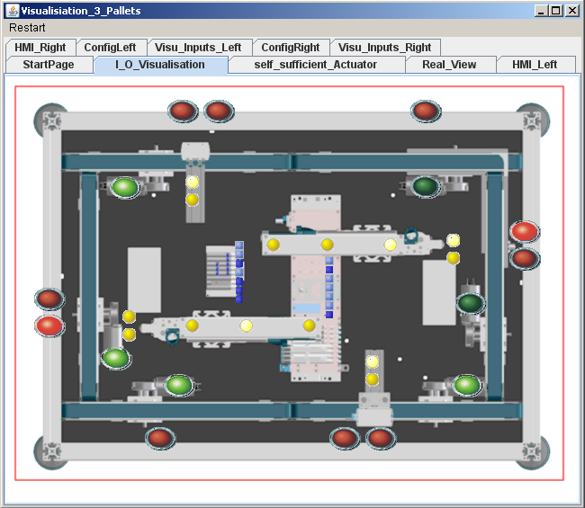
Automatic Generation of the I/O-Adapter
Eclipse-PlugIn for 4DIAC
Apdapter inserted from the pallet as new group (grey headline)
Inputs and Outputs
Comment
DataType
General
Define used SIFB
PubInputs
PubOutputs
Time to ReRead the inputs
Define Adress

Slide 10
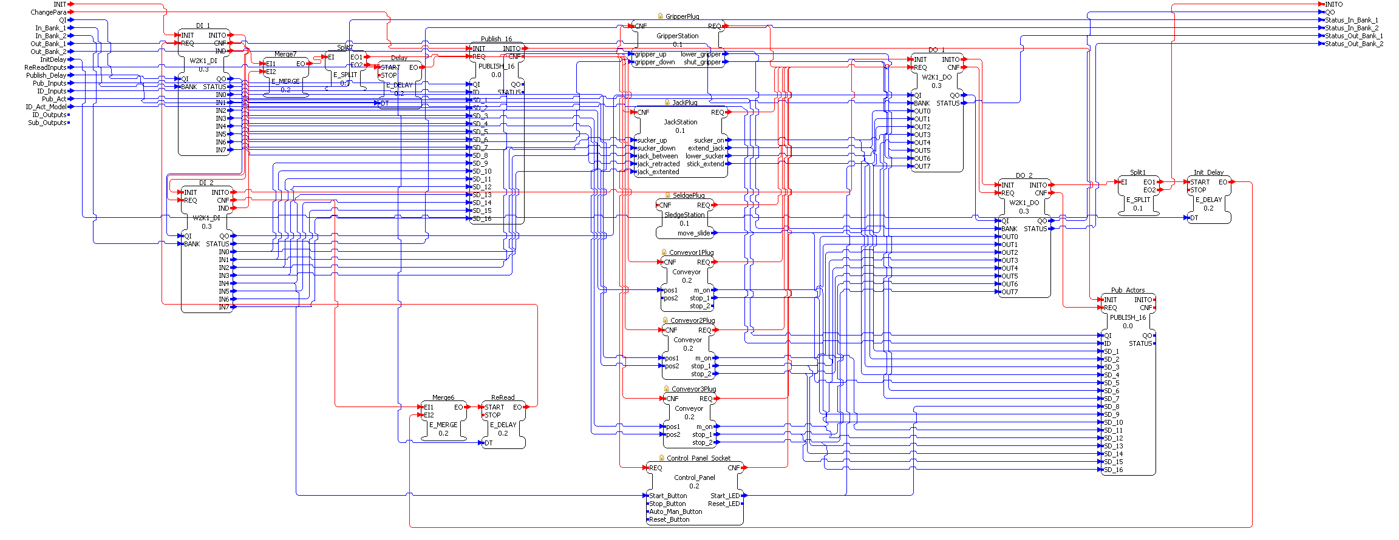
Automatic Generation of the I/O-Adapter
Generated I/O-Adapter
Textual representation eases maintenance (data connection results from adress)
Reconnection by providing a new adress
Export to LaTex ➔ PDF generation for documentation

Slide 11
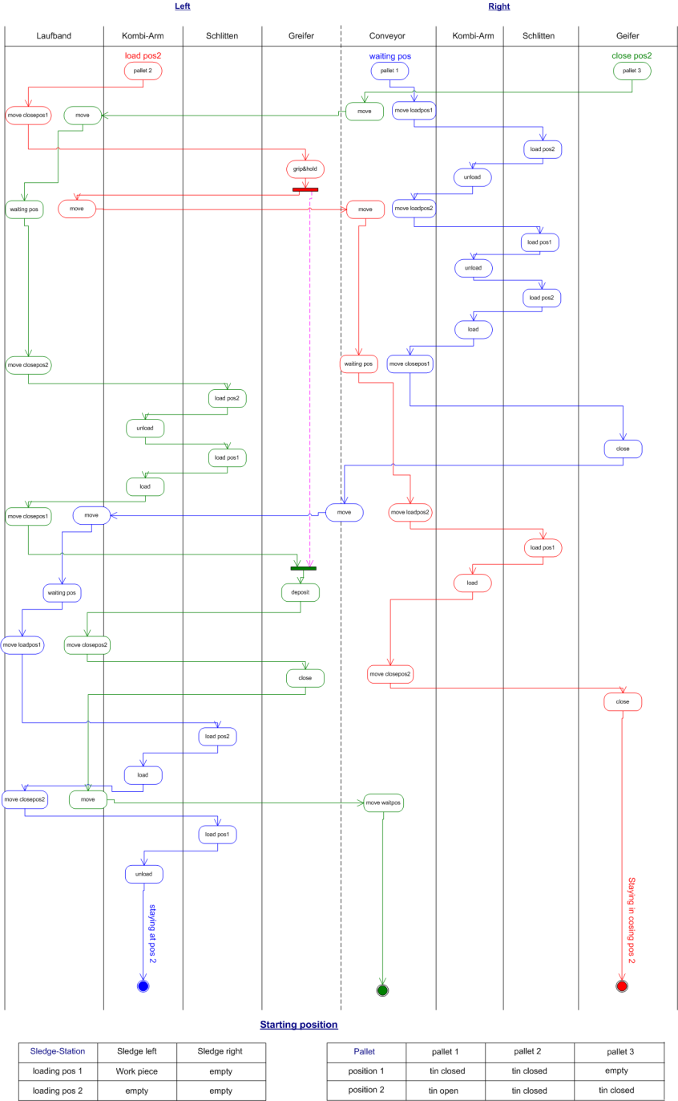
Developing a Production Scenario
SysML Activity Diagram
Partition for each control of a mechanical component
Pallet 1 – blue
Pallet 2- red
Pallet 3 – green
Note the actions to be performed
Array of Actions
From top to down
Translate to numbers according to the tables
Parameterize new productoin scenario via HMI
Complexity shifted from the development of the Master-Controller to the production scenario

Slide 12
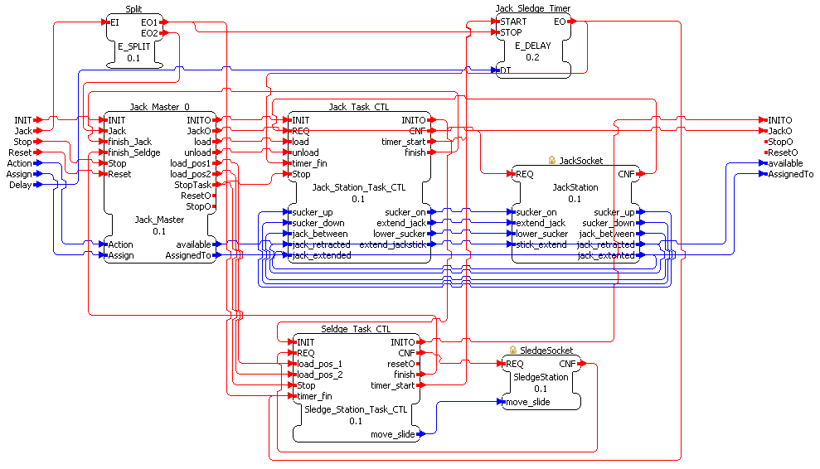
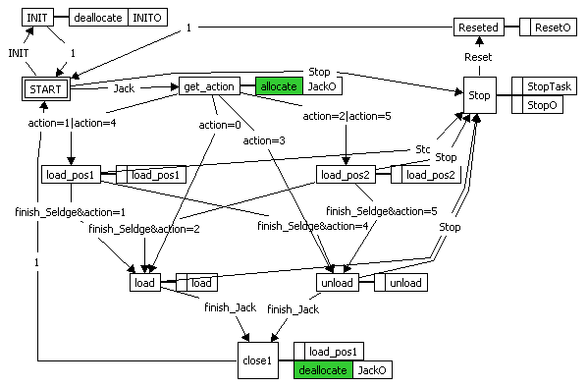
Future Work - Workpiece-Controller
Improvement of the Parameterized Master-Task Controller approach with an additional coordination layer ➔ The Workpiece-Controller
Workpiece Controller allocates /deallocates Master controller
Master-Controller is a kind of event multiplexer (see ECC)
Additional Inputs
Actions - [INT] → Action INT
Assign – INT
Additional Outputs
Available – BOOL
AssignedTo – INT
Additional Algorithms
Allocate Available := False; AssignedTo := Assign;
Deallocate Available := True; AssignedTo := 0;

Slide 13
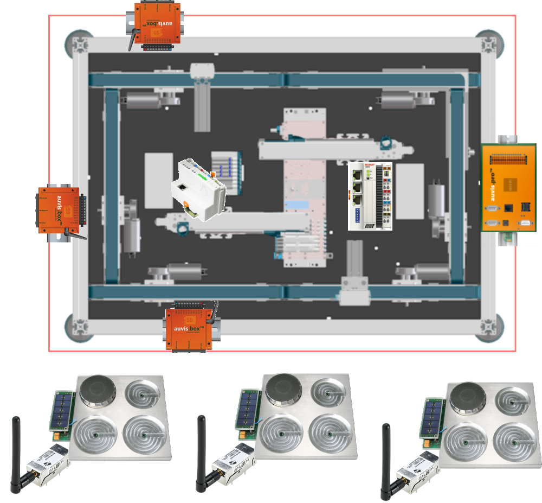
Future Work – Workpiece-Controller
Digi-Connect-Wi-Me
Workpiece-Controller at the pallet
Energy supply ?
Beckhoff CX8000
Jack, Slide and Gripper Station through the wireless auctuator sensor system
Wago IPC 750-860
Jack and Slide Station
Auvis.pro
All 3 left conveyors
Auvis.box
1 conveyor each as well as the Gripper Station
WebServer at all of them
Linked websites between all

Slide 14
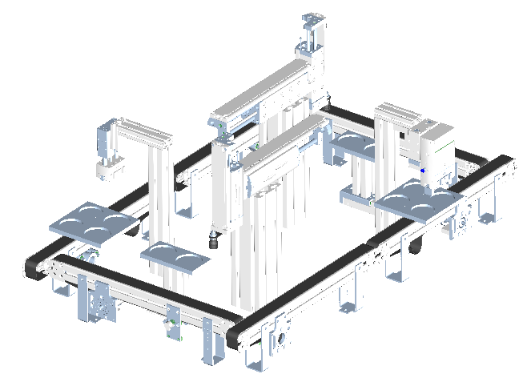
Future Work – Closed-Loop 3d Simulation
Export CAD – Data of non-moving and moving parts as 3D Models
3ds files– AutoCAD, Autodesk
VRML files – Solid Edge, Solid Works
Simulation Tool - Enterprise Dynamics
Modelling of process flows (Sources, Servers, Sinks)
Based on atoms and subatoms
e.g. Pallet is a subatom of the conveyor
Communication between atoms via channels (listen to events, exchange subatoms)
2D and 3D models
Extendable by external libraries e.g. communication via Profibus to a Siemens PLC ➔ new library to communicate with a distributed control system
e.g. TCP-Socket encoding and decoding messages according to the compliance profile

Slide 15
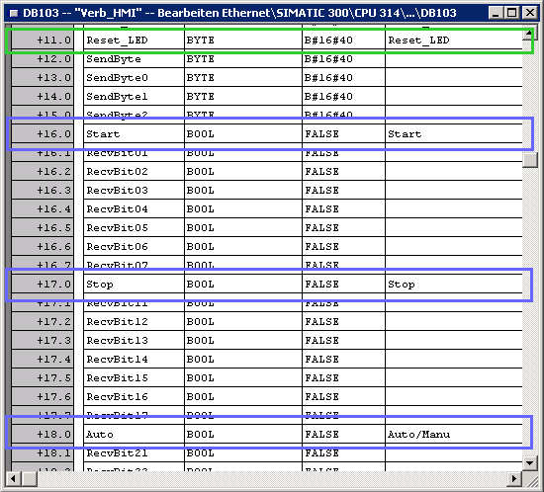
Communication with a Siemens PLC
Create a DataFB (definition of a Struct to save data)
Read and writing to the struct
Data encoding
Data decoding (Compliance profile of the IEC 61499)
Provide a Server Socket
Call “AG_Send” with startposition at the DataFB and the length
Call “AG_Recv” with startposition at the DataFB and the length

Slide 16
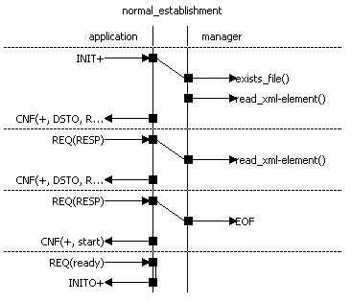
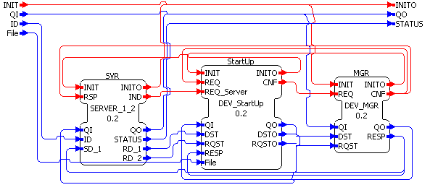
Future Work – Instant Start-Up after Power Down
Extension of the management resource with the FB StartUp of the type DEV_StartUp
Initialized after the MGR FB
Checks if the File exists
If true - while EOF
read xml-element
encode it to a destination and request
wait for response
Check response
publish INITO+ ➔ initialize the SVR
REQ_Server(DST, RQST)
Store DST and RQST at the File
CNF(DSTO, RQSTO)
Device still has the management interface as well as a Start-Up configuration up to the last change

Slide 17
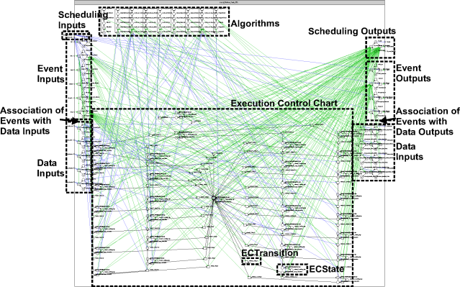
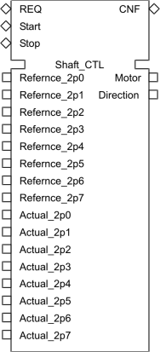
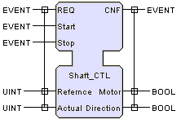
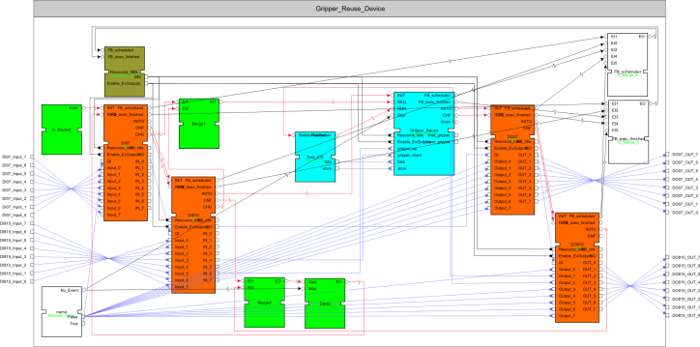
Formal Controller Modelling
Definition of several rules to transform
simple and basic FBs
Function networks and composite FBs as well as application
Modelling of Process and Communication Interface (SIFB)
Service primitives (ISO-IEC 10731)
Modelling of resources
Include the different schedulings of FBs (Scheduling Function)
Modelling of devices

Slide 18
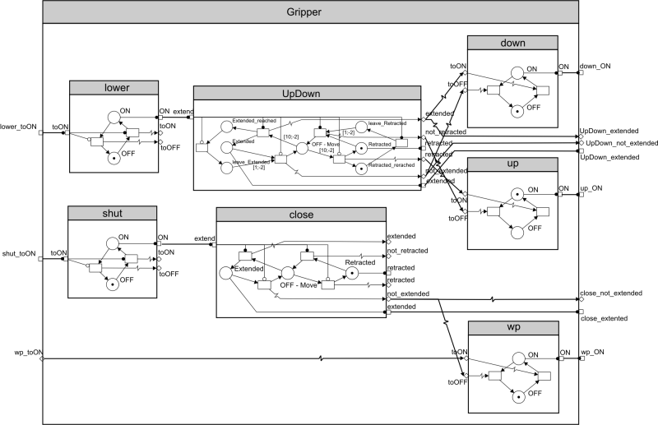
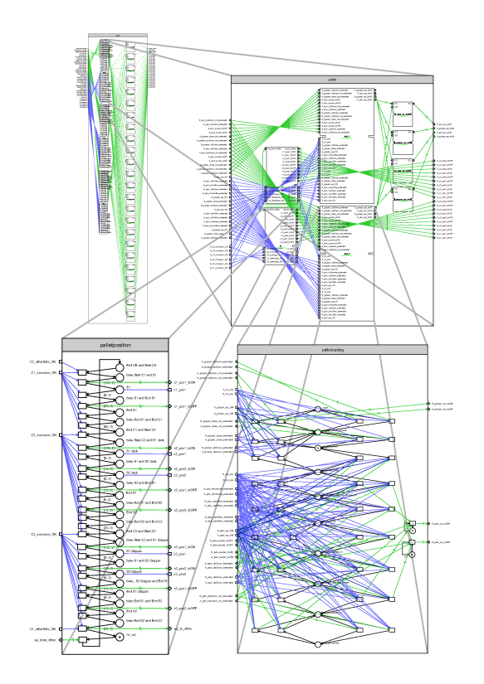
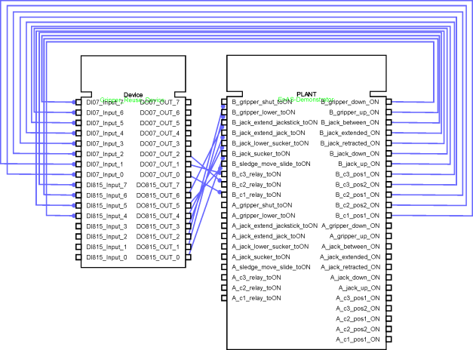
Formal Plant and Closed-Loop Modelling
Modelling of the mechanical components
Modelling of the workpiece behaviour
Establishing the Closed-Loop

Slide 19
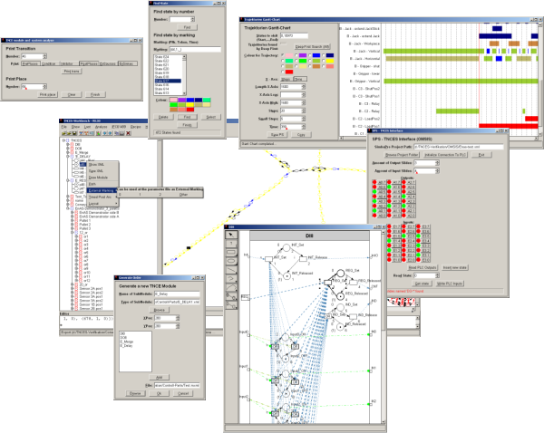
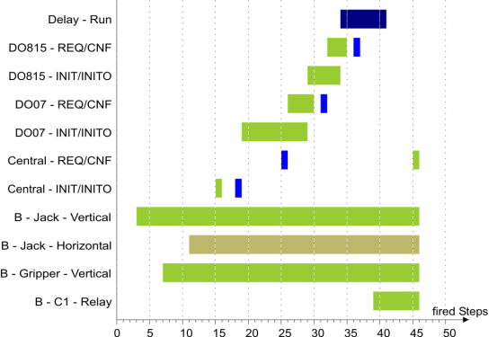
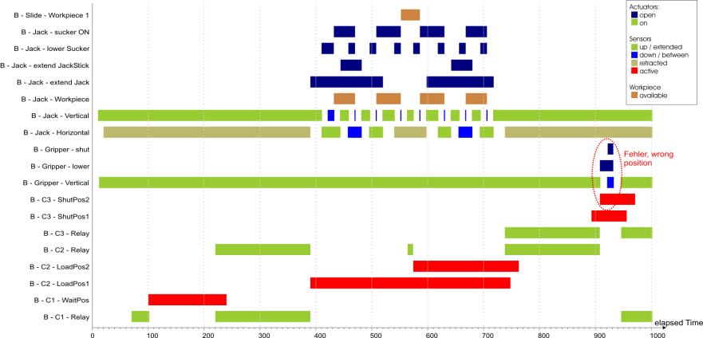
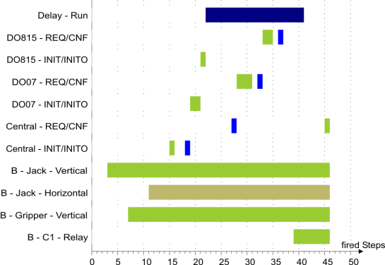
Verification of the Closed-Loop System
SWI-Prolog based TNCES-Workbench
Model-Checker
FB Transformator
Search for trajectories and Gantt-Chart Visualisation …
Analysis of different FB schedules
Analysis of counter examples and modifying the control

Slide 20
Thanks for your attention!
Supported by:
German Ministry for Commerce and Industry (BMWI)
Deutsche Forschungsgemeinschaft (DFG)
Festo AG & Co. KG)
Christian Gerber
Chair of Automation Technology
30.08.2010
http://aut.informatik.uni-halle.de

