Slide 1

Distributed Intelligent Sensing and Control (DISC) for Automotive Factory Automation. Dr. Robert Brennan Dr. Ningxu Cai Mohammad Gholami

Slide 2

Distributed Intelligent Sensing and Control (DISC) for Automotive Factory Automation.
This project is part of the Canadian AUTO21 Networks of Centres of Excellence: a nation-wide, interdisciplinary research effort that is focused on automotive research. Our contribution to AUTO21 is a collaborative venture between researchers at the University of Windsor, the University of Calgary, and the University of Western Ontario and spans the disciplines of micro-sensor design, embedded real-time control, and agent based systems.

Slide 3
DISC: Definition & Challenges
An application of WSN to the lowest level of factory automation systems,
How to exploit IEC61499 to integrate WSN with extant systems that monitor and control shop floor resources.
Challenges:
Harsh, uncertain, dynamic shop conditions.
Integration with new control software approaches to realize the flexibility and responsiveness of the whole system.

Slide 4
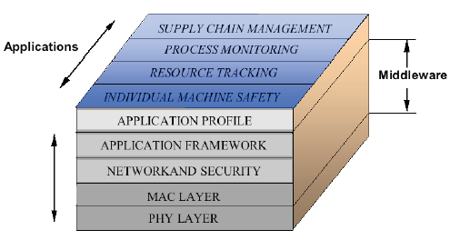
THE WSN MIDDLEWARE
The integration of WSN technology with extant factory automation systems is of key importance.
An interface or middleware is required that can help
hide the complexity and heterogeneity of the underlying hardware and network platforms,
ease the management of system resources,
and increase the predictability of applications.
It basically bridges the gap between the application level and network standards

Slide 5
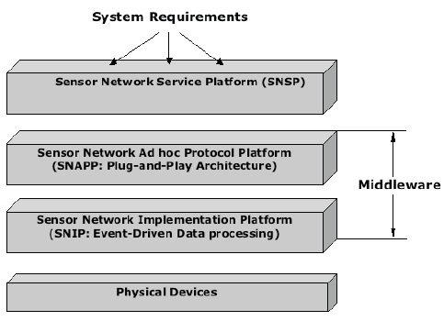
A distributed intelligent sensing and control (DISC) architecture for factory automation
The middleware is built in two platforms:
sensor network ad hoc protocol platform
sensor network implementation platform
Key features desired for these two platforms are:
the plug-and-participate architecture
event-driven data processing

Slide 6
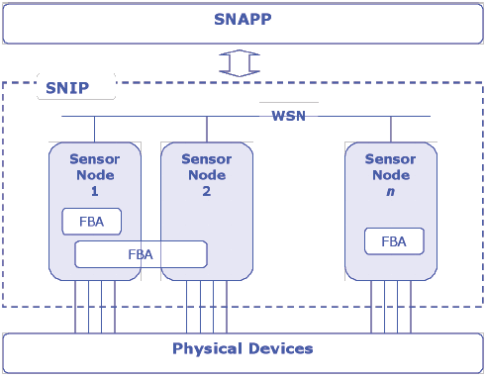
SNIP Level and IEC61499
There is a direct mapping between IEC 61499 devices and WSN sensor nodes:
At the sensor node implementation platform (SNIP), sensor nodes are represented by IEC 61499 devices that are linked by a WSN.
Embedded node intelligence is supported by IEC 61499 function block applications (FBA).

Slide 7
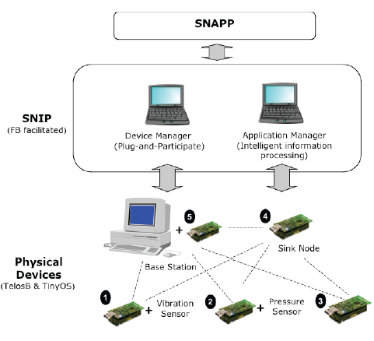
TESTBED IMPLEMENTATION
To validate proposed DISC approach for factory automation and algorithms at SNIP level, a testbed implementation is being conducted at University of Calgary using:
TelosB wireless sensor motes,
TinyOS-2.x open source operating system,
and IEC 61499 function blocks.

Slide 8
Platform-level Information Processing
Device Manager and Application Manager are designed to responsible for Plug-and-participate and Event-driven data processing respectively.
To implement these two task modules, we propose the IEC 61499 function block model for distributed process measurement and control.
Even-driven and modularity features of the TinyOS at the physical device level combined with IEC 61499 function blocks at platform level appears to be a logical match.
More specifically, TinyOS nesC (network embedded system C) components have a direct parallel with IEC 61499 basic function blocks:
both encapsulate state and couple state with functionality.
As well, like the IEC 61499 execution model, nesC is event-driven.

Slide 9
FB vs. TinyOS

