Slide 1
Blockchain based E-voting system

Slide 2
Team Members
Group 1
Pusarapu Sujith
(2019AAPS0246H)
Chinimilli Gita Krishna
(2019AAPS0314H)
Pugalenthi Selvan S
(2019AAPS1284H)

Slide 3
TABLE OF CONTENTS:
Introduction
Problems
Solution
Implementation
Work Progress

Slide 4
INTRODUCTION
E-voting systems will benefit everyone who participates in elections. Transparency, completeness (only voters have the right to vote and their votes are correctly counted), and verifiability (voters can check that their vote is correctly counted) are all characteristics of ideal e-voting systems, making them superior to existing voting systems.
When considering the implementation of a digital voting system, the security of digital voting is always the primary concern. With such significant decisions on the line, there can be no doubt about the system's ability to secure data and defend against potential attacks. Blockchain technology has the potential to solve some of the security issues.

Slide 5
Problems
Whether we are talking about traditional paper-based voting, digital voting machines, or an online voting system, many such conditions must be met:
Unreusability: Evey citizen may only vote once.
Eligibility: Only the legitimate voters must be allowed to vote.
Privacy: Nobody except the voter has access to the information about their choice.
Objectivity: No one can obtain intermediate voting results.
Accuracy: All valid ballots must be tallied correctly.
Validity: Invalid ballots must be identified and not counted during the voting process.
Security problem of e-voting can be succeeded by blockchain technology.

Slide 6
Solution:
How actually blockchain help?
Blockchain technology provides decentralised nodes for electronic voting. It is utilised to create electronic voting systems primarily due to its end-to-end verification benefits.
With dispersed, non-repudiation, and security protection features, this technology is a lovely replacement for traditional electronic voting solutions. The blockchain is a decentralised and distributed ledger in which all additions and changes are made through a consensus procedure.
Hence, Blockchain can be used very effectively in storing data that should not be edited once it is being recorded

Slide 7
Implementation
We create blocks that contain information such as the previous block hash code, the current block hash code, and voting information (i.e. to whom they vote).
These blocks are linked together using an array list. In order to implement e-voting via blockchain, we will use the following functions:
createBlock() : This function is used to create the blocks and connect them through array list. The hash codes are generated using mineBlock() function and it gets stored in the current hash variable.
verifyTransaction() : This function is used to verify the voter details using zero knowledge proof.
mineBlock() : This function is used to create the hash codes

Slide 8
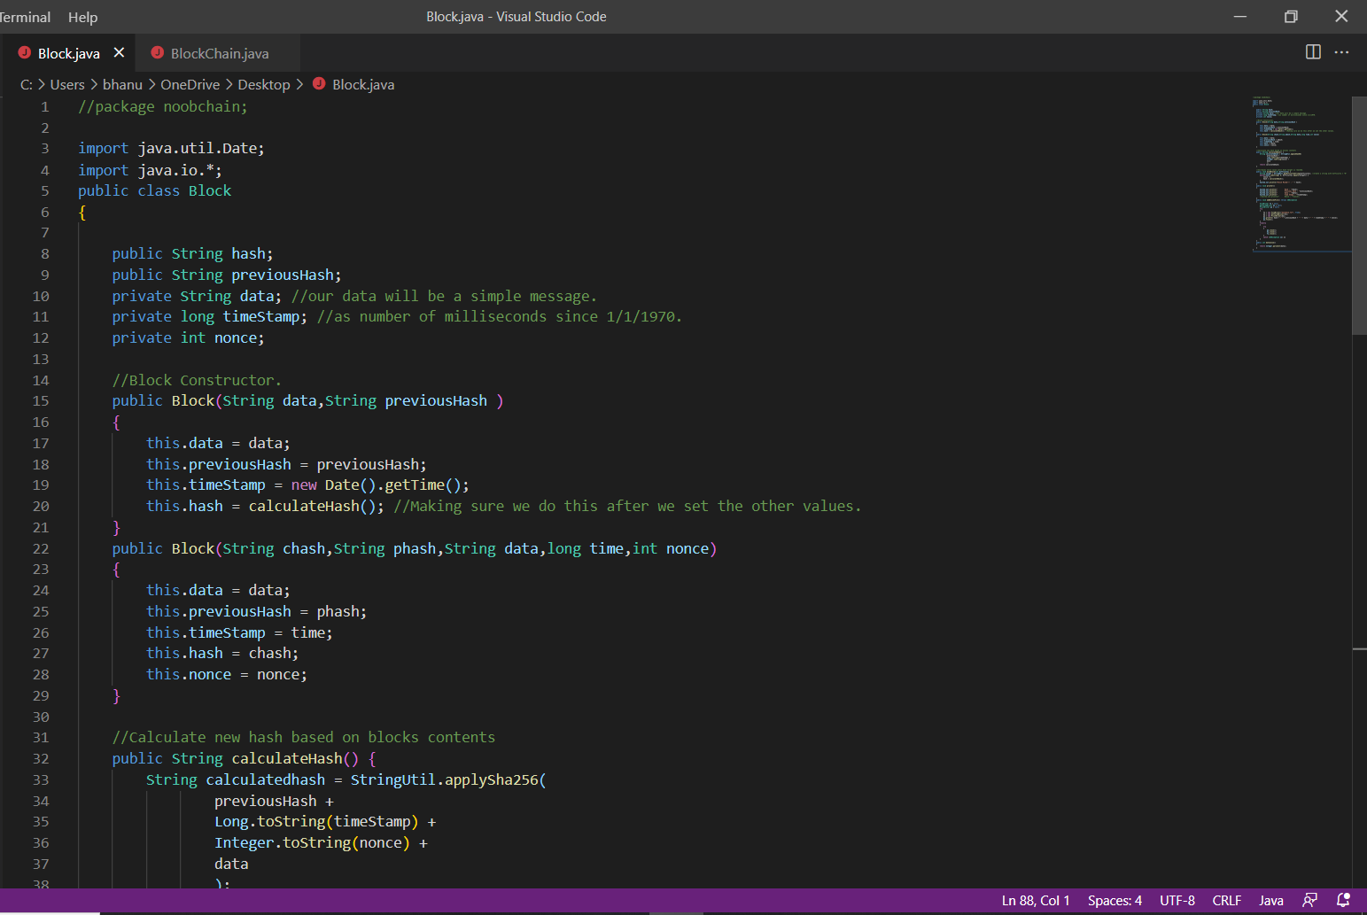
Work Progress

Slide 9
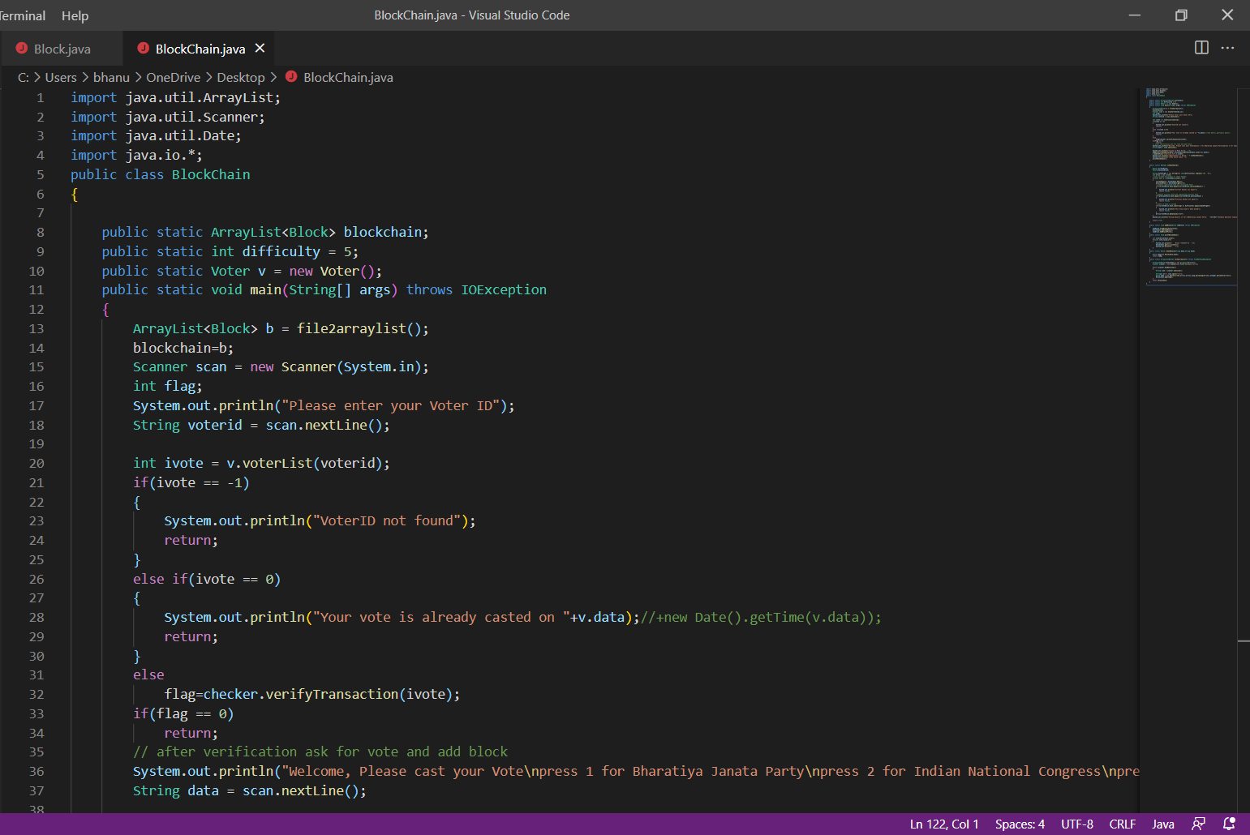

Slide 10
THANK YOU

