Slide 1

Intelligent Traffic Flow Detection Using Deep Neural Network Algorithm
By Prateesh Talasu

Slide 2

Introduction
Traffic data plays an important role whenever we want to know traffic flow.
This flow of traffic can be used to analyze and make better decisions regarding traffic.
The traffic flow prediction is mainly based on real-time data which is collected with the help of various cameras and video.
In recent times, deep learning concepts have been used to detect traffic flow predictions.
Deep Neural Networks (DNNs) are powerful models that can achieve excellent performance on learning tasks.
DNNs work well whenever labeled features are available.
Our method uses the Yolov4 algorithm to make super-fast vehicle detectors with speed and high quality in terms of accuracy.
Our main result is to find the state of traffic by giving the video as an input which uses Yolov4 as an algorithm.

Slide 3
Literature Survey
- Deep learning techniques used for traffic density, speed, and flow prediction
- Mining Road Network Correlation for traffic estimation
- Machine learning algorithms applied to urban traffic congestion
- Navigation devices and applications for traffic prediction services

Slide 4
Problem Identification and Objectives
Problem:
- Huge demand for accurate and efficient traffic forecasting services
- Essential for traffic regulations, route planning, and ETA prediction
Objectives:
- Develop a powerful traffic prediction model
- Accurate prediction during normal and abnormal traffic conditions
- Easy implementation without burdensome calibration and maintenance
- Predict traffic based on CCTV camera feed

Slide 5
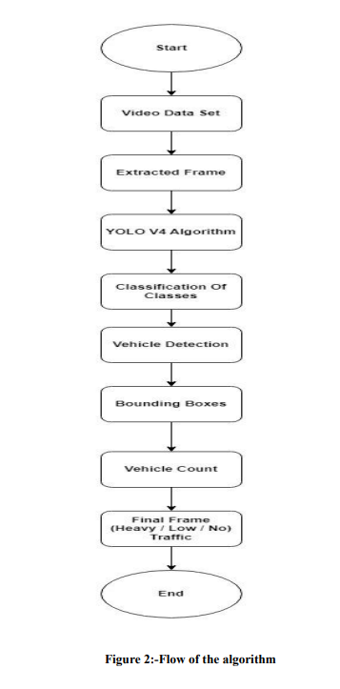
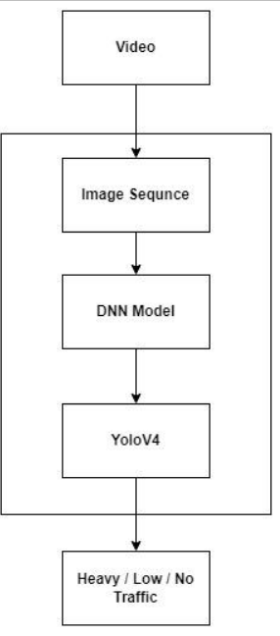
Proposed System Design

Slide 6
Proposed System
Requirements:
- Hardware: PC with Windows/Linux OS, 1.7-2.4GHz processor, 8GB RAM, 2GB GPU
- Software: Visual Studio Code, Python libraries (cv2, glob, os, numpy)
Proposed System Architecture for Object Detection:
- One-stage object detection: YOLO algorithm
- Versions: YOLOv4 used in this project

Slide 7
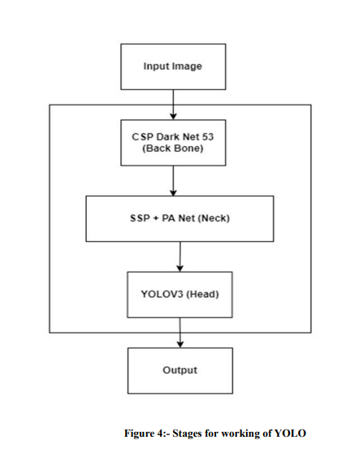
YOLO Algorithm for Traffic Detection
Divides input image into cells (19x19 grid)
- Each cell locates K-bounding boxes
- Calculates class probabilities and eliminates redundant boxes
- Non-max suppression using Intersection over Union (IoU)
- Produces bounding boxes for each detected object

Slide 8
Implementation
YOLOv4 Algorithm:
Training Efficiency: YOLO v4 allows training on a single GPU with a smaller mini-batch size, making the process quicker and more efficient.
Working Stages: YOLO v4 algorithm comprises three stages: Backbone, Neck, and Head.
Backbone :
Feature Extraction: The backbone serves as the foundation, creating feature maps from input photos.
Feature Extractors: Models like ResNet, DenseNet, and VGG are used for feature extraction, pre-trained on datasets like ImageNet.
CSPDarknet53: The feature-extractor model for the GPU version of YOLO v4, demonstrating superior object detection.
Neck:
Path Aggregation Block (PAN) + Additional Block (SPP): Utilizes PAN and Spatial Pyramid Pooling to broaden the receptive area and isolate core functionality.
Spatial Pyramid Pooling (SPP): Separates feature along depth dimension and combines for output feature map.

Slide 9
Implementation
Head :
Object Detection: The head, also known as the object detector, locates areas where objects may be present.
Bounding Boxes: Carries out detection phase of bounding boxes, defining projected bounding box and class probabilities.
Bag of Freebies (BoF) and Bag of Specials (BoS):
BoF: Methods to improve accuracy without increasing inference cost, such as data augmentation and regularization techniques.
BoS: Methods to increase accuracy at a slightly higher inference cost, including Mish activation and Cross Stage Partial Connection.

Slide 10
Code Implementation
# Frame extraction
# Vehicle detection
# Vehicle counting

Slide 11
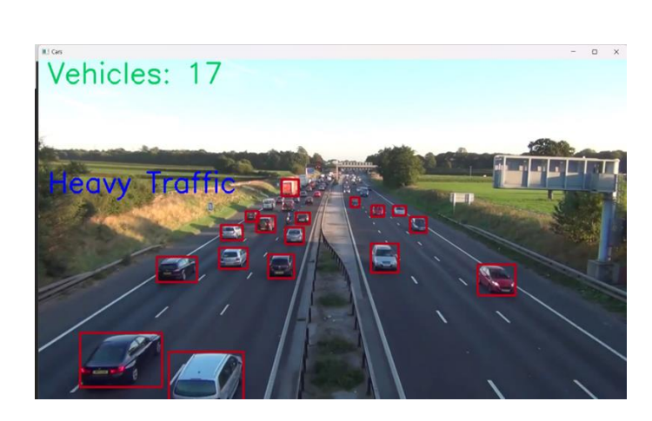
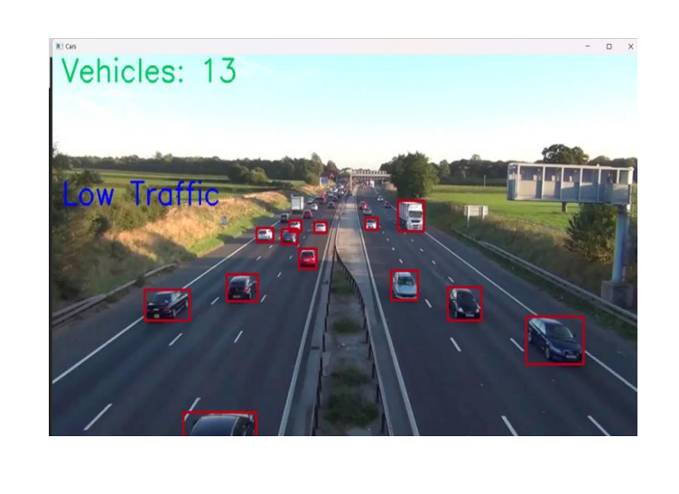
Result Analysis and Output
Vehicle count threshold for traffic type classification
Heavy traffic: count > 15
Low traffic: 10 < count <= 15
No traffic: count <= 10

Slide 12
Conclusion
- Developed an accurate and efficient traffic prediction model using YOLO algorithm
- Can be used for GPS navigation, maps, and traffic diversion
- Identifies heavy, low, and no traffic areas for route planning
- Scope for further improvements and integration with ITS

Slide 13
References
[1] Meena et al. (2020), Traffic Prediction for ITS using ML
[2] Lin & Sun (2018), A YOLO-Based Traffic Counting System
[3] Oltean et al. (2020), Real-Time Vehicle Counting with YOLO
[4] Pavani & Ramya (2022), Traffic Flow Detection Algorithms
[5] Karthika et al. (2019), A Research of Traffic Prediction using DL

