Slide 1


Digitalizing the evaluation of interlaboratory comparison
DME
API
API
AI
A Digital Metrological Expert software tool
D. Hutzschenreuter, W. El-Jaoua, D. Urban, M. Gafert, C. Brown

Slide 2
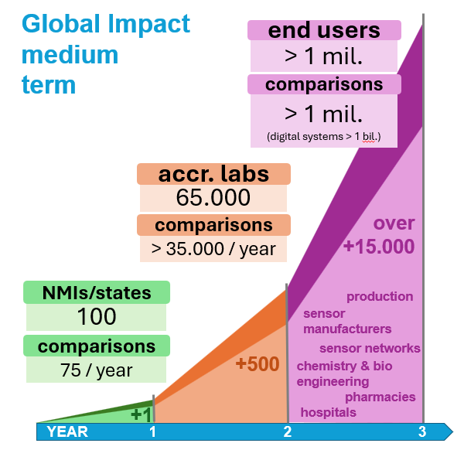
Motivation
Improving consistency and integrity of outcomes
Supporting suitable measurements and reporting
Saving time for creation of reports
Enabling non-IT experts to use emerging digital tools
Emerging interdisciplinary use of comparison methods
Numbers estimated for participants under CIPM MRA and their customers
Notes:
Estimation of numbers:
75 comparisons of NMIs will lead to at least 75 subsequent comparisons in each state involved
100 * 75 = 7500 comparisons by accredited labs
Labs are also comparing several industry standards, different device classes, etc. that are traceable to the primary standards adding to the 7500 comparisons (estimate of factor 5 – this factor may still be not enought)
7500 * 5 = 35.000 comparisons
End-users are customers of accredited labs, who themselves participate in comparisons run by accredited labs, such as laboratories in production, pharmacy laboratories conducting wider comparisons of pharmacies, pahramceutical companies, hospitals who have to prove their capacities through comparisons etc…. But also future cross domain applications in sensor networks, etc.
Over 1 Mio End users worldwide
Over 1 Million comparisons a year
In digital systems (sensor networks and digital application)s potential billions of comparisons on daily basis…as part of maintenance and real time anomaly detection

Slide 3
Digital Metrological Expert concept
For standard work, e.g., evaluation of comparison, calculation of measurands, etc. (taking over tedious human work)
Exchange information in environment of quality infrastructure (QI) through SI-based data and FAIR services
Assess data and propose ways of processing including verification, filter, uncertainty propagation, use of AI, etc.
Results as machine-actionable reports disclosing (metrological) traceability of outputs to inputs (utilizing PIDs)
Itself digital standard in QI when operated and maintained by authoritative organizations
DME
API
API
AI

Slide 4
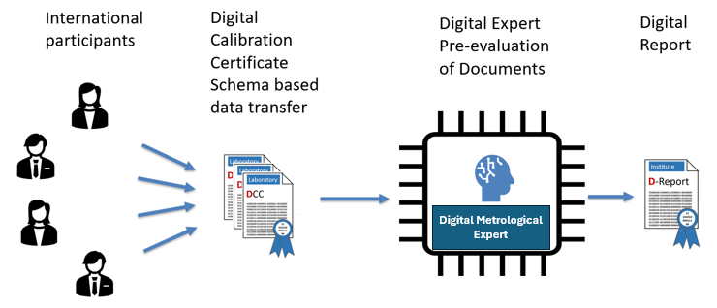
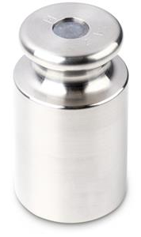
Example: Virtual Mass Comparison
Degrees of Equivalence
Measured values
x₁ = 1.000000287 kg
U₁ = 4.6𝐸-8 kg
…
x_{n} = 1.000000324 kg
U_{n} = 4.5𝐸-8 kg
Reference value: weighted mean
x_{ref} = 1.0000002596 kg
U_{ref} = 1.670𝐸-8 kg
Outlier filter
|En|=|x_{i}-x_{ref}|/U(x_{i}-x_{ref}) > 1

Slide 5
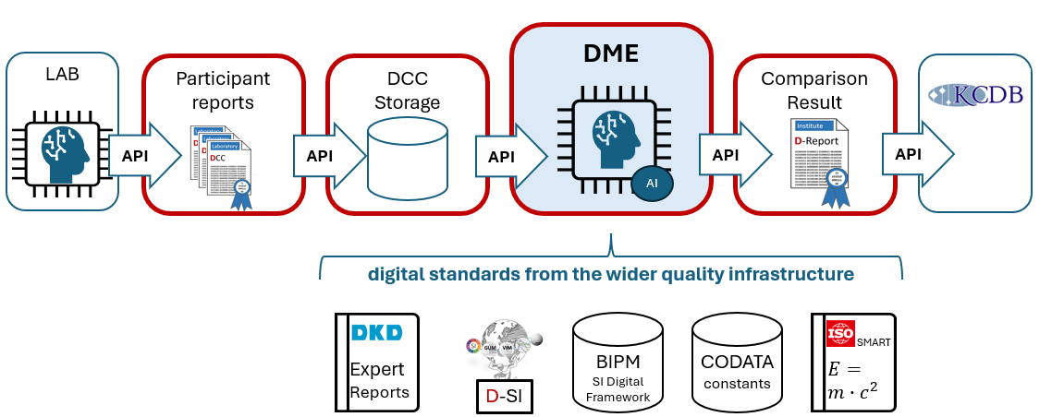
Concept of workflow(s)
round robin, star, petal, running KCRV →
draft A, B, final →
pre-normative

Slide 6
Generic data analysis process
Apply next statistical method or
Remove participant
Consistent analysis
output
1.
Start
2.
Calculate some statistics value
3.
Assess the value of the statistics
4.
Decide how to progress
N.
End
Examples
Calculate
KCRV, En-values
Is there En > 1?
Remove first En > 1
and repeat
Calculate test statistic “normal data”
Does threshold for normal data apply?
If “normal data” continue with method A, else use method B

Slide 7
DME Architecture
Web user interface for non-IT experts https://d-si.ptb.de/#/d-comparison
Reader Service
for participant input data
API interface for IT-experts and machines to run and to control the comparison evaluation service
Writer Service
for KC report creation
Software modules for analysis and evaluation
Main Service
Domain specific KC analysis services
Modules for KCRV, DoE, filter, consistency checks, mean values, rounding, pre & post processing, conversions, …
Data models for storing all input data, interim results, and final evaluation outcomes, terminology, DCC data, …

Slide 8
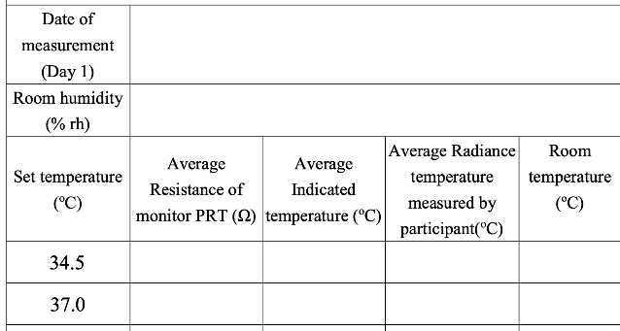
Comparison data model inside DME
Example reporting template
CCT-K11 EURAMET loop
Comparison Data Model
Smart Standard
Radiation temperature comparison model
Contributions
1 .. n
Contribution
34.45
Contribution ID
PTB1
Participant
“PTB”
PID report
https://repository.nmi.org/report-ptb1
1 .. m
Entities under comparison
Entity u. c.
Entity ID
“day1-set-temperature-34.5”
Data identifiers
“resistance of monitor”, “indicated temperature”, “temperature measured”, “room temperature”
Entity data
“temperature measured : PTB1 34.45 °C (U), NMI2 34.6 °C (U), …
Analysis outputs
Reference value 34.51 °C (U), PTB1 En 0.81, NMI2 En 0.76, …

Slide 9
Conclusion & Outlook
DME ready to accommodate and automate various comparison approaches
Open-source tool and open for metrology community to use and extend
First implementations accompanying virtual mass comparison and EURAMET loop of CCT-K11
Starting implementation CCQM comparison use-case; utilizing NIST Decision Tree
Testbed for ongoing digitalization in the quality infrastructure for interoperating SMART standards, BIPM’s SI Digital Framework, etc.

Slide 10
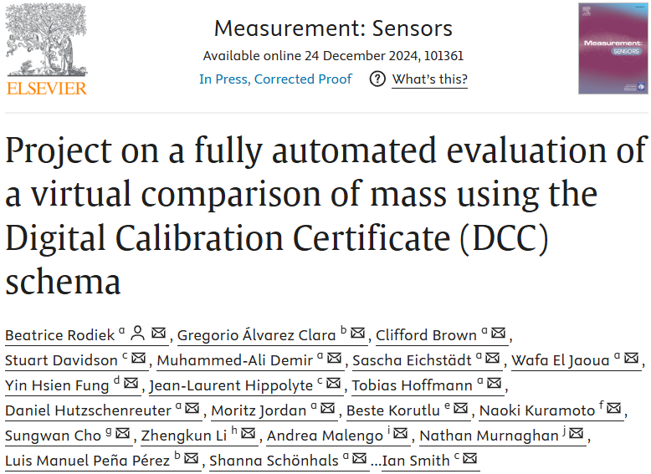
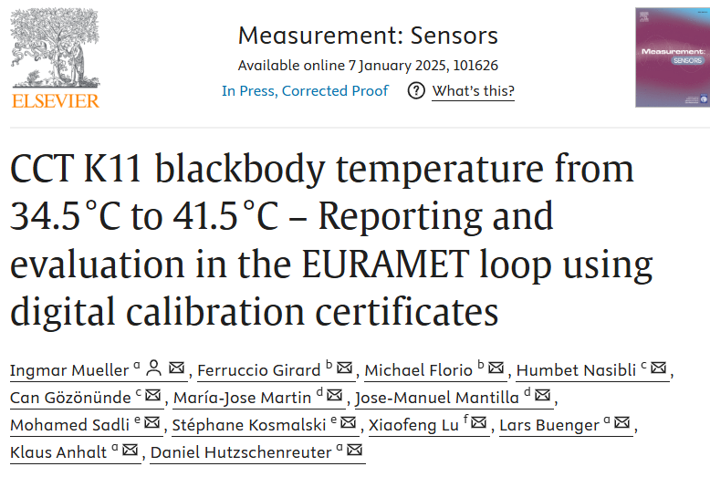
Acknowledgements
https://doi.org/10.1016/j.measen.2024.101361
https://doi.org/10.1016/j.measen.2024.101626

Slide 11

Thank you
CONTACT
Daniel.Hutzschenreuter@ptb.de | https://d-si.ptb.de/#/d-comparison | https://github.com/PTB-M4D/DME_Backend

