Slide 1
Consume AR API from Grafana
UTD Spring 2024

Slide 2
About this document
This document outlines a quick overview on how to consume AR APIs and create dashboards in Grafana
Key Steps
1.Install JSON API plugin
2. Configure the “Connection URL” of AR Web Server
3.Populate Query tab
4.Transformation tab - Optional
5.Create visualization charts

Slide 3
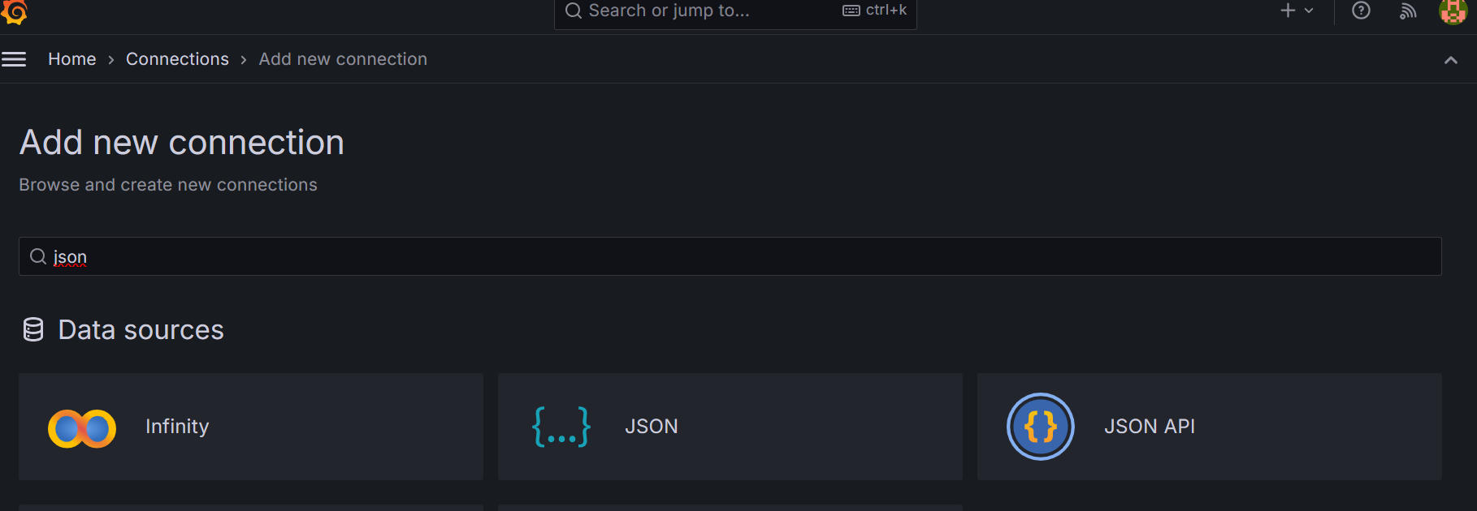
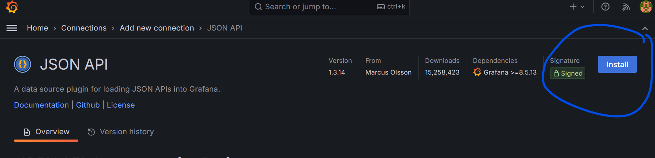

Slide 4
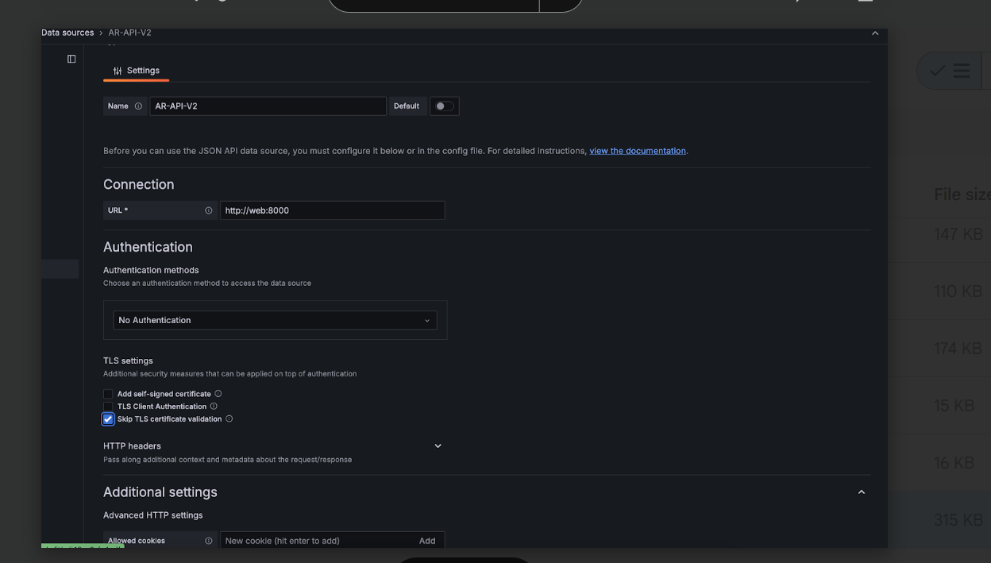
Configuring URL Path

Slide 5
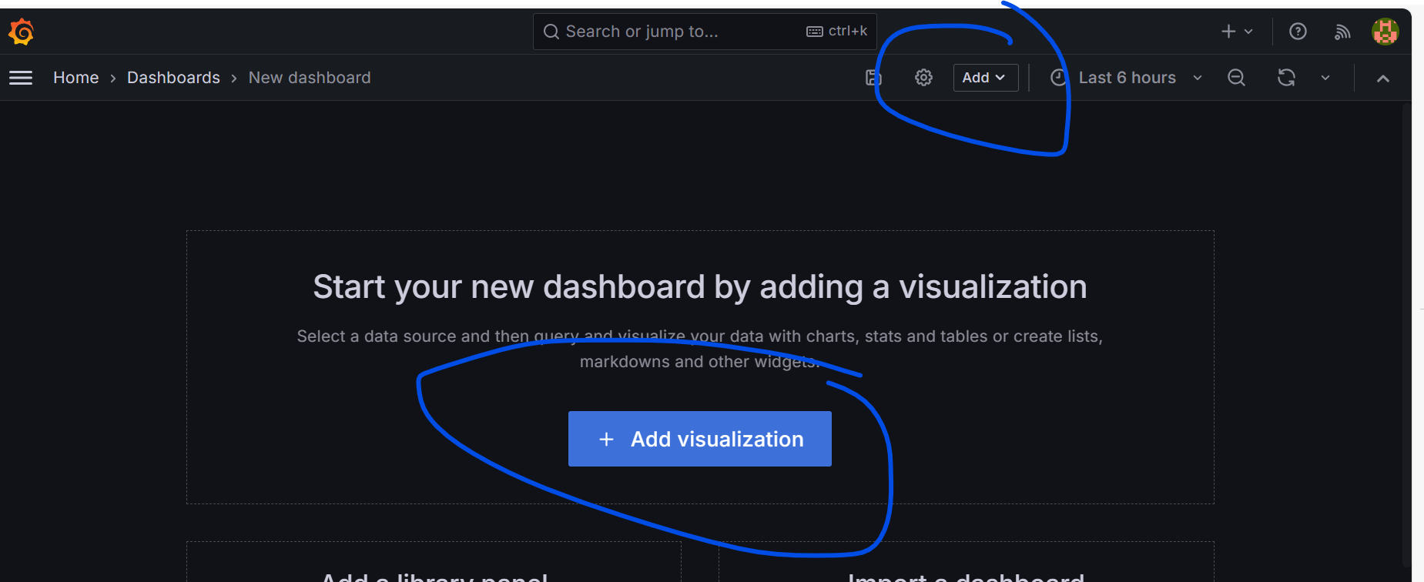
Start a new Visualization

Slide 6
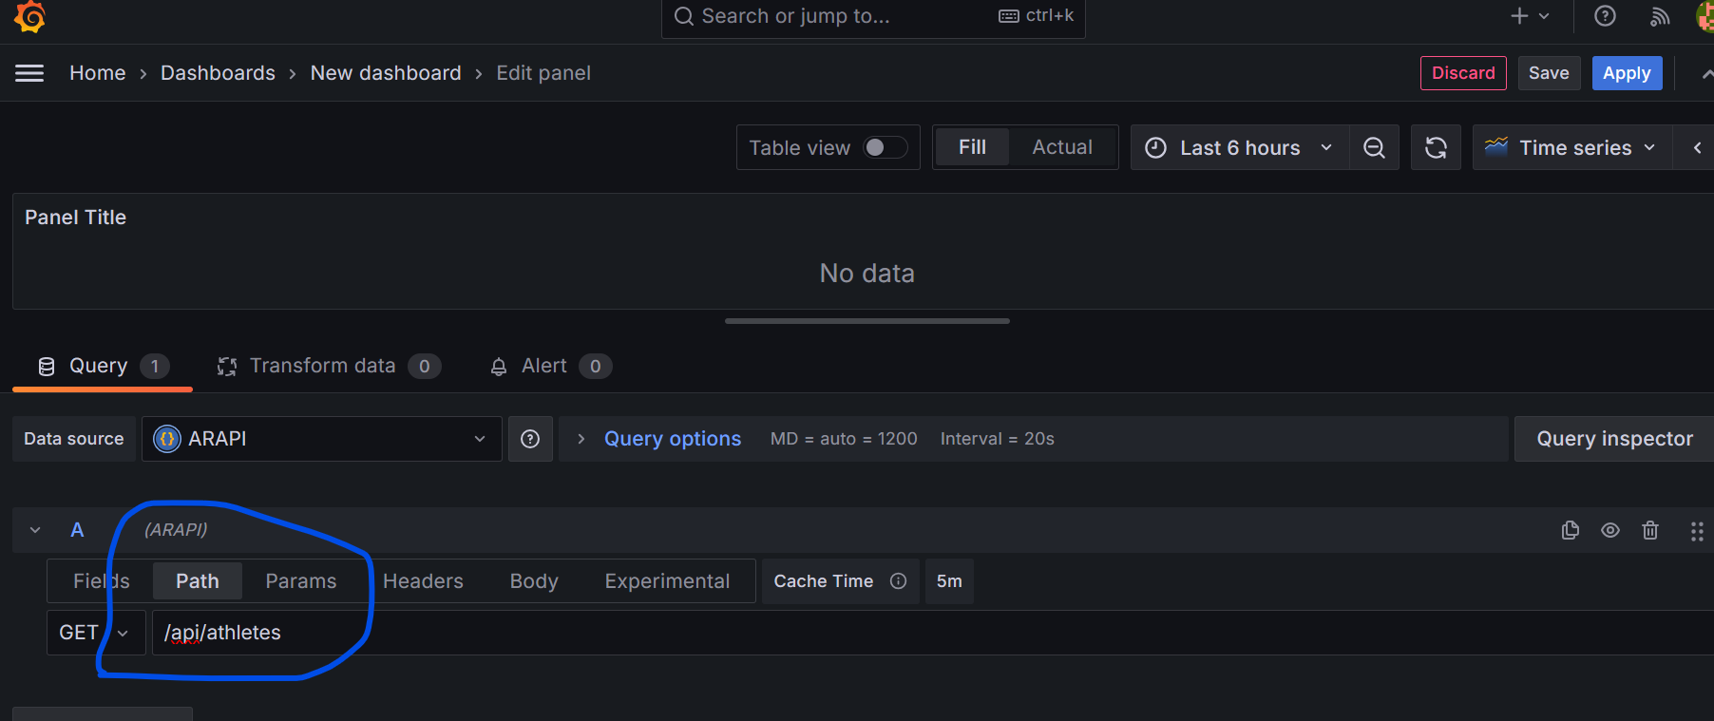
Setting Grafana to Use JSON API Pluggin

Slide 7
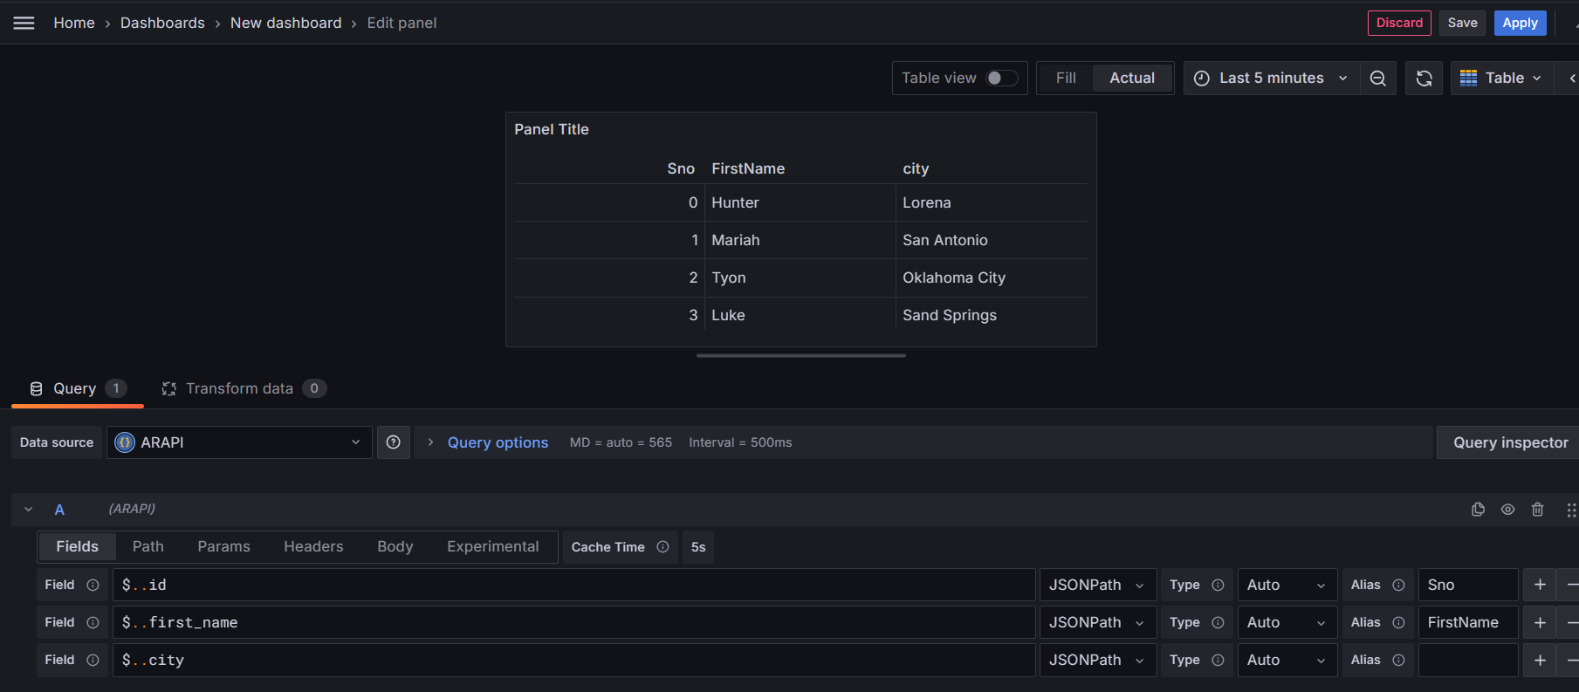
Using JSON API to query
See the field selection $..field_name

Slide 8
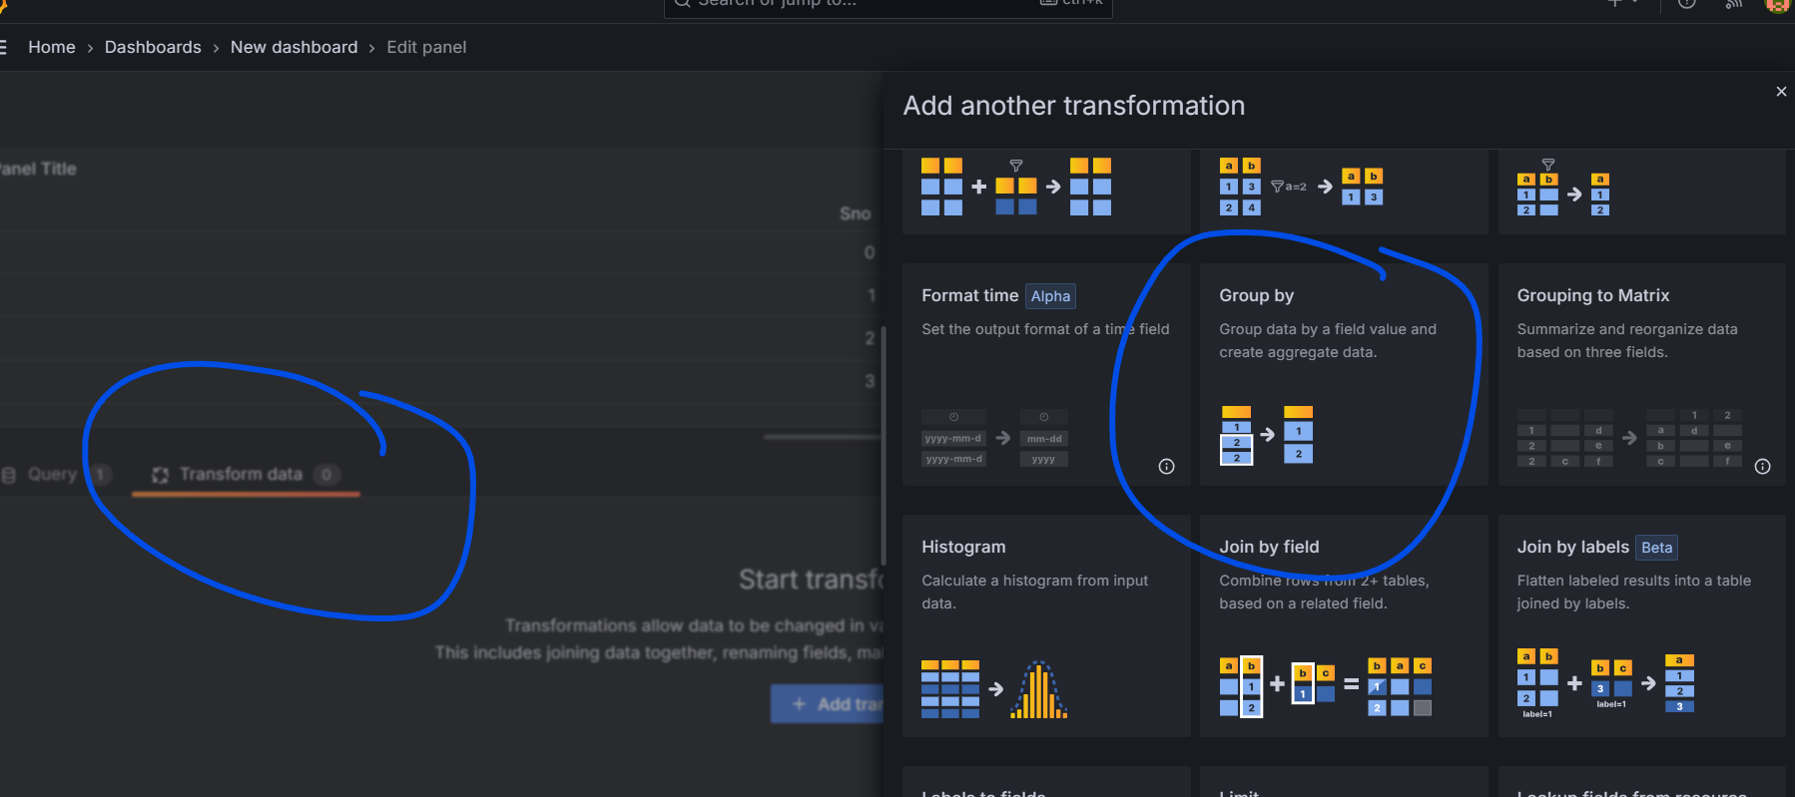
Transformation - Optional -Group by

Slide 9
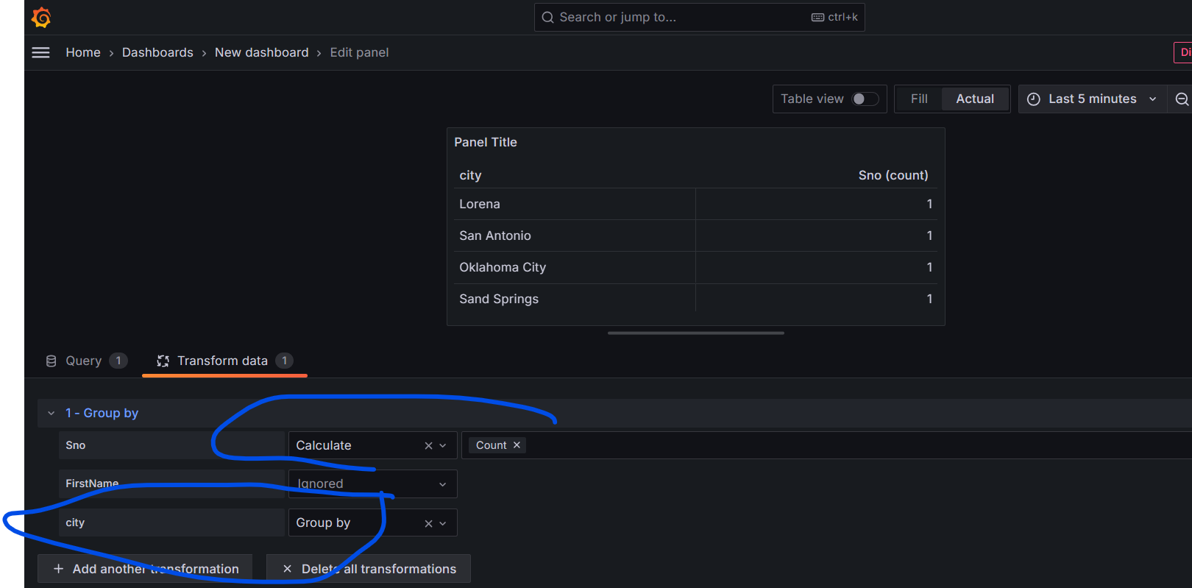
Transformation - Group by
Here we select - Group by City,

Slide 10
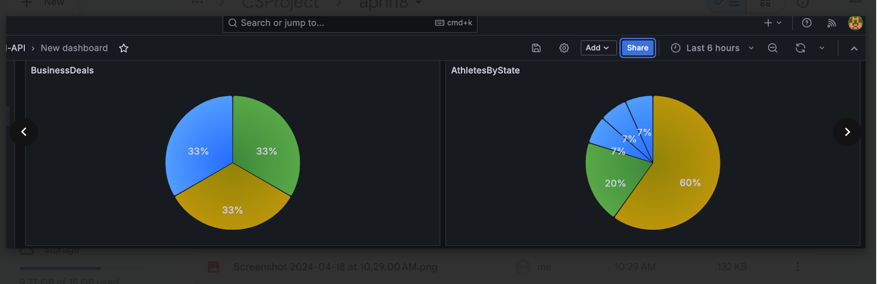
Some Dashboards ….

Slide 11
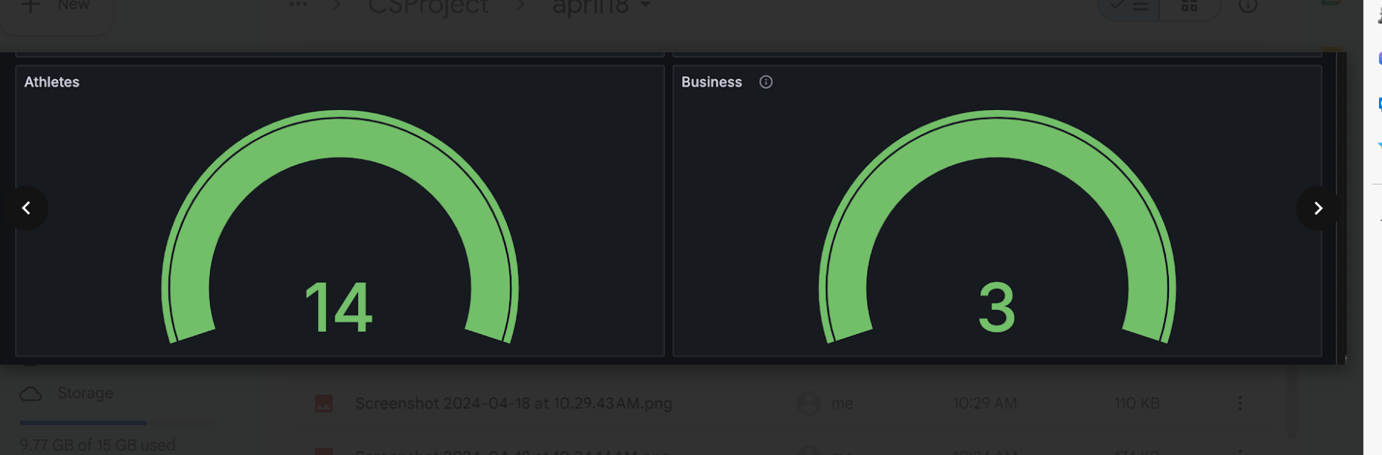
AR Metrics

Slide 12
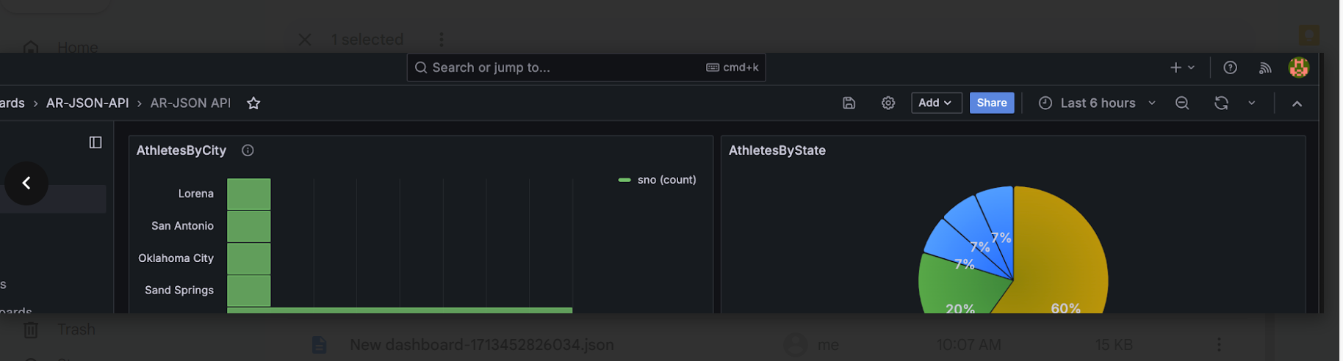
More dashboards

