Slide 1

Data & Information Management CMPT428 / MSIS591 Fall 2015
High level data processing languages (Hive)
(extracted and adapted from from a variety of sources, see last slide)

Slide 2
Topics Covered
About Hive
Comparing Hive to SQL
Hive Architecture
Hive DDL and Queries
Defining Tables
Storing Results to a File
Views in Hive
Hive Partitions and Buckets
Text processing in Hive
HCatalog

Slide 3
Need for High-Level Languages
Hadoop is great for large-data processing
But writing Java programs for everything is verbose and slow
Data scientists don’t want to write Java
Solution: develop higher-level data processing languages
Hive: HiveQL is like SQL
Pig: Pig Latin is a dataflow language

Slide 4

Hive
Used for majority of Facebook jobs
Hive is not
A relational database
A design for OnLine Transaction Processing (OLTP)
A language for real-time queries and row-level updates
Features of Hive
It stores schema in a database and processed data into HDFS.
It is designed for OLAP.
It provides SQL type language for querying called HiveQL or HQL.
It is familiar, fast, scalable, and extensible.
Can call Hadoop Streaming scripts from HiveQL
Supports table partitioning, clustering, complex data types, some optimizations
Source: tutorialspoint.com

Slide 5







About Hive
Store and Query all
Data in Hive
Use Existing SQL Tools
and Existing SQL Processes
Operational
/ MPP
Weblog
Mobile
Sensor
Apache Hive is a data warehouse system for Hadoop. Hive is not a relational database; it only maintains metadata information about your big data stored on HDFS.
It treats your big data as tables
It performs SQL-like operations on the data using a scripting language called HiveQL

Slide 6
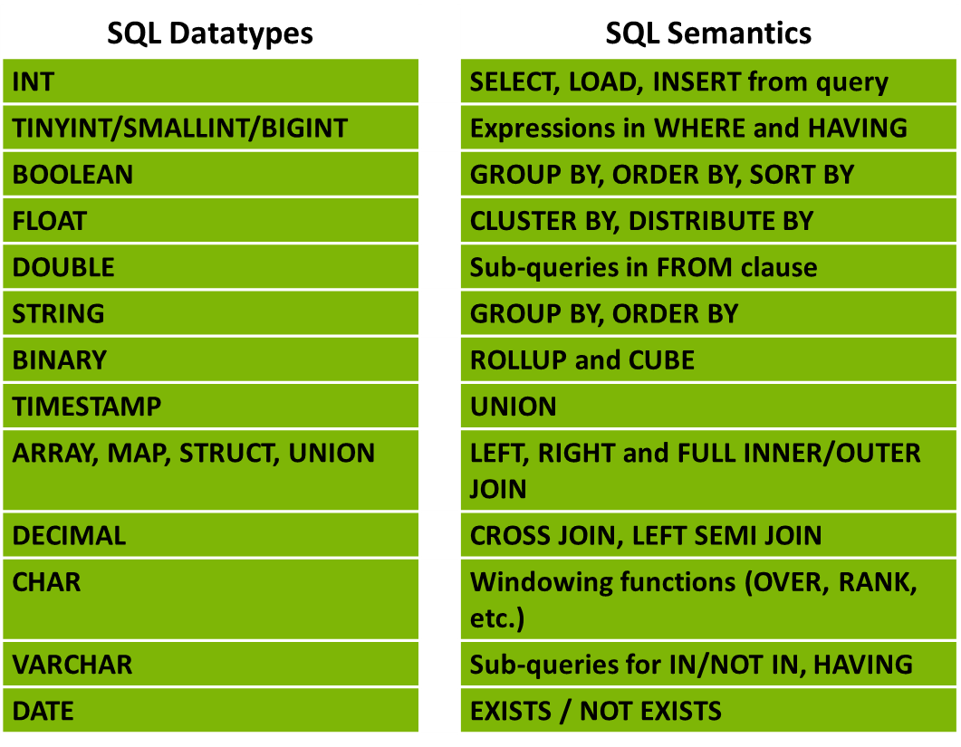
Comparing Hive to SQL
HiveQL is the Hive query language.
Like all SQL dialects in widespread use, it doesn’t fully conform to any particular revision of the ANSI SQL standard.
More on data types later on
It is perhaps closest to MySQL’s dialect, but with significant differences:
Hive offers no support for row-level inserts, updates, and deletes.
Hive doesn’t support transactions.
Hive adds extensions to provide better performance in the context of Hadoop and to integrate with custom extensions and even external programs
Notes:
This slide is to simply demonstrate that HiveQL looks a lot like SQL. Do not discuss each item above – remember we are assuming the students are already familiar with SQL.

Slide 7
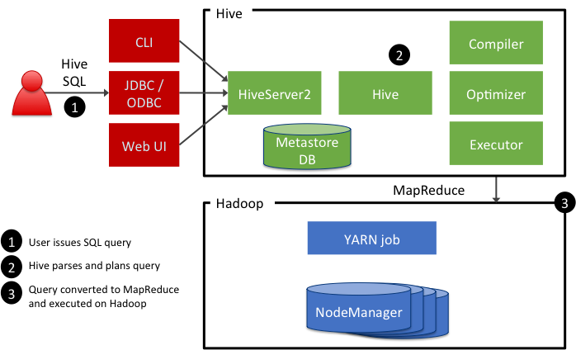
Hive Architecture
Hive queries are submitted to a HiveServer2 process that typically runs on a master node in the cluster. The Hive query is converted to either a:
MapReduce job, or Tez job

Slide 8
Submitting Hive Queries
Hive CLI
Traditional Hive client that connects to a HiveServer instance
It connects directly to HDFS and the Hive Metastore, and can be used only on a host with access to those services
$ hive hive>
Notes:
Hive queries are written using the HiveQL language, an SQL-like scripting language that simplifies the creation of MapReduce jobs. You have two options for executing HiveQL commands:
- Hive CLI
- Beeline

Slide 9
Hive Data types
Integral Types: Integer type data can be specified using integral data types
Type Postfix Example
TINYINT Y 10Y
SMALLINT S 10S
INT - 10
BIGINT L 10L
String Types: String type data types can be specified using single quotes (' ') or double quotes (" ").
Data Type Length
VARCHAR 1 to 65355
CHAR 255
Timestamp: It supports traditional UNIX timestamp with optional nanosecond precision
Dates: DATE values are described in year/month/day format in the form {{YYYY-MM-DD}}.
Decimals: The DECIMAL type in Hive is as same as Big Decimal format of Java. It is used for representing immutable arbitrary precision. The syntax and example is as follows:
DECIMAL(precision, scale)
decimal(10,0)
Literals: the following literals are used in Hive:
Integral types
Floating point types (DOUBLE)
String type
Null Value: Missing values are represented by the special value NULL.
UNIONTYPE: Similar to unions in C. A Union type can hold one (only one) data type from its specified data types
Complex types:
STRUCT: Analogous to a C struct or an “object. Fields can be accessed using the “dot” notation.
E.g. struct('John', 'Doe').
MAP: A collection of key-value tuples, where the fields are accessed using array notation.
E.g. map('first', 'John', 'last', 'Doe')
ARRAY: Ordered sequences of the same type that are indexable using zero-based integers.
E.g. array('John', 'Doe')

Slide 10
Union Type
CREATE TABLE test(col1 UNIONTYPE<INT, DOUBLE, ARRAY<VARCHAR>, STRUCT<a:INT,b:CHAR>>);
The retrieving results for col1 can be any of the below possibilities:
SELECT col1 FROM test;
{0:1} // Matching INT types
{1:10.0} // Matching DOUBLE types
{2:["hello","world"]} // Matching ARRAY with VARCHAR type
{3:{"a":50,"b":"Good"}} // Matching STRUCT with INT & CHAR types
{2:["hadoop","tutorial"]} // Again 2: represent it is Array type
{3:{"a":100,"b":".info"}} //3: indicate the fourth element type in Union
{0:150}
{1:100.0}

Slide 11
HiveQL: DDL Database Statements
Create Database is a statement used to create a database in Hive. A database in Hive is a namespace or a collection of tables
CREATE DATABASE|SCHEMA [IF NOT EXISTS] <database name>
Here, IF NOT EXISTS is an optional clause, which notifies the user that a database with the same name already exists. We can use SCHEMA in place of DATABASE in this command. The following query is executed to create a database named userdb:
hive> CREATE DATABASE [IF NOT EXISTS] userdb;
or
hive> CREATE SCHEMA userdb;
The following query is used to verify a databases list:
hive> SHOW DATABASES;
default
Userdb
Access a database: hive> USE default;
List tables in a database: hive> SHOW TABLES;
DROP (DATABASE|SCHEMA) [IF EXISTS] database_name [RESTRICT|CASCADE];
hive> DROP DATABASE IF EXISTS userdb;
The following query drops the database using CASCADE. It means dropping respective tables before dropping the database.
hive> DROP DATABASE IF EXISTS userdb CASCADE;
The following query drops the database using SCHEMA.
hive> DROP SCHEMA userdb;

Slide 12
Defining a Hive-Managed Table
CREATE TABLE customer (
customerID INT,
firstName STRING,
lastName STRING,
birthday TIMESTAMP
) ROW FORMAT DELIMITED
FIELDS TERMINATED BY ',';
Notes:
A Hive managed table means that when the table is dropped, the underlying folder in HDFS is deleted.

Slide 13
Defining an External Table
CREATE EXTERNAL TABLE SALARIES (
gender string,
age int,
salary double,
zip int
) ROW FORMAT DELIMITED
FIELDS TERMINATED BY ','
LOCATION '/user/train/salaries/';
If the table is EXTERNAL, then the data remains in HDFS if the table is dropped.
The LOCATION directive allows you to specify the folder that is associated with the table.
Notes:
If the table is EXTERNAL, then the data remains in HDFS if the table is dropped.

Slide 14
Loading Data into Hive
The data does not actually get “loaded” into anything, but the data does get moved:
- For Hive-managed tables, the data is moved into a special Hive subfolders of /apps/hive/warehouse
- For external tables, the data is moved to the folder specified by the LOCATION clause in the table’s definition
LOAD DATA LOCAL INPATH ’/tmp/customers.csv' OVERWRITE INTO TABLE customers;
LOAD DATA INPATH '/user/train/customers.csv' OVERWRITE INTO TABLE customers;
INSERT INTO TABLE birthdays
SELECT firstName, lastName, birthday
FROM customers
WHERE birthday IS NOT NULL;

Slide 15
Performing Queries
SELECT * FROM customers;
FROM customers SELECT firstName, lastName, address, zip WHERE orderID > 0 ORDER BY zip;
SELECT customers.*, orders.* FROM customers JOIN orders ON (customers.customerID = orders.customerID);
Notes:
This is a simple slide that is meant to demonstrate how Hive queries look exactly like SQL queries.

Slide 16
Hive Partitions
You can define a table to have a partition, which results in the underlying data being stored in files partitioned by a specified column (or columns) in the table. Partitioning the data can greatly improve the performance of queries because the data is already separated into files based on the column value, which can decrease the number of mappers and greatly decrease the amount of shuffling and sorting of data in the resulting MapReduce job.
Use the partitioned by clause to define a partition when creating a table:
create table employees (id int, name string, salary double)
partitioned by (dept string);
Subfolders are created based on the partition values:
/apps/hive/warehouse/employees
/dept=hr/
/dept=support/
/dept=engineering/
/dept=training/

Slide 17
Sorting Data
Hive has two sorting clauses:
order by: a complete ordering of the data
sort by: data output is sorted per reducer
Notes:
Order by implements a total ordering across all reducers.

Slide 18
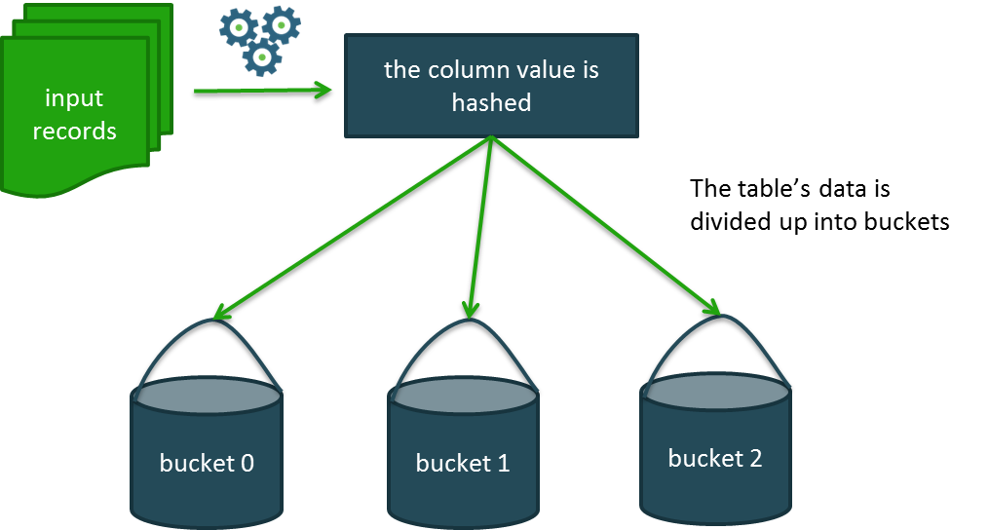
Hive Buckets
Hive tables can be organized into buckets, which imposes extra structure on the table and the way the underlying files are stored. Buckets are created using the clustered by clause.
CREATE TABLE bucketed_user(
firstname VARCHAR(64),
lastname VARCHAR(64),
address STRING,
city VARCHAR(64),
state VARCHAR(64),
post STRING,
phone1 VARCHAR(64),
phone2 STRING,
email STRING,
web STRING
)
COMMENT 'A bucketed sorted user table'
PARTITIONED BY (country VARCHAR(64))
CLUSTERED BY (state) SORTED BY (city) INTO 32 BUCKETS;

Slide 19
Storing Results to a File
INSERT OVERWRITE DIRECTORY '/user/train/ca_or_sd/' from names
select name, state where state = 'CA'
or state = 'SD';

Slide 20
Understanding Views
Hive
Metastore
Table_1
View_1
Table_2
View_2
Table_3
Hive tables map to folders in HDFS
Hive views are the results of queries and have no underlying stored data
HDFS
Notes:
Views are great, and most students will be familiar with the concept. The interesting part about views in Hive is that they are not materialized, which is important to understand.

Slide 21
Defining and using Views
CREATE VIEW 2010_visitors AS
SELECT fname, lname, time_of_arrival, info_comment
FROM wh_visits
WHERE cast(substring(time_of_arrival,6,4) AS int) >= 2010 AND cast(substring(time_of_arrival,6,4) AS int) < 2011;
select *
from 2010_visitors
where info_comment like "%CONGRESS%"
order by lname;
Notes:
A view is defined using the CREATE VIEW statement. A view is not a table in Hive with actual data, but a view can be treated like a table. For example, you can run the DESCRIBE command on a view to see its schema and also see it in the list of “show tables;”

Slide 22
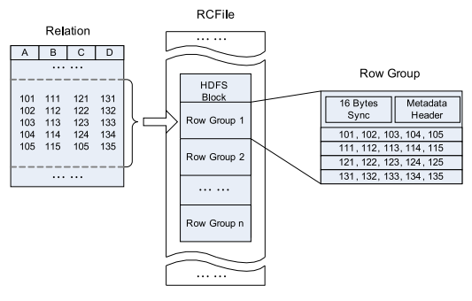
Hive File Formats
CREATE TABLE names(name string, lname string) STORED AS RCFile;
File Formats
Text file
SequenceFile: is a flat file consisting of binary key/value pairs.
RCFile: The RCFile (row columnar) splits data horizontally into row groups. For example, rows 1 to 100 are stored in one group and rows 101 to 200 in the next and so on. One or several groups are stored in a HDFS file. The RCFile saves the row group data in a columnar format. So instead of storing row one then row two, it stores column one across all rows then column two across all rows and so on.
ORC File: Optimized Row Columnar) file format. ORC provides substantial improvements beyond RCFile.
RCfile
format
Notes:
As you have seen, Hive does not store data. The data for a table is stored in HDFS in one of these formats.
Using the STORED AS clause, you specify a file format when you create the table.

Slide 23
Function APIs in Hive
There are three types of function APIs in Hive, UDF, UDTF, and UDAF
Normal (UDF) functions take inputs from a single row, and output a single value
UDTF, or table functions are similar to UDF functions, but they can output both multiple columns AND multiple rows of data Examples of built-in table functions include explode(), json_tuple(), and inline()
Aggregate functions (UDAF) can operate over an entire table at once to perform some sort of aggregation. Examples of built-in aggregate functions include sum(), count(), min(), max(), sentences (), ngrams(), and context_ngrams()

Slide 24
Invoking a Hive UDF
ADD JAR /myapp/lib/myhiveudfs.jar;
CREATE TEMPORARY FUNCTION ComputeShipping
AS 'hiveudfs.ComputeShipping';
FROM orders SELECT
address,
description,
ComputeShipping(zip, weight);
Notes:
Similar to Pig, Hive has the ability to use User-Defined Functions written in Java to perform computations that would otherwise be difficult (or impossible) to perform using the built-in Hive functions and SQL commands.

Slide 25
Built-in UDTF example: explode()
explode() takes in an array (or a map) as an input and outputs the elements of the array (map) as separate rows. UDTFs can be used in the SELECT expression list and as a part of LATERAL VIEW.
As an example of using explode() in the SELECT expression list, consider a table named myTable that has a single column (myCol) and two rows:
Array<int> myCol
[100,200,300]
[400,500,600]
Then running the query:
SELECT explode(myCol) AS myNewCol FROM myTable;
will produce:
(int) myNewCol
100
200
300
400
500
600
The usage with Maps is similar:
SELECT explode(myMap) AS (myMapKey, myMapValue)
FROM myMapTable;

Slide 26
explode() with LATERAL VIEW
LATERAL VIEW is used in conjunction with UDTF functions such as explode().
A lateral view first applies the UDTF to each row of the base table and then joins resulting output rows to the input rows to form a virtual table having the supplied table alias.
Consider the following base table named pageAds. It has two columns: pageid (name of the page) and adid_list (an array of ads appearing on the page):
Pageid (string) adid_list Array <int>
“front_page” [1, 2, 3]
“contact_page” [3, 4, 5]
The user would like to count the total number of times an ad appears across all pages.
A lateral view with explode() can be used to convert adid_list into separate rows using the query:
SELECT pageid, adid
FROM pageAds LATERAL VIEW explode(adid_list) adTable AS adid;
The resulting output will be:
pageid (string) adid (int)
"front_page" 1
"front_page" 2
"front_page" 3
"contact_page" 3
"contact_page" 4
"contact_page" 5

Slide 27
Text Processing in Hive – sentences()
The sentences UDAF tokenizes a string of natural language text into words and sentences, where each sentence is broken at the appropriate sentence boundary and returned as an array of words.
The result is an array of sentences, where each sentence is an array of words: array<array<string>>
sentences(string str, string lang, string locale)
The 'lang' and 'locale' are optional arguments.
For example:
sentences('Hello there! How are you?')
returns
( ("Hello", "there"), ("How", "are", "you") )

Slide 28
Text Processing in Hive – ngrams()
An n-gram is a subsequence of text within a large document.
The “n” represents the length of the subsequence.
The ngrams() UDAF finds the k most frequent n-grams from one or more sequences.
The ngram output from the query below is called a trigram, because the result will be sets of three words. The 100 argument specifies you want the top 100 trigrams from this dataset.
select ngrams(sentences(val),3,100) from mytable;
Contextual n-grams are similar to n-grams, but allow you to specify a 'context' string around which n-grams are to be estimated. The command below will return a list of the top 100 words that follow the phrase "i love" in a hypothetical table of Twitter tweets. Each null specifies the position of an n-gram component to estimate; therefore, every query must contain at least one null in the context array
SELECT context_ngrams(sentences(lower(tweet)),
array("i","love",null),
100)
FROM twitter;
You could achieve the same result by manually stripping sentences of non-contextual content and then passing them to ngrams(), but context_ngrams() makes it much easier.
Notes:
An ngram is a subsequence of text within a large document. The “n” represents the length of the subsequence. The result of an ngram is a frequency distribution

Slide 29
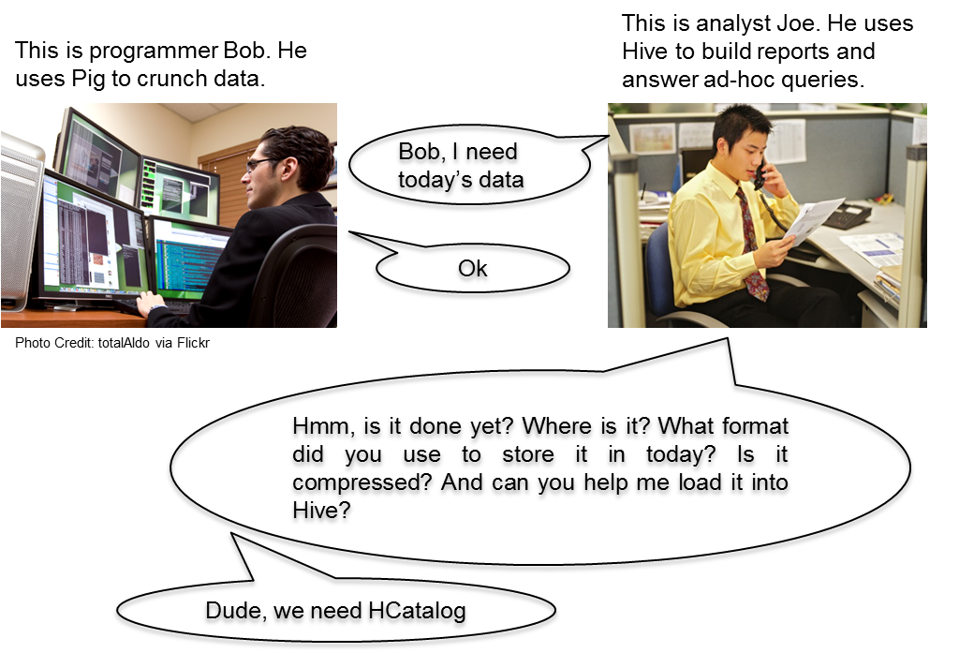
About Hcatalog (if we have time)
Makes the Hive metastore available to users of other tools on Hadoop
Provides connectors for MapReduce and Pig so that users of those tools can read data from and write data to Hive’s warehouse
Allows users to share data and metadata across Hive, Pig, and MapReduce
Provides a relational view through an SQL-like language (HiveQL) to data within Hadoop
Allows users to write their applications without being concerned about how or where the data is stored
Insulates users from schema- and storage-format changes

Slide 30
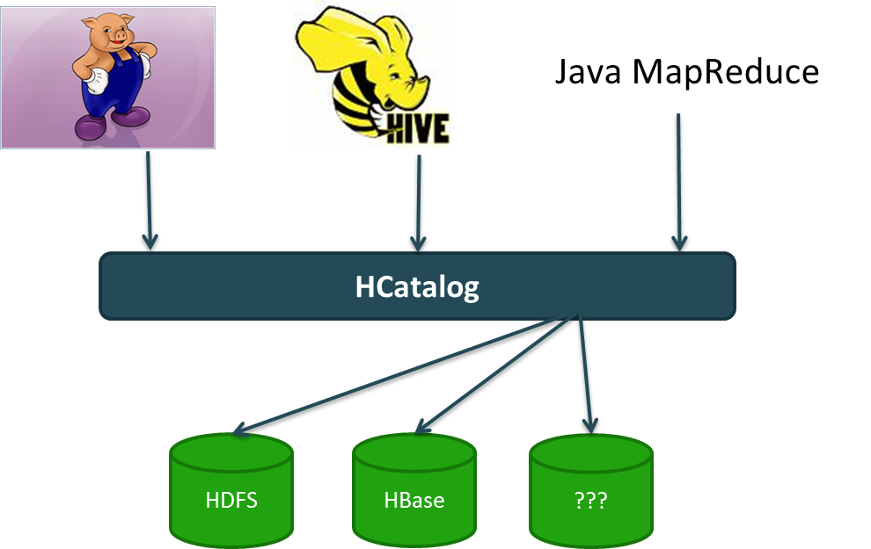
HCatalog in the Ecosystem
HCatalog provides a consistent data model for the various tools that use Hadoop.
It also provides table abstraction, which abstracts some of the details about your data like:
How the data is stored
Where the data resides on the filesystem
What format that data is in
What the schema is of the data

Slide 31
Defining a New Schema
create table mytable (
id int,
firstname string,
lastname string
)
comment 'An example of an HCatalog table'
partitioned by (birthday string)
stored as sequencefile;
Notes:
To define a new HCatalog schema, you simply define a table in Hive.

Slide 32
Using HCatLoader with Pig
HCatLoader: used to read data from HCatalog managed tables.
emp_relation = LOAD 'employees'
USING org.apache.hcatalog.pig.HCatLoader();
Notes:
Notice that you do not provide a schema when loading a relation with HCatalog. The schema of the relation emp_relation is whatever the schema is of the employees table.

Slide 33
Using HCatStorer with Pig
HCatStorer: used to write data to HCatalog-managed tables.
STORE customer_projection INTO 'customers' USING org.apache.hcatalog.pig.HCatStorer();
Notes:
For the above command to execute successfully, the field names of the customer_projection relation must match the column names of the customers table. You will see how this works in the upcoming lab.

Slide 34
The Pig SQL Command
The SQL command allows you to run an HCatalog DDL command from within your Pig script:
grunt> sql create table movies (
title string,
rating string,
length double)
partitioned by (genre string)
stored as ORC;
Notes:
For example, you could create a table from within a Pig script (or the Grunt shell) using the command above.

Slide 35
Resources
Hortonworks student guide
Edward Capriolo, Dean Wampler, Jason Rutherglen , Programming Hive, Data Warehouse and Query Language for Hadoop, by , O'Reilly Media, 2012
http://www.tutorialspoint.com/hadoop/index.htm

