Slide 1
Pocket size PowerShell
Getting started with PowerShell IoT.

Slide 2
Agenda
The road to PowerShell IoT
GPIO – The fast lane to hardware automation.
I2C – getting started
Output... The linux way to my display.
Notes:
My setup – Pi 2, Phat Stack, SenseHat, T-Cobbler, Breakoutboard, leds.

Slide 3
The path to PowerShell IoT
Some Linux required
pinout
..But thats enough.
sudo WIRINGPI_CODES=1 ~/powershell/pwsh
Microsoft.PowerShell.IoT – Available from gallery
Notes:
powershell 6.0 - open source, .Net core
released for Linux. - Raspberry Pi runs Linux,
the cool thing with the Pi isn’t only the size and capability, but the pins, so lets start there.
Tools available for unix / python since start
PowerShell IoT release spring 2018
Based on .net library WiringPi – requires ”special” start
Very simple module – 6 CmdLets, 3 protocols

Slide 4
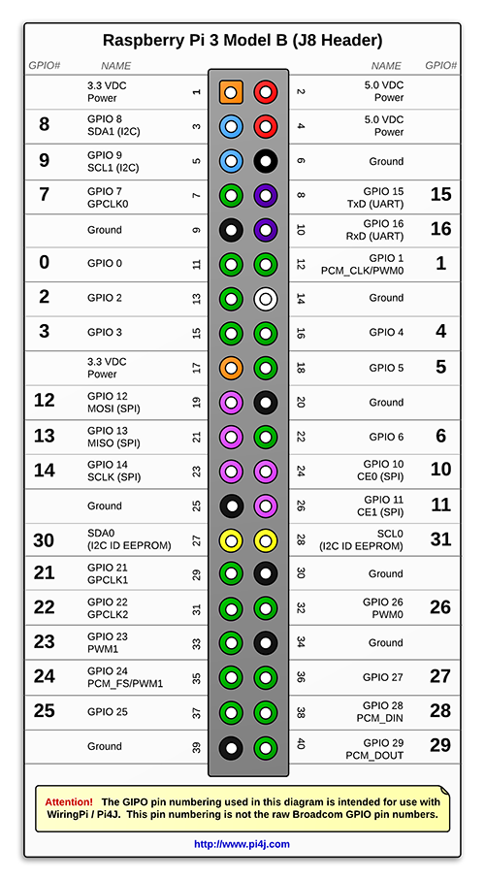
GPIO – The fast lane to hardware automation.
Serial protocol
Two values – Low and High
WiringPi pins –ne Raspberry Pi pins
Notes:
GPIO – General purpose input output
Serial protocol, you can read data, but not implemented.
Two cables, + and ground
3.3v delivery on high.
8 ”clean” GPIO ports, 20 odd shared (do not use without verifying functionality!)
WiringPi codes –ne raspberry pi pins

Slide 5
I2C – getting started
Serial protocol, but can read and write values!
I2cdetect –y 1 # List all available i2c devices
Use master address to define device, slave addresses to read and write values
Notes:
I2c – Inter-Integrated circuit.
Serial protocol, using three wires or more - data, clock and power, groud and more depending on model and usage.
Each device has a unique device address
I2cdetect
Use master address to send commands
Each device has multiple read and write addresses to get values and set settings, all in byte format

Slide 6
Output... The linux way to my display.
Everything is a file. Even the display.
Write 64 bits to framebuffer
RGB565 values
1111100000011111
First 5 bytes – Red
Second 6 bytes – Green
Third 5 bytes - Blue
Notes:
In linux, everything is a file. Even the screen.
Uses Framebuffer, bitarrays, rgb565 values

