Slide 1


ATLIQ HARDWARE CONSUMER GOODS DOMAIN

Slide 2
.
CONTENTS
Project Objective
Problem Statement
Connect Data Model
Export SQL database to csv file & create Visualization
10 Ad hoc Queries
Thank You

Slide 3
About Atliq Hardware Company
Atliq Hardware imaginary companies is one of the prominent computer hardware producer based in India, holding a leading positions not only in the Indian market.
However, the management noticed that they do not get enough insights to make quick and smart data-informed decisions. They want to expand their data analytics team by adding several junior data analysts. Tony Sharma, their data analytics director wanted to hire someone who is good at both tech and soft skills. Hence, he decided to conduct a SQL challenge which will help him understand both the skills.

Slide 4
PROBLEM STATEMENT
The management team at Atliq Hardware has observed a significant gap in their ability to make timely, data driven decision. Despite having access to vast amounts of data, the insights generated are not sufficiently actionable, hindering the organization’s responsive and strategic agility. The issue is exacerbated by the current team’s limited capacity to analyze and interpret data effectively, leading to slower decision – making processes and missed opportunities for optimization.

Slide 5
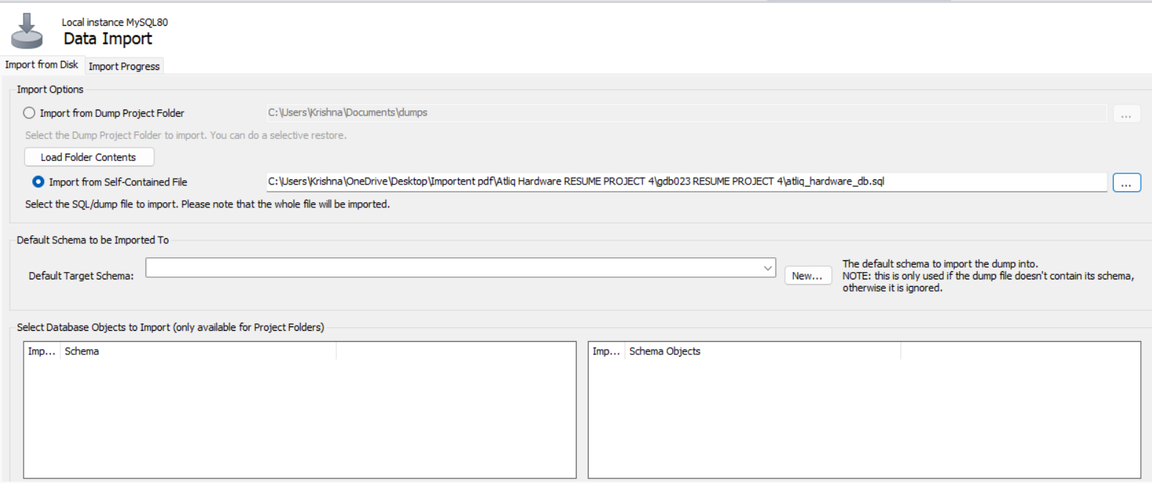
CONNECT DATA MODEL
Import from Self – Contained file. Select the SQL/dumb file and import.

Slide 6
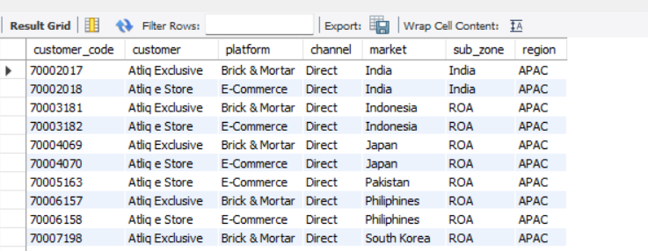
Export SQL database to csv file & create
Here I export all the csv file from SQL database.
SQL allows you to create and edit tables, perform queries, and add or delete records. It is designed to be robust, reliable, scalable and to handle large amounts of data. You can run SQL Server on many platforms, including Windows, Linux, and cloud services.

Slide 7
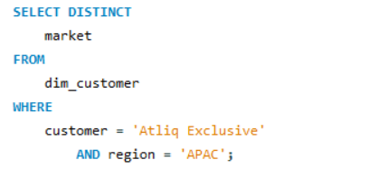
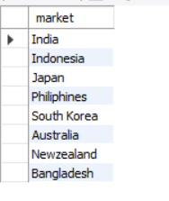
01
Provide a list of markets in which customer "Atliq Exclusive" operates its business in the APAC region.

Slide 8
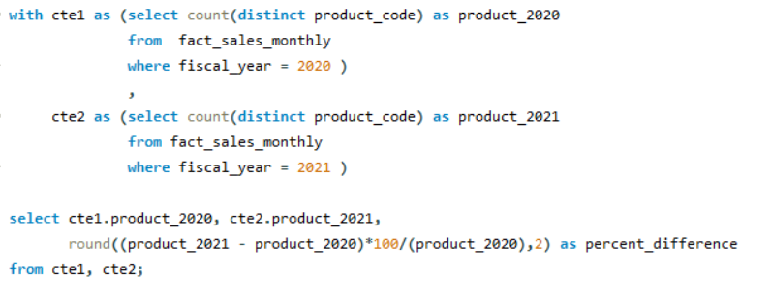
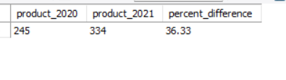
02
What is the percentage of unique product increase in 2020 vs 2021?
The final output contain these: unique_product_2020, unique_product_2021, percentage.

Slide 9
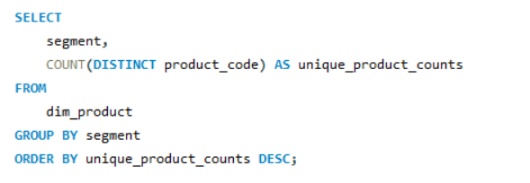
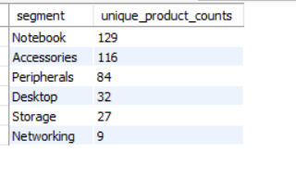
Provide a report with all the unique product counts for each segment and sort them in desc order of product counts. The final output contains two files- Segment, unique product count.
03

Slide 10
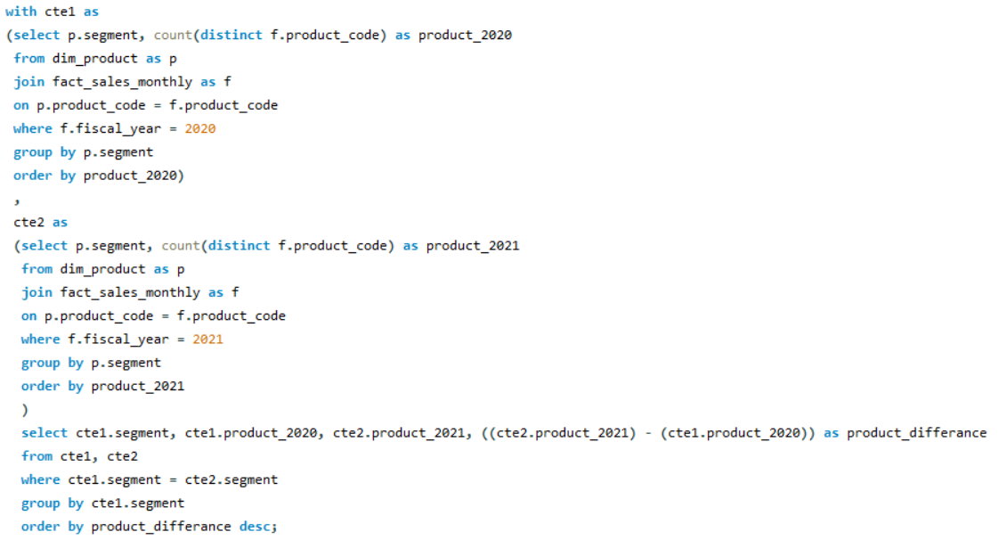
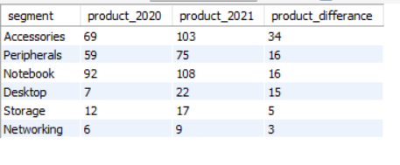
04
Which segment has the most increase in unique product 2020 vs. 2021.
The final output contain these field - segment, product_count_2020, product_count_2021

Slide 11
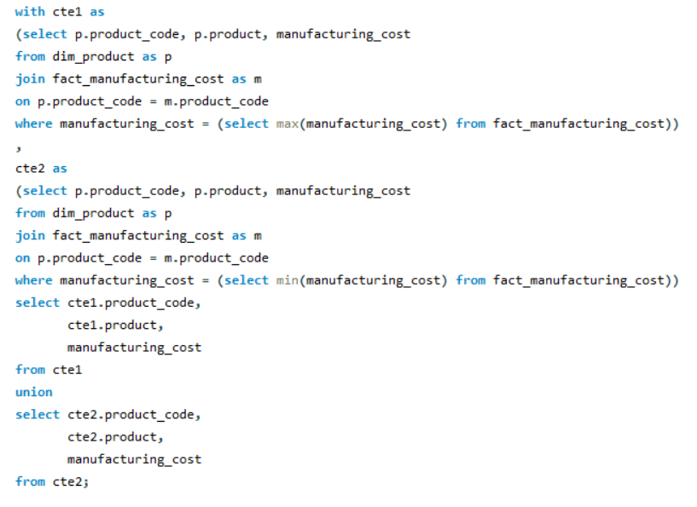
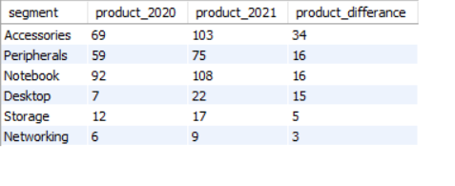
05
Get the products that have the highest and lowest manufacturing_cost.
The output should contain these field: Product_code, Product, manufacturing_cost.

Slide 12
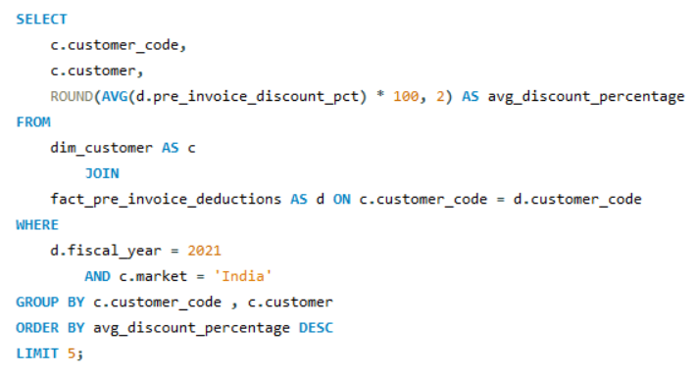
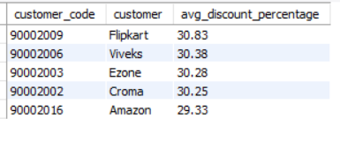
Generate a report which contain the top 5 customer who received an average high pre_invoice_discount_pct for the year 2021 and in the Indian market.
The final output contains these field: Customer, Customer code, average_discount_pct.
06

Slide 13
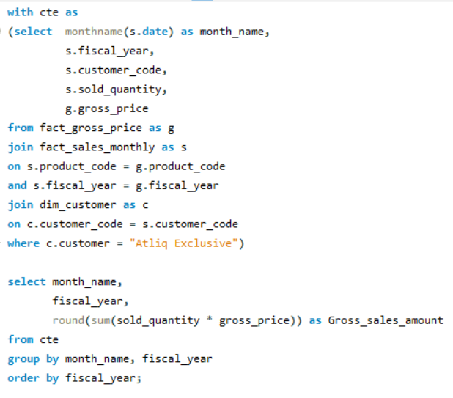
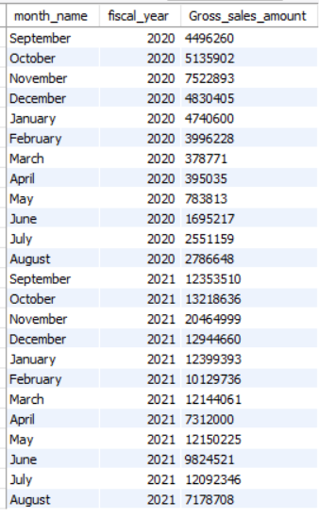
Get the complete report of the gross sales amount for the customer "Atliq Exclusive" for each month. This analysis helps to get an idea of low and high performing months and take strategic decision.
The final output contains: Month, year, gross_sales_month.
07

Slide 14
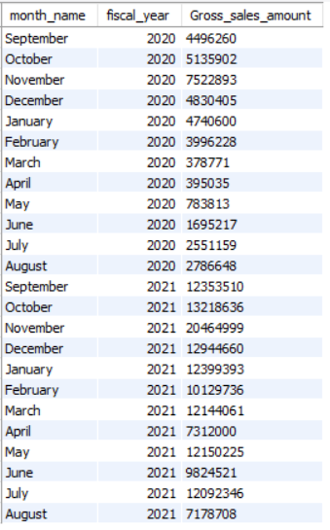
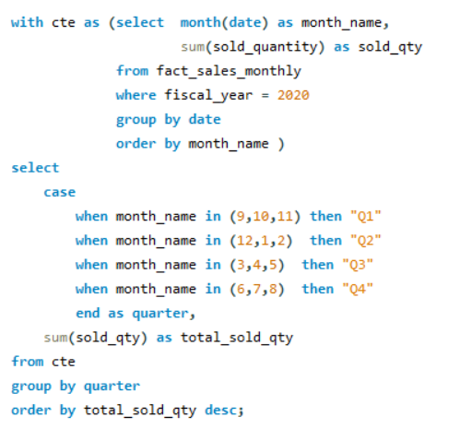
08
In which quarter of 2020, got the maximum told_sold_quntity?
The final output contain these field sorted by the total_sold_quantity.

Slide 15
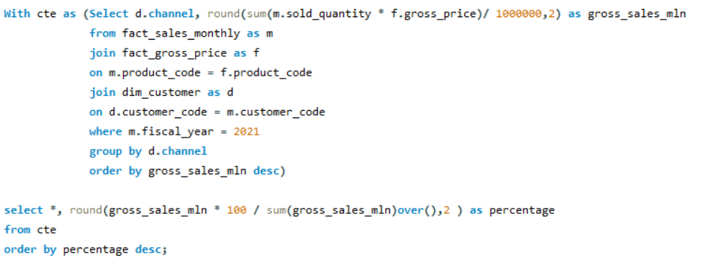
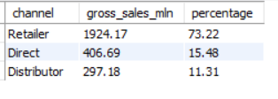
09
Which channel helped to bring more gross sales in the fiscal year 2021 and the percentage of contribution?
The final output contains: Channel, gross_sales_min_percentage.

Slide 16
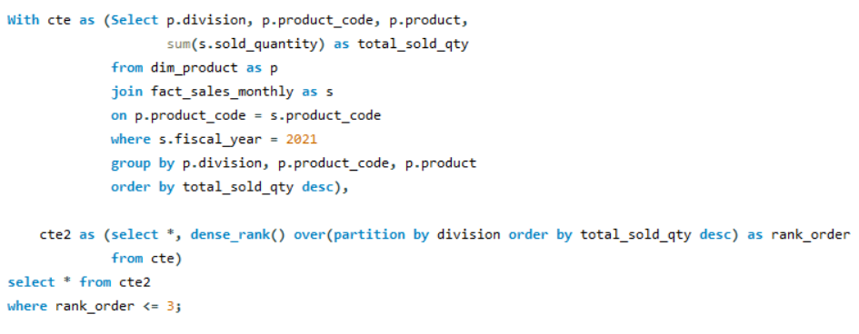
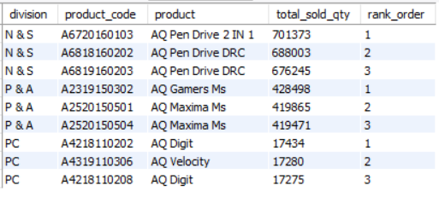
Get the top 3 products in each division that have a high total_sold_quantity in the fiscal_year_2021?
The final output contains these field: Division, Product_code, Product, Total_sold_qty, rank_order.
10

Slide 17



pujajana8509@gmail.com
https://www.linkedin.com/in/puja-jana-682267285/

