Slide 1




MiraculousHer
Learn and Grow Together
By Khushi Arora and Puja Asha Mangale

Slide 2
INDEX
Aim and Vision
Tech Stack
Azure Cognitive Services
Features of Site
Site Details
Services Details

Slide 3




Aim and Vision
Our main motive is to promote women empowerment in rural area, to achieve this goal we have taken up following practices:
Monthly scholarship exams for female learners.
Discounts on certain courses through assessments.
MiraculousHer
User friendly platform making it easy for rural women to uploading their crafts and skills.
Free certification for female.

Slide 4





Tech Stack Used
Azure Cognitive Services
HTML
CSS
WordPress

Slide 5
Azure Cognitive Services Used
AK
Speech To Text for easier searching.
Text Translation to accommodating the website for everyone.
E
A
Azure Media Player for playback video services.

Slide 6








Features
Free and Paid Courses
blogs and
articles
social
platform
Creates Employment
Certified
Courses
custom price for course
Ecommerce
Website
Ratings and Reviews

Slide 7
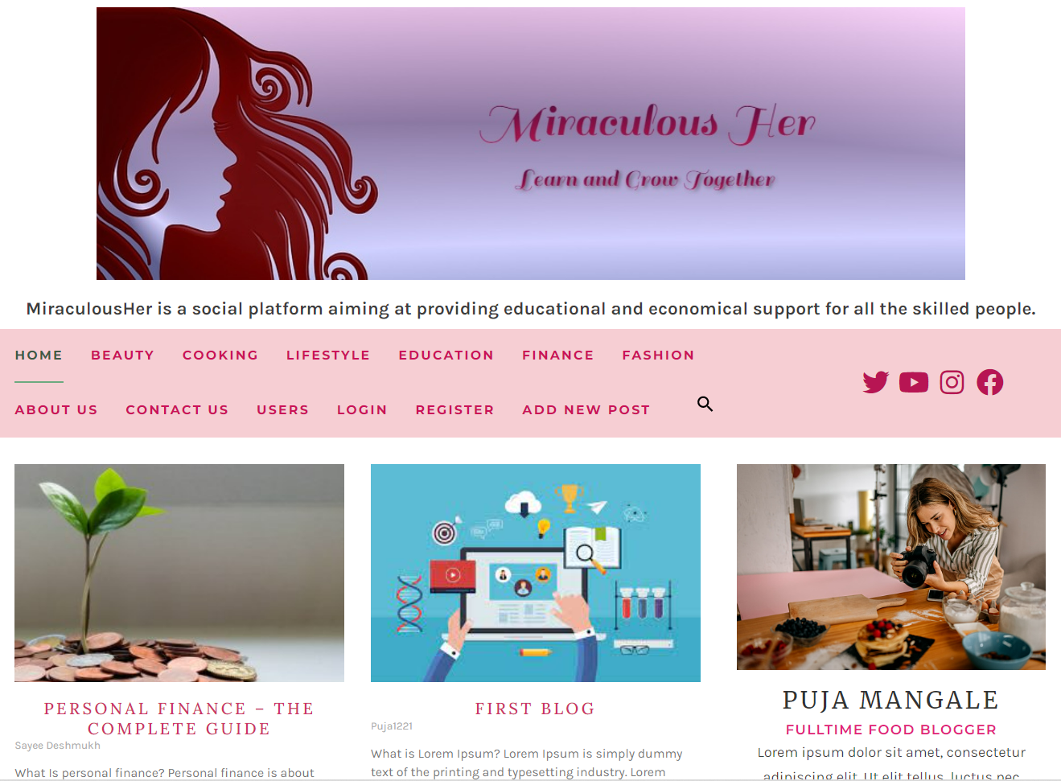
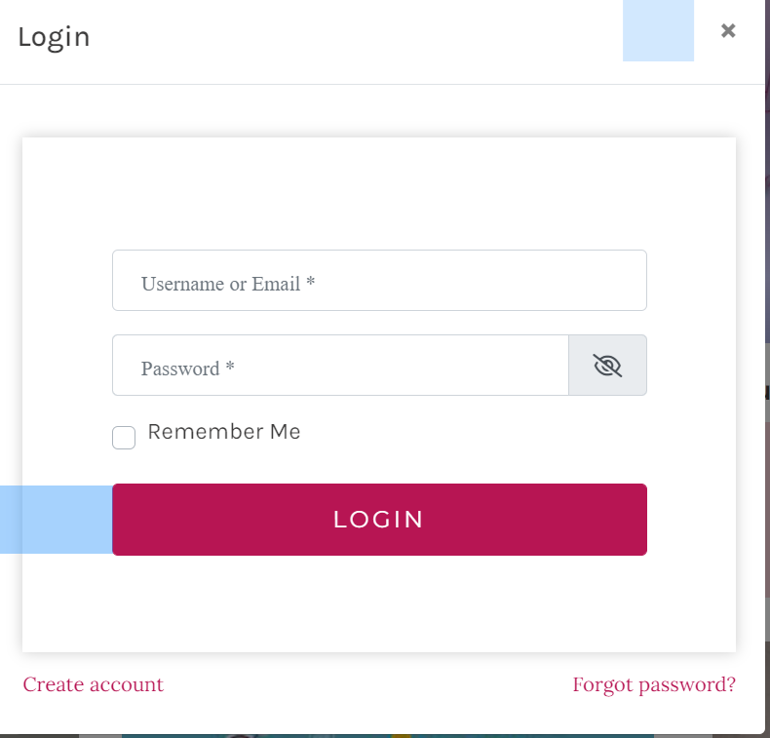
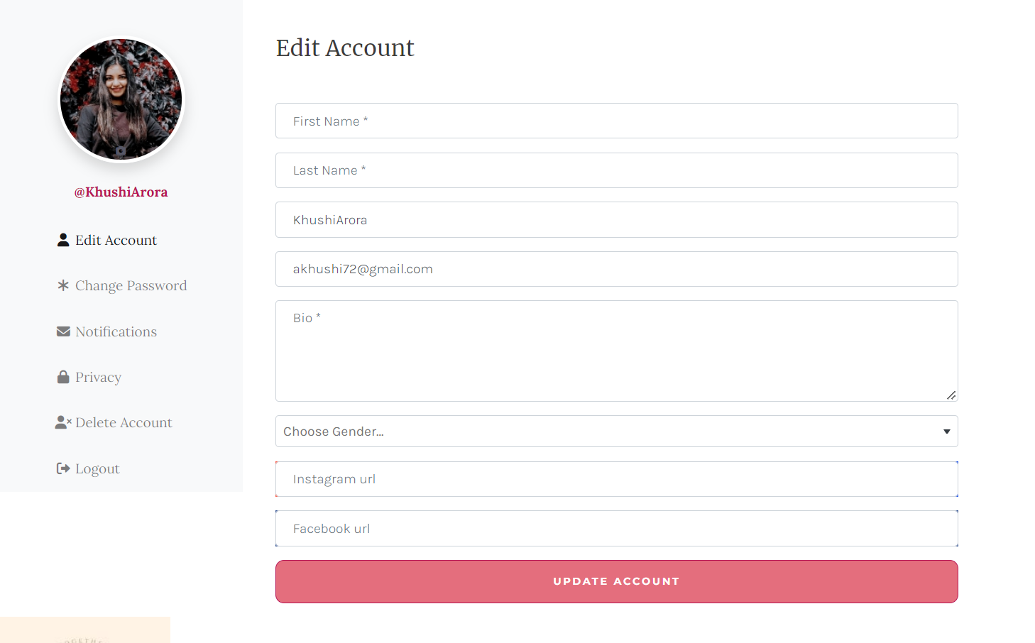
Site Details
MiraculousHer Site opens with a collection of blogs written by the User.
Blogs from variety of skill categories can be found here.
Once the user is logged in, they can edit their profile to stand out and add new blogs of their own.

Slide 8
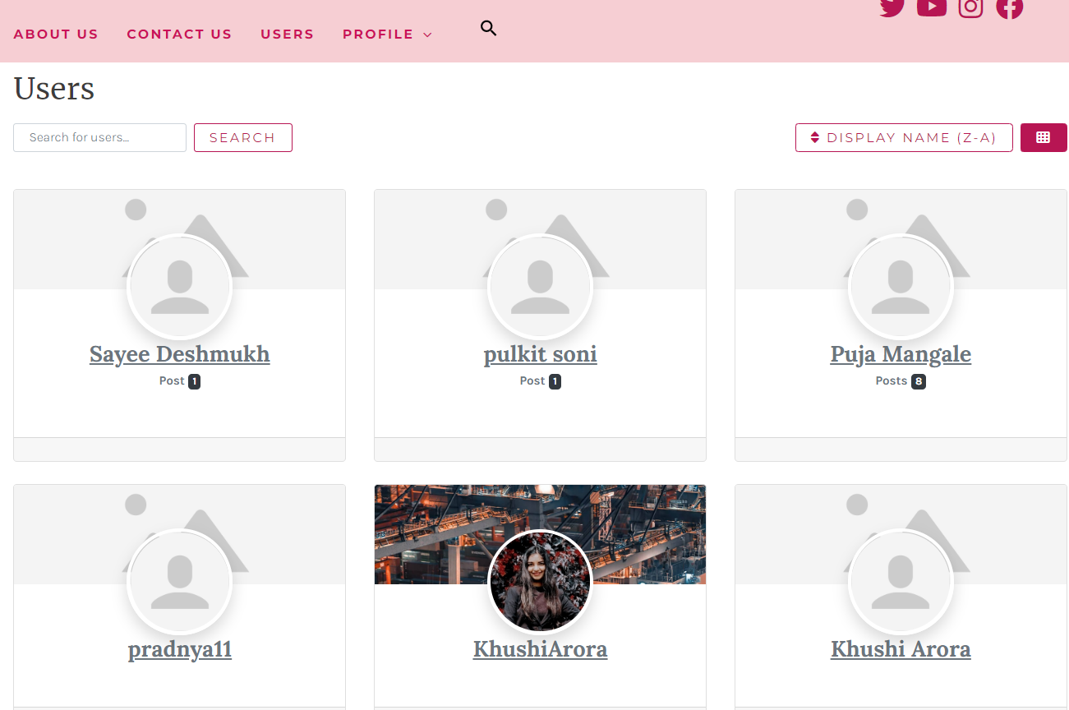
In the user section all the users are shown along with their respective number of posts for better outreach to the community.
A filter function and a search bar is added to facilitate the process more efficiently

Slide 9

Learn about the Author of the blog
Discover the popular blogs
Get sponsors from our monthly exams

Slide 10
Services Provided by our site
Creates Employment opportunities for people skilled in any craft by providing them a platform to upload tutorial videos.
Creators can write blogs and articles.
Accommodates Free and Paid Courses.
Accommodates a shopping space where creators can sell their products.
User can set custom price for their course.
Certificates certified by our plateforms are given to each customer upon finishing a skill course.
Works as a social plateform where people can follow the content creaters.
Ratings and Reviews can be added for each course and product for sale.

Slide 11
Thankyou

