Slide 1
MUSIC PLAYER USING ANDROID EMULATOR
PULIPATI VENKATA MANIKANTA SURESH
192011205
CSA3731(SOFTWARE TESTING) DATE:31/01/2023

Slide 2
PROJECT INCLUDE
1)OBJECTIVE
2)ABSTRACT
3)PROPOSED WORK
4)WORKING PROCESS
5)CONCEPT MAP
6)TEST CASE
7)APPLICATION USED
8)APPS AND TOOLS
9)APPIUM SERVER
10)IMPLEMENTATION AND TESTING
11)TESTING OUTPUT
12)CONCLUSION

Slide 3
OBJECTIVE
TO test different strategies(test cases)on music player application
To find all possible out comes of the test

Slide 4
ABSTACT
Music player consists of many buttons like play , pause etc
It consists of buttons and instructions
For every button there is one function
Based on button u can change the functions

Slide 5
PROPOSED WORK
Install android studio, intellij and Appium software
To Develop Music player application Run the Application using Android Studio Emulator. Test the Application in Appium Software. App launch, performance, instructions and buttons will be tested

Slide 6
WORKING PROCESS
INSTALL ANDROID STUDIO
PLAY/PAUSE MUSIC(TESTING)
FORWARD/BACKWARD MUSIC(TESTING)
INSTALL INTELLIJ
UPLOAD
MUSIC(TESTING)
AUTOMATE THE TESTING
INSTALL APPIUM
OPEN APPIUM SOFTWARE
POSITIVE&NEGATIVE OUTCOMES
DEVELOP APP IN ANDROID STUDIO
OPEN APP IN EMULATOR
TESTING COMPLETED

Slide 7
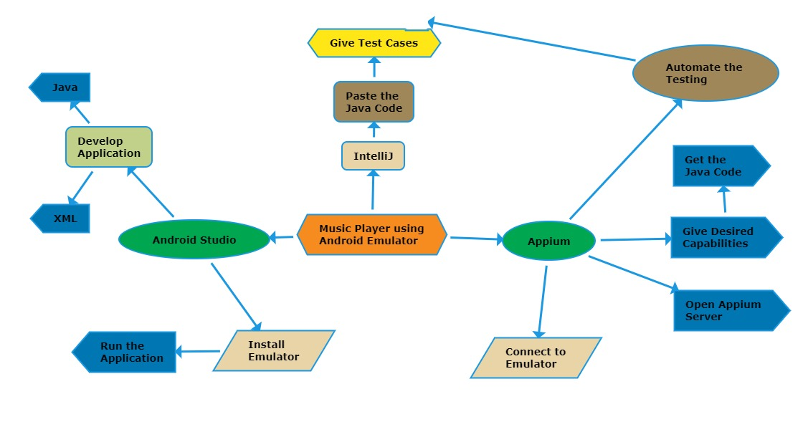
CONCEPT MAP

Slide 8
TEST CASE
Play
Pause
Forward
Backward
Upload
Search
Download
Shuffle
Repeat
Set as ring tone
Replay

Slide 9



APPLICATIONS USED

Slide 10
APPS AND TOOLS
APPIUM 1) Appium is an open source tool.
2) Appium is cross-platform.
3) It supports multiple programming languages (java, python, ruby, c# and many more). 4) Appium can work on the emulator as well as on the real devices.

Slide 11
APPS AND TOOLS
ANDROID STUDIO
It is Integrated development Environment. It has fast Emulator for App Testing.
Used to Develop applications for Android devices.
It is an open source software.

Slide 12
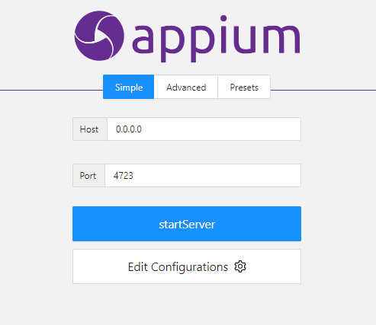
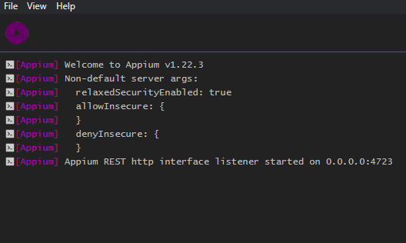
APPIUM SERVER

Slide 13
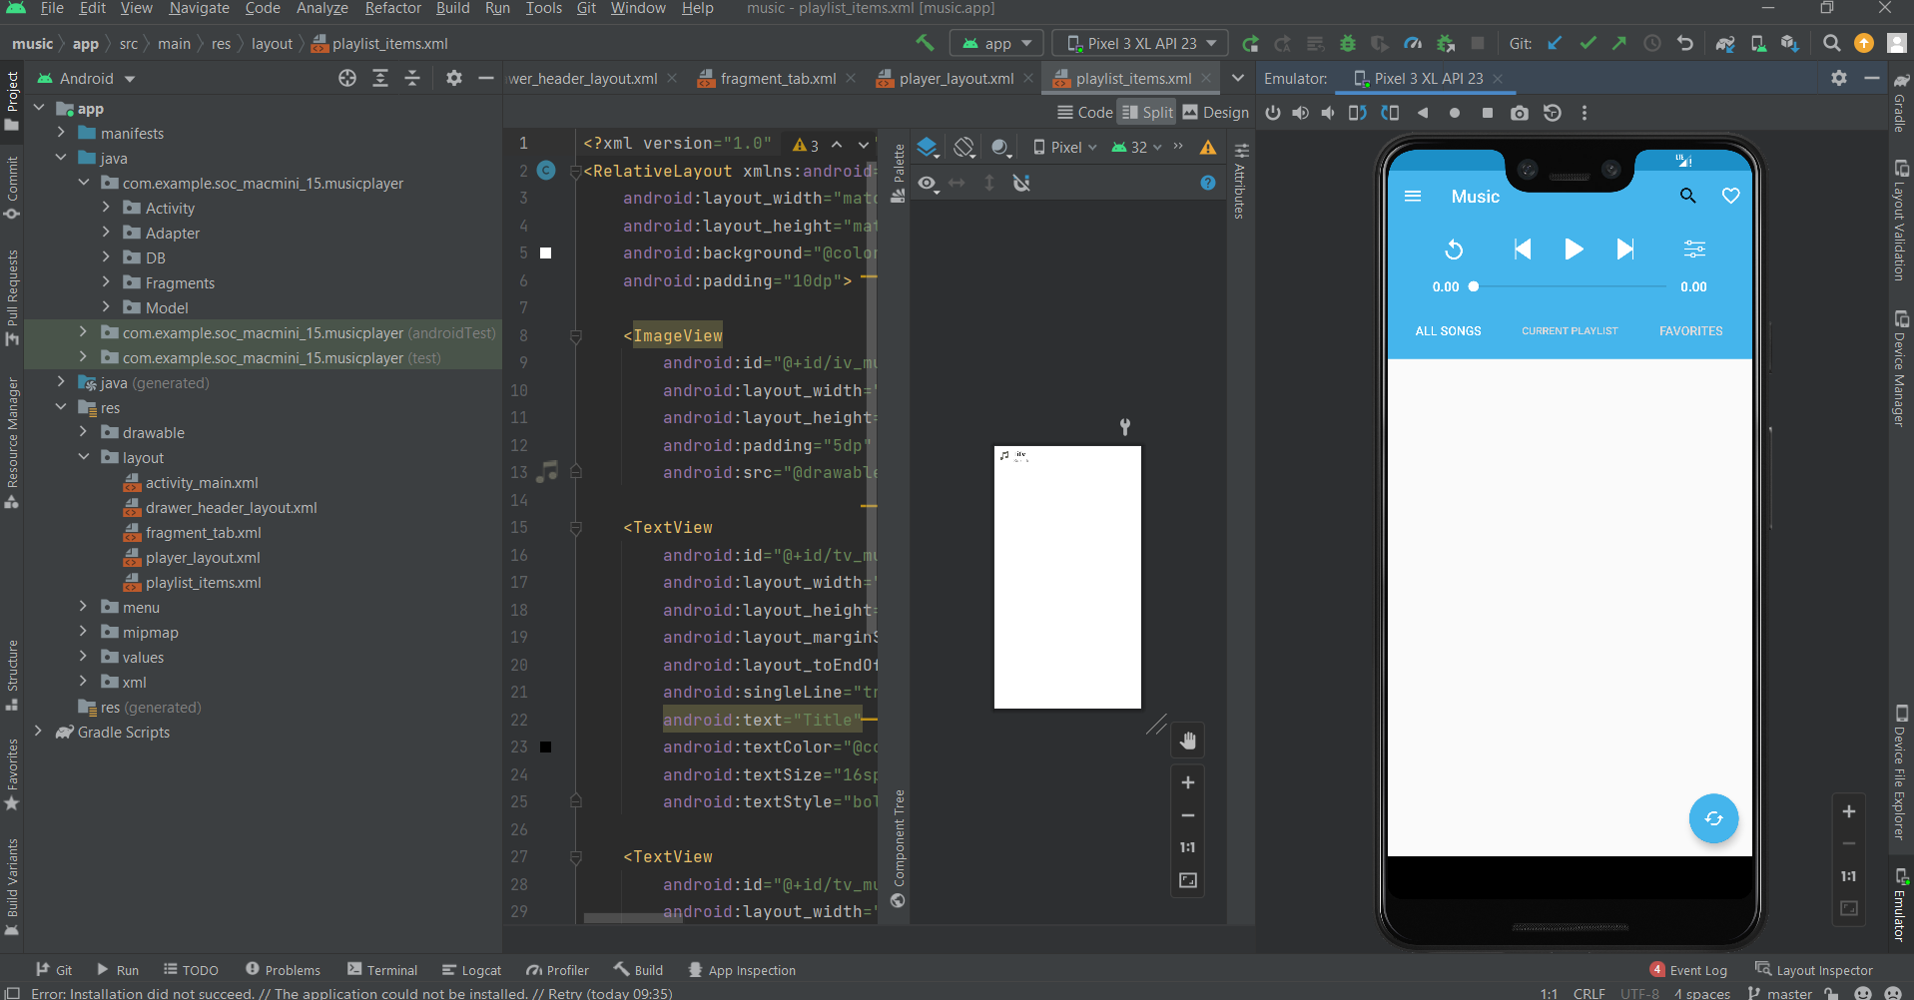
ANDROID STUDIO

Slide 14
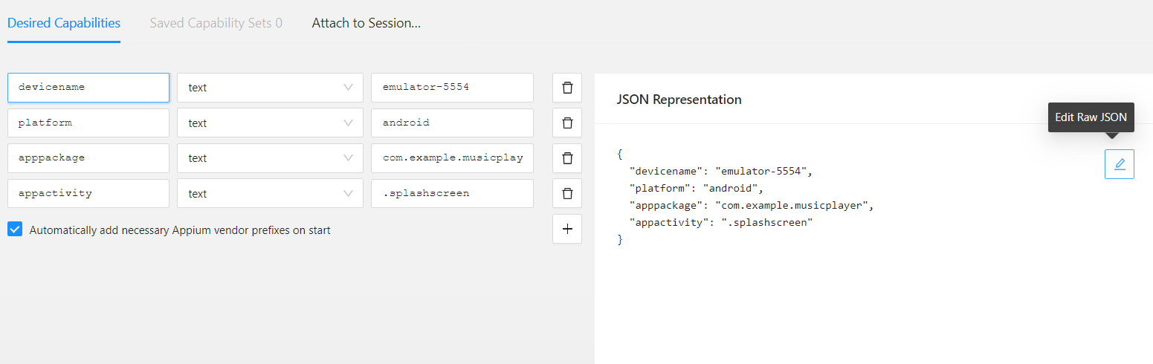
IMPLEMENTATION AND TESTING(APPIUM INSPECTOR)
Give the Desired Capabilities in Appium Inspector.
It will start the session and gives you java code to start testing.
Paste the code in IntelliJ IDE and Start the Testing.

Slide 15
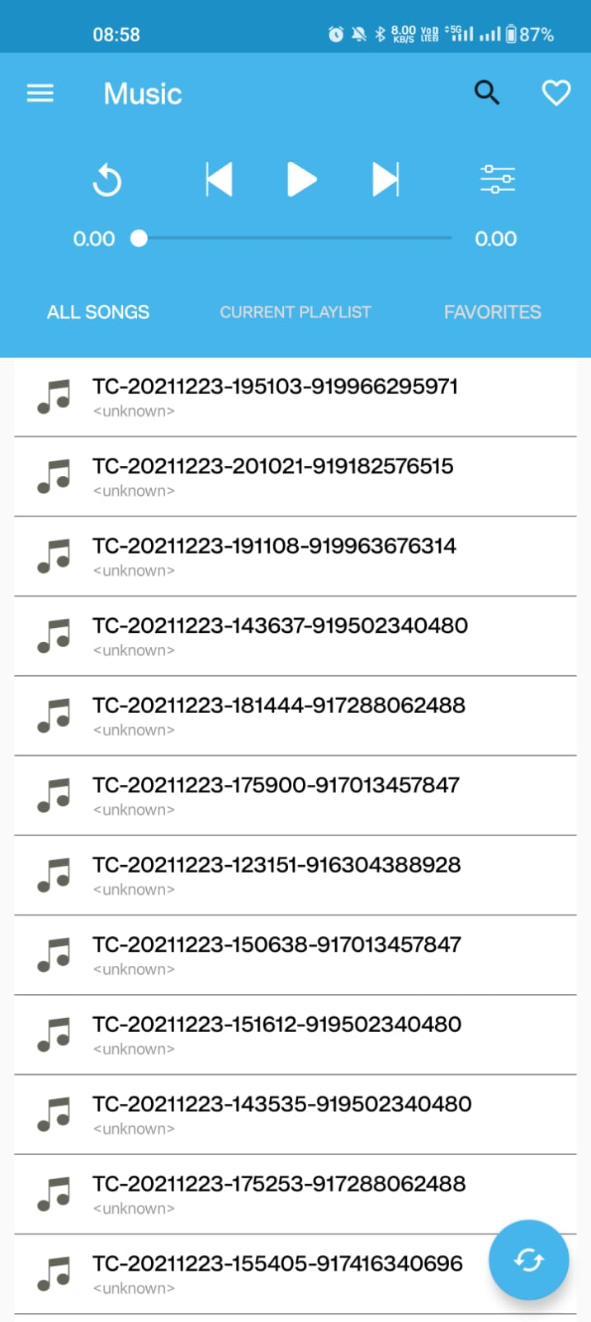
TESTING OUTPUT

Slide 16
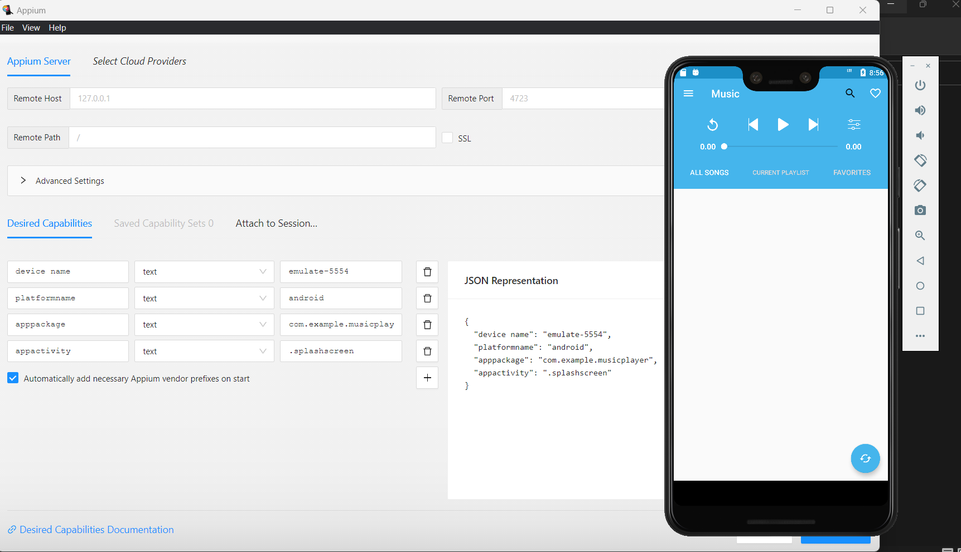
TESTING OUTPUT

Slide 17
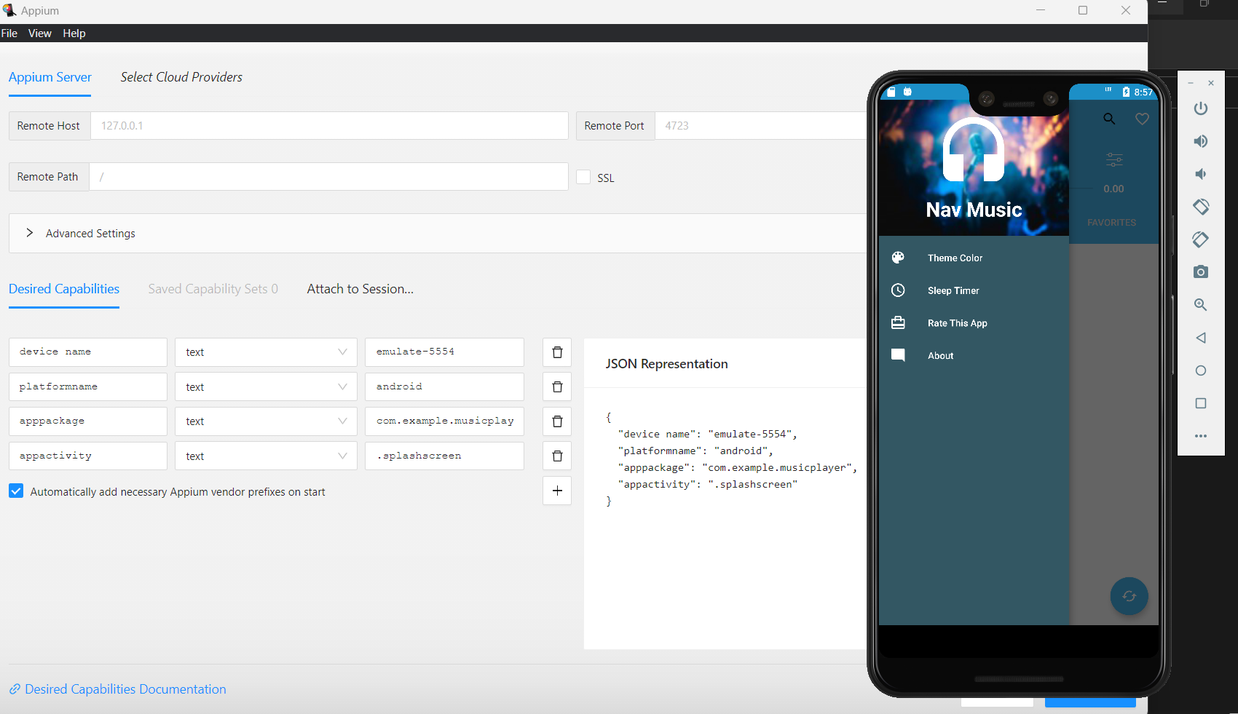
TESTING OUTPUT

Slide 18
TEST CASE OUTCOMES
TEST CASES | RESULT
CHECKING WHETHER TRACK IS PLAYING | POSITIVE
CHECKING WHETHER TRACK IS PAUSE OR NOT | POSITIVE
VERIFYING THE SONG IS MOVING FORWARD | POSITIVE
VERIFYING THE SONG IS MOVING BACKWARD | POSITIVE
WHETHER THE SONG IS UPLOAD | NEGATIVE
CHECKING THE SONGS ARE SEARCHING OR NOT | POSITIVE
CHECKING THE ONLINE SONGS ARE DOWLOADING | NEGATIVE
VERIFYING SUFFLE BUTTON IS WORKING OR NOT | POSITIVE
VERIFYING REPEAT BUTTON IS WORKING OR NOT | POSITIVE
CHECKING IT POSSIBLE SET AS RING TONE | NEGATIVE
VERIFYING THE SONG IS REPLAYING OR NOT | POSITIVE

Slide 19
CONCLUSION
Hence , the music player is Developed using the Android Studio. Then , the music player accessed using the Emulator. All the Buttons, instructions and Possible Outcomes were Tested using the Appium Server.
The testcases i.e , play , pause etc are getting positive out comes
The testcases i.e , online download , set as ring tone, upload are getting negative out comes
80 percentage of test cases are positive
20 percentage of test cases are negative

