Slide 1

GLA UNIVERSITY
TOPIC: MINI PROJECT ON HOSTEL ACCOMODATION : PGLife

Slide 2
SUBMITTED BY: SUBMITTED TO:
Name: Puneet kumar
Id: Puneet.kumar_cs20@gla.ac.in Dr. Manoj Varshney
University Roll no: 201500534 (Assistant Professor)
K-45

Slide 3
INTRODUCTION The main objective of the Hotel Booking System is to manage the details of Hotel, Rooms, Services, Customers. It manages all the information about Hotel, Booking, Customers, Hotel. The project is totally built at administrative end and thus only the administrator is guaranteed the access. The purpose of the project is to build an application program to reduce the manual work for managing the Hotel, Booking, Rooms. It tracks all the details about the Rooms, Services, Customers.

Slide 4
About the Project The project named “PGLife” is a Food is a hostel accomodation website where The aim of developing the Online hostel booking project is to replace the traditional way of going physically to the place with a computerized system. Another important reason for developing this project is to prepare order summary reports quickly and in the correct format at any point in time when required.

Slide 5
EXISTING SYSTEM
The existing system work manually. The existing system has got lot of intricacies within itself and need lot of human effort and paper works. All above the data need to be maintained on ledgers and maintaining this is a tedious and risky process. As the transactions increases, so the data too. So the task of maintaining them increases exponentially. To view a data may need lot of paper to be searched.
Some of the negative aspects of the existing system are as follows:
Time Consuming:
Course of action is time consuming. Wherever a need for search arises, the process evolves search through paper records.
Readability Problem:
Readability of records is constrained. All the records may not be handled or written by the same person. So the format and style of records differ and hence it is difficult to understand.
Reliability:
Paper records are easily damaged in course of time. The life time of paper record is unreliable less that it easily gets spoiled.
Man Power:
Expenditure is high. Manual system needs added man power.
Security Problem:
Prone to corruption by unauthorized users. Securing of manual system is not fully guaranteed. Inaccuracy can be expected. Data can get easily scratched.
Complicated Page:
Techniques used are more complicated. Proper techniques are not exposed, so the functioning is intricate.

Slide 6
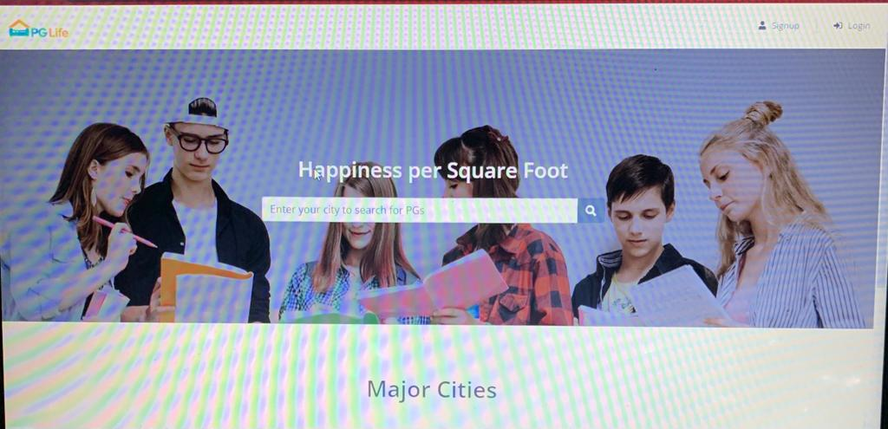
THIS IS HOW FRONTEND LOOKS LIKE

Slide 7
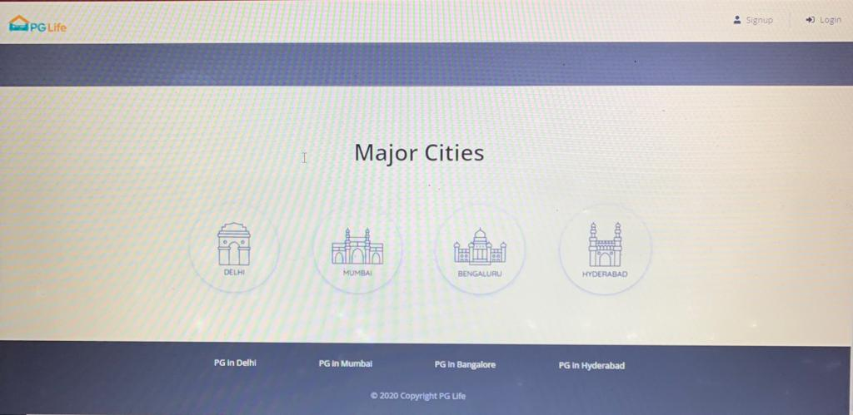
Footer Section looks like.

Slide 8
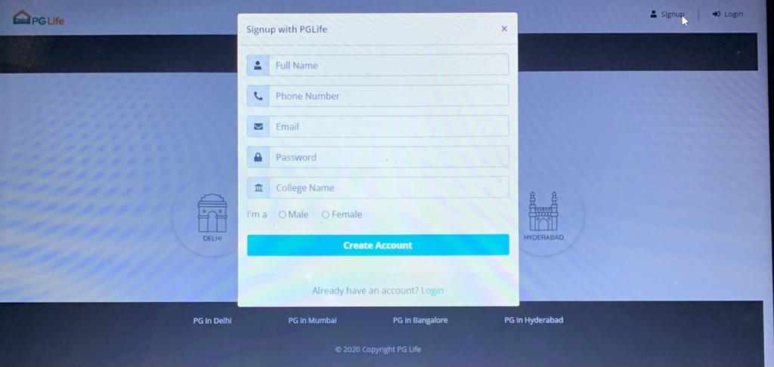
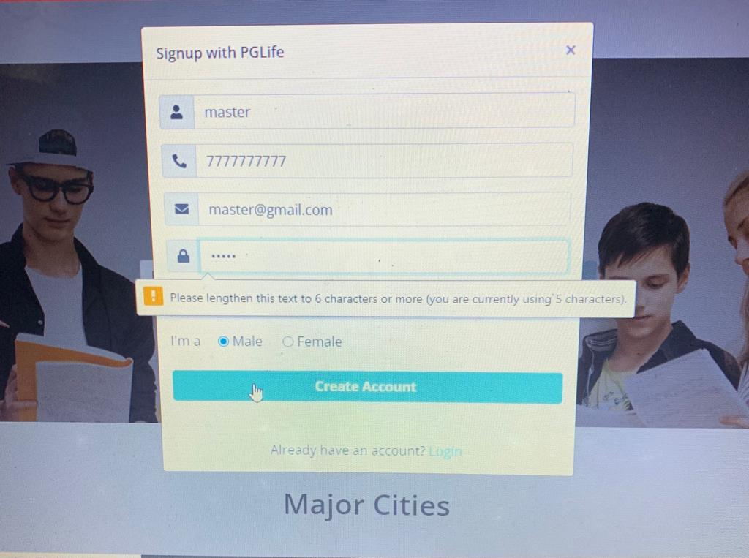
SIGNUP PAGE WITH PARAMETERS WARNING!
Signup page
If password is not Strong

Slide 9
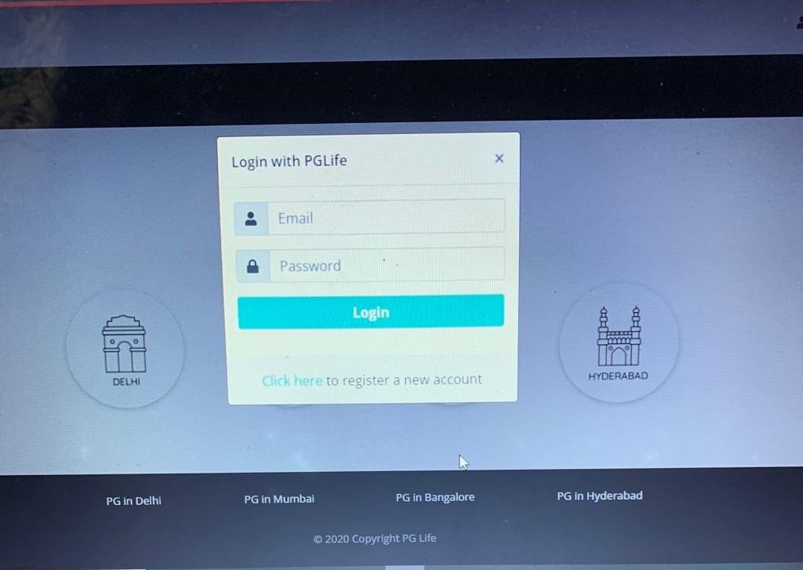
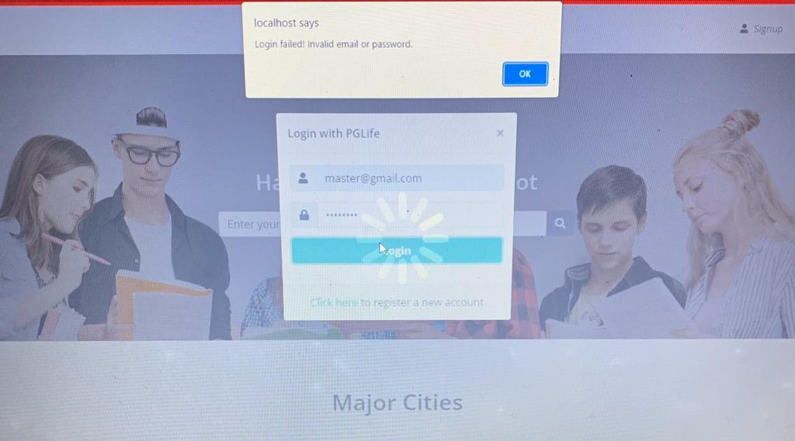
LOGIN MODAL.
LOGIN PAGE
SECURITY POPUP

Slide 10
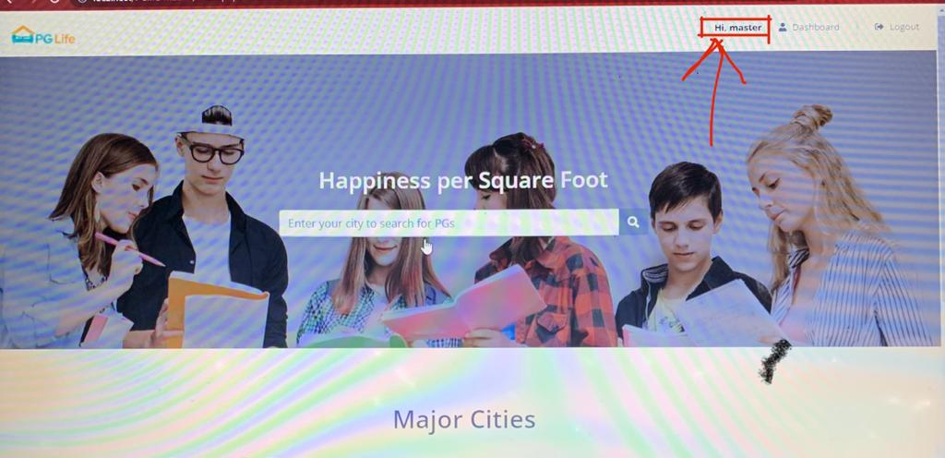
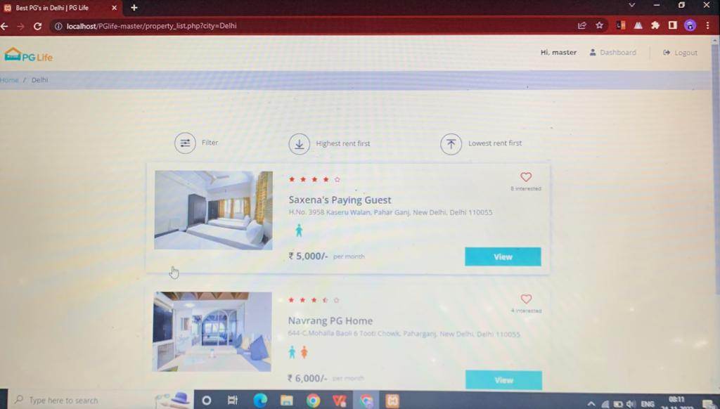
HOME PAGE
PROPERTY LIST PAGE

Slide 11
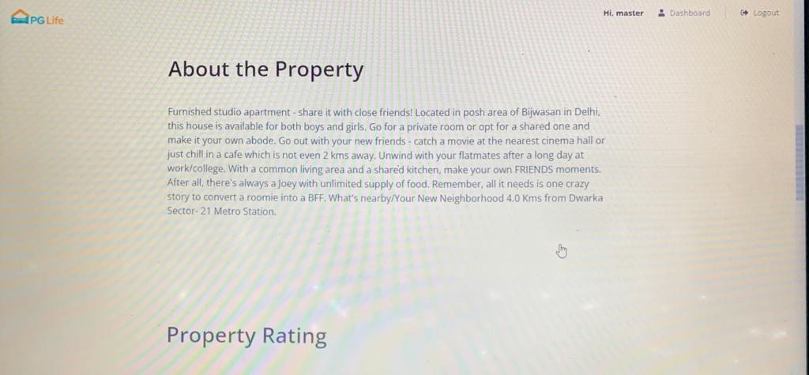
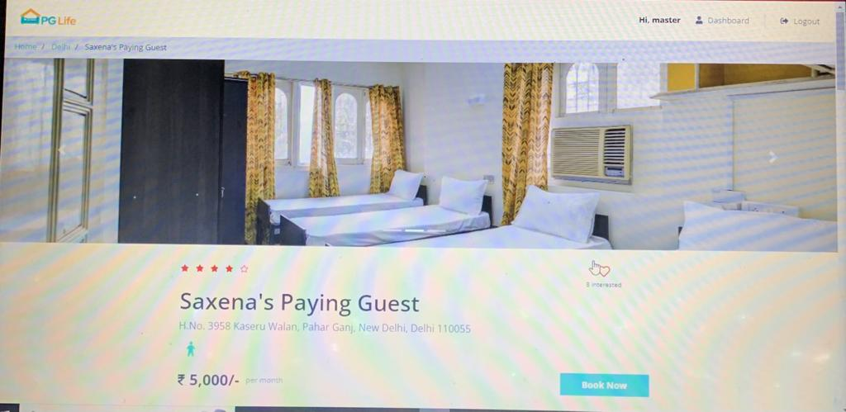
PROPERTY DETAILS
ABOUT PROPRTY

Slide 12
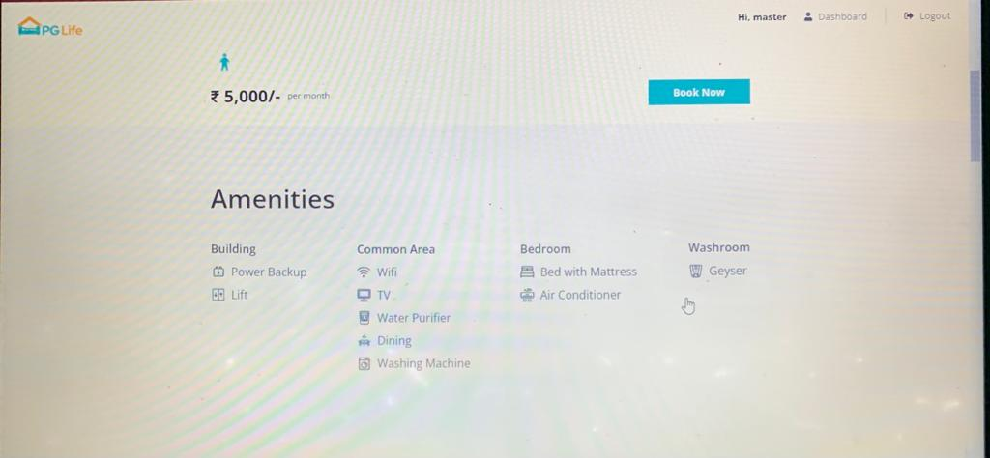
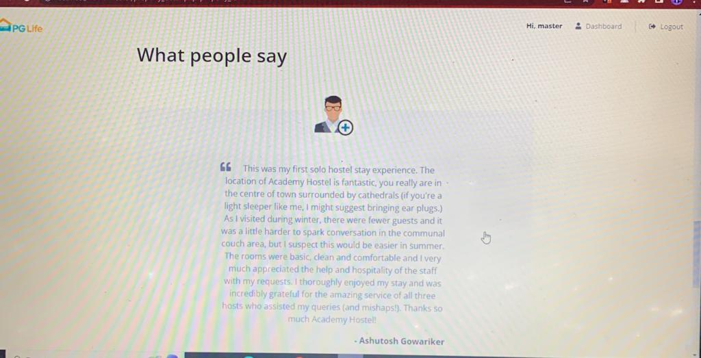
AMENITIES
TESTIMONIALS

Slide 13
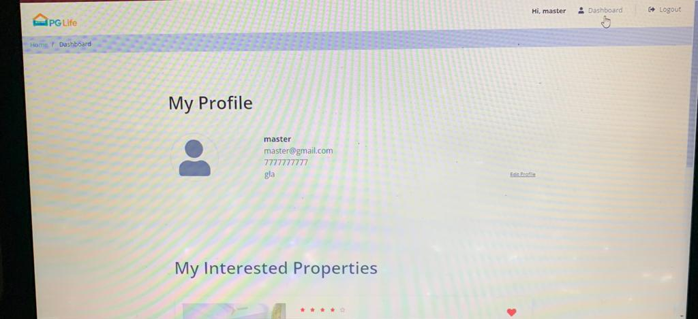
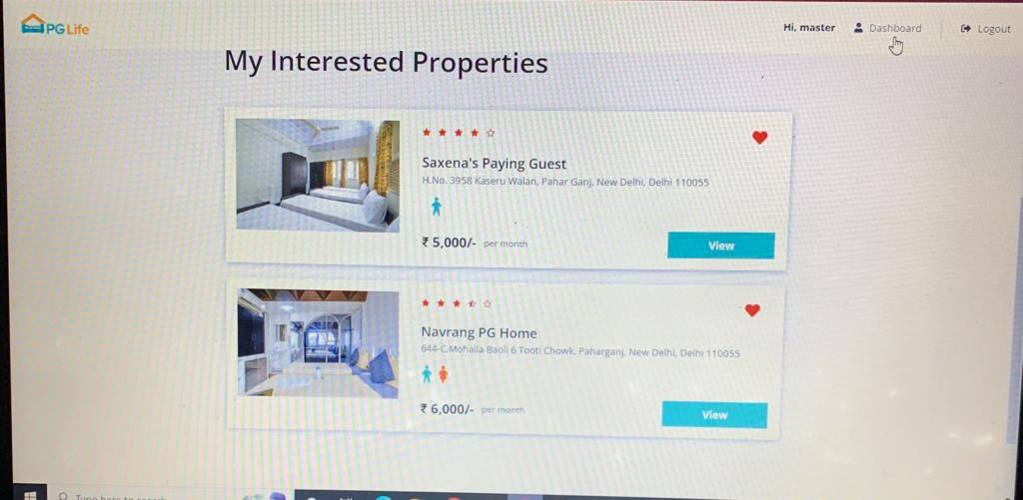
DASHBOASRD
INTERESTED PROPERTIES

Slide 14
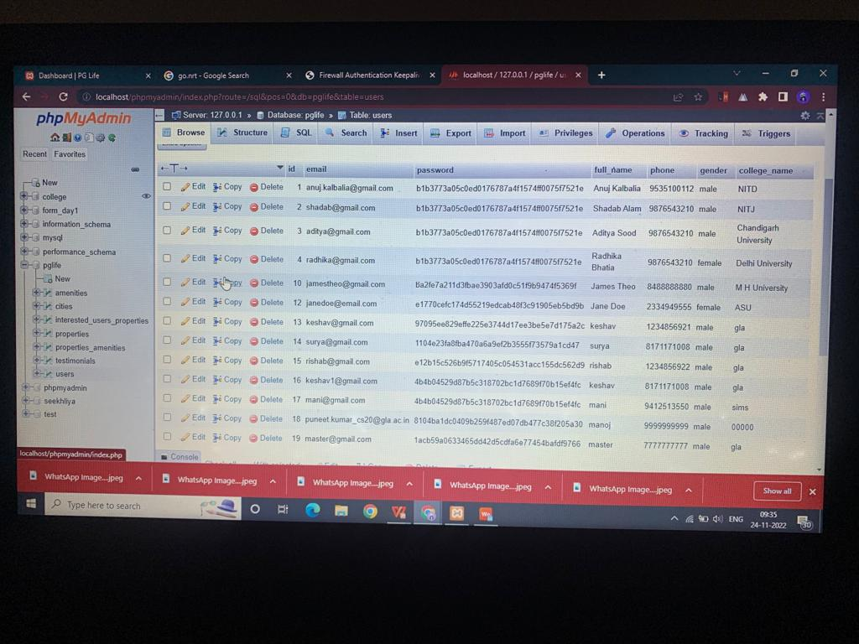
DATABASE

Slide 15
Thank you

