Slide 1
🎓
Smart College Event Management System
Database Design & Methodology
DBMS Mini Project
4 Tables • BCNF Normalized • ER Model • Referential Integrity
Triggers • Views • Transactions • Indexes • ACID Properties

Slide 2
📌 Problem Statement
Colleges conduct numerous events (workshops, fests, seminars) throughout the year.
Managing registrations manually leads to:
▸ Overbooking — more students registered than seats available
▸ Data redundancy — same information stored in multiple places
▸ No tracking — no record of who registered for what
Our Solution
👨‍🎓 For Students
🛡️ For Admins
🗄️ Database Goals
▸ Register using USN (unique ID)
▸ Browse & search events
▸ Register/unregister for events
▸ View their registrations
▸ Create, edit, delete events
▸ View registrations per event
▸ Manage student records
▸ See participation summary
▸ Eliminate data redundancy
▸ Ensure data integrity
▸ Prevent overbooking automatically
▸ ACID-compliant transactions

Slide 3
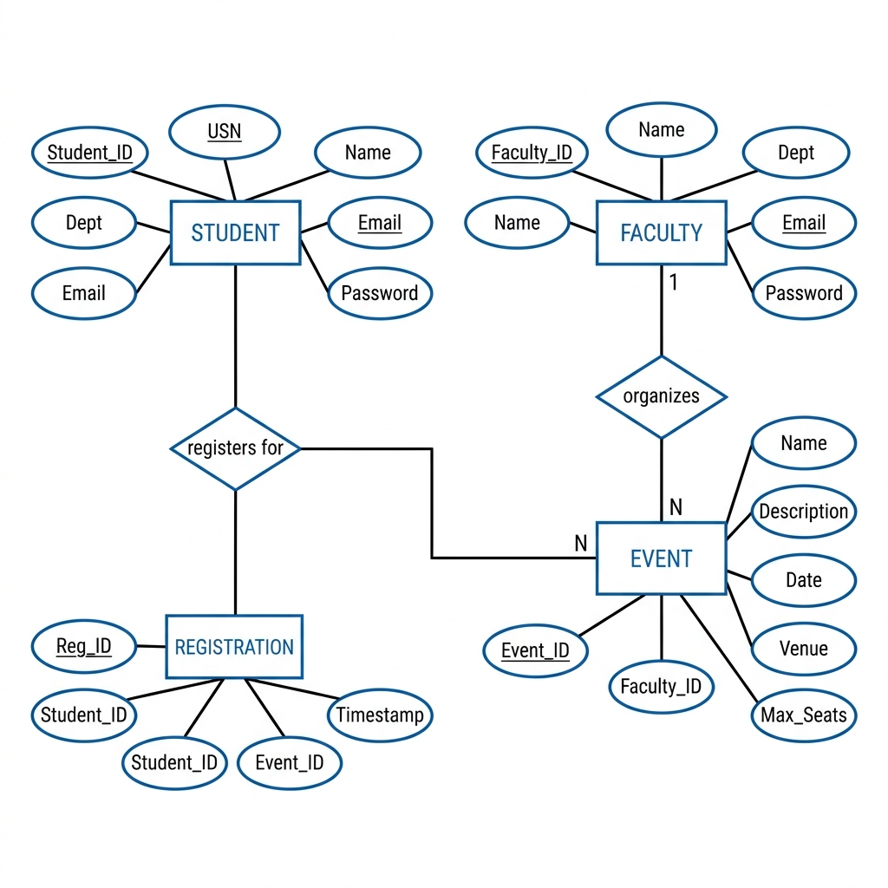
📐 Entity-Relationship (ER) Diagram
Entities
▸ STUDENT — stores student data (USN, name, dept)
▸ FACULTY — stores admin data
▸ EVENT — stores event details (name, date, venue)
▸ REGISTRATION — links students to events
Relationships
▸ Faculty ORGANIZES Events → 1 : N
▸ Students REGISTER FOR Events → M : N
Key Observation
▸ M:N relationship resolved via REGISTRATION table
▸ Acts as a junction/bridge table

Slide 4
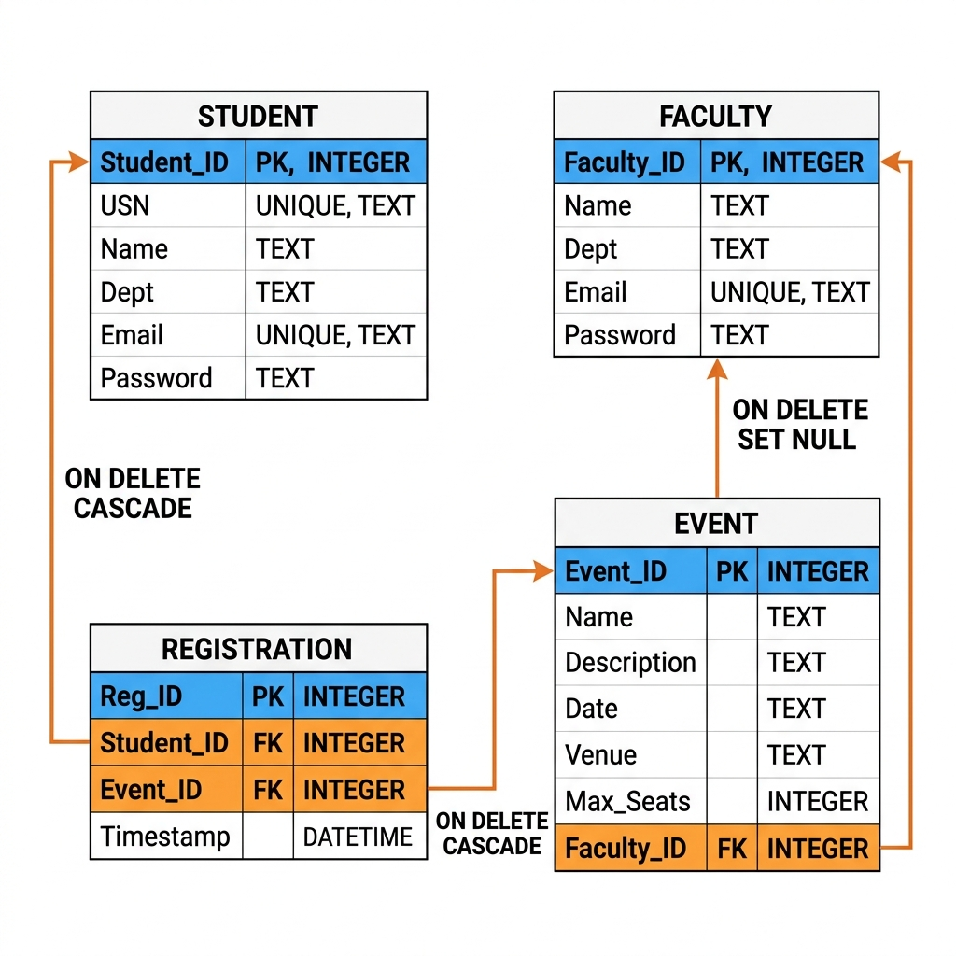
🗂️ Relational Schema
Primary Keys (Blue)
▸ Student_ID — uniquely identifies each student
▸ Faculty_ID — uniquely identifies each admin
▸ Event_ID — uniquely identifies each event
▸ Reg_ID — uniquely identifies each registration
Foreign Keys (Orange)
▸ EVENT.Faculty_ID → FACULTY (ON DELETE SET NULL)
▸ REG.Student_ID → STUDENT (ON DELETE CASCADE)
▸ REG.Event_ID → EVENT (ON DELETE CASCADE)
▸ Ensures referential integrity across tables
Unique Constraints
▸ Student USN — primary identity for students
▸ Student & Faculty Email — prevents duplicates
▸ UNIQUE(Student_ID, Event_ID) — no double registration

Slide 5
✅ Normalization — BCNF
All tables satisfy Boyce-Codd Normal Form, eliminating all anomalies
1NF
2NF
3NF
BCNF
First Normal Form
Second Normal Form
Third Normal Form
Boyce-Codd NF
▸ All attribute values are atomic
▸ No multi-valued attributes
▸ No repeating groups
▸ Each cell has a single value
▸ Satisfies 1NF
▸ No partial dependencies
▸ Non-key attributes depend on
the ENTIRE primary key
▸ Satisfies 2NF
▸ No transitive dependencies
▸ Non-key attributes depend
ONLY on primary key
▸ Satisfies 3NF
▸ Every determinant is a
candidate key
▸ Strictest practical form
Why Normalize?
Without normalization, databases suffer from anomalies:
▸ Insertion Anomaly — cannot add data without unrelated data
▸ Update Anomaly — inconsistency when same data stored in multiple rows
▸ Deletion Anomaly — deleting one record accidentally removes other needed data

Slide 6
🔒 Data Integrity & Constraints
🔑 Entity Integrity
🔗 Referential Integrity
🛡️ Domain Integrity
▸ Every table has a PRIMARY KEY
▸ Primary keys are auto-incremented
▸ PRIMARY KEY = NOT NULL + UNIQUE
▸ Guarantees every row is identifiable
▸ Foreign keys reference valid primary keys
▸ ON DELETE CASCADE — auto-remove child rows
▸ ON DELETE SET NULL — preserve but unlink
▸ No orphan records possible
▸ NOT NULL — required fields enforced
▸ UNIQUE — no duplicate USN or email
▸ DEFAULT values — Max_Seats = 100
▸ TEXT, INTEGER types enforce format
Constraints Applied in Our Schema
PRIMARY KEY → Student_ID, Faculty_ID, Event_ID, Reg_ID (Unique row identifier)
FOREIGN KEY → EVENT → FACULTY, REGISTRATION → STUDENT, EVENT (Referential links)
UNIQUE → Student USN, Student Email, Faculty Email (No duplicates)
NOT NULL → Name, Email, Password, USN, Date, Venue (Required fields)
COMPOSITE UNIQUE → UNIQUE(Student_ID, Event_ID) in REGISTRATION (Prevents double registration)
DEFAULT → Max_Seats DEFAULT 100, Timestamp DEFAULT CURRENT_TIMESTAMP (Auto-fill values)

Slide 7
⚡ Database Features — Trigger & View
⚡ Trigger: Prevent Overbooking
👁️ View: Participation Summary
Type: BEFORE INSERT trigger on REGISTRATION
What it does:
▸ Fires automatically before any new registration
▸ Counts current registrations for that event
▸ Compares count with Max_Seats of the event
▸ If event is FULL → ABORTs the insert automatically
Why it matters:
▸ Database-level enforcement, not just application code
▸ Impossible to overbook even via direct SQL access
▸ Ensures data consistency at all times
View Name: vw_event_participation
What it does:
▸ A virtual table (no data stored separately)
▸ JOINs 3 tables: EVENT + FACULTY + REGISTRATION
▸ Uses GROUP BY to count participants per event
▸ Shows event name, date, venue, admin, count
Why it matters:
▸ Simplifies complex queries into a single access
▸ Always returns real-time data from base tables
▸ Used in admin dashboard for live statistics

Slide 8
🔄 Transactions & ACID Properties
Transaction: Event Registration Flow
A
C
I
D
Step 1 → BEGIN transaction
Step 2 → Verify event exists in database
Step 3 → Insert registration (trigger checks capacity)
Step 4a → COMMIT if everything succeeds ✓
Step 4b → ROLLBACK if any error occurs ✗
→ Either ALL steps succeed or NONE take effect
Atomicity
Consistency
Isolation
Durability
All or nothing — partial operations are impossible
Database moves from one valid state to another
Concurrent transactions don't interfere with each other
Once committed, data survives system crashes
📑 Indexes for Performance Optimization
▸ Index on REGISTRATION(Student_ID)
→ Fast lookup of student's registrations
▸ Index on REGISTRATION(Event_ID)
→ Fast participant count per event
▸ Index on EVENT(Faculty_ID)
→ Fast lookup of admin's events
▸ Index on EVENT(Date)
→ Fast sorting and filtering by date

Slide 9
📝 SQL Operations & Methodology
Data Manipulation & Queries
Advanced Features
INSERT
Adding new students, admins, events, registrations
GROUP BY
Counting participants per event (aggregation)
SELECT
Querying data with WHERE, LIKE for search/filter
SUBQUERY
Inline participant count within SELECT statements
UPDATE
Modifying event details (name, date, venue, seats)
TRIGGER
Automatic overbooking prevention (BEFORE INSERT)
DELETE
Removing events, students, and registrations
VIEW
Virtual table for participation summary
JOIN
LEFT JOIN across 3 tables (Event ↔ Faculty ↔ Registration)
TRANSACTION
ACID-compliant BEGIN / COMMIT / ROLLBACK

Slide 10
🎉
Thank You!
Smart College Event Management System
4
BCNF
1
1
4
ACID
Tables
Normalized
Trigger
View
Indexes
Compliant
Questions?

