Slide 1

Employee Data Analysis Using Excel
STUDENT NAME: PUNITHA R
REGISTER NO: E238508582D3A94936647D66CFBF2E8C ,312208744
DEPARTMENT: B.COM(GENERAL)
COLLEGE: MEENAKSHI COLLEGE FOR WOMEN
1

Slide 2
PROJECT TITLE
Employee Data Analysis Based Job Role, Level, Gender Using Excel
2

Slide 3




AGENDA
1.Problem Statement 2.Project Overview 3.End Users
4.Our Solution and Proposition 5.Dataset Description 6.Modelling Approach 7.Results and Discussion 8.Conclusion
3/21/2024 Annual Review
3

Slide 4

PROBLEM STATEMENT
Analyze the gender distribution across various job roles and levels within the organization
to identify potential imbalances or trends
that could inform diversity and inclusion initiatives.
4

Slide 5

PROJECT OVERVIEW
Pivot Tables for distribution analysis, and create visualizations. Identify trends and imbalances, then provide HR recommendations.
Summarize findings in a dashboard and present to stakeholders.
5

Slide 6

WHO ARE THE END USERS?
HUMAN RESOURCE DEPARTMENTS
MANAGEMENT AND LEADERSHIP
TEAM LEADERS AND SUPERVISORS
EMPLOYEES
EXECUTIVE LEADERSHIP
BUSINESS ANALYSTS
RECRUITERS
6

Slide 7

OUR SOLUTION AND ITS VALUE PROPOSITION
FILTERING- REMOVE VALUES
PIVOT TABLE - SUMMARY OF EMPLOYEE PERFORMANCE
BAR DIAGRAM - FINAL REPORT
7

Slide 8
Dataset Description
EMPLOYEE DATA SET- NAN MUDHALVAN PORTAL
9 FEATURES IN EXCEL:
EMPLOYEE ID- ALPHANUMERIC(TEXT)
AGE- NUMERICAL(TEXT)
GENDER- ALPHABETICAL(TEXT) JOBROLE - ALPHABETICAL(TEXT) SALARY - NUMERICAL
JOB LEVEL- ALPHANUMERIC(TEXT) NUMBER OF PROMOTION- NUMERICAL EMPLOYEE TYPE- ALPHABETICAL(TEXT)
EMPLOYEE LOCATION- ALPHABETICAL(TEXT)
3 FEATURES USED:
DEPARTMENT - ALPHABETICAL(TEXT)
EMPLOYEE RECOGNITION - ALPHABETICAL(TEXT)
EMPLOYEE TYPE- ALPHABETICAL(TEXT)

Slide 9


THE "WOW" IN OUR SOLUTION
Apply Conditional Formatting to highlight gender disparities.
Create custom Calculated Fields for insights like gender ratio.
Visualize with clustered bar or stacked column charts.
3/21/2024 Annual Re

Slide 10
MODELLING
STEP -1
DOWNLOAD THE EMPLOYEE DATASET AND OPEN THE EMPLOYEE DATASET IN EXCEL.
STEP -2
SELECT THE ENTIRE DATA AND CLICK ON DATA AND CLICK ON FILTER OPTION.
STEP -3
FILTER FTP FROM A TO Z ORDER.
STEP -4
SELECT THE ENTIRE DATA AND CLICK ON INSERT AND CLICK ON PIVOT TABLE TO CREATE PIVOT TABLE.
10

Slide 11
STEP -5
DRAG THE NEEDED DATA AND CREATE A PIVOT TABLE.
STEP -6
SELECT THE PIVOT TABLE AND CLICK ON INSERT.
STEP-7
NOW CLICK ON THE CHART THAT YOU WANT.
STEP -8
THE CHART IS CREATED.

Slide 12
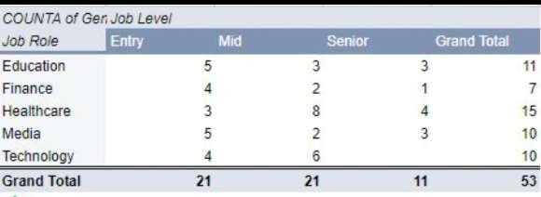
RESULTS 1.TABLE
12

Slide 13
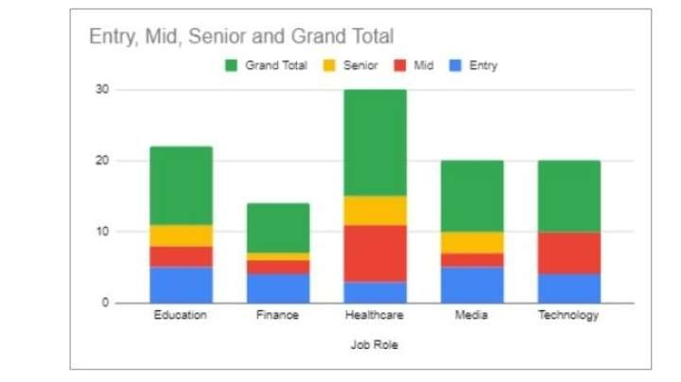
2. BAR DIAGRAM

Slide 14
Conclusion
Employee data analysis shows that men dominate senior roles, with women underrepresented in leadership positions. While entry and mid-level roles are more balanced, pay gaps favor men, especially at higher levels. This highlights a need for improved gender equity in promotions and leadership.
Men dominate senior roles, while women are underrepresented in leadership positions. Gender pay gaps favor men, especially in higher roles. This highlights the need for better gender equity in promotions and leadership. Targeted diversity initiatives are essential.

