Slide 1

A Study of the advanced models of convolutional neural network utilizing Chest X-ray images
By
Purna Mitra
Id-14701072 Under the supervision of
Nihad Karim Chowdhury
Associate professor
Dept. of Computer Science and Engineering
University of Chittagong

Slide 2
Contents
Motivation
Problem Statement
Objectives
Benefits
Methodology
Conclusion

Slide 3
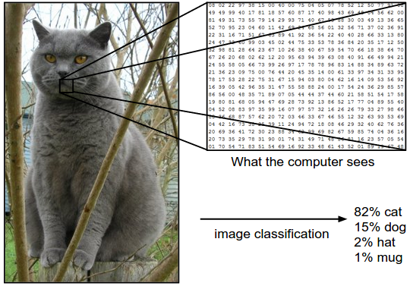
Introduction
Image classification analyzes
the numerical properties
of various image features
and organizes data
into categories.

Slide 4

Introduction
Deep learning is a subfield of machine learning concerned with algorithms inspired by the structure and function of the brain called artificial neural network.
A deep neural network (DNN) is an artificial neural network(ANN) with multiple hidden layers between the input and output layers. DNNs can model complex non-linear relationships.
a variant of neural network with an architecture that uses multiple layers
of nodes , each layer making new predictions.
layerwise reconstruction to learn multiple levels of representation and abstraction that helps to make the sense of data

Slide 5
Motivation
has many real world applications
helps in identifying suspects in security footage
Also use in Google for self driving car program
reduce overfitting
reduce computation time

Slide 6
Problem Statement
maximum overfitting
high computation time
misclassification of pixels
degraded accuracy

Slide 7
Objectives
The objective of this work to:
to gain higher accuracy applying the model
estimating probability of each class
making correct predictions of the classes

Slide 8
Benefit
Useful for processing large amount of data
Provides efficient process
can handle large amounts of continuous input data/ it’s powered by massive amount of data

Slide 9
Methodology
Selection
Of
training samples
Image
preprocessing
Feature
extraction
Accuracy
Assessment
Post classification processing
Selection
of Deep Learning approach

Slide 10
Methodology
Loading the
dataset
Data partition
Define the training and test data
Define the neural network model
Make predictions
Evaluate model
Fit model
Compile model

Slide 11
Methodology
Test data
Learning
Deep
learningmodel
Model
Apply Deep Learning model to predict
Features
Network connections
user activity and responses
interactions
Dataset
network with user attribute
Feature
Extraction
Dataset
collection
Using training
data
Output

Slide 12
Conclusion
hope that ,this research give a better understanding of Deep Learning in image classification in various field
Mitigates different categorical problem
Inspire others in future to use Deep Learning in other fields.

Slide 13
THANK YOU

