Slide 1

Learners
Submitted by
Pushpa Kumari
Collage name: Nsti(w) Salt lake Kolkata
Reg No:ADIT19AU03683

Slide 2
Agenda
Introduction to education system
Modes of education
Benefits of Online Education Over Regular Education
Why Online Education is Important
In what ways online education is helpful ?
Graph of Online Courses
Courses Outline
Conclusion

Slide 3
Introduction
Education
Education is gaining knowledge
and skills which may use the past
information, present and also with future
information transferred from one person to
another through teaching, research, training.
Nowadays it is of 2 types.

Slide 4


Two Modes of Education
Education
Online Education
Regular Education

Slide 5



Benefits of Online Education Over Regular Education
Online Education
Regular Education
It is easy. Sitting at home can gain the
knowledge.
Less expensive.
Missed classes can be gained on any time.
No timings.
Can get more explanations.
Knowledge is gained in a particular center.
Bit costlier.
Missed classes are difficult to gain.
Done on a perfect time
Less explanations

Slide 6

Impact of Online Education
It's flexible.
It’s accessible.
It offers a wide selection of programs.
It allows for a customized learning experience
It’s more cost-effective than Regular education.

Slide 7

In what ways online education is helpful ?
Study from anywhere, at any time
Review lectures instantly
Less intimidating
More time to think before sharing
Group communication
Flexible learning schedule
Instructor availability

Slide 8
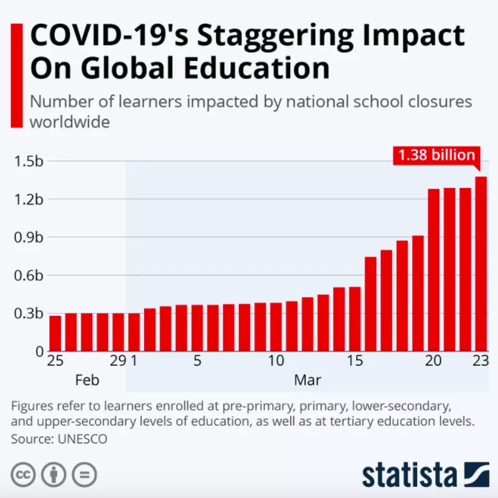
Growth in Online Education

Slide 9
Variety of Courses Online
We will cover these skills
Data Analyst
Artificial Intelligence
Full stack development

Slide 10

Data Analytics
Data analysis is a process of inspecting, cleansing, transforming, and modelling data with the goal of discovering useful information, informing conclusions, and supporting decision-making. Data analysis has multiple facets and approaches, encompassing diverse techniques under a variety of names, and is used in different business, science, and social science domains.
This Data Analytics course introduces beginners to the fundamental concepts of data analytics through real-world case studies and examples. You’ll learn about project lifecycles, the difference between data analytics, data science, and machine learning; building an analytics framework, and using analytics tools to draw business insights.

Slide 11
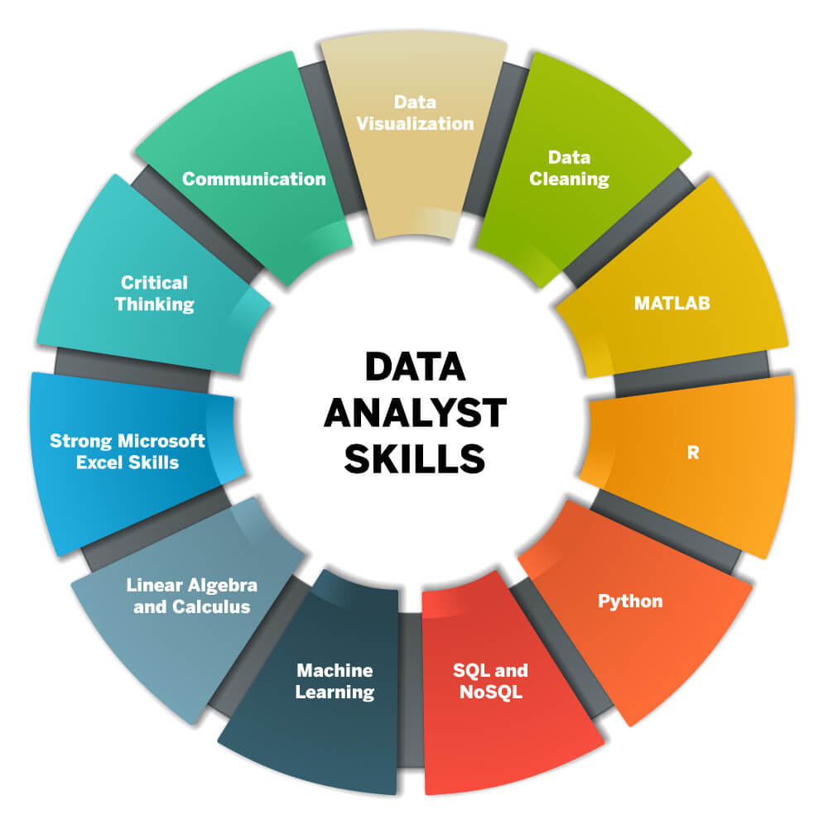
These language you can learn in Data Analysis Course

Slide 12

What are the job opportunities upon completing this data analysis course
Data Analytics Manager/Lead
Business Analyst/Senior Business Analyst
Business Intelligence Analyst
Business Intelligence Engineer
Various managerial roles

Slide 13

Who should take this Data analyst course
IT professionals
Banking and finance professionals
Marketing managers
Sales professionals
Supply chain network managers
Beginners in the data analytics domain
Students in UG/ PG programs

Slide 14

Artificial Intelligence
Artificial intelligence (AI) is intelligence demonstrated by machines, as opposed to the natural intelligence displayed by humans or animals. Leading AI textbooks define the field as the study of "intelligent agents": any system that perceives its environment and takes actions that maximize its chance of achieving its goals.
Some popular accounts use the term "artificial intelligence" to describe machines that mimic "cognitive" functions that humans associate with the human mind, such as "learning" and "problem solving", however this definition is rejected by major AI researchers.
First Skill

Slide 15




Statistics
Scala
Spark
Algorithm
Sci PY
Artificial Intelligence Skills
NumPy
Advance Excel
Panda
Deep Learning
Power BI
R language
Python
Keras

Slide 16
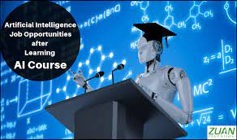
What are the job opportunities upon completing this Artificial Intelligence course
Artificial Intelligence Engineer
Data Scientist
Analytics Manager/Lead
Machine Learning Engineer
Statistical Programming Specialist

Slide 17

Why become a AI Engineer
The current and future demand is staggering. The New York Times reports a candidate shortage for certified AI Engineers, with fewer than 10,000 qualified people in the world to fill these jobs, which according to Paysa earn an average salary of $172,000 per year in the U.S. (or Rs.17 lakhs to Rs. 25 lakhs in India) for AI Engineers with the required skills.

Slide 18
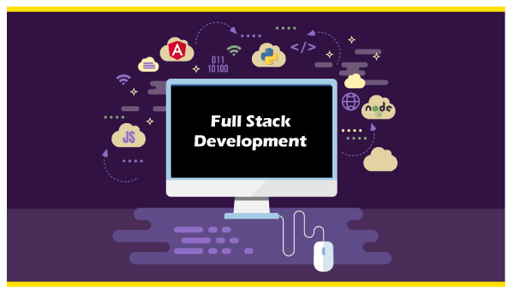
Full stack development
It refers to the development of both front end(client side) and back end(server side) portions of web application. ... They work on the frontend, backend, database and debugging of web application or websites

Slide 19
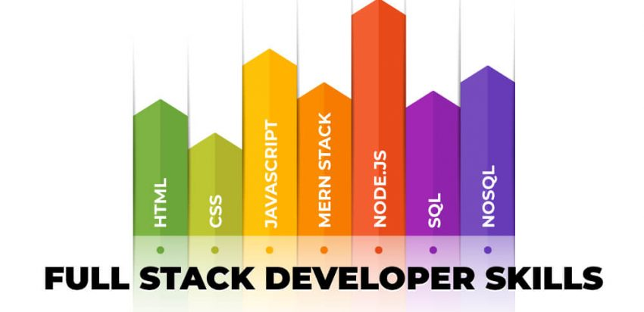
Skill Needed to be a Full Stack Developer

Slide 20

Career opportunity in Full Stack Development
1. Full-Stack Developer
2. Back-End Developer
3. Front-End Developer
4. Web Developer
5. Web Designer

Slide 21
Conclusion
Learners website is created based on online education. This is very helpful those people whose want to increase own knowledge in IT Field’s popular courses such as Data Analysis ,Artificial Intelligence and full stack development which is trending and most demanding Courses in market .
May be various types of people couldn’t have time to do these types of course from institute due to economic problem . He/she have to do job or whose is a student but in his/her area haven’t any instate or good trainer . Then Don’t worry . Learners website have a greatest opportunity for you .
You able to learn your favorite skills just like Artificial Intelligence ,Data Analysis & Full Stack Development anywhere and anytime . You get your dream Job .

Slide 22


