Slide 1
Predicting Dementia: A Naive Approach
Presented by:
Puspamita Banerjee (23MM60007) Camellia Mitra (23MM61R03)
Vivek Anand (23MM61R13) Ayushi Saxena (23MM45001)
Shubhaditya Gautam (23MM45006)

Slide 2
PROBLEM STATEMENT
We aim to develop a Classification model using the Naïve Bayes Classification Algorithm to predict the presence or absence of Dementia. Our prediction will be based on various health parameters, lifestyle, and demographic factors. Additionally, we will evaluate the performance of our model.

Slide 3
ABSTRACT
Dementia is a widespread condition with significant global impact.
This study aims to explore the relationships between health indicators, lifestyle choices, and dementia using a comprehensive dataset.
Our objectives include early detection of dementia, understanding the connections between health, lifestyle, and dementia status, and identifying patterns related to dementia development.
This research seeks to contribute to improved detection strategies and our understanding of dementia.
Notes:
Brain fails to function properly, Day to day activity hampered , correlate dementia with health parameters and lifestyle choices for an early prediction of dementia understanding the connections.

Slide 4
Why?
To understand risk factors associated with dementia development.
To explore correlations between health indicators, lifestyle choices, and dementia.
To identify patterns and trends that may contribute to dementia.
To develop predictive models for early detection and intervention.
To contribute to scientific research and advancements in dementia care.

Slide 5
DATASET DESCRIPTION
Dataset comprises diverse health parameters , lifestyle and Demographic factors.
Health Parameters include alcohol level, heart rate, blood oxygen, body temperature, weight, MRI delay, prescriptions and APOE_ε4 status, alongside chronic health conditions and dementia status for each individual.
Also covers demographics like age, education, gender, family history, smoking.
Additional lifestyle data on physical activity, depression, cognitive tests, medication, nutrition, sleep.
Offers comprehensive insights into correlations between health, lifestyle, and medical conditions.

Slide 6
Why, Naïve Bayes Algorithm ?
1. Naive Bayes is selected for dementia prediction due to its simplicity and efficiency, offering computational efficiency and requiring fewer parameters.
2. It assumes independence among features, making it suitable for high-dimensional datasets with potentially correlated features.
3. Naive Bayes gracefully handles few missing data and is less prone to overfitting, particularly in sparse datasets.
4. The model provides probabilistic predictions, offering valuable insights into the likelihood of outcomes based on given features.
Notes:
P(A∣B)=P(B)/[P(B∣A)×P(A)​]
Where:
P(A∣B)P(A∣B) is the conditional probability of event A given that event B has occurred.
P(B∣A)P(B∣A) is the conditional probability of event B given that event A has occurred.
P(A)P(A) and P(B)P(B) are the probabilities of events A and B occurring independently.

Slide 7
Decoding our Code
Importing Python Libraries
Reading and Visualisation of data frame
Assessing data and null values present in the dataset.
Data preprocessing
Scaling of features and dividing into testing and training data.
Training the model based on Naïve bayes Algorithm
Prediction with test data
Model evaluation

Slide 8
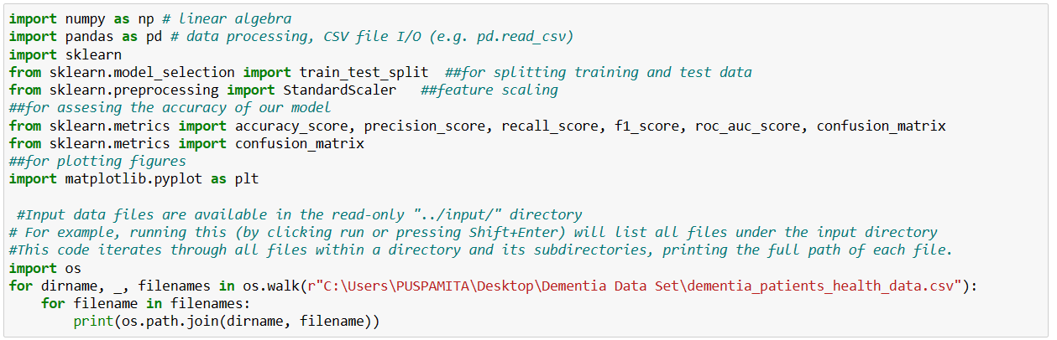
IMPORTING PYTHON LIBRARIES

Slide 9
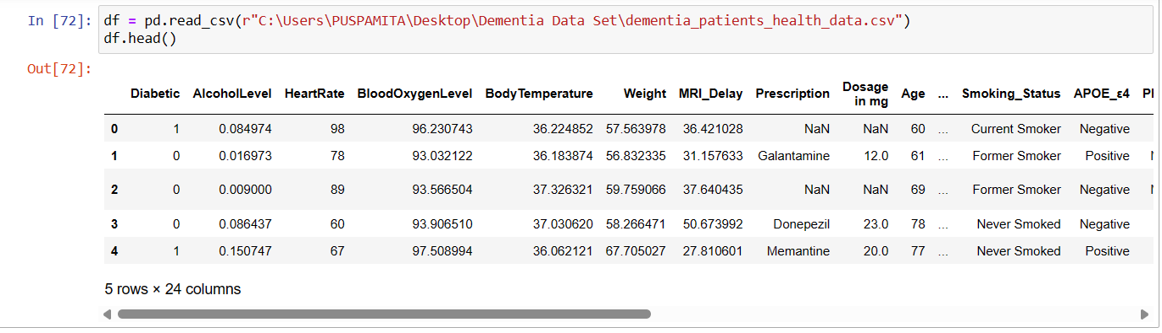
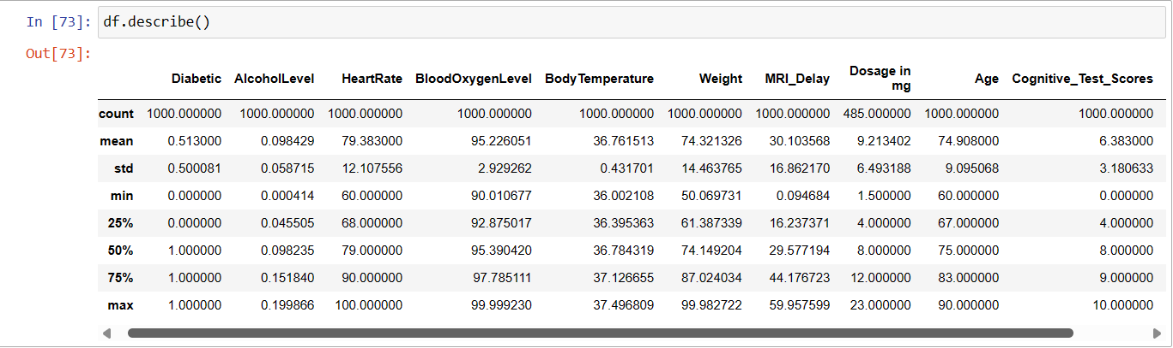

READING AND VISUALIZATION OF DATA FRAME

Slide 10
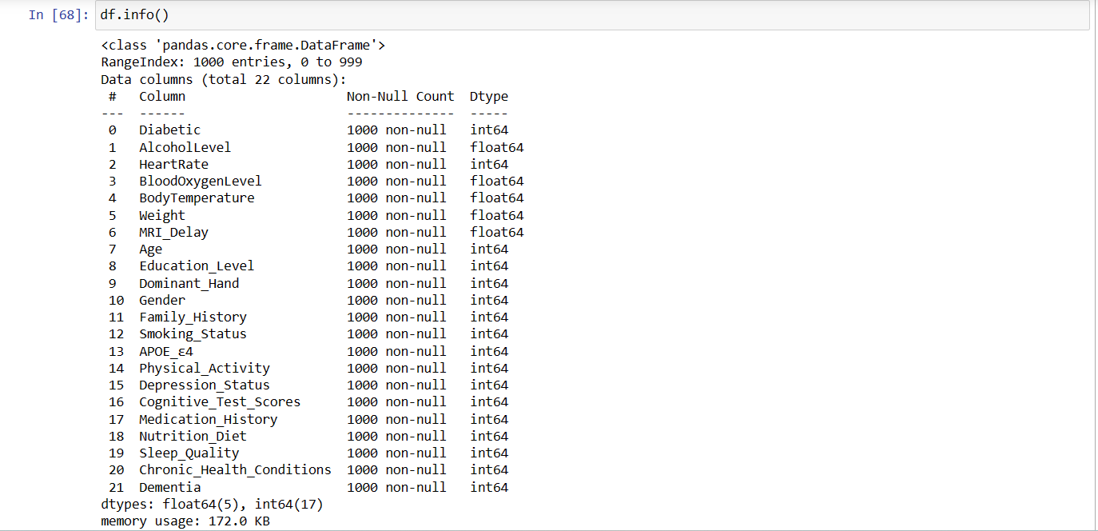
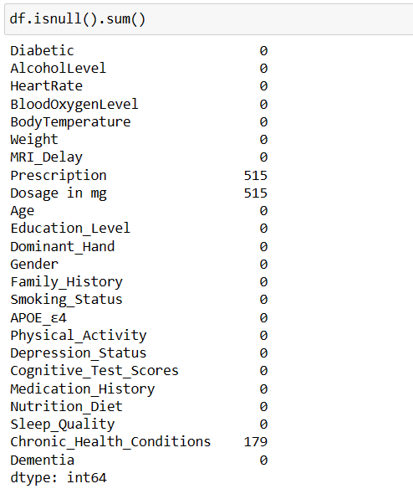
ASSESSING DATA AND NULL VALUES PRESENT IN THE DATASET

Slide 11
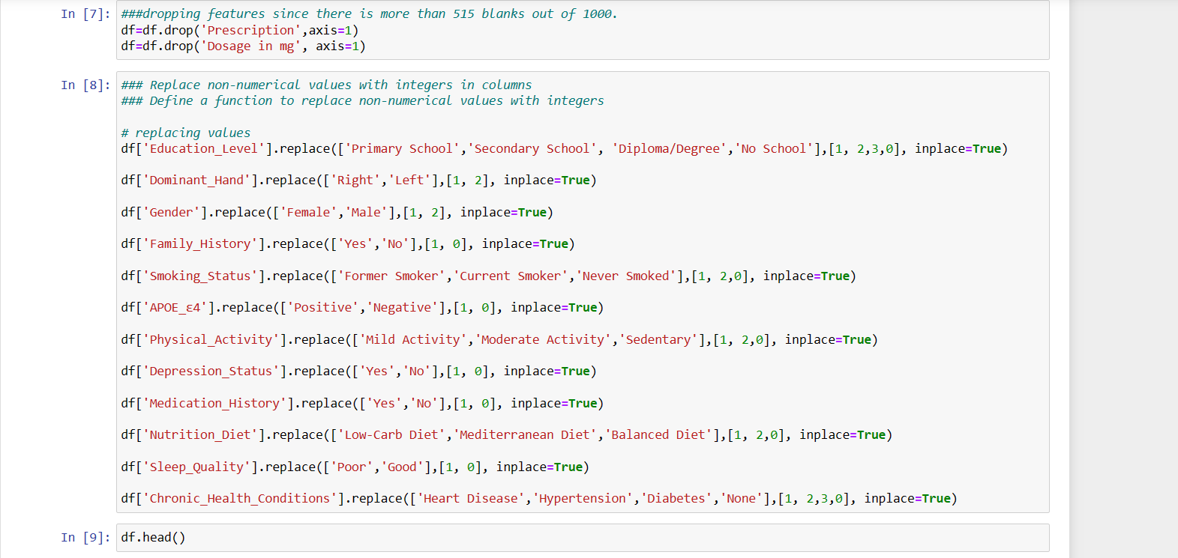
DATA PRE PROCESSING
We have dropped two features, “ Prescription” and “ Dosage in mg ” . Reason: there were 515 gaps among the 1000 samples.
We replaced the object datatype for those particular features, with numerical values (integers).

Slide 12
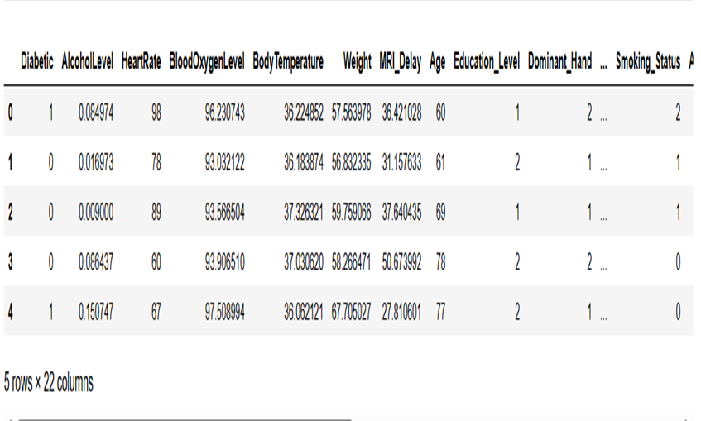
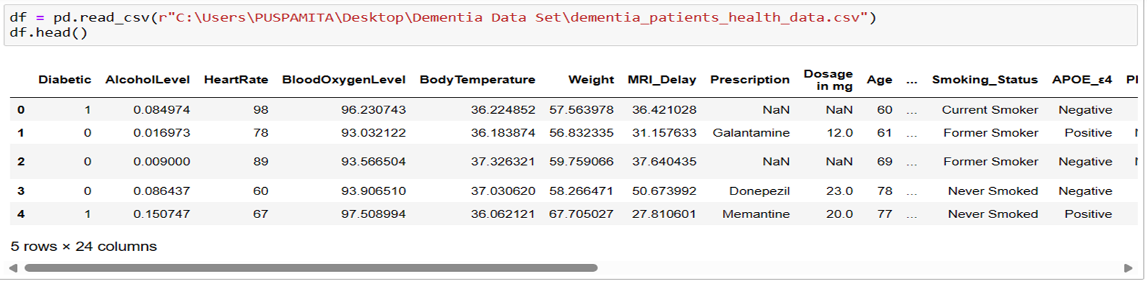
COMPARISON OF THE DATA FRAME
Before processing
After processing

Slide 13
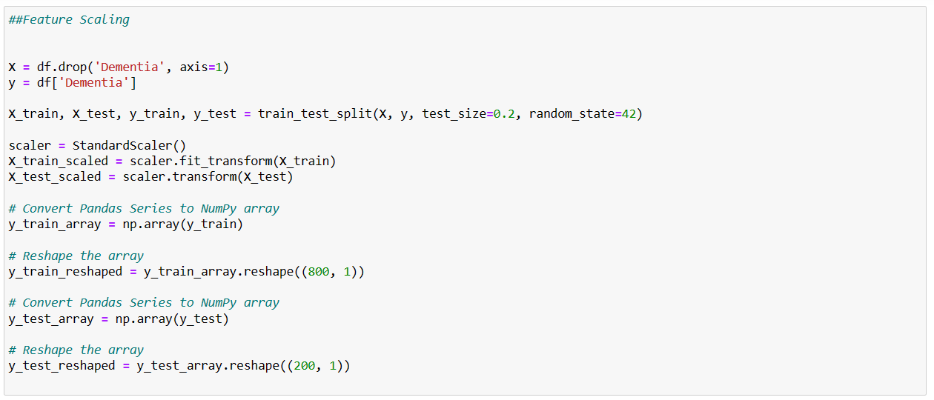
SCALING OF FEATURES AND DIVIDING INTO TESTING AND TRAINING DATA
Notes:
Notes: reshape to make it into a column array. Random_state random number generator.

Slide 14
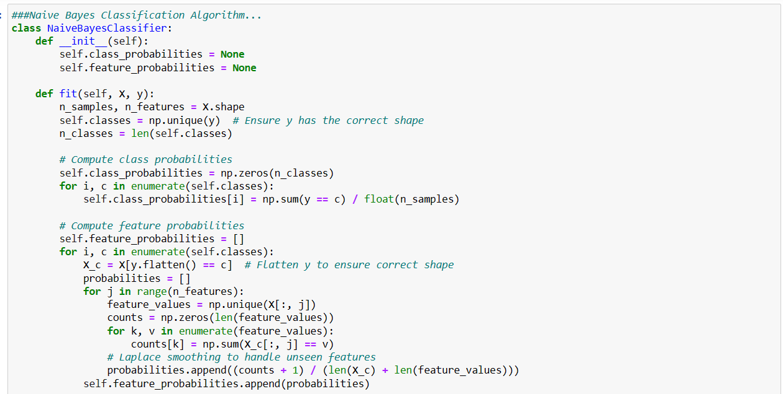
TRAINING THE MODEL BASED ON NAÏVE BAYES ALGORITHM
Notes:
LINEAR COMPUTATION POWER

Slide 15
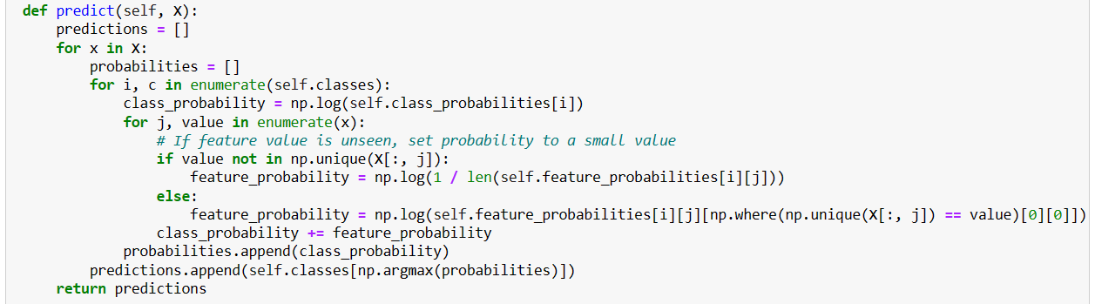

Slide 16
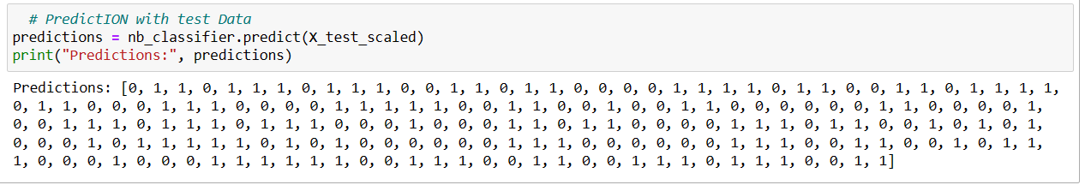
PREDICTION WITH TEST DATA

Slide 17
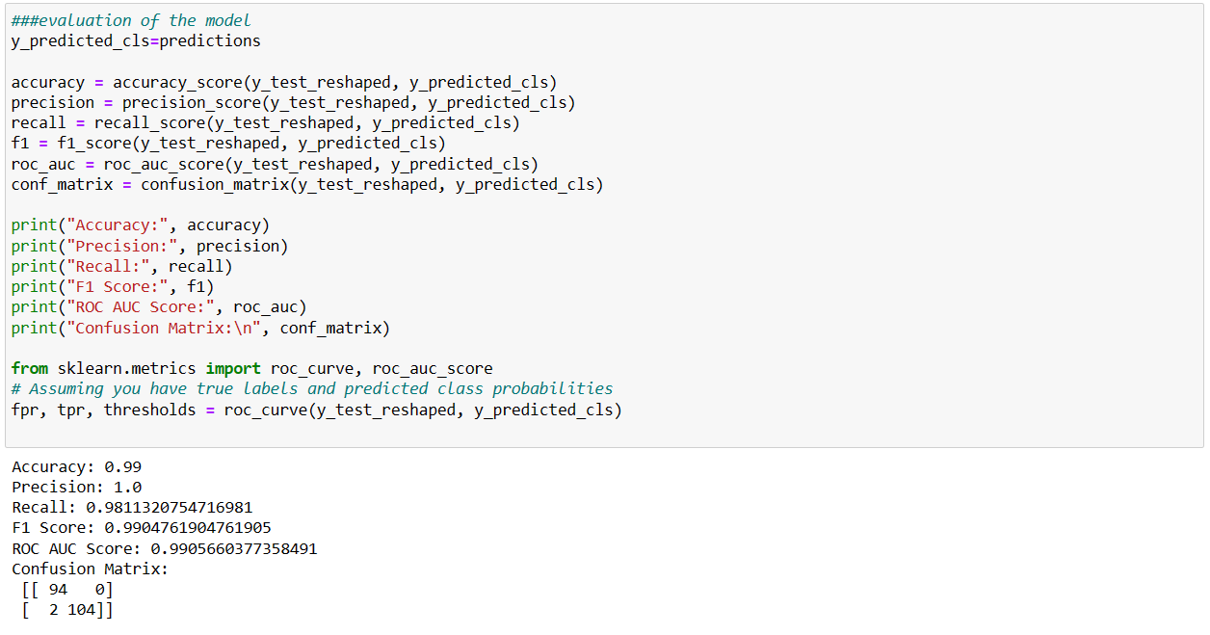
MODEL EVALUATION

Slide 18
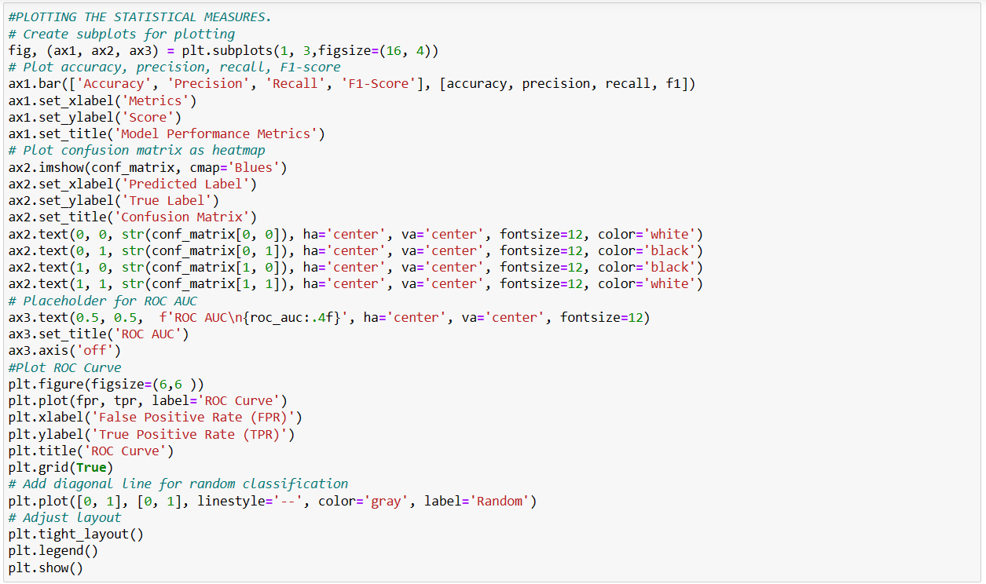
PLOTTING THE STATISTICAL VALUES

Slide 19
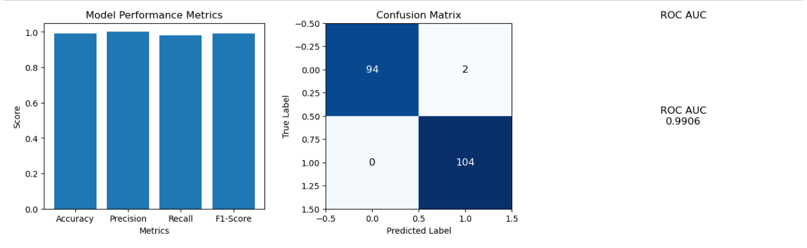
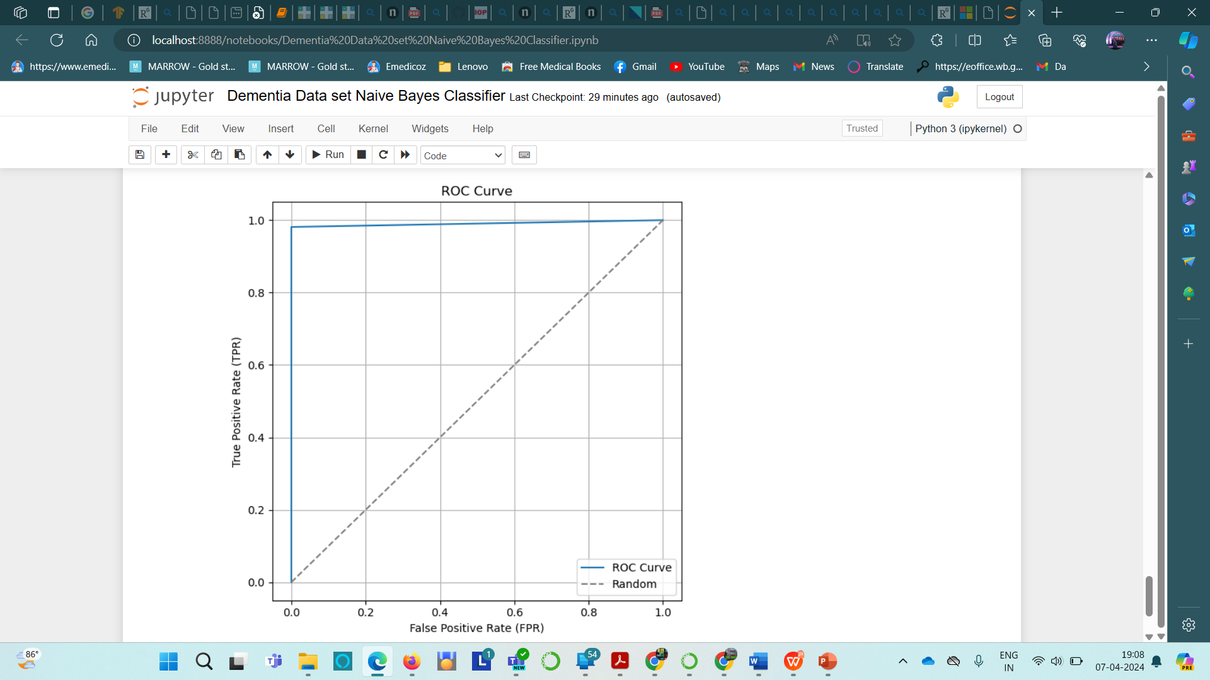
MODEL PERFORMANCE RESULTS
Notes:
The ROC curve is used to assess the overall diagnostic performance of a test and to compare the performance of two or more diagnostic tests. It is also used to select an optimal cut-off value for determining the presence or absence of a disease.
RECALL = TP/(TP+FN)
F1 SCORE= 2*P*R/(P+R)
PRECISION= TP/(TP+FP)
ACCURRACY= TP+TN/(TP+TN+FP+FN)

Slide 20
CONCLUSION
1. The model achieved a high accuracy rate of 99%, indicating strong overall performance in classification tasks.
2. With perfect precision and a recall rate of approximately 98%, the model effectively minimized false positives and captured a significant portion of actual positive instances.
3. The F1 score of approximately 99% suggests a balanced trade-off between precision and recall, showcasing the model's robustness in handling imbalanced datasets.
4. The ROC AUC score of approximately 99% highlights the model's strong discriminatory power in distinguishing between positive and negative classes.

Slide 21
DISCUSSION
LIMITATIONS:
FURTHUR SCOPE:
Consider the interdependency of the features while developing the model
Balancing the gaps in the features
We assumed independence among all features contributing to dementia.
We dropped two features owing to very large number of gaps in the feature column.

Slide 22
Details of the Data Set: Kaggle Access our project and details of code : @Project_link
REFERENCES

Slide 23
THANK YOU

