Slide 1
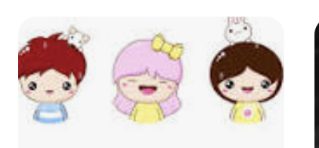
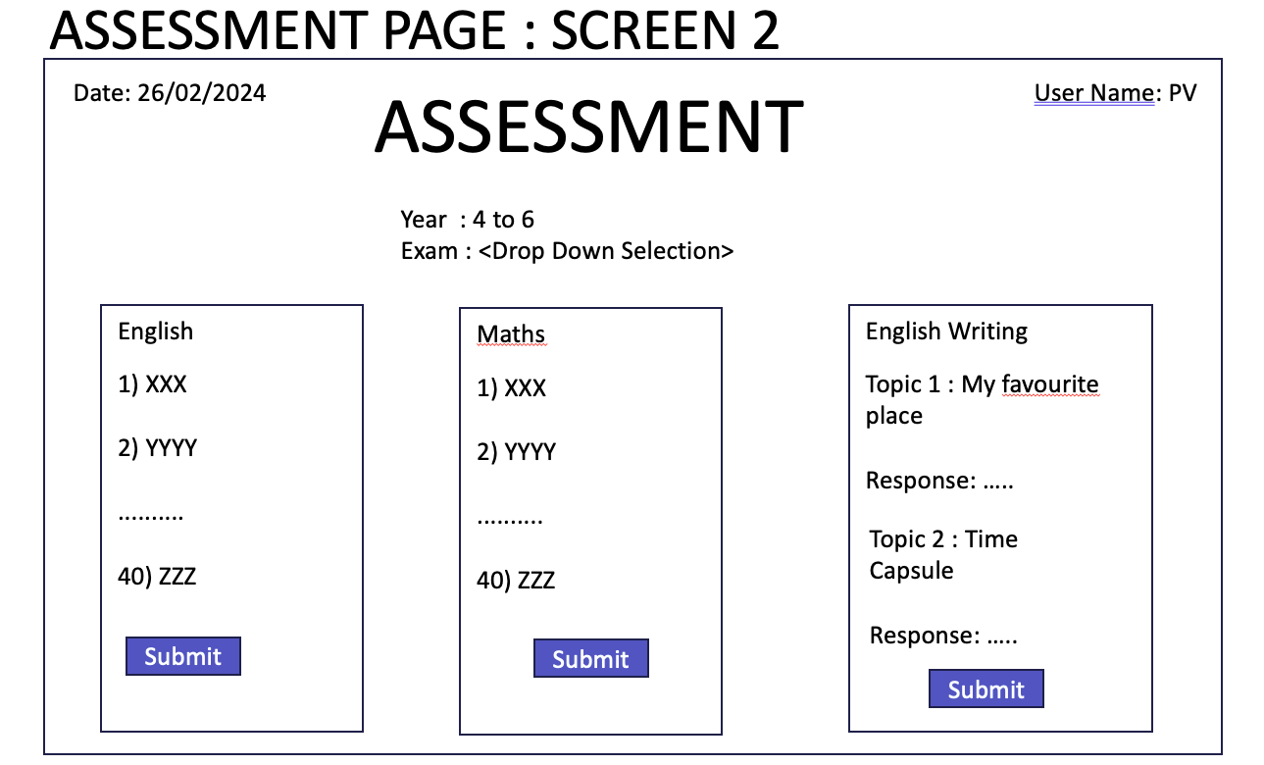
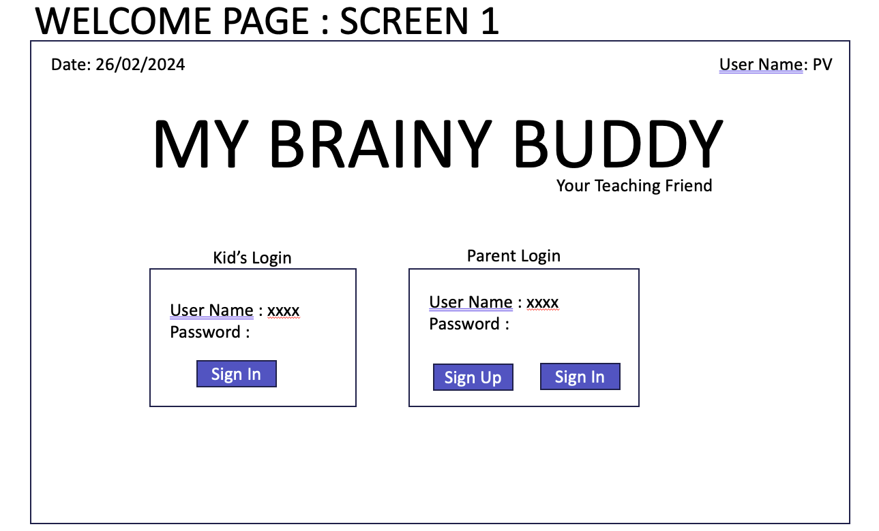
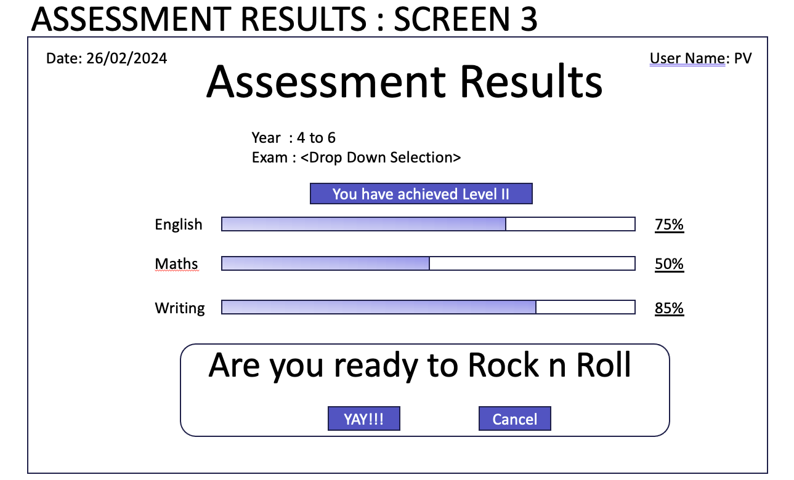
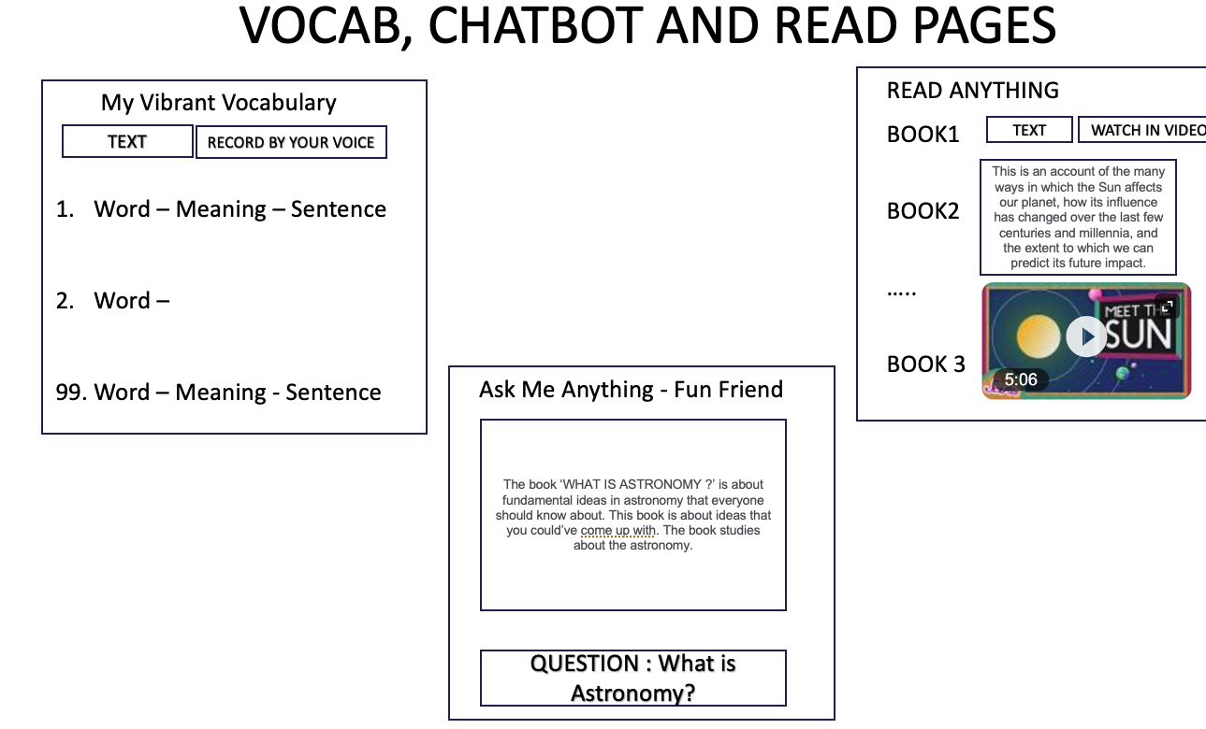
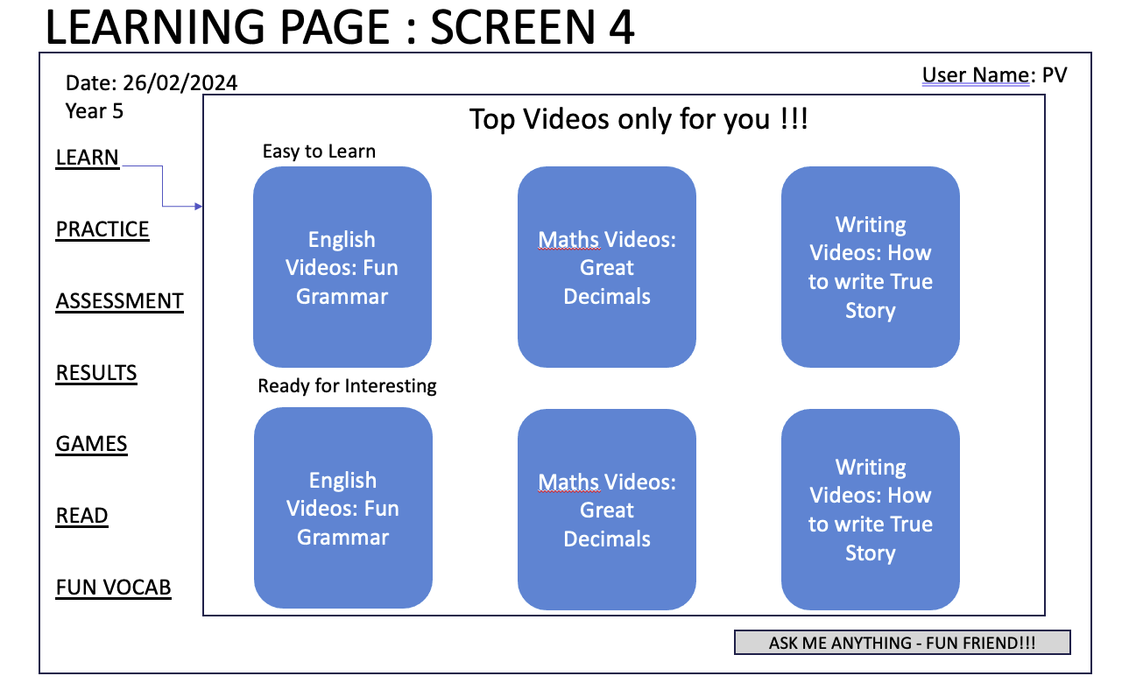
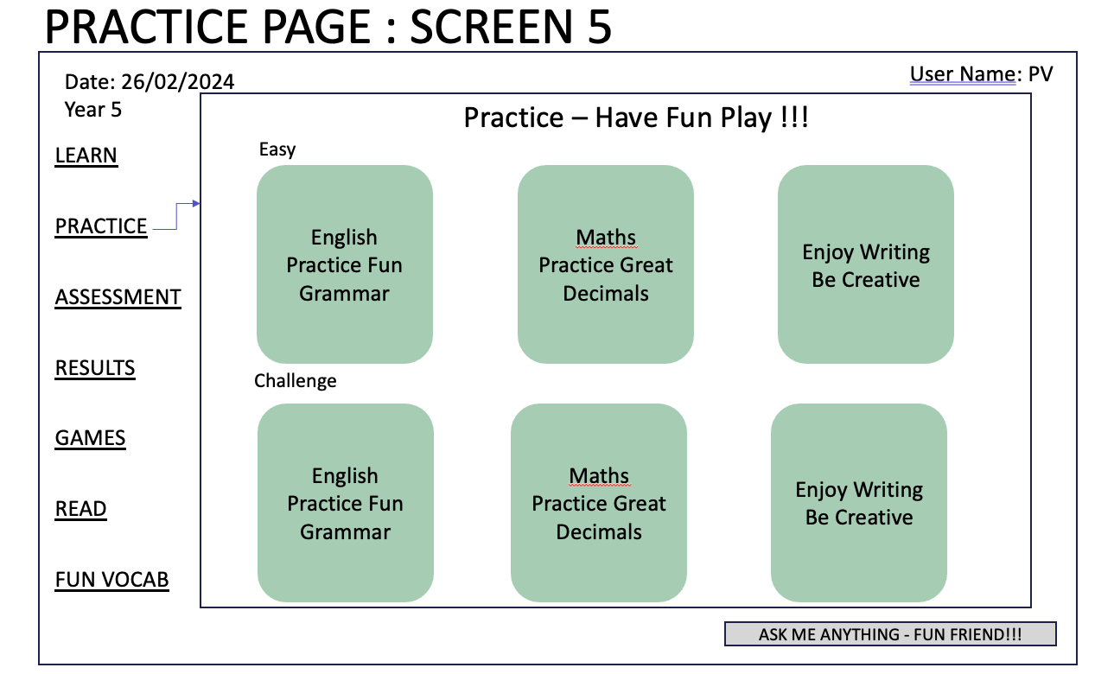



My Brainy Buddy - Summary

Slide 2
WELCOME PAGE : SCREEN 1
Date: 26/02/2024
User Name: PV
MY BRAINY BUDDY
Your Teaching Friend
Kid’s Login
Parent Login
User Name : xxxx
Password :
Sign In
User Name : xxxx
Password :
Sign In
Sign Up
Sign In

Slide 3
ASSESSMENT PAGE : SCREEN 2
Date: 26/02/2024
ASSESSMENT
User Name: PV
Year : 4 to 6
Exam : <Drop Down Selection>
Sub
Sub
Sub
English
Maths
English Writing
1) XXX
2) YYYY
..........
40) ZZZ
1) XXX
2) YYYY
..........
40) ZZZ
Topic 1 : My favourite place
Response: …..
Topic 2 : Time Capsule
Response: …..
Submit
Submit
Submit

Slide 4
ASSESSMENT RESULTS : SCREEN 3
Date: 26/02/2024
Assessment Results
User Name: PV
Year : 4 to 6
Exam : <Drop Down Selection>
You have achieved Level II
English
75%
Maths
50%
Writing
85%
Are you ready to Rock n Roll
YAY!!!
Cancel

Slide 5
LEARNING PAGE : SCREEN 4
Date: 26/02/2024
Year 5
User Name: PV
LEARN
PRACTICE
ASSESSMENT
RESULTS
GAMES
READ
FUN VOCAB
Top Videos only for you !!!
Easy to Learn
English Videos: Fun Grammar
Maths Videos: Great Decimals
Writing Videos: How to write True Story
Ready for Interesting
English Videos: Fun Grammar
Maths Videos: Great Decimals
Writing Videos: How to write True Story
ASK ME ANYTHING - FUN FRIEND!!!

Slide 6
PRACTICE PAGE : SCREEN 5
Date: 26/02/2024
Year 5
User Name: PV
LEARN
PRACTICE
ASSESSMENT
RESULTS
GAMES
READ
FUN VOCAB
Practice – Have Fun Play !!!
Easy
English Practice Fun Grammar
Maths Practice Great Decimals
Enjoy Writing Be Creative
Challenge
English Practice Fun Grammar
Maths Practice Great Decimals
Enjoy Writing Be Creative
ASK ME ANYTHING - FUN FRIEND!!!

Slide 7
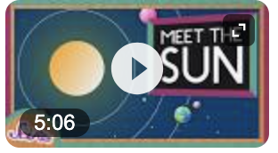
VOCAB, CHATBOT AND READ PAGES
READ ANYTHING
My Vibrant Vocabulary
BOOK1
BOOK2
…..
BOOK 3
TEXT
RECORD BY YOUR VOICE
TEXT
WATCH IN VIDEO
Word – Meaning – Sentence
Word –
99. Word – Meaning - Sentence
This is an account of the many ways in which the Sun affects our planet, how its influence has changed over the last few centuries and millennia, and the extent to which we can predict its future impact.
Ask Me Anything - Fun Friend
The book ‘WHAT IS ASTRONOMY ?’ is about fundamental ideas in astronomy that everyone should know about. This book is about ideas that you could’ve come up with. The book studies about the astronomy.
QUESTION : What is Astronomy?

