Slide 1
LAB LOG
AN APPLICATION THAT TRACK DAY TO DAY LAB PROGRESS OF A STUDENT.

Slide 2
ABSTRACT :
Lab log is a web application that lets you know the day to day lab progress of a student.
This is a kind of website in which a student can log in to the site ,which shows the list of subjects he/she has. The user is assigned with tasks in every lab and Analysis will be made based on the performance of the student in those tasks.

Slide 3
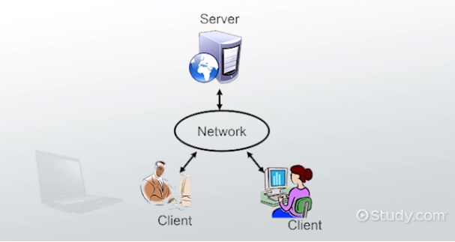
What is a web application ?
A web application is a client server computer
program that the client runs in a web browser.
A web application development project
is the process of developing a website,
activities in a network which are aimed at a
pre defined goals.

Slide 4
Functional requirement :
Login
Upload
Download

Slide 5
Software requirement :
HTML
CSS
Python flask
Bootstrap
SQL Alchemy
Java script

Slide 6

WHAT DO YOU MEAN BY FLASK ?
Flask is a web framework written in python .
This means flask provides you with tools ,libraries and technologies that allow you to build a web application.

Slide 7
Software Quality Attributes :
AVAILABILITY: Since we are hosting our project on the server it will be available all the time.
CORRECTNESS: The system should generate an appropriate report about different activities of the lab and should keep track of all records.
MAINTAINABILITY: The system should maintain correct schedules of labs and the documentation of all the lab equipment.
USABILITY: The system should satisfy the maximum number of users needs.

Slide 8
Working of project :
Student has to login to the website by entering their user name and password.
The dashboard is displayed ,which contains subjects.
The student has to select the subject on which he want to work. Then the list of experiments of that particular subject will be displayed.
The student can download or upload a document containing his work.

Slide 9
CONCLUSION :
Students can work accordingly by looking at their day to day progress.
They come to know in which subject they are a bit step down.
Previously they were able to look after their info only when they are in campus premises . But know they can access their lab info from any where through network.

Slide 10
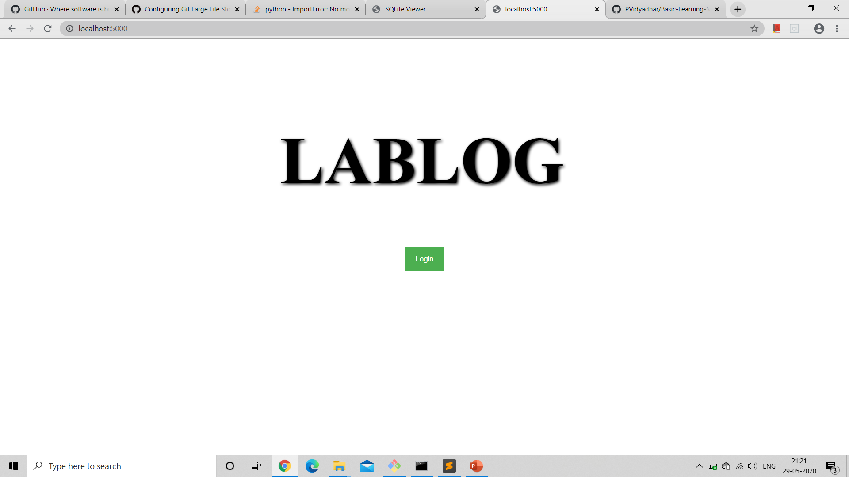
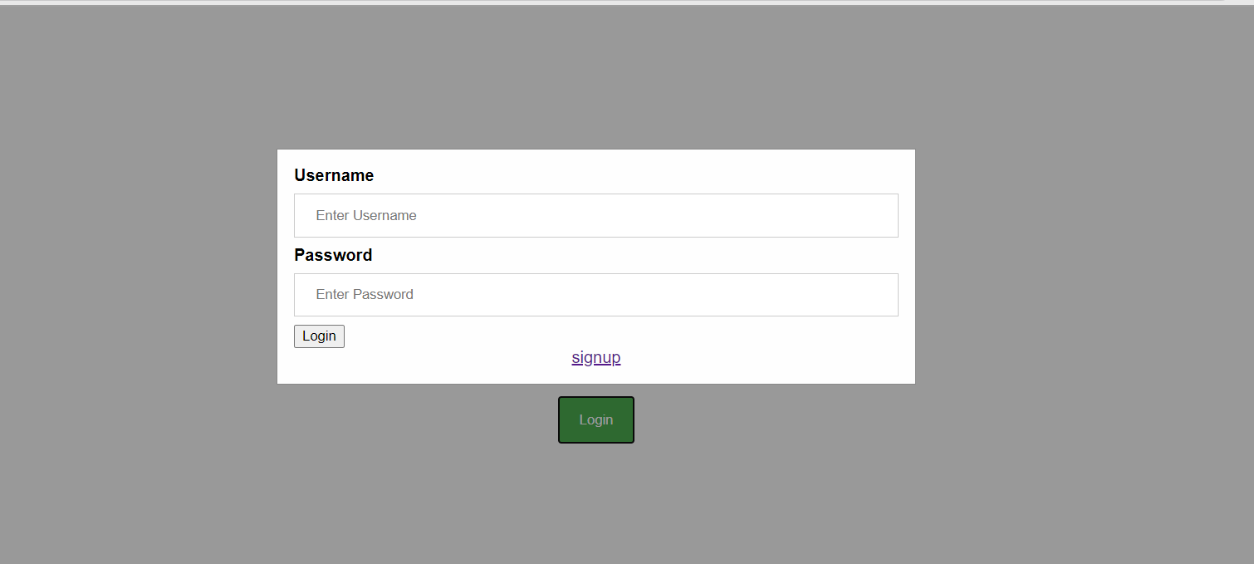
OutPUt :

Slide 11
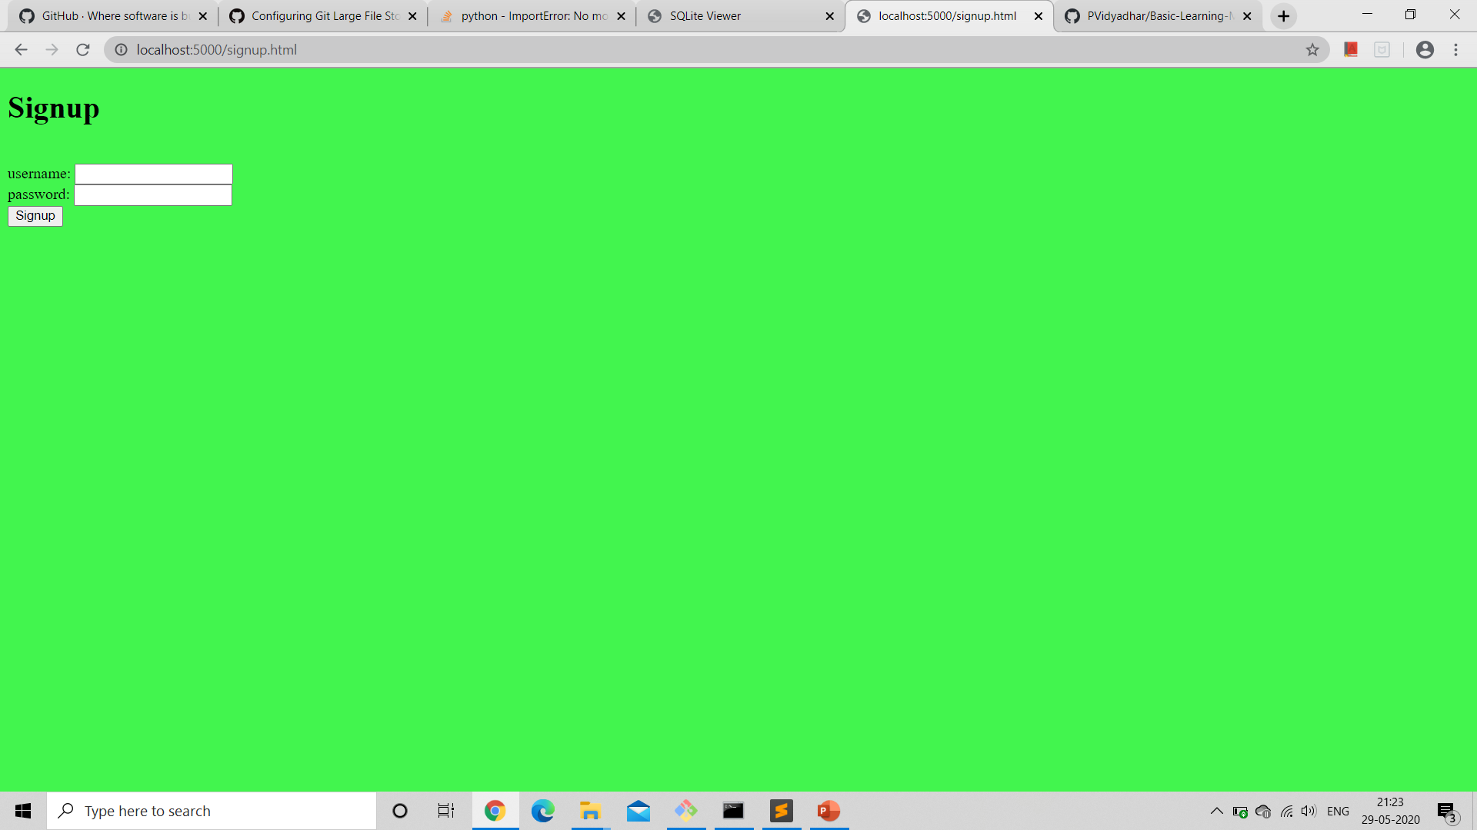
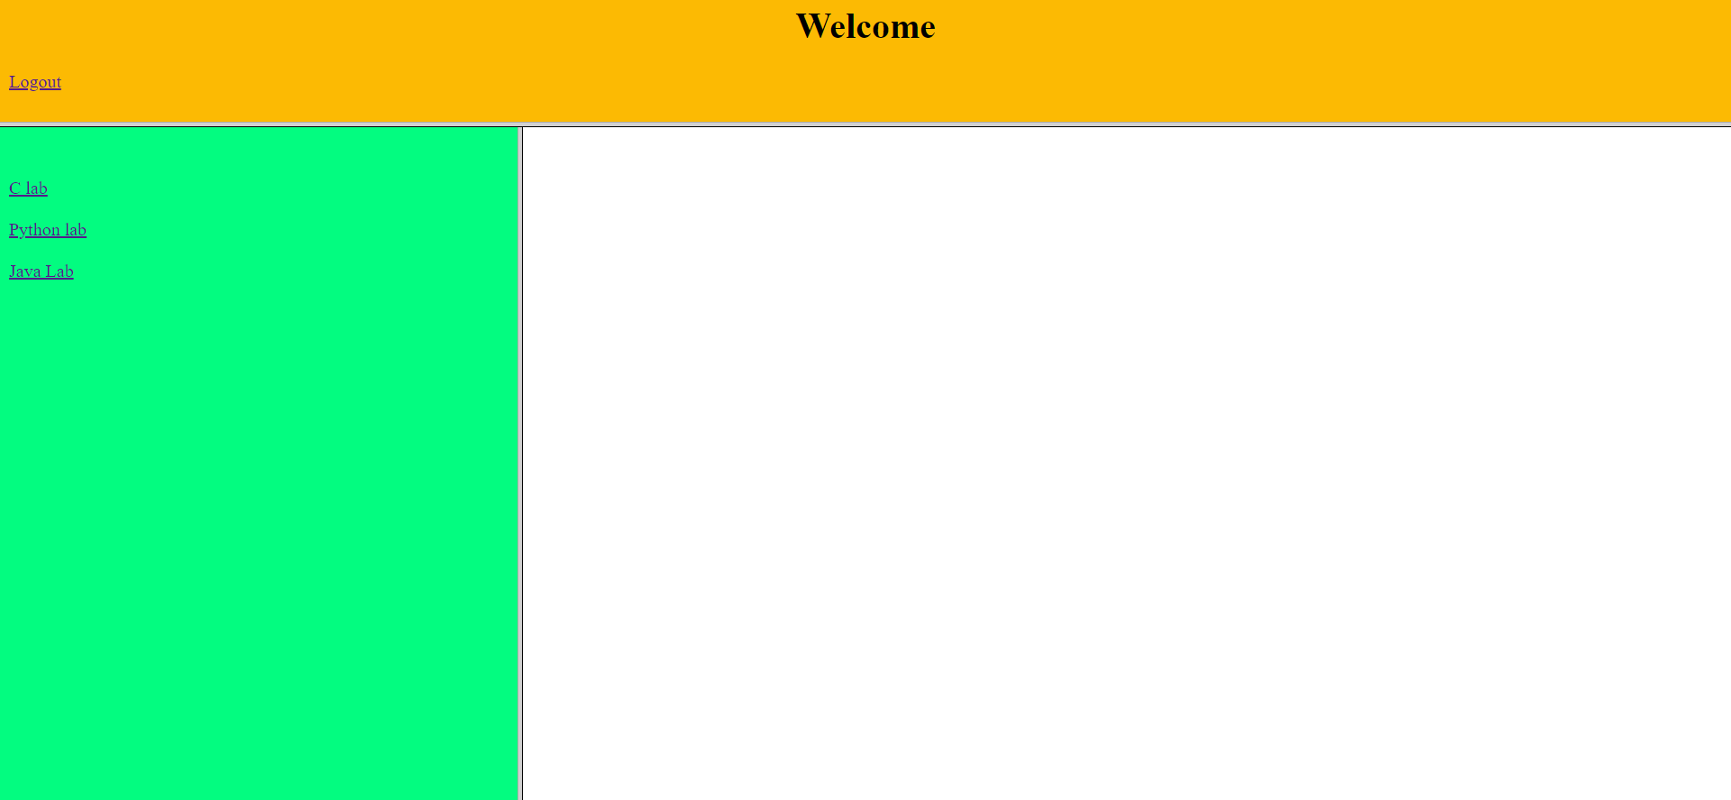

Slide 12
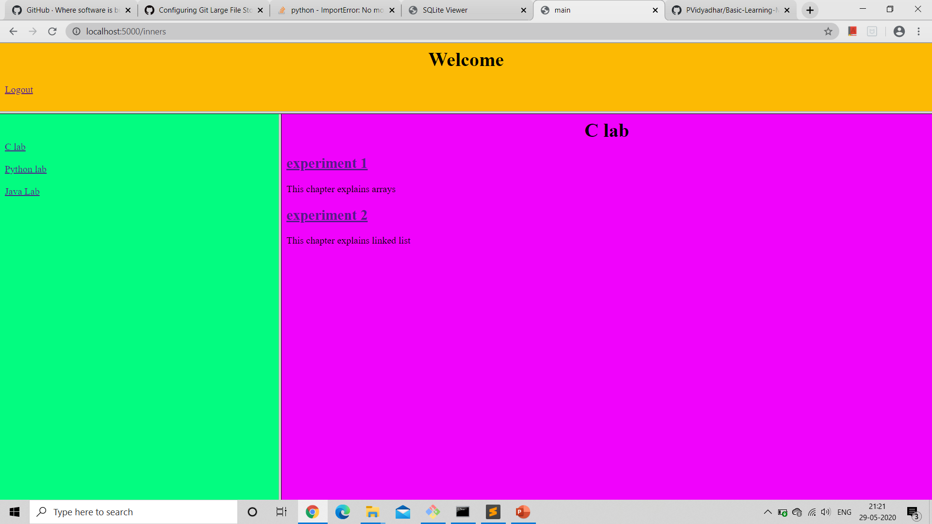
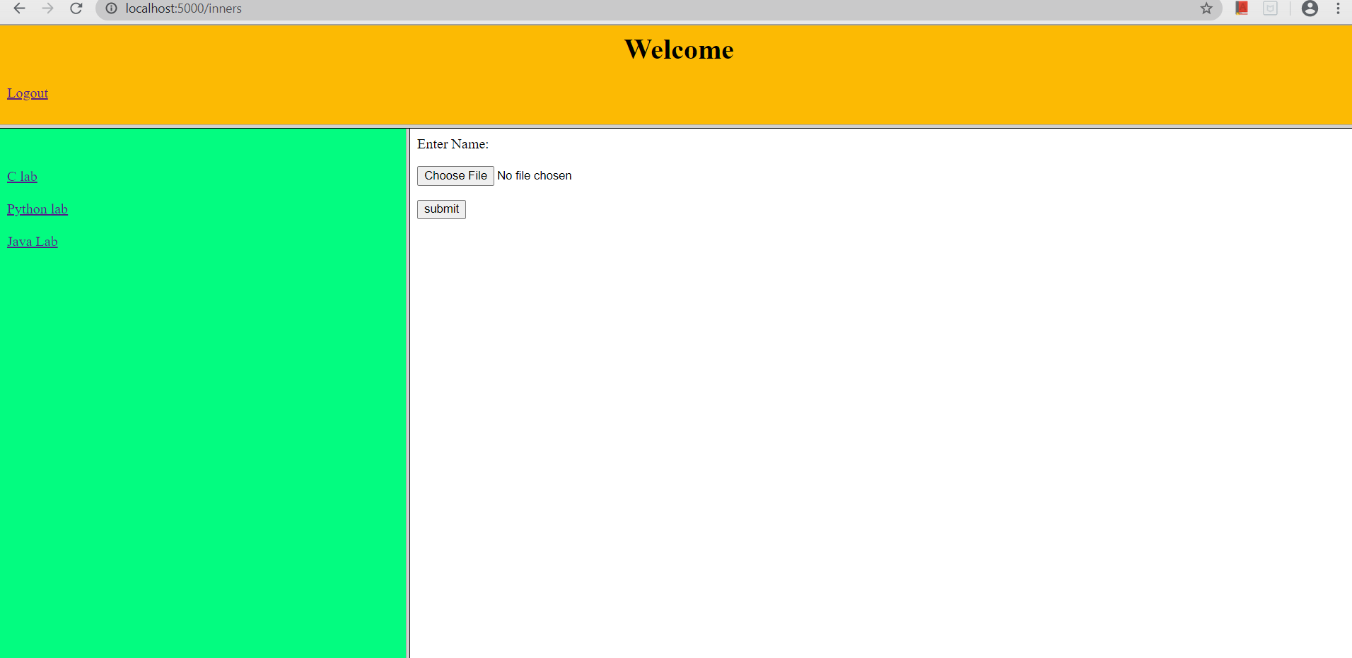

Slide 13


Slide 14
THANK YOU

