Slide 1

Task Dispatching System During Emergencies
WHERE TO GO. WHAT TO DO.
Predefined scenarios that turn an alarm into coordinated action — for civil administration, medical services and the military.
Notes:
Hi, we are the Siren team. Siren — in Polish 'Wyjec' — is a task dispatching system for emergencies. One sentence to remember: when the alarm sounds, Siren tells every person where to go and what to do. In the next few minutes: the problem, how Siren works, why it keeps working when networks fail, and where it can be used.

Slide 2
In an Emergency, There Is No Time to Plan
When the alarm is raised, everyone should know:
WHERE TO GO.
WHAT TO DO.
Siren brings this principle into the digital age.
Notes:
Think about the first minutes of an emergency. The plans exist — but they are in binders nobody opens under stress. Phone trees break the moment networks are overloaded. And whoever is in charge has no idea who actually received the order. The old rule is simple: everyone must know where to go and what to do. Siren brings that rule into the digital age.

Slide 3
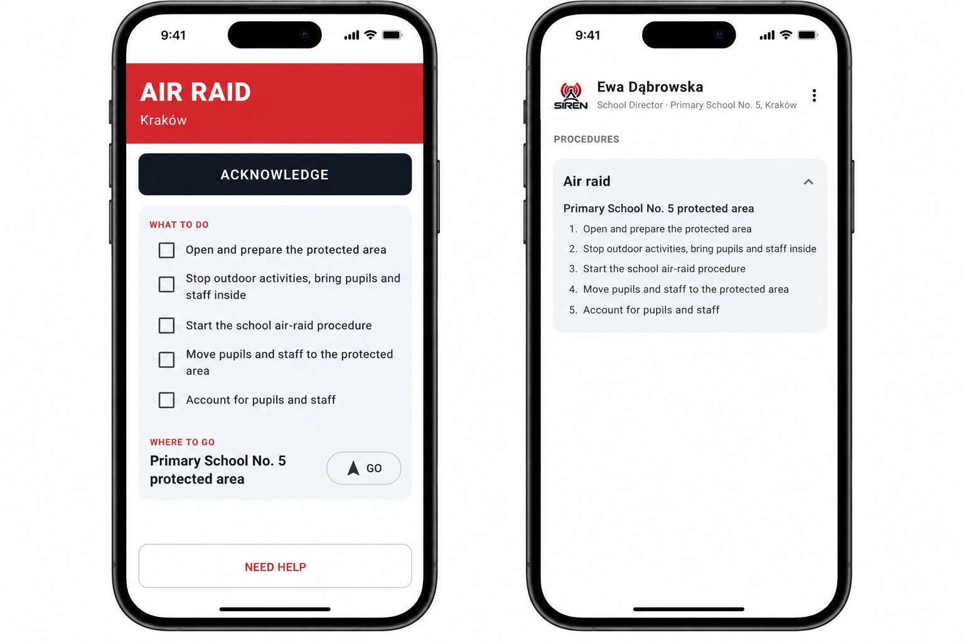

From Instructions to Action
NORMALLY
ON ALARM
A pocket library
A live to-do list
Every emergency procedure in one app, always at hand,
always updated.
The app switches to the person's own tasks — step by step, with progress reported back.
Notes:
Siren is a flexible system for distributing tasks in emergencies. On a normal day it is simply a pocket library: every emergency procedure in one app. But the moment an alarm is raised, the app transforms. It stops being a library and becomes an interactive to-do list — only the tasks this person must do, in order. Here: a school principal during an air raid alarm, ticking off tasks as they go.

Slide 4




One Alarm. Clear Orders.
Alarm
Scenario
Task Group
Person
Starts the emergency response.
Predefined response plan tied to that alarm.
A set of tasks to carry out at one location.
Gets exactly their tasks — where they need to act.
Result: every person gets their own tasks, at the place where they need to act.
Notes:
The model is deliberately simple. An alarm triggers a scenario — a response plan prepared in advance. The scenario contains task groups. Each task group is assigned to a specific person at a specific location. So nobody receives a generic broadcast: each person gets exactly their own tasks, at the place where they need to act.

Slide 5



Always Ready — Even Offline
Distributed in advance
0
Scenarios and alarm keys are pushed to every device periodically.
Stored offline on the device
Each phone keeps its scenarios offline — ready without a server.
seconds spent searching for the right procedure.
Just click the notification.
Instant on alarm
Users never hunt for procedures when an emergency starts.
Notes:
Siren is ready before anything happens. Scenarios — together with the cryptographic keys needed for alarms — are distributed to devices periodically and stored offline. So when the alarm comes, the plan is already on the phone. Nobody searches for a procedure: zero seconds lost.

Slide 6








Communication-Independent
The alarm does not depend on a single communication medium.
Authorized person
radio
Every device that receives a valid alarm forwards it to others in reach. The medium can change from hop to hop.
mesh
BT
Radio
Bluetooth
Pager
BT
pager
Mesh
Internet
Server (optional)
Alarms can reach people before the server does — or without it.
Notes:
The second pillar: Siren does not rely on one communication channel. The alarm itself is a small signed message. Every device that receives a valid alarm repeats it to devices in reach — over radio, Bluetooth, pager networks, mesh networks or the Internet, and the medium may change between hops. The central server is optional for delivery: an alarm can reach people before it reaches the server, or with no server at all.

Slide 7



Every Alarm Is Signed and Verified
Server ↔ App channel
Alarm cryptography
Per-device symmetric credentials, like VPN pre-shared keys
Asymmetric signatures, independent of the server
Scenario download and updates
Delivery of new alarm keys
Status reports (online only)
Private key only for authorized controllers
Public key on every receiving device
Checked on every device before accepting
Timestamp and ID mark each event
Alarm authenticity never depends on the server or the delivery medium.
Notes:
If anyone can forward an alarm, how do we stop fake ones? Siren uses two separate mechanisms. The server-to-app channel uses individual, per-device credentials — like pre-shared keys in a VPN — for scenario updates, new keys and status reports. Alarms use asymmetric cryptography: only authorized controllers hold the private key to raise or cancel an alarm; every device holds the public key and verifies each message before accepting it. Timestamps and identifiers are signed too, as the basis for replay protection. The principle: an alarm is trusted because of its signature — not because of the server or the channel it came through.

Slide 8
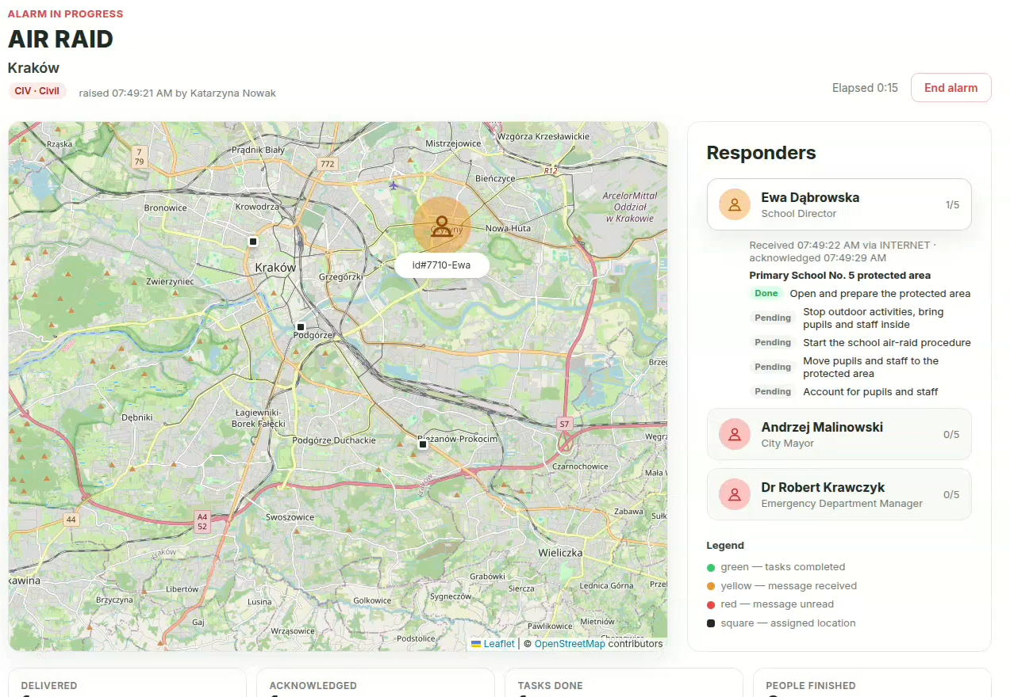



Know What Is Happening
During an active alarm, the coordinator using web panel, can see on a live map:
Who received the alarm
Where people are
How far each task has got
Location is shared only when alarm is raised.
Notes:
For the people in charge, Siren closes the loop. During an active alarm, devices report back — whenever an online path is available — who received the alarm, where people are, and how far each task has progressed. The administrator sees it all on a live map: green is done, amber is in progress, red has not replied. Location sharing is limited to what the response needs, with access and retention defined by the deploying organization.

Slide 9



One Principle. Three Domains.
The scenario changes — the coordination principle stays the same.
CIV · CIVIL ADMINISTRATION
MED · HOSPITALS
MIL · ARMED FORCES
Air raid alarm
Mass-casualty alarm
Mobilization alarm
A school principal turns the school into a shelter:
Emergency Department staff move to posts:
Replaces paper instructions for each soldier:
Open the building
Open the shelter
Display required signs
Anesthesiologist → ED
Surgeon → operating room
Nurses → triage
Radiology tech → imaging
Collect equipment and ammo at the store
Take up guard position at the bunker
Notes:
The same engine serves three domains. Civil: during an air raid alarm, a school principal is told to go to the school, open the building and the shelter, and put up the required signs. Medical: a mass-casualty alarm sends the anesthesiologist to the ED, the surgeon to the operating room, nurses to triage and radiology to imaging. Military: on mobilization, each soldier gets digital orders instead of paper — collect equipment and ammunition, then take a guard position at the designated bunker. The scenario changes; the coordination principle stays the same.

Slide 10


Siren — From Alarm to Action
When the alarm comes, there is no time to think. Siren tells people:
WHERE TO GO.
WHAT TO DO.
Offline-ready
Medium-independent
Signed alarms
Thank you — questions?
Notes:
To sum up: when the alarm comes, there is no time to think. Siren tells people where to go and what to do. It is ready offline, it does not depend on any single communication channel, and every alarm is signed, so it can be trusted wherever it came from. Siren — from alarm to action. Thank you, we are happy to take your questions.

