Slide 1
The Employee Retention Predictor
Seeing attrition before the resignation letter.
PHILIP WOUTER ROOS
The Employee Retention Predictor
02
Notes:
I'm Philip Roos. During this engagement, I've focused on one core question: can we identify the people about to leave Helix before they hand in their notice?

Slide 2
Context & Objective
AUDIENCE
Executive committee, Helix Systems Group
OCCASION
Ten-minute investment decision briefing
THE ASK
$185,000 for a gated proof of concept
The Employee Retention Predictor
01
Notes:
I am presenting today to the Helix executive committee: our CHRO, our Finance Director, and our VP of Engineering. My goal is to secure one hundred and eighty-five thousand dollars for Phase 1. However, I am asking you to keep the actual intervention budget locked down until we pass two specific validation gates. Here is why.

Slide 3
$20.4M
Annual replacement cost — spent entirely after the decision to leave.
237
16.1%
DEPARTURES
OF WORKFORCE
Assumes a one-year observation window — see slide 10.
The Employee Retention Predictor
03
Notes:
Last year, we lost two hundred and thirty-seven people, or sixteen percent of our workforce. Applying the industry-standard replacement cost of one and a half times salary, that is twenty point four million dollars walking out the door. The real issue is how we spent that money. We paid recruiters and absorbed vacancy gaps reactively, long after the employee decided to leave. This hurts us deeply because sixty-five percent of our staff are in R&D. Our regulatory depth and integrated technology stack degrade the moment an engineer leaves. Since half of departing tech talent goes to competitors, a huge chunk of that twenty million dollars is actively funding our competition.

Slide 4
Timing, Not Pay
TODAY
Employee decides
→
Secures offer
→
Resigns
→
HR enters here
→
Backfill
PROPOSED
Model scores
→
Risk flagged
→
HR conversation
→
Employee decides
Overtime: 30.5% departure rate against 10.4%.
The Employee Retention Predictor
04
Notes:
It is easy to assume this is just a compensation issue, but the data says otherwise. Workload is a massive factor. Employees putting in sustained overtime leave at a rate of thirty point five percent, compared to ten point four percent for those working standard hours. We also see first-year employees leaving at thirty-five percent, and employees adjusting to a new manager leaving at thirty-two percent. These are timing problems, not pay scale problems. Our HR process only kicks in at resignation, exactly when we lose our leverage. Without a ranked list of who is actually at risk, we either spread our retention budget too thin or rely on managerial gut feeling. We have a targeting problem.

Slide 5
A Sensor, Not a Cure
COMPRESSOR
Vibration sensor
→
Lead time
→
Maintenance action
→
Failure avoided
WORKFORCE
Attrition model
→
Lead time
→
Retention conversation
→
Departure avoided
The sensor creates the opportunity. The action captures the value.
The Employee Retention Predictor
05
Notes:
I want to be very clear about what we built here. Think about how we run condition monitoring on our plant compressors. A vibration sensor doesn't fix a broken bearing. It gives you the lead time to do the maintenance. This predictive model is the sensor. It scores every employee's propensity to leave, ranks them, and isolates the specific drivers pushing that score up. It buys us lead time. The model does not retain anyone. The conversation HR has with that employee is what retains them. That distinction drives my final recommendation.

Slide 6
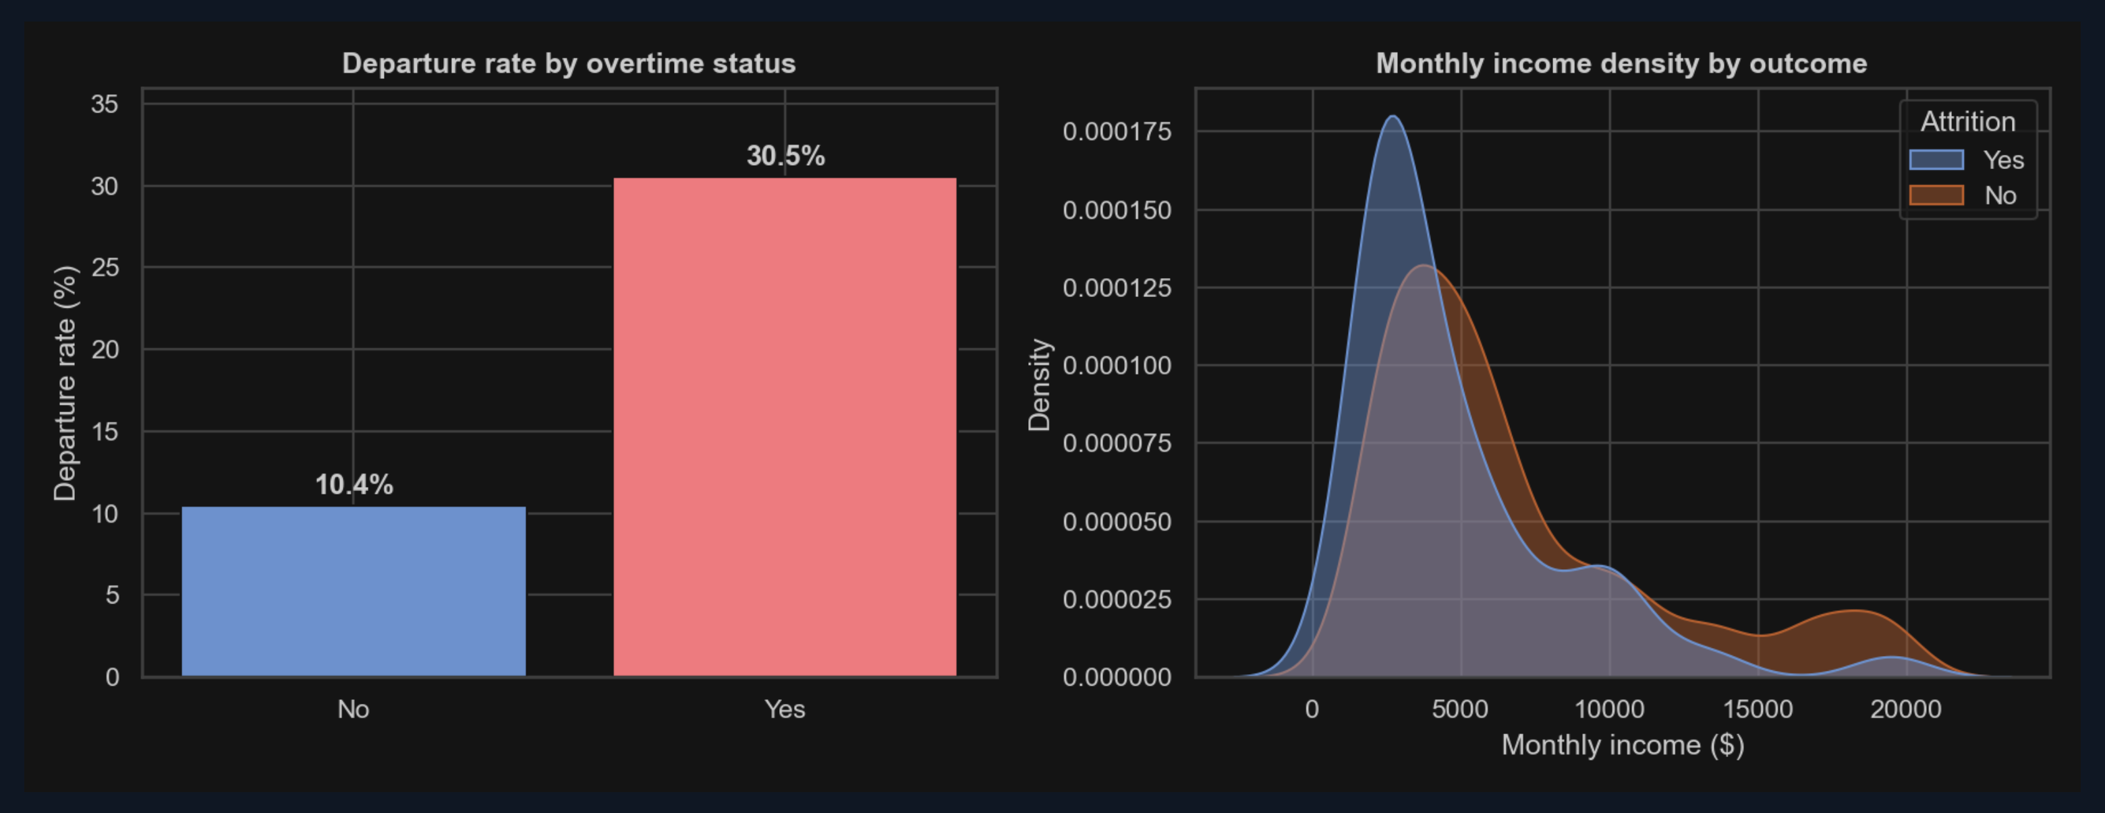
What the Data Knows
2.9× departure rate on a variable we control.
No single variable predicts departure — the strongest correlation is 0.17.
The Employee Retention Predictor
06
Notes:
We didn't launch any new surveys for this. We used thirty-five existing fields from our HRIS. Interestingly, no single variable acts as a perfect predictor. But when we combine these variables, the signal becomes incredibly clear. A standard dashboard will tell you high overtime is bad. This model will tell you that a specific engineer with high overtime, a recent manager change, and no stock options represents an eighty-six thousand dollar flight risk liability. One thing that surprised me was promotion stagnation. In the raw numbers, it doesn't look like a flight risk. But people who haven't been promoted recently also tend to be our most tenured staff, which protects against attrition. Once the model controls for tenure, promotion stagnation lights up as a major risk driver.

Slide 7
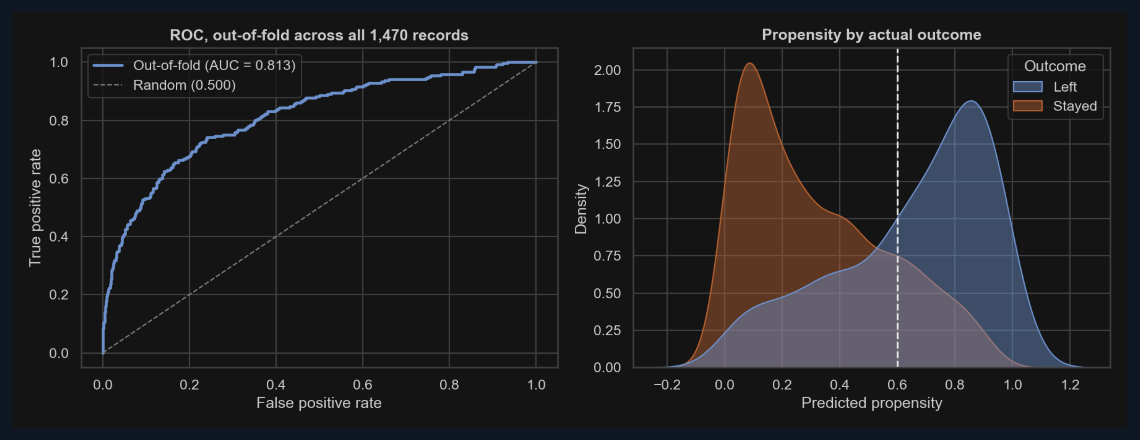
Validated Performance
0.813
65%
43%
AUC
Recall — of leavers identified
Precision — of flags are genuine
Nested cross-validation — 1,470 employees, no data leakage.
The Employee Retention Predictor
07
Notes:
Now, does it actually work? I rigorously validated the model. Let me explain how.
The easy approach is to split your data, tune on one half, report on the other.
I did that at first, and it was wrong – I tuned my decision threshold on the same data I was reporting from, which subsequently inflates every number.
So I rebuilt it with nested cross-validation.
The threshold is chosen inside an inner loop, then tested on data that loop never saw.
Every one of our fourteen hundred and seventy employees gets an honest, out-of-sample score.
The result: Area Under Curve of zero point eight one three.
We catch sixty-five percent of people who subsequently left, and forty-three percent of everyone we flag is genuine.
Roughly one in two conversations is with a real flight risk.
And because it's validated across two hundred and thirty-seven departures rather than the forty-seven you'd get from a single holdout, the confidence interval on that recall figure is roughly half as wide.
That's the difference between a number you can budget against and a number you can only gesture at.
Lastly, I’ll briefly touch on model comparisons.
I tested a random forest against a plain logistic regression.
The simple model won – so every score can be explained to the employee it describes without sacrificing accuracy and predictive performance.

Slide 8
Fair by Construction
EXCLUDED
0.908
Gender
Age
Gender impact ratio — passes four-fifths rule.
Marital Status
Distance From Home
Cost of fairness: 0.011 AUC. Worth it.
The Employee Retention Predictor
08
Notes:
Before anyone asks the governance question – I've excluded gender, age and marital status entirely.
That costs us about a one point one hundredths or one percent of predictive performance.
I'll take that trade every time.
I also excluded commute distance, which is the interesting one.
The Chief HR Officer asked for a commute threshold to trigger hybrid-working policy.
I am NOT delivering it.
Commute distance is a well-documented proxy for race through residential segregation, and I have no race data to test whether that proxy is active here.
I'm not building a policy lever on an untestable proxy.
Where I could test — gender — the impact ratio is zero point nine one. That passes the four-fifths rule comfortably. On live data we test every protected class before anyone is scored.

Slide 9
The Economics
$86,000
15:1
$5,700
Cost of missing a leaver
Cost of an intervention
16.9% break-even
30% benchmark
$1.7M
77%
6.8 months
NET
ROI
PAYBACK
The Employee Retention Predictor
09

Slide 10
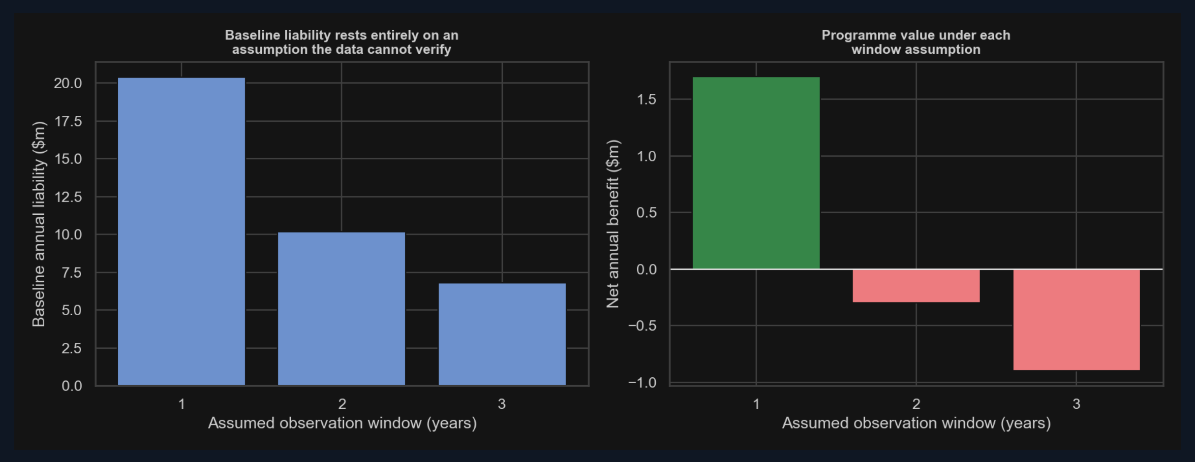
We don't know the observation window.
1 year
+$1.7M
2 years
−$0.3M
3 years
−$0.9M
Resolved by one query against date-stamped HRIS records.
The Employee Retention Predictor
10

Slide 11
What We Haven't Proven
✓
?
VALIDATED
NOT VALIDATED
The model identifies who is at risk.
Whether the intervention changes their decision.
PROJECTED ROI ACROSS THE EFFECTIVENESS ASSUMPTION
18%
136%
The Employee Retention Predictor
11

Slide 12
The Ask
$185,000
Phase 1 only.
PHASE 1
GATE 1
PHASE 2
GATE 2
PHASE 3
PHASE 4
Foundation
Confirm attrition velocity
Pilot
Effectiveness ≥16.9%
Deployment
Extension
Months 1–3
Months 4–6
Months 7–12
Year 2
Intervention budget stays locked until both gates clear.
The Employee Retention Predictor
12

Slide 13
Not a forecast. A cheap, gated, measurable experiment — against an eight-figure liability.
The Employee Retention Predictor
13

Slide 14
Sources
Bureau of Labor Statistics. 2026. "Industry and Occupational Employment Projections Overview, 2024–34." Monthly Labor Review . Washington, DC: U.S. Department of Labor.
LinkedIn Talent Solutions. 2018. "LinkedIn Data Analysis Reveals the Latest Talent Turnover Trends." LinkedIn Newsroom, March 15.
Bureau of Labor Statistics. 2025. Occupational Outlook Handbook: Software Developers, Quality Assurance Analysts, and Testers . Washington, DC: U.S. Department of Labor.
ManpowerGroup. 2026. "Global Talent Shortage Reaches Turning Point as AI Skills Claim Top Spot." 2026 Talent Shortage Survey.
Chartered Institute of Personnel and Development. n.d. Resourcing and Talent Planning . London: CIPD.
Payscale. n.d. "Employee Retention: What Employee Turnover Really Costs Your Company."
Gallup. 2019. "This Fixable Problem Costs U.S. Businesses $1 Trillion." Gallup Workplace.
Pedregosa, Fabian, et al. 2011. "Scikit-learn: Machine Learning in Python." Journal of Machine Learning Research 12: 2825–2830.
IBM. n.d. "IBM HR Analytics Employee Attrition & Performance." Dataset. Kaggle.
Robert Half. 2026. 2026 Salary Guide . Menlo Park, CA: Robert Half International.
Society for Human Resource Management. 2025. "The Myth of Replaceability: Preparing for the Loss of Key Employees." SHRM Executive Network.
Wilson, Edwin B. 1927. "Probable Inference, the Law of Succession, and Statistical Inference." Journal of the American Statistical Association 22 (158): 209–212.
Analysis conducted in Python (pandas, scikit-learn, seaborn). LLM assistance cited per Quantic conventions.
All charts are the author's own analysis of the IBM HR Analytics dataset.
The Employee Retention Predictor
14

