Slide 1

Jake Vestal
Design and Testing of Algorithmic Trading Systems with Python
Video 1:
Trading System Architecture

Slide 2
You’re here because:
You want to build a trading system.
You’re following along on the Internet
Welcome!
These videos can still help you
Many publicly available substitutes exist for the Duke-specific resources we use
→ let me know if something works → particularly well for you.
Take a look at the Duke FINTECH Master of Engineering Program: https://fintech.meng.duke.edu/
You’re in one of my Duke FINTECH Courses
Congratulations!
This and other videos will be your guides for the course
We’ll be using some Duke-only resources, e.g., Duke VCM

Slide 3
Trading App: Functional Requirements
A live trading app:
Stays on and running all the time
Safely reboots/restarts in the event of system failure
Accessible as an interactive web site
Uses SSL – avoid warning messages in browsers & improve page rank

Slide 4
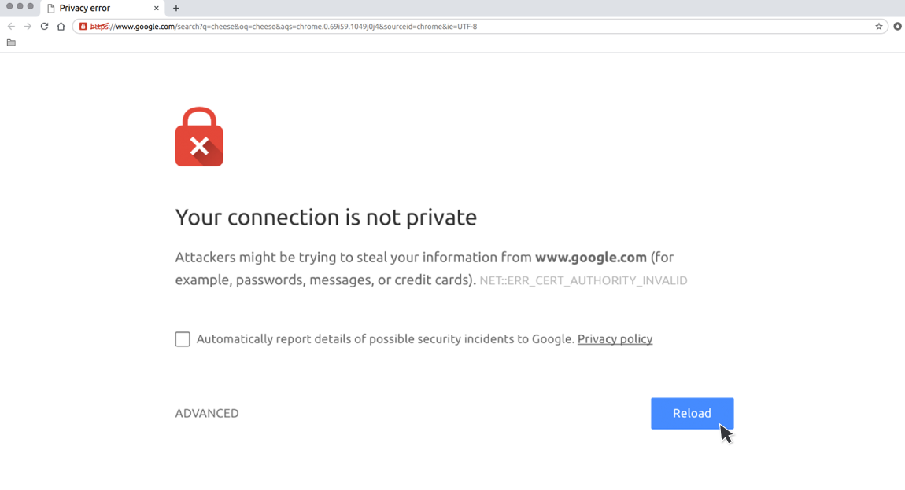

Slide 5
Trading App: Functional Requirements
A live trading app:
Stays on and running all the time
Safely reboots/restarts in the event of system failure
Accessible as an interactive web site
Uses SSL – avoid warning messages in browsers & improve page rank
Easy for developers (i.e., you) to work with
Communicates with trade execution systems for placing orders and querying account information
Sensitive pages containing proprietary data can be password protected
FREE for Duke students with the option of being owned & hosted by you; i.e., not an external company like Heroku or AWS
Provides a smooth workflow for updating, viewing, and troubleshooting in a team environment with multiple collaborators

Slide 6
Trading App: System Architecture
Your Server: (uses WINDOWS) A computer that is always turned on and connected to the Internet.

Slide 7
Where to Get a Server
You have to run your app on something. You have a few options:
Buy a computer, connect it to the Internet, configure it for remote access, leave it on 24/7 and just use that.
Use a service like AWS, Heroku, Digital Ocean, or similar.
If you’re with a university or large organization, use their server offering. Usually called VPS (virtual private server), VCM (virtual computing machine), or something similar. Call/message your IT office and ask but watch out for tech transfer obligations that grant the organization rights to intellectual property that you develop using their resources.
The point is: get yourself a server set up so that you’ve got admin rights, it’s reliably connected to the Internet, and accessible remotely.
Duke students in my courses should use Duke OIT’s VCM service.

Slide 8


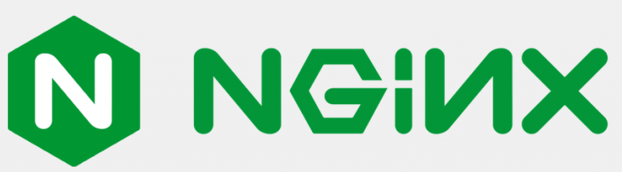

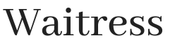

Trading App: System Architecture
Your Server: (uses WINDOWS) A computer that is always turned on and connected to the Internet.
Your Clients
Web Server
Your Trading App
Access limited to certain pages
You & Your Team
Web Server Gateway Interface (WSGI)
Full Access

Slide 9
Trading App: Workflow
Apps are complex. Things change over time. 💩 happens. For example:
You upgrade to a new data provider that provides data in a different structure (say, JSON instead of XML), requiring you to change your app’s onboarding code
Something weird occurs (a company issues a dividend on a non-trading day, you get a NULL, NA, None, empty, value when you expected something else, a new error message from your data vendor… and so on) requiring you to make a quick fix (usually at 3am, while you’re travelling, on the day before a presentation)
You want to add new code, fix a bug, or otherwise update your app
Your workflow is the disciplined process by which your team (or you) writes, updates, and tests your app.
As long as you keep at it, a team with a good workflow will always eventually arrive at a successful trading app given time and dedication… even if it takes years. In this way, a good workflow is more important to success than any app – which can fail at any time.

Slide 10

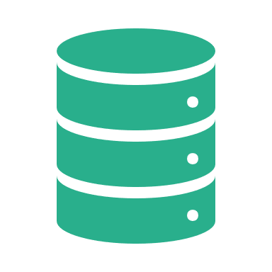
Trading App: System Architecture
GitHub automatically tests & updates the app on your server when you push
Your Server: (uses WINDOWS) A computer that is always turned on and connected to the Internet.
Your GitHub Repo
Your Clients
You &
Your Team
Web Server
Your Trading App
Access limited to certain pages
You & Your Team
Web Server Gateway Interface (WSGI)
Reference Data
Full Access

Slide 11
Reference Data
Data that does not change over time
All historical prices
Descriptive data
Username/password/permissions data
…etc
Reference data goes on your server… NEVER in your GitHub repo!

Slide 12

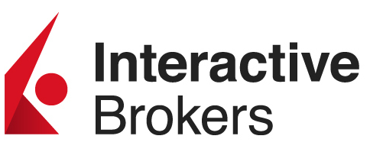


Trading App: System Architecture
GitHub automatically tests & updates the app on your server when you push
Your Server: (uses WINDOWS) A computer that is always turned on and connected to the Internet.
Your GitHub Repo
Your Clients
You &
Your Team
Web Server
Your Trading App
Access limited to certain pages
Other Internet Data Sources
You & Your Team
Web Server Gateway Interface (WSGI)
Your Trading Account
Reference Data
Non-Sucking Service Manager (NSSM)
Full Access
Execution System Client

Slide 13
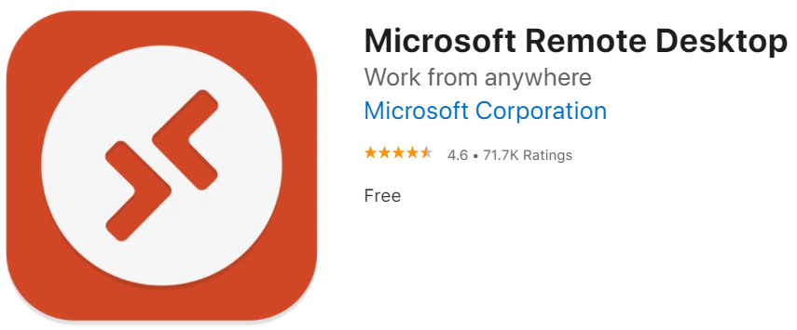
VCM Setup
Spin up a Windows VCM: https://vcm.duke.edu/
Be sure to turn it on and deactivate the auto shutdown
Do a test connection on your VCM with Microsoft Remote Desktop
You’ll need Cisco AnyConnect, instructions here: https://oit.duke.edu/what-we-do/services/vpn
Mac Users will need to install Microsoft Remote Desktop from the Apple Store:

Slide 14
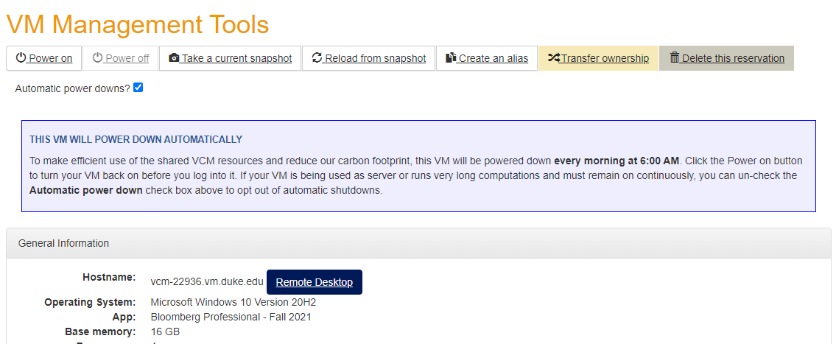
Duke VCM Service
If you don’t turn this off…
…then you’ll need to log in to Duke VCM every day in order to turn your server back on so that you can use it.
Bottom Line: just un-check the button and write a little note that it’s for a class and you need an always-on server to host your app.

Slide 15
Breakout

