Slide 1

Jake Vestal
Design and Testing of Algorithmic Trading Systems with Python
Video 2:
DNS Setup

Slide 2
You should already have set up:
Required setup:
Windows VCM*, to which you can connect via Microsoft Remote Desktop (RDP) and for which you have admin rights
You’ll need the IP Address of that VCM handy.
*for the purposes of this video, “VCM” = “virtual computing machine” = “VPS” = “virtual private server” = “the computer that you’re going to use to host your webapp”

Slide 3
In this video:
*
We’ll purchase a domain name from a DNS vendor and configure it to point to our app server’s IP Address.
Why are we doing this?
Because if we don’t, anyone who wants to use the app needs to remember an IP address and enter it every time into their browser.
Achievements in this video:
DNS Management
*These can be purchased for less than $5.

Slide 4
Some Terminology
IP Address:
A unique numeric name that identifies every Internet-connected device.
Four 8-bit fields separated by periods (e.g., “151.101.194.2”)
Web Domain:
Alphabetic name for an IP Address (e.g., “seekingalpha.com”)
URL (Uniform Resource Locator):
Contains a Web Domain
Points to one unique page on that domain; for example:
https://seekingalpha.com/: main page for Seeking Alpha
https://seekingalpha.com/symbol/AAPL: Apple Inc’s Seeking Alpha page

Slide 5
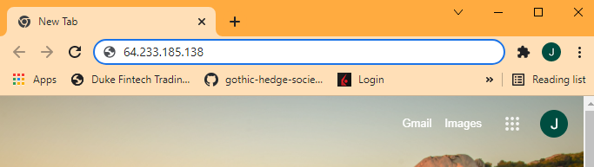
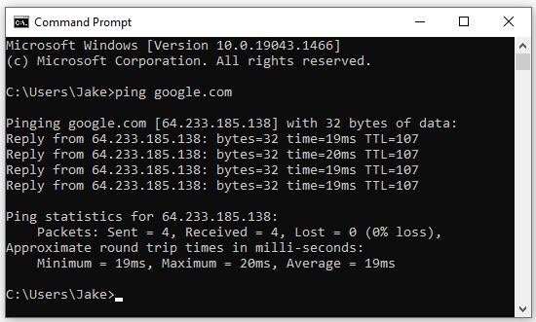
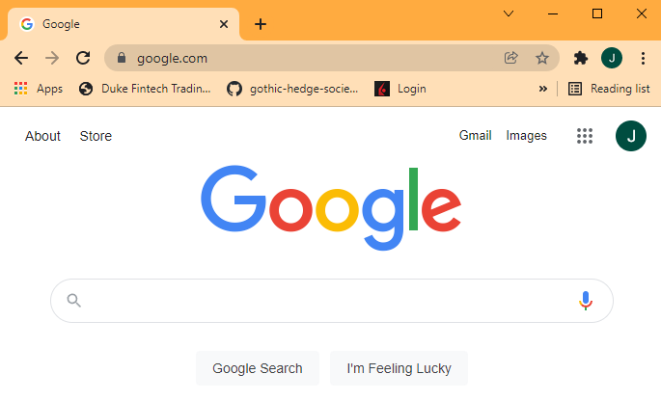
Domain Name System: Basic Overview
Websites aren’t “really” located at their URLs.
→ They’re “actually” located at an IP Address.
You can see this for yourself. Use ping from a command prompt:
Copy & paste the IP Address into a browser:
“Resolves” to the familiar URL.

Slide 6
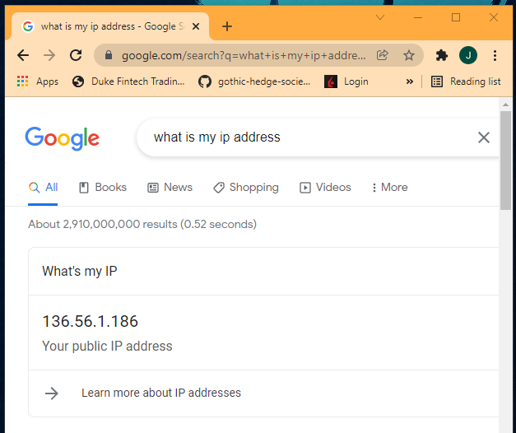
How to get your IP Address: Two Ways
Way 1: Google “what is my IP Address”
Way 2: Use ipconfig
Type ipconfig /all into a command line
Get a lot of information… including IP Addresses for connected devices
See that each Internet-enabled device on your computer – your adapters for Wireless, physical Ethernet, Bluetooth, etc – all have their own entries
The interested may read ipconfig /? for more info about using ipconfig
…and there are many other ways, of course.
Bottom Line: You’ll need the IP Address of your server, so retrieve that information and have it handy for this tutorial.

Slide 7
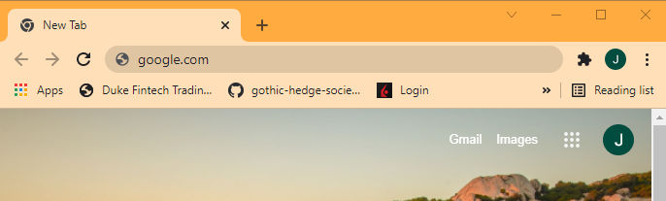

Domain Name System: Basic Overview
URLs only exist because remembering IP Addresses is difficult for (most) humans.
Machines don’t really see the Internet in terms of URLs… they see it in terms of IP Addresses.
If memorizing URLs were easy for people, we’d just say “64.233.185.138” instead of “google.com”
Conceptually, when you type in a URL, your browser goes through a process like this:
1) You enter a URL: “google.com”
3) DNS pulls the correct record for ‘google.com’ and gives an answer
2) Browser asks the DNS: “What IP Address do you have on record for ‘google.com’”?
The DNS
5) Resolves URL and serves page.
4) DNS Responds: “Use 64.233.185.138.”
The Domain Name System (DNS) is like a gigantic phonebook of records matching URLs to their IP Addresses.

Slide 8
Domain Name System: Basic Overview
The DNS is the Internet’s official registry of what IP addresses map to what domains
Includes other data such as WHOIS info and routing rules
For example, Facebook configured the DNS records of its old domain “thefacebook.com” to resolve to the newer domain “facebook.com” – users don’t see a difference
What happens when an Internet user navigates to a domain is controlled by that domain’s records
DNS Records are written by the domain’s owner
“Owning a domain” == “Control of that domain’s DNS records”
The ability to add, delete and edit DNS rules is a service sold by private companies that allow you to “buy a domain”; i.e., “purchase the rights to have a company configure that domain’s DNS entry as you see fit”.

Slide 9
Purchase a Domain Name
This lecture series uses GoDaddy.
Pick a cool domain name for yourself: https://www.godaddy.com/en-ca/domains/domain-name-search
Create an account and buy a domain.
Don’t spend more than $5 or $10 on it unless you really want it for something other than my course

Slide 10
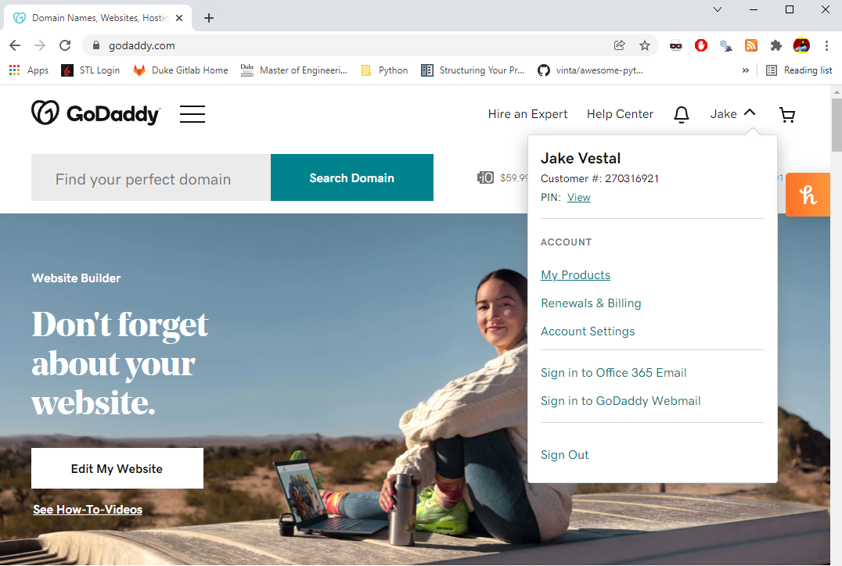
Configure Your DNS Entry
After you purchase a domain name, sign in to your account and go to “My Products”

Slide 11
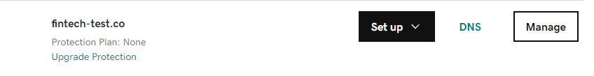
Configure Your DNS Records
In the “My Products” screen, scroll down to find your domain
Click “DNS”

Slide 12
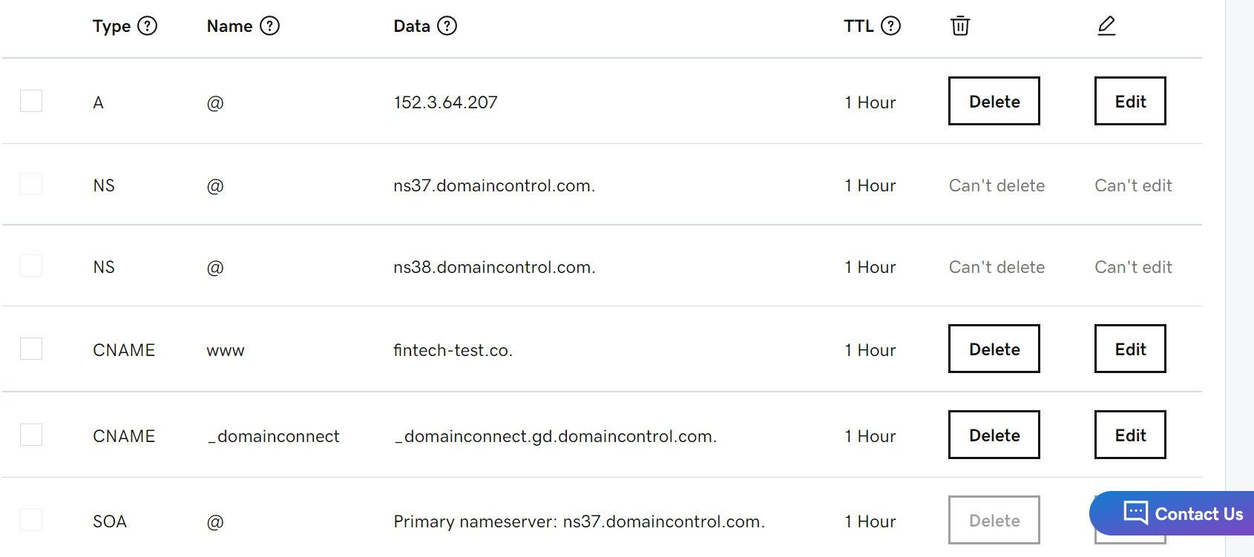
Configure Your DNS Records
Your DNS Records screen
You own the domain, so you now control its records.
Create an “A” rule that contains the IP address of the server running your app.
The “A” rule will direct anyone who visits your domain at “your-domain.com” to the IP Address you provide.
Your app server’s IP address
The “A” rule is the important part
Delete other “A” rules such as “parked” if they’re present.

Slide 13
TTL: Time to Live
Keep TTL set to 1 Hour (the default)
Changes made to your DNS records don’t take effect immediately.
It takes a little bit of time for the rest of the Internet to recognize those changes (i.e., propagate)
TTL (Time to Live) can be thought of as: “how long it takes for a DNS rule change to propagate”
Shorter TTL settings mean faster updating, but that comes at the cost of your site’s performance because the nameserver is being queried more often.
More info here: https://www.godaddy.com/help/what-factors-affect-dns-propagation-time-1746

Slide 14
Achievement Unlocked!
DNS Management
From here forward, in this and in following videos:
You understand the basics of what the DNS is
You know the difference between a domain name and a URL
You know how to purchase a domain name and configure it to point to an IP Address
You know what “TTL” means
Consequentially: you don’t expect new DNS Rules to immediately take effect…
(…although it’s nice if/when they do)

Slide 15
Now, give your new DNS rules time to propagate while you work on something else.

