Slide 1

Jake Vestal
Design and Testing of Algorithmic Trading Systems with Python
Video 3:
PyCharm Installation and First Time Setup

Slide 2
In this Tutorial
Sign up for JetBrains’ Education Pack
Download PyCharm Pro
Install PyCharm Pro with the recommended options
Configure PyCharm Pro with the recommended settings
Achievements in this video:
Installers

Slide 3
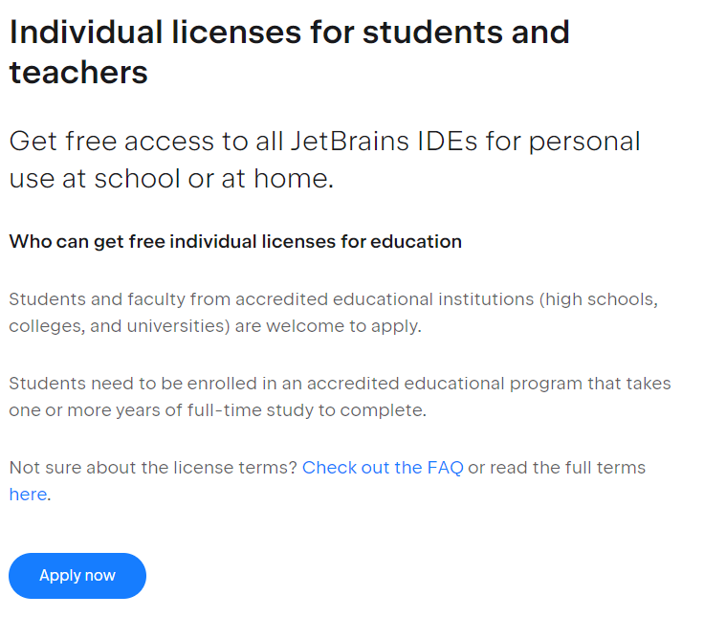
Sign up for JetBrains’ Education Pack
https://www.jetbrains.com/community/education/#students
If you’re asked for some kind of verification that you’re a student – we’ve found that sending a screenshot of your course schedule (e.g., from DukeHub) works to get you approved.
If you’re a student or an educator, you should get PyCharm Pro.
PyCharm Pro is required for students in my courses at Duke
Mostly because Jupyter now only works with PyCharm Pro – not Community ☹
You’ll get an email response from JetBrains
Follow the instructions to get your JetBrains account login and password.
Save your login info!
You’ll need it later.
Click here

Slide 4
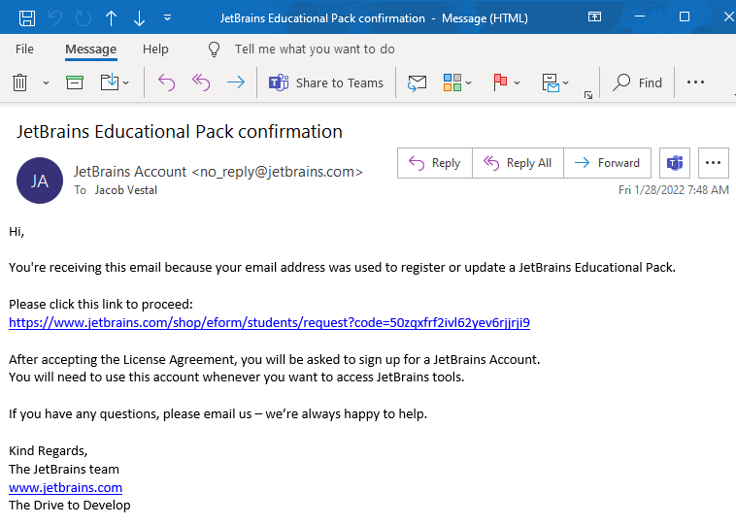
My JetBrains Email (example)
Yours may differ somewhat.
Fill out the application on the previous page
Receive email
Follow the link
Record your JetBrains username and password somewhere where you’ll be able to retrieve it!
go here

Slide 5
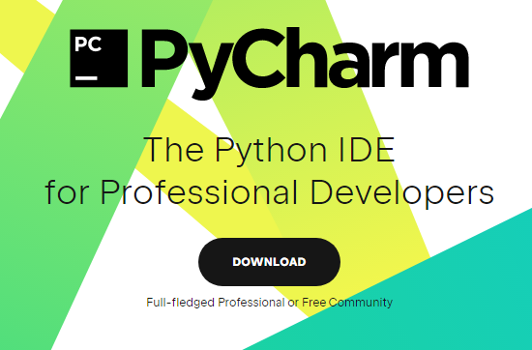
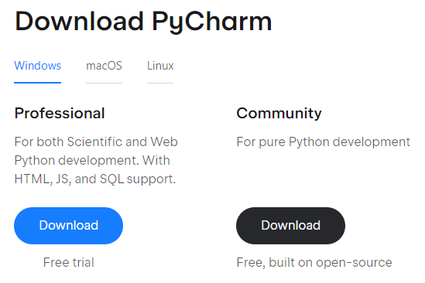
Download & Install PyCharm Pro
Do this on your own computer AND on your VCM.
Go Here: https://www.jetbrains.com/pycharm/
Takes you here…
Choose your OS
Click here
Download Professional Edition
Install on your OS.
Windows Users: run the downloaded .exe file
Mac Users: install the .dmg file
Linux Users: you know what to do (you’re Linux user)

Slide 6

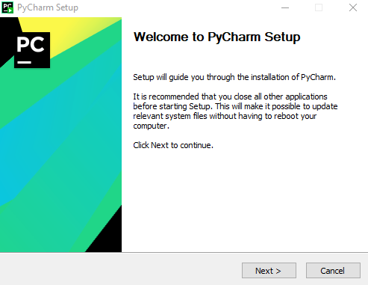
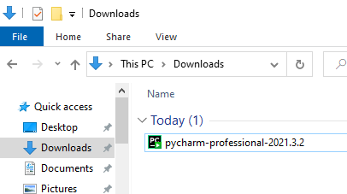

Download & Install PyCharm Pro
Do this on your own computer AND on your VCM
Run your installer.
If you’re asked about allowing the installer to make changes, allow it.
On Windows, you do that just by double-clicking the installer .exe file in your Downloads folder.
Click “Next”

Slide 7

Be on the lookout for this icon
Windows Defender / Security Shield
Sometimes shows up as a popup
Sometimes as a flashing icon in the Windows taskbar at the bottom of your screen
Asks you for permission to install something
Check your Windows taskbar:
Right here.
In order to install anything you’ll need to give Windows permission, otherwise it won’t install.

Slide 8
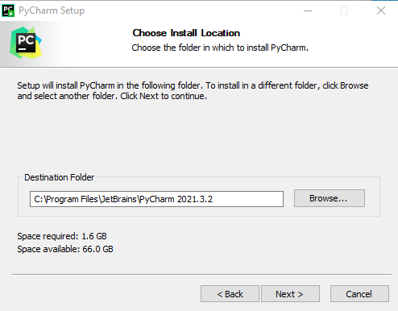
Download & Install PyCharm Pro
Do this on your own computer AND on your VCM
Install it in:
C:\Program Files\JetBrains\PyCharm[your_version_number]
Click “Next”

Slide 9
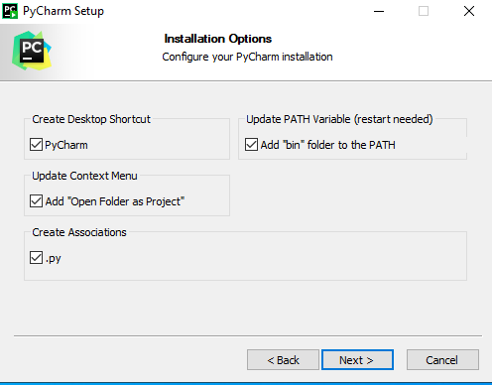
Download & Install PyCharm Pro
Do this on your own computer AND on your VCM
Check all of these.
a PATH variable! Make a mental note of this, we’ll be talking about that again soon.
Click “Next”

Slide 10
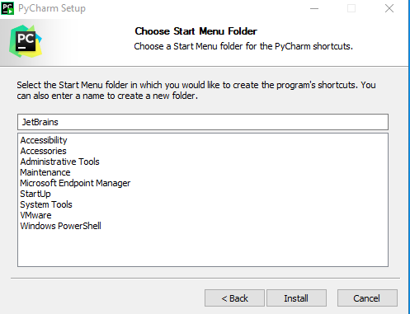
Download & Install PyCharm Pro
Do this on your own computer AND on your VCM
Keep defaults
…unless you really want to put JetBrains (including PyCharm) somewhere else in your Start Menu.
Click “Install”

Slide 11
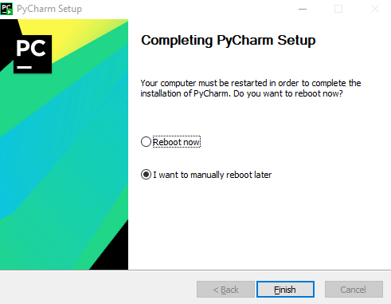
Download & Install PyCharm Pro
Do this on your own computer AND on your VCM
Reboot Later
(we’re going to configure some settings)
Click “Finish”

Slide 12

Achievement Unlocked!
Installers
From here forward, in this and in following videos:
If you’re instructed to “install something” and provided a link, you’re expected to:
Follow the link and download the installer from the linked webpage
You might have to select the installer for your OS from a list of choices (Mac, Windows, etc)
Run the installer after downloading
Instructions will always be provided special cases; otherwise just use defaults
Don’t forget to notice and click on the Windows Defender shield that might be flashing in the taskbar the bottom of your screen in order to allow installation… if an installer seems like it’s not working.

Slide 13
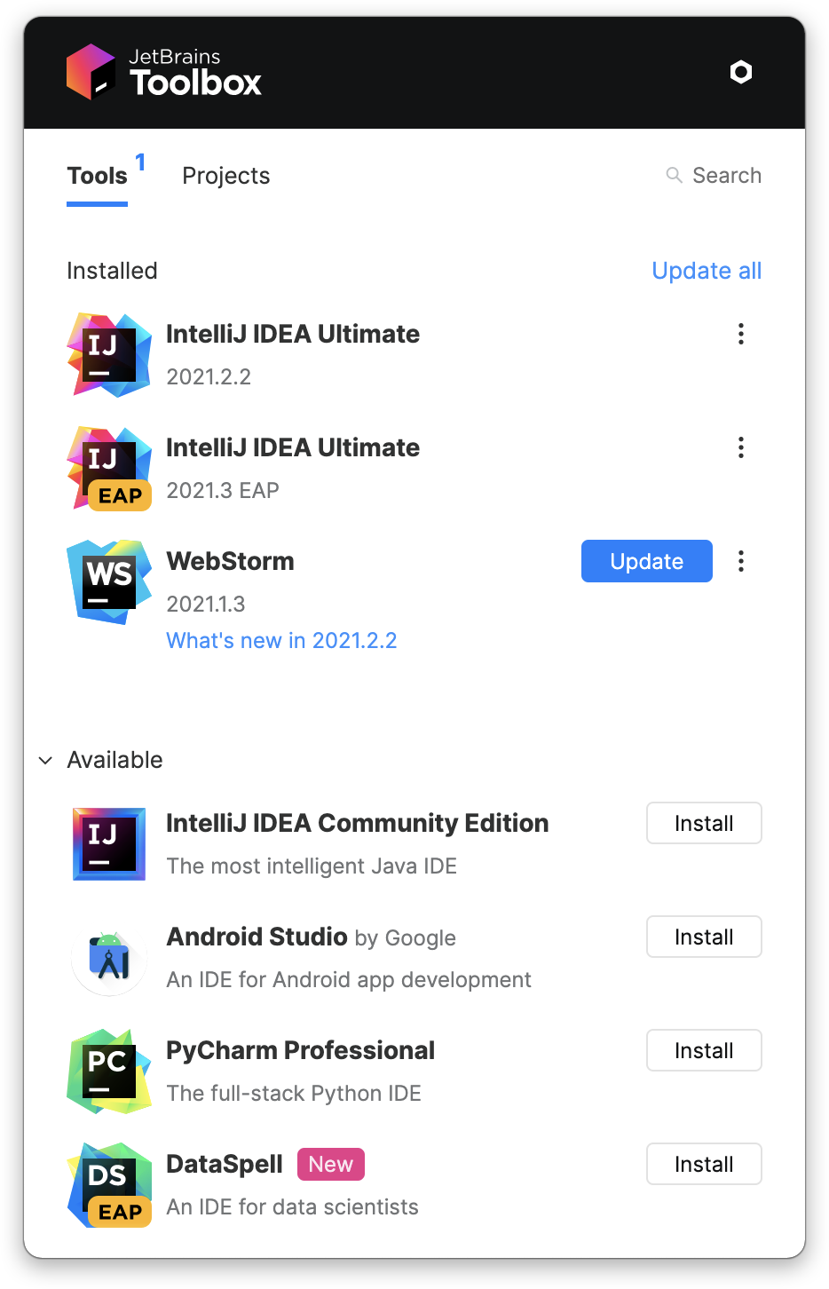
Install JetBrains’ Toolbox App
Installers
Installer Link:
https://www.jetbrains.com/toolbox-app/
Searches your computer for all JetBrains products (such as PyCharm)
Gives you a handy ‘Update’ button when there’s a newer version available
Easily updates your existing version of PyCharm to most recent version

Slide 14
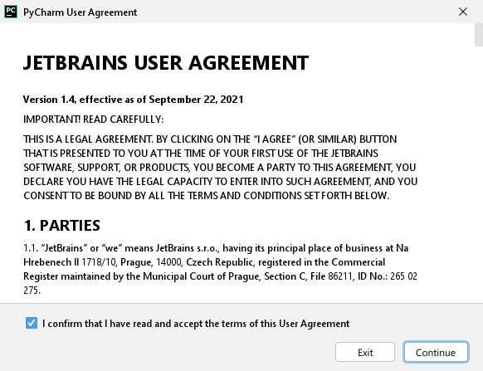
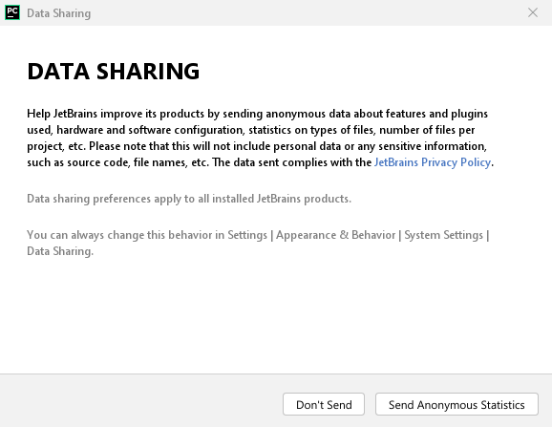
Start PyCharm
Run PyCharm.
When it starts up for the first time you’ll see:
Accept the User Agreement
Your choice: I usually click “don’t send” if installing on a server intended to run an app

Slide 15
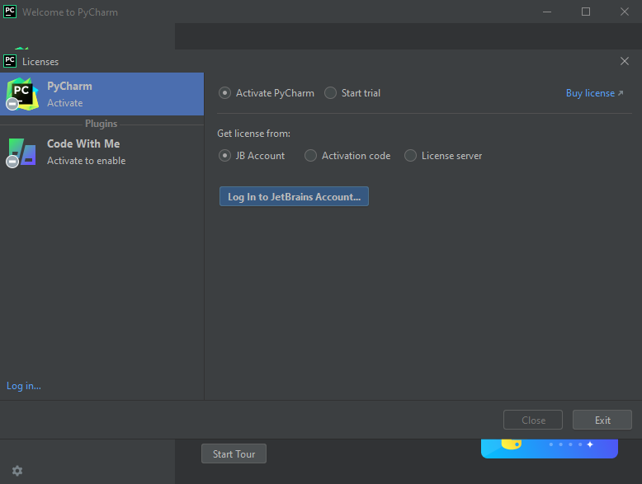
PyCharm First Time Setup: Activate License
Next you’ll see this screen.
If you received an activation code in your email, you can click here and enter that code.
Otherwise, proceed by using your JB Account as follows.
Click here

Slide 16
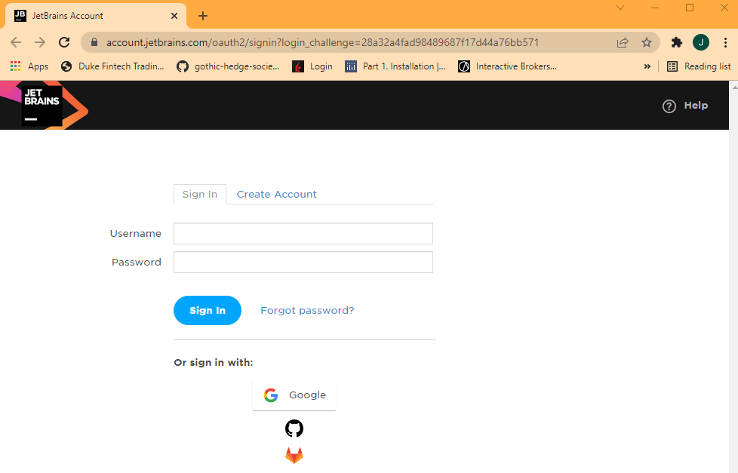
PyCharm First Time Setup: Activate License
A browser window opens…
Log in with the JetBrains username and password that you received when you registered for the JetBrains Education Pack.

Slide 17
PyCharm First Time Setup: Activate License
A browser window opens…
Log in with the JetBrains username and password that you received when you registered for the JetBrains Education Pack.

Slide 18
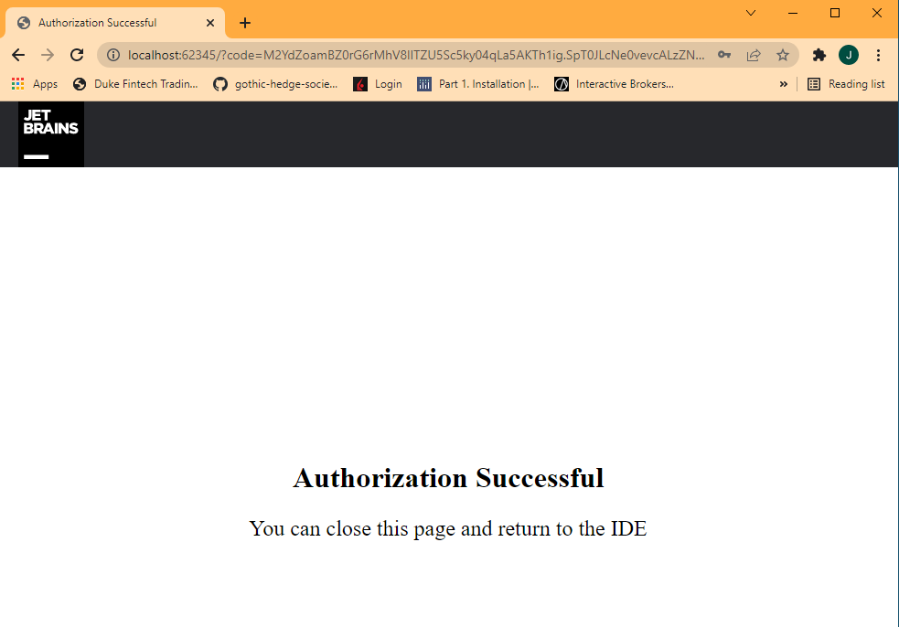
PyCharm First Time Setup: Activate License
See this message → you can close your browser and go back to PyCharm

Slide 19
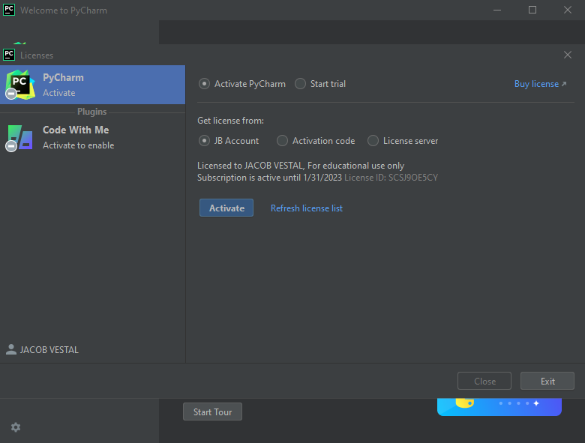
PyCharm First Time Setup: Activate License
Now you’ll see a License appear in the PyCharm window
Click here

Slide 20
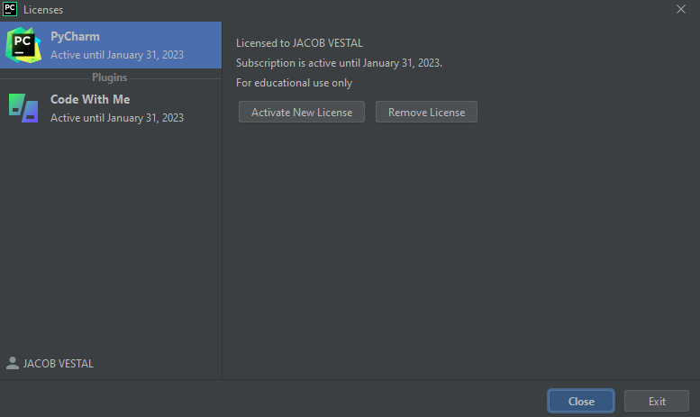
PyCharm First Time Setup: Activate License
Activate New License
Click here

Slide 21
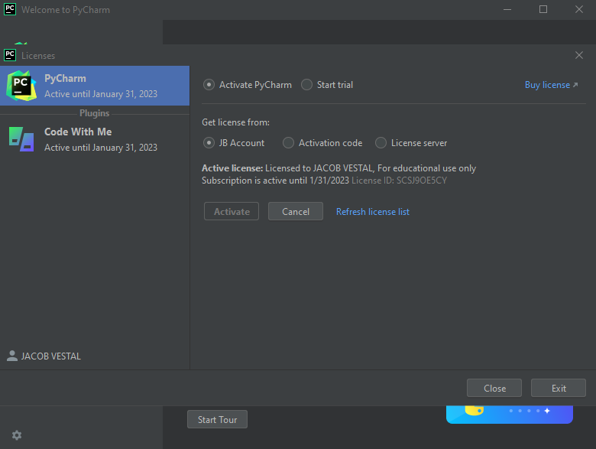
PyCharm First Time Setup: Activate License
Click “Close”

Slide 22
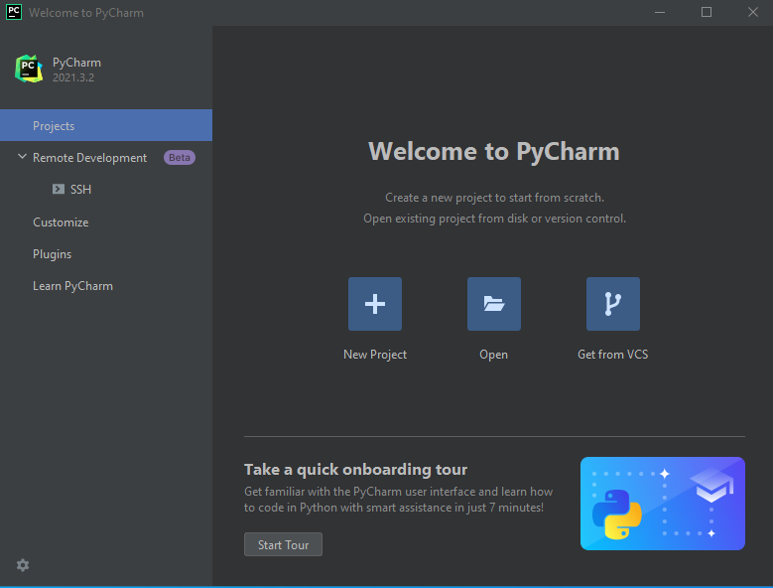
PyCharm First Time Setup: Customize Settings
Click “Close”

Slide 23
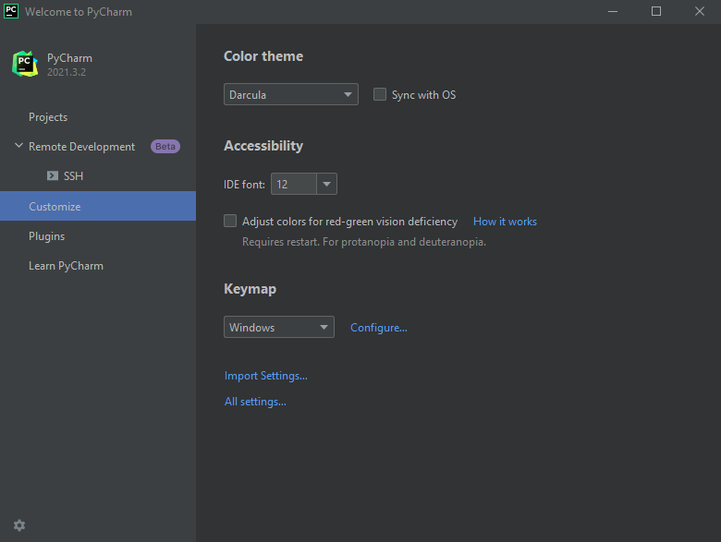
PyCharm First Time Setup: Customize Settings
Pick a color theme
I like Darcula because it’s easy on the eyes
Click “All Settings”

Slide 24
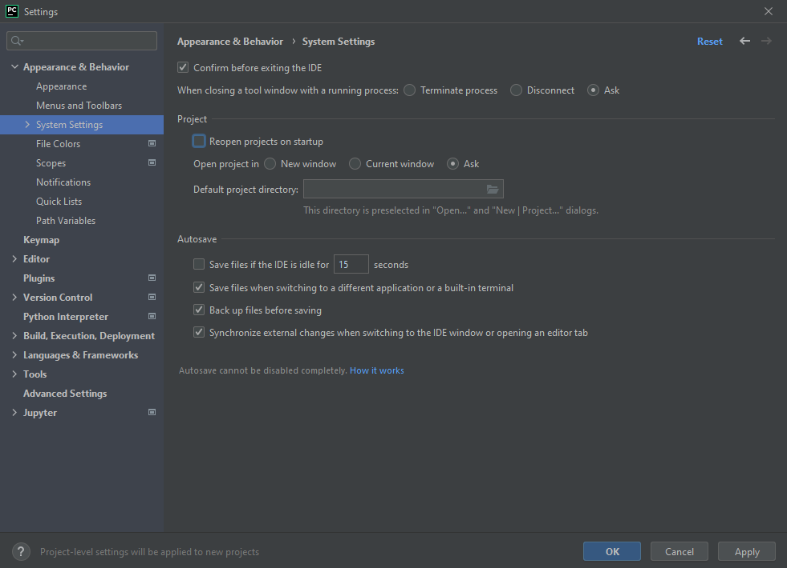
PyCharm First Time Setup: Customize Settings
Un-check “Reopen Projects on Startup”
Click “Apply”, then “OK”
Click “Apply” then “OK”

