Slide 1

Jake Vestal
Design and Testing of Algorithmic Trading Systems with Python
Video 4:
Environmental Variables in Windows

Slide 2
In this Video
What environmental variables are on ANY operating system
How to view, edit, create, delete, and modify them in Windows
Understand the “PATH” and “Path” environmental variables
What they are and why they’re special
How to edit them
Observe that they combine together if they’re both present.
‘echo’ and ‘%’ in the Windows command line
Difference between a Command Prompt and the Admin Command Prompt
Difference between SYSTEM and USER environmental variables
Env Var names & values are fetched when a command prompt STARTS
Meaning that you have to restart a new prompt to see added/changed variables
Why env vars are a good place to store sensitive info (like keys)
Achievements in this video:
Admin Command
Environmental Variables

Slide 3

Environmental Variables
In ANY computer system, a “variable” is taken to mean “some kind of value stored in memory, to which a name is assigned”.
In the simple Python code below, the value ‘Hello’ is assigned to a variable who’s name is a. When print(a) is called, Python knows to look up the value that’s stored under the name a and apply the print() function to it.
Operating systems such as Mac, Windows, Linux, etc. have variables too (they’re just programs, after all). These variables are always there, in OS’s environment, waiting to be called upon as needed.
Such variables are aptly named environmental variables and they can be created, modified, deleted, and retrieved by you, the user, to suit your needs.

Slide 4
Why do we care?
Main reason:
Because you can’t really build much functionality into an app (or trading system) before you end up having to interact with environmental variables in one way or another.
More Specifically:
Environmental variables are easy for your programs to access
No file reading
Just have to remember a name, not a path
In Python, to retrieve the value of an environmental variable named “A_VARIABLE”, all you need to do: "os.getenv(‘A_VARIABLE’)"
Environmental variables are a secure place to store sensitive information like keys and credentials
Your apps can access them
Users navigating to your app’s website can’t access them in the page’s Javascript… because they live on the SERVER itself.
All you have to do is right-click > inspect any website in Chrome to see an entire world of variables open up. That’s ok for things like button click status and scroll window placement… NOT ok for passwords and keys!
Environmental variables control how your OS works – like the PATH variable.

Slide 5
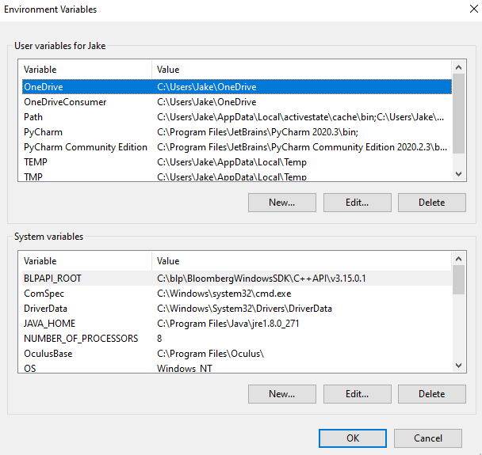
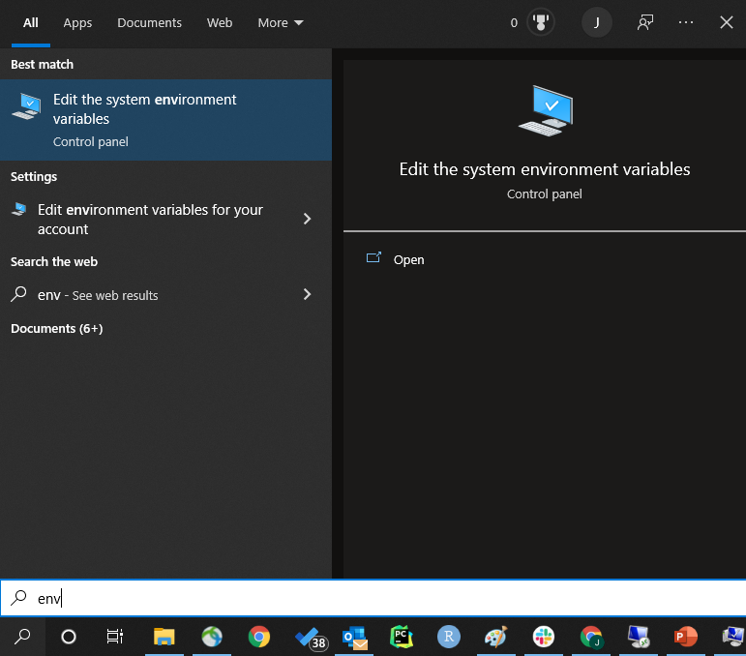
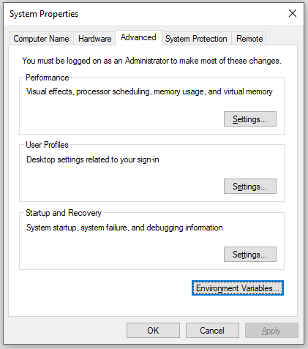
Environmental Variables are Variables Just Like Any Other
Except that:
They live in a special namespace within the OS
They’re scoped by user: only the users who are allowed to can see them
They’re persistent: they remain in the OS’s environment until you or a program modifies or deletes them.
How to open the Environmental Variables Control Panel
-> Use this panel to add, delete, and modify environmental variables.
Environmental Variables!
In the Search field in the Windows taskbar, start typing “environment” (as below) and open the “Edit the system environmental variables” control panel.
Click here

Slide 6

The Environmental Variables Control Panel
User variables:
Can only be accessed by the specified user (“Jake”) in this case, or by a user with Administrator privileges.
Useful for storing data for user-specific tasks like individual user preferences, apps that maybe only one user has installed, etc.
We won’t be using these for our apps.
Some things to note:
See how every variable is just a “name”:“value” pair
A lot of these variables are paths that certain programs – Bloomberg’s API (BLAPI_ROOT), Oculus (OculusBase) – use to know where files are kept
Others are information about my system – NUMBER_OF_PROCESSORS, for example, has the value ‘8’ because I have an 8-core processor on this machine.
Make a new variable
(USER)
Modify an existing variable
(USER)
Delete a variable
(USER)
System variables:
Can only be access by a user with Administrator privileges.
We will be using these for our apps.
Delete a variable
(SYSTEM)
On the next slide we’ll open a command prompt to see how these variables can be accessed programmatically.
Make a new variable
(SYSTEM)
Modify an existing variable
(SYSTEM)

Slide 7
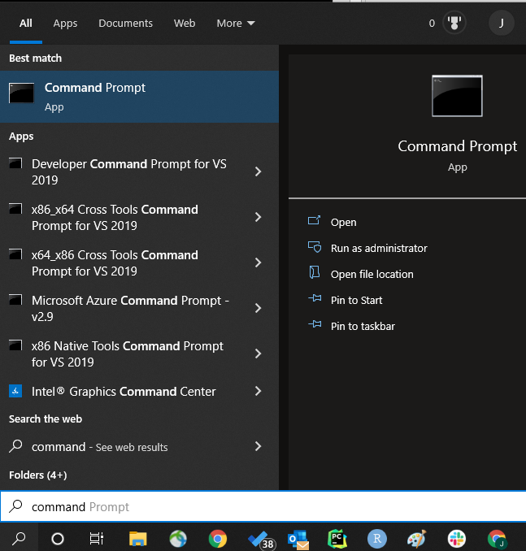
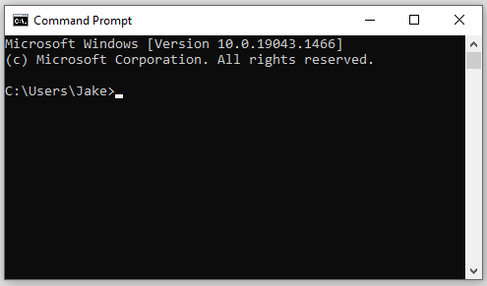
The Command Prompt
Usually you’re interacting with your OS through apps with windows, icons, and user interfaces, but you can interact in a more direct way using some kind of command line application. In Windows, that application is the “Command Prompt” which can be launched in the following way:
Doing so will open a command prompt window:
Go to the ‘search’ bar in your Windows Taskbar (lower left hand side of your screen)
Start typing ‘command’
Click on ‘command prompt’
Right here:

Slide 8
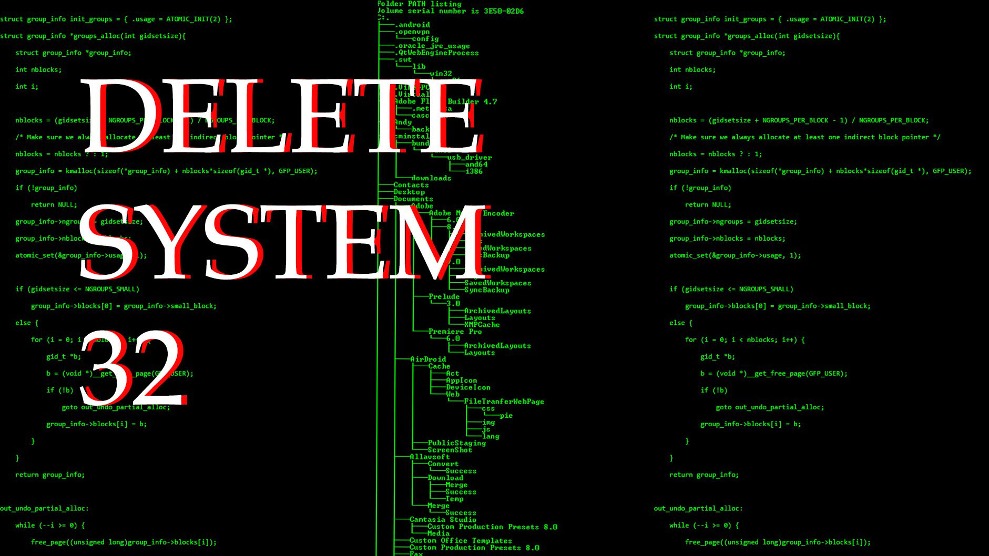
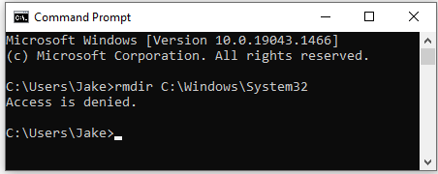
The Admin Command Prompt
Admin Command Prompt is reserved for commands that modify critical Windows files.
Open an Admin Command Prompt by right-clicking here
…or by clicking here
You must be logged into your Windows computer as a user who has Administrator privileges, otherwise this won’t work.
Seriously, don’t do this.
“Delete System 32” is an ancient trolling technique from the early days of the Internet in which inexperienced users (n00bz) are tricked into deleting C:\Windows\System32. Windows needs System32 to function, so this “practical joke” can cause serious problems on someone’s computer.
The Admin Command prompt provides a sort of mental ‘safety check’ because it allows you to make modifications to critical system files that aren’t allowed in Command Prompt.
Note that, above, the normal Command Prompt denies access to System32. The Admin Command Prompt would have allowed that command. Be careful (never feed trolls)!
You often need Admin Command Prompt when installing or configuring software but be extra careful when you’re using it!

Slide 9
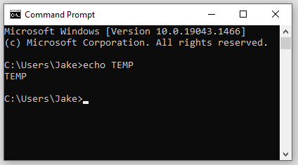
Fetch an Env Var with echo
Take a look at all of the environmental variables you see in your Environmental Variables control panel and pick one from the User Variables list (it doesn’t matter which)
I picked “TEMP”, which is a variable that tells Windows where to look for temporary files that different apps create & delete all the time when I’m running them while logged in as “Jake”.
From my command prompt, I’m going to print the value of TEMP to my terminal window:
…that didn’t quite work… echo TEMP just printed out “TEMP” instead of the value I was looking for.

Slide 10
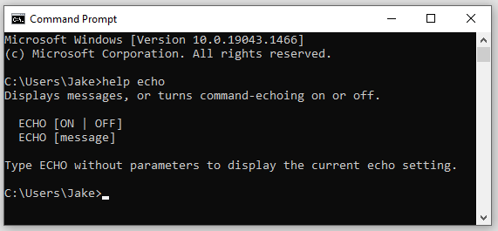
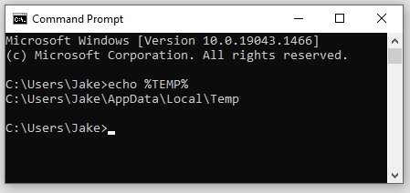

Fetch an Env Var with echo
echo’s behavior on the previous slide is not an error – it’s working correctly.
Let’s use Microsoft’s built-in help command – which works on just about any inbuilt command line function – to learn a little more
From the help message, see that echo displays messages it’s given.
When we typed echo TEMP, echo simply did it’s job and displayed the message we passed to it… in this case, “TEMP”.
We must be a little stricter about what we want echo to do here.
We DON’T want to print the name of TEMP
We DO want to print the value of TEMP
Instruct Windows cmd to do this by enclosing “TEMP” between two “%” symbols.
You can think of enclosing “%” as meaning: the value of the variable who’s name is enclosed.
Try it:
Works!
echo is useful for checking the value of environmental variables without having to open the control panel window.

Slide 11
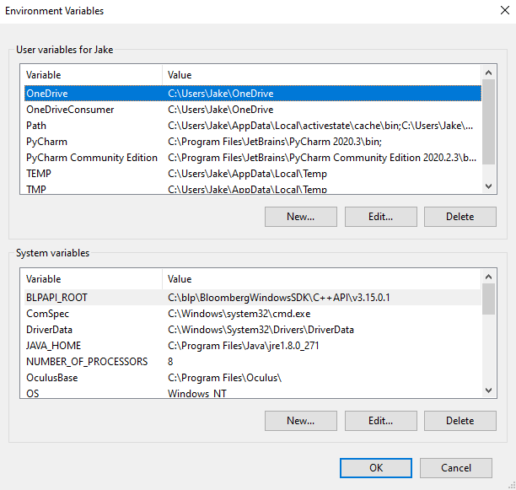
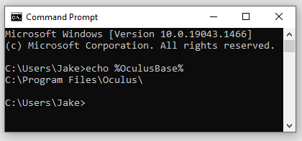
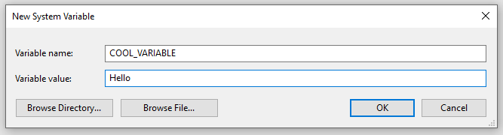
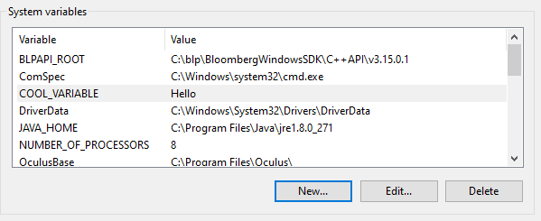
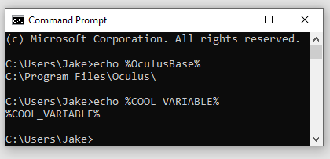
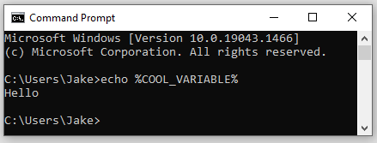

Working with Environmental Variables
Create, modify, delete, and verify with echo
Open a command prompt now (if you don’t already have one open)
Open the Environmental Variables control panel (if it’s not already open)
Create a new variable with a name and value of your choice by clicking the “New” button
Click “Apply” and/or “OK” in your control panel windows
Creating a new System Variable
Name = “COOL_VARIABLE”
Value = “HELLO”
echo a variable for practice:
works
Now appears in the window:
(you must do this for your changes to take effect)
Verify your new variable with echo in the same command prompt:
Why?
Because Command Prompt is only aware of environmental variables as they existed at the time the command prompt was started.
We started a prompt first and added a new variable afterwards.
Therefore, this prompt doesn’t know that the new variable exists.
If you open a new prompt, your new environmental variable becomes available:
works
does NOT work.

Slide 12
Achievement Unlocked!
Admin Command
From here forward, in this and in following videos you’re expected to:
Know how to open a Command Prompt or an Admin Command prompt (and know why they’re different)
Understand how to use help and echo
Be able to check the value you’ve set for an environmental variable with echo or the control panel
Understand enclosing “%” and the difference between “the name of a variable”; i.e., “A_VARIABLE”, and “the value of the variable who’s name is ____” ; i.e., %A_VARIABLE%
Understand that command prompts read in all environmental variables that are available at the time you open the prompt
Therefore, if you open a command prompt and THEN create a new environmental variable, it will NOT ‘echo’ in that prompt
You’ll have to start another one

Slide 13
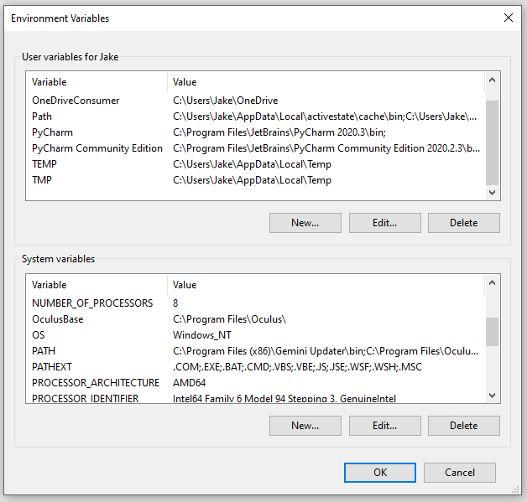
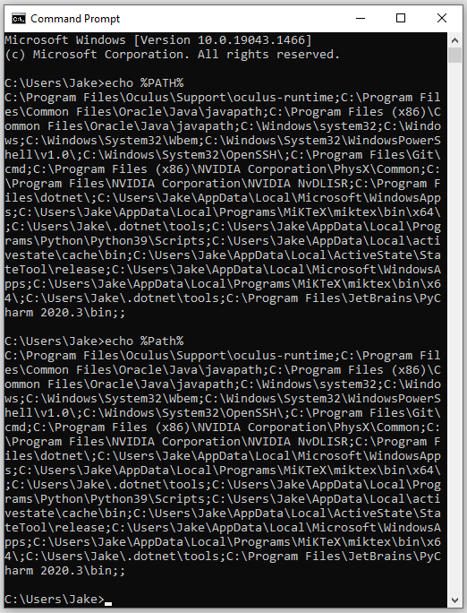
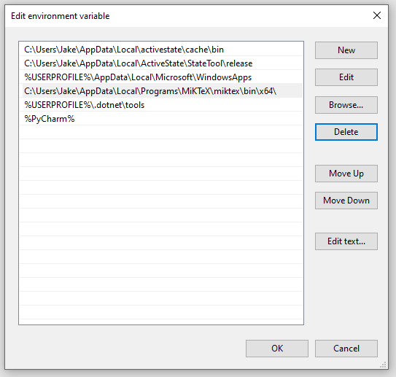
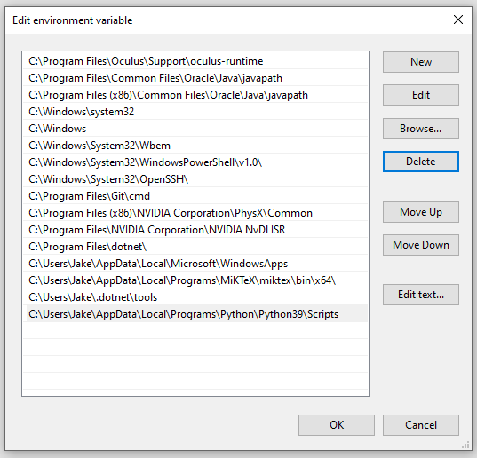
The PATH Environmental Variable(s)
Environmental variables named “PATH” or “Path” (different case) are special.
You may have more than one variable named “path” (any case)
If you don’t see this variable, then you’re probably on a brand-new system on which you haven’t installed anything yet (like a fresh VCM)
When you edit one of these vars, you see a list of paths:
echo %PATH% and echo %Path% give the same result.
The contents of PATH and Path are combined
This is intentional. The reason is because the paths stored in path variables tell Windows where to look for programs and commands.
For example, if you ran the command ‘python’ in the command line, then Windows would start searching each directory contained in your path variables until it found a directory that contained python.exe, and the it would run.
Contents of my USER Path var:
Contents of my SYSTEM PATH var:
When you select a PATH variable and click “edit”:
You get a screen that displays the entries stored within the PATH variable you selected
Each entry is (not surprisingly) a path.
You can add, delete, or edit your PATH variable entries from this screen.
This is why, in order to install a new program that runs when you enter a command (e.g., “nssm”), you need to add a new entry to your PATH variable that contains the path where nssm.exe is kept.

Slide 14
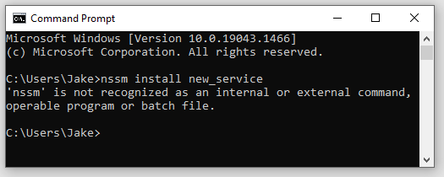
The PATH Environmental Variable(s)
If you try to run a command – for example, ‘nssm’ – and you get a response like this:
→ It means that Windows looked in all the entries for the PATH configured for your user and the system and couldn’t find any that contained “nssm.exe” either because:
You did not add the path that contains nssm.exe to an entry in your PATH variable
You did add the path entry, but nssm.exe isn’t there.

Slide 15
Achievement Unlocked!
Environmental Variables
From here forward, in this and in following videos you’re expected to:
Be able to create a new environmental variable having some name and some value if instructed
Understand the difference between SYSTEM and USER environmental variables
How to add, create, and edit environmental variables

